Slide 1

ME 599 J, K / IND E 599 A AI/ML for Smart Manufacturing Clustering
Professor Ashis G. Banerjee
April 06 - 13, 2026

Slide 2
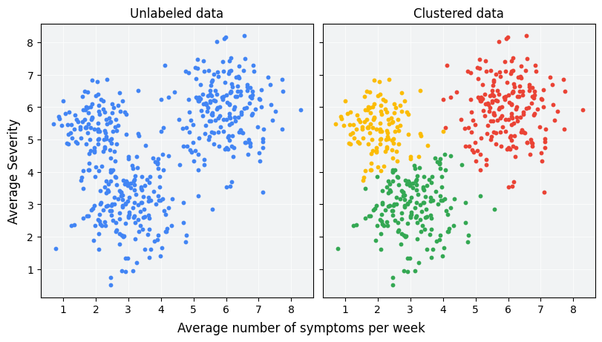
Basics
Clustering
Unsupervised machine learning technique designed to group unlabeled observations/samples/points based on their similarity to each other

Slide 3
Connectivity / Hierarchical Model
Agglomerative (bottom-up):
Each observation starts in its own cluster, and pairs of clusters are merged as one moves up the hierarchy; output is called dendogram
Divisive (top-down):
All the observations start in one cluster, and splits are performed recursively as one moves down the hierarchy
Choices
Distance d as (dis)similarity measure between individual observations; e.g., Euclidean, Manhattan/taxicab, etc.
Linkage criterion for (dis)similarity between sets of observations
Maximum or complete-linkage clustering
Minimum or single-linkage clustering
Average-linkage clustering, and many more

Slide 4
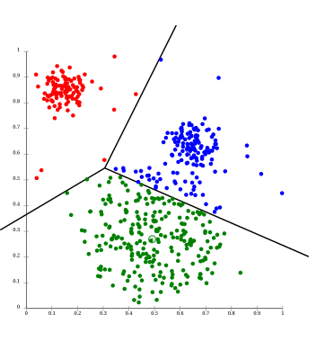
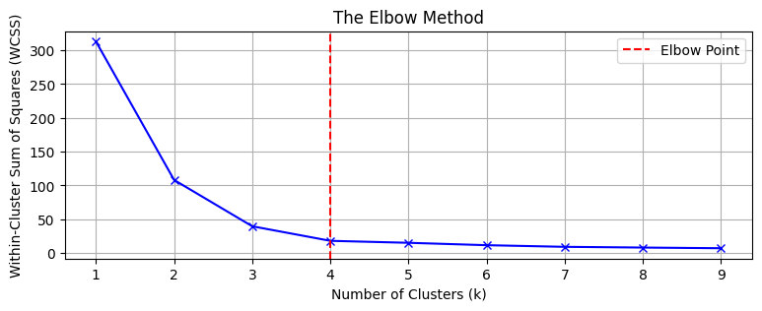
Centroid Model
Most common form is k-means clustering
Find k cluster centers and assign the samples to the nearest cluster center such that the squared distances from the center are minimized
Approximately solved to partition the sample space into a Voronoi diagram structure
Conceptually, it is like k-nearest neighbor (k-NN) classification
Challenges
How do you select k?
How good is the approximate solution?
Works only when the clusters are (almost) of the same size

Slide 5
Density Models
Clusters are defined as areas of higher density than the remainder of the data set; observations in sparse areas are considered as noise or border points
Most popular method is DBSCAN
Clusters all the observations within a chosen distance threshold, called the range, such that a minimum no. of observations are included
Similar to linkage-based clustering
A widely-used generalization is called OPTICS
Removes requirement of specific value of range parameter to generate a hierarchical output

Slide 6
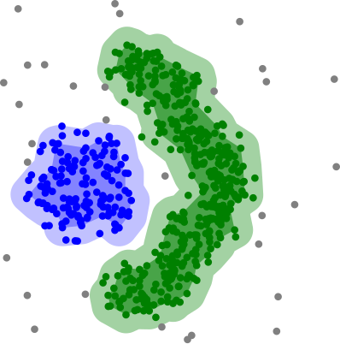
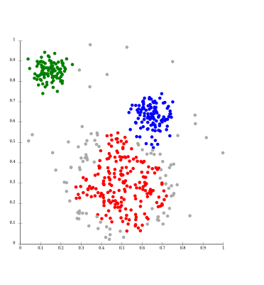
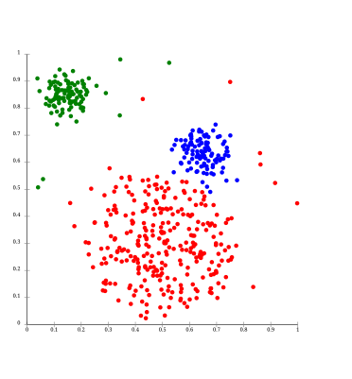
Density Models (Cont’d.)
DBSCAN works well
DBSCAN cannot separate nearby samples
OPTICS alleviates nearby sample separation problem

Slide 7
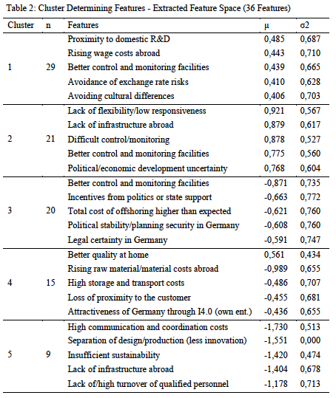
Case Study: Grouping of Enterprises Based on Reshoring Incentives
Unterberger, P. and Müller, J.M., 2021. Clustering and classification of manufacturing enterprises regarding their industry 4.0 reshoring incentives. Procedia Computer Science, 180, pp.696-705.
K-means clustering of 94 companies using a carefully-crafted questionnaire
Elbow test with K={2,…,15}

Slide 8
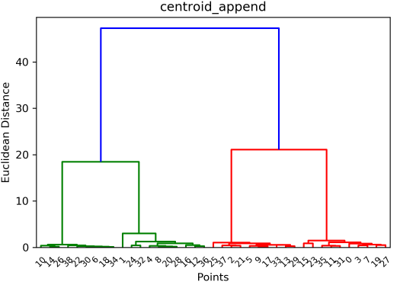
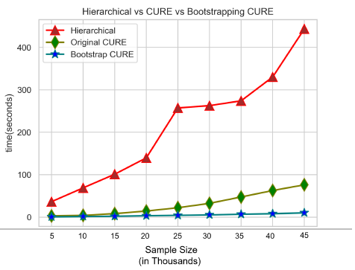
Case Study: 3D Printing Sensor Data Analytics
Suman, S., Karna, A. and Gibert, K., 2022. Bootstrap–CURE: A novel clustering approach for sensor data—an application to 3D printing industry. Applied Sciences, 12(4), p.2191.
8 machines, 41 sensors, 46,821 sensor readings, clustered into 4 groups based on usefulness in indicating successful printing jobs

Slide 9
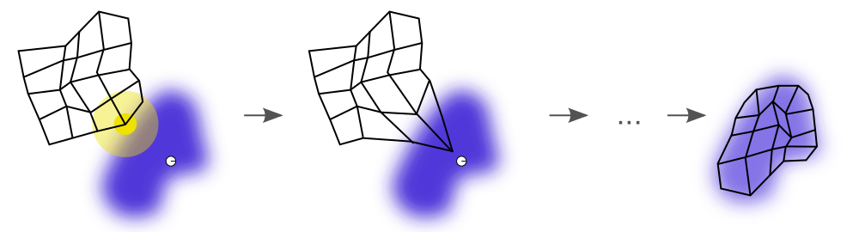
Advanced Technique: Neural Models
Most common type is a self-organizing map (SOM)
Produce a low-dimensional representation (map) of a higher-dimensional data set while preserving its topological structure
The map, typically a weighted neural network, is trained using competitive learning, where the neural weights are often initialized by sampling from the largest principal component eigen vectors
An illustration of the training of a SOM. The blue blob is the distribution of the training data, and the small white disc is the current training datum drawn from that distribution. At first (left), the SOM nodes are arbitrarily positioned. The node (highlighted in yellow) which is nearest to the training datum is selected. It is moved towards the training datum, as (to a lesser extent) are its neighbors on the grid. After many iterations, the map tends to approximate the data distribution (right).

