Slide 1

ME 599 J, K / IND E 599 A AI/ML for Smart Manufacturing Dimensionality Reduction
Professor Ashis G. Banerjee
March 30 – April 06, 2026

Slide 2

Motivation
Alleviate the curse of dimensionality
$p ≫N$or even just a large $p$ can lead to several issues
Long model training time
Model overfitting (inadequate generalization)
Presence of correlated features (problem for downstream classification / regression)
Lack of model interpretability

Slide 3
Feature Selection
Find the most suitable subset of input variables (features or predictors) for a given ML task
Approaches
Filtering
Identify the most relevant features using statistical tests, such as pairwise Pearson’s correlation for continuous features and ANOVA for categorical features (with continuous response variables)
How about detecting non-linear relationships among the features?
Mutual information is widely used
What about continuous features and categorical response variables?
What about categorical features and categorical response variables?
Incremental addition or deletion
Add (or, remove) one feature at a time based on whether prediction accuracy (or, some other performance measure) is increased

Slide 4
Feature Extraction: Non-Linear PCA-Based Methods
Kernel PCA
Extend PCA to extract non-linear mappings (among the features) that maximize the variance in the data
Done using ‘kernel trick’ where the linear PCA operations (eigen decompositions) are now performed in a reproducing kernel Hilbert space (RKHS)
Manifold learning
Several methods exist, many of which define a graph-based kernel
Multidimensional scaling (MDS): Direct analogue of PCA
Isometric feature mapping (ISOMAP): Uses geodesic distance
Diffusion maps: Uses diffusion distance
t-distributed stochastic neighbor embedding (t-SNE): Minimizes the divergence between distributions over pairs of points
Autoencoders

Slide 5
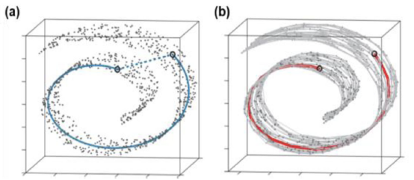
Case Study
Liu, C., Kong, Z., Babu, S., Joslin, C. and Ferguson, J., 2021. An integrated manifold learning approach for high-dimensional data feature extractions and its applications to online process monitoring of additive manufacturing. IISE Transactions, 53(11), pp.1215-1230.
Integration of ISOMAP with multi-kernel metric learning
Euclidean distance not useful when samples lie on a manifold
Geodesic distance provides meaningful similarity measure

Slide 6
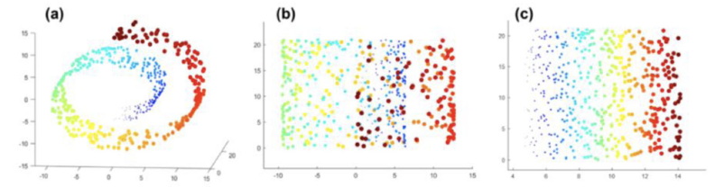
Case Study: Core Contributions
ISOMAP leads to meaningful clustering of samples in lower dimensions but requires high sampling rates and low noise levels which is challenging for process monitoring
Develop a new multi-kernel function defined by a conical sum-based linear combination of multiple kernel basis
Provides a parametric representation of geodesic distance that is more robust to noise and easier to compute
Swiss roll-shaped data
Clustering after PCA
Clustering after ISOMAP

Slide 7
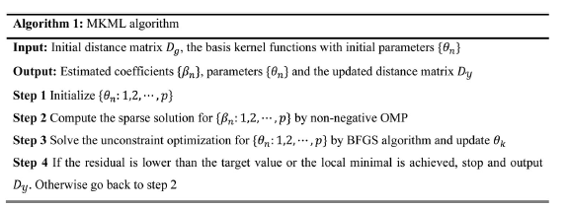
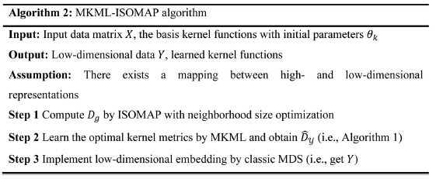
Case Study: Overall Algorithm

Slide 8
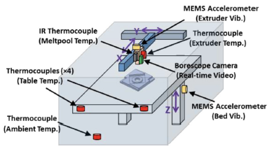
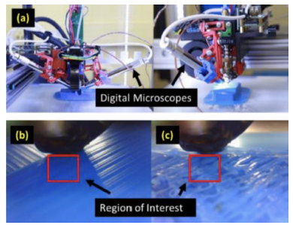
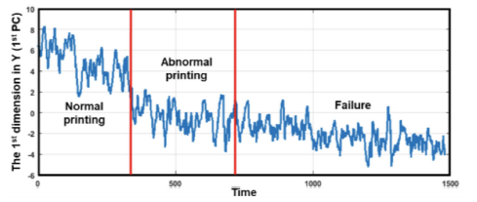
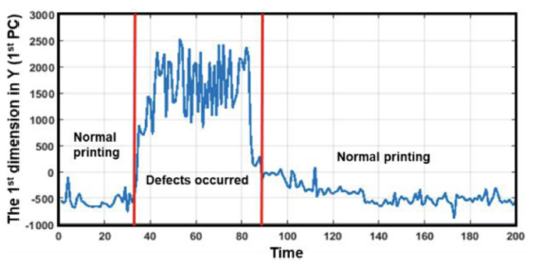
Case Study: System & Results
Schematic of online sensing system for FDM machine
(a) Image acquisition system; (b): Defect-free surface; (c) Surface w/ defect
Process state identification using MKML-ISOMAP algorithm

