Slide 1

ME 599 J, K / IND E 599 A AI/ML for Smart Manufacturing Regression
Professor Ashis G. Banerjee
April 27, 2026

Slide 2
Case Study: Paper
Baturynska, I. and Martinsen, K., 2021. Prediction of geometry deviations in additive manufactured parts: comparison of linear regression with machine learning algorithms. Journal of Intelligent Manufacturing, 32(1), pp.179-200.
Overall goal: Investigate effects of part placement, part orientation, and CAD model properties on dimensional accuracy of AM parts
Compare and contrast different regression models in terms of predicting thickness, width, and length of parts separately

Slide 3
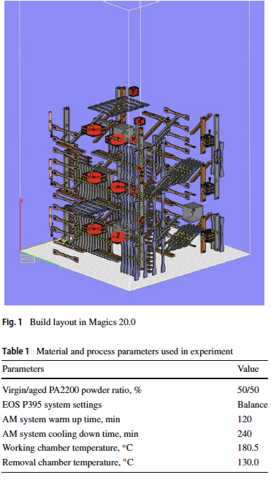
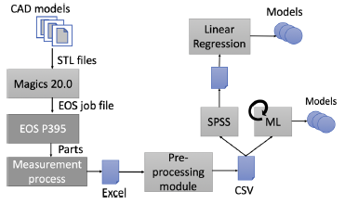
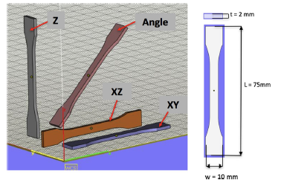
Case Study: Manufacturing Process

Slide 4
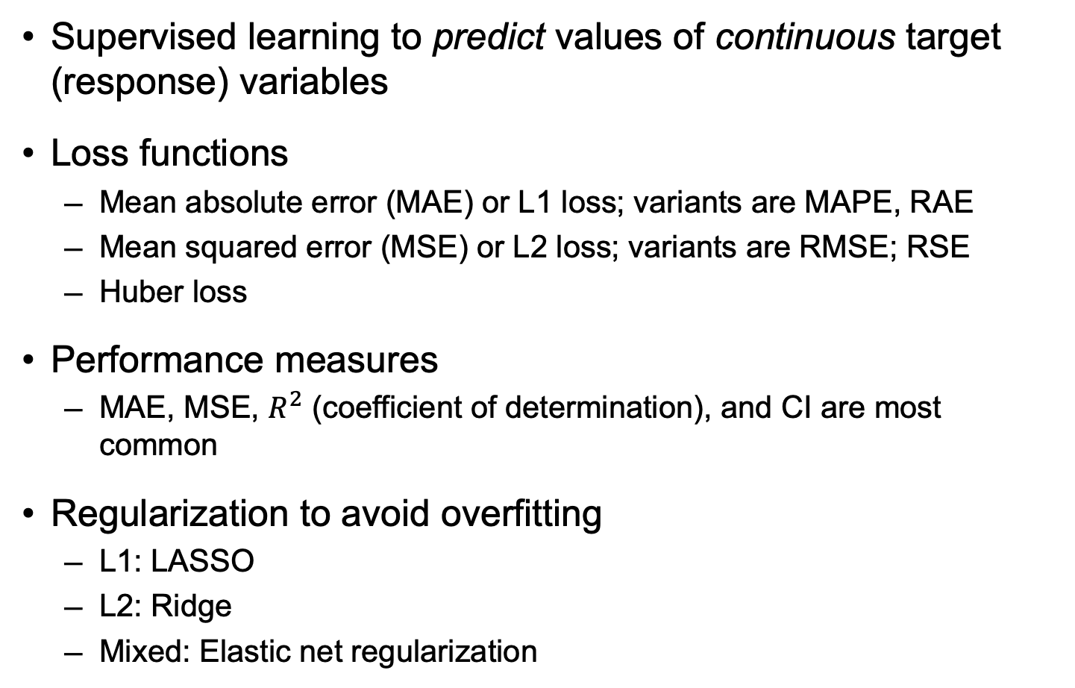
Basics
Supervised learning to predict values of continuous target (response) variables
Loss functions
Mean absolute error (MAE) or L1 loss; variants are MAPE, RAE
Mean squared error (MSE) or L2 loss; variants are RMSE; RSE
Huber loss
Performance measures
MAE, MSE, $R^{2}$ (coefficient of determination), and CI are most common
Regularization to avoid overfitting
L1: LASSO
L2: Ridge
Mixed: Elastic net regularization

Slide 5
Linear Regression
Typically, solved using least squares estimation
Can includes higher order polynomial terms
Use one-hot encoding to include categorical predictors

Slide 6
Generalized Regression
Regression (decision) trees
Random forest regression
Gradient boosting trees
Support vector regression
Logistic regression

Slide 7
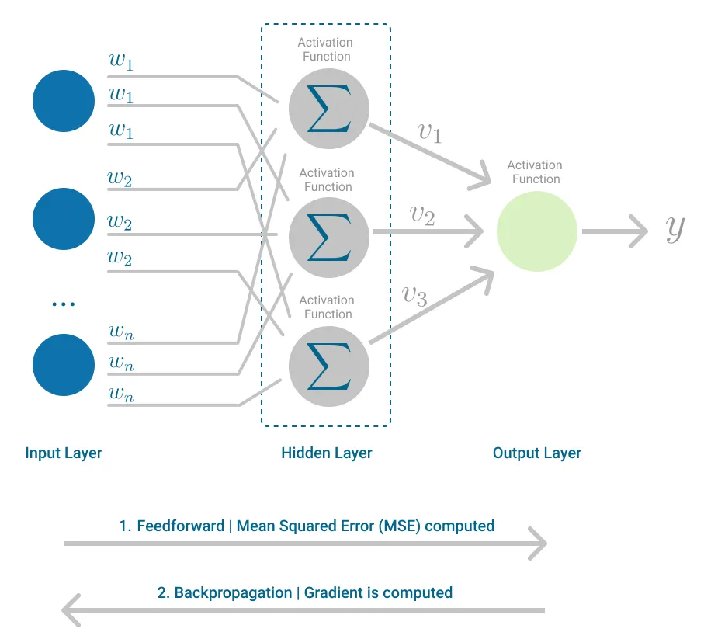
Multi-Layer Perceptron
Mapping between predictor and target variables is non-linear
Key ingredients
Activation functions, such as sigmoid function and Rectified Linear Unit (ReLU)
Backpropagation to iteratively adjust the network weights
Image source: https://medium.com/towards-data-science/multilayer-perceptron-explained-with-a-real-life-example-and-python-code-sentiment-analysis-cb408ee93141

Slide 8
Backpropagation Algorithm
Efficient application of gradient descent-based estimation of network weights to minimize loss function using the chain rule
Activation functions need to be differentiable with bounded derivatives
Critical issues, such as local minima convergence, exploding gradient, vanishing gradient, etc.

Slide 9
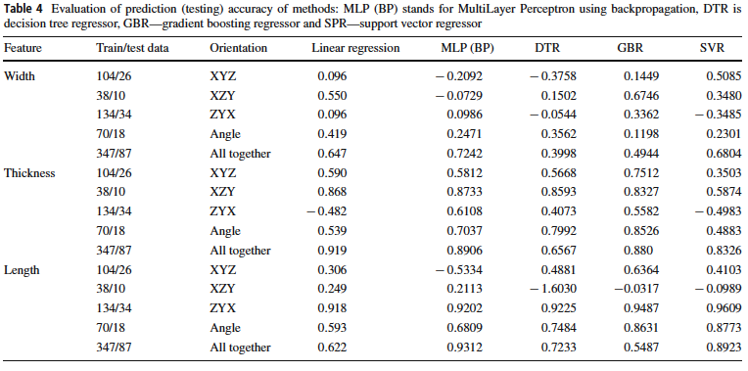
Case Study: Results

Slide 10
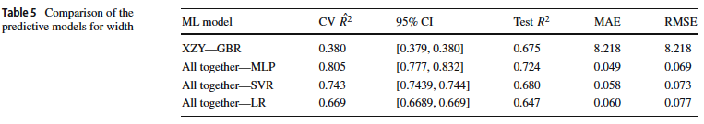
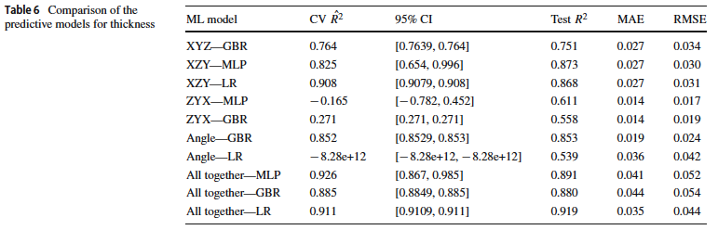
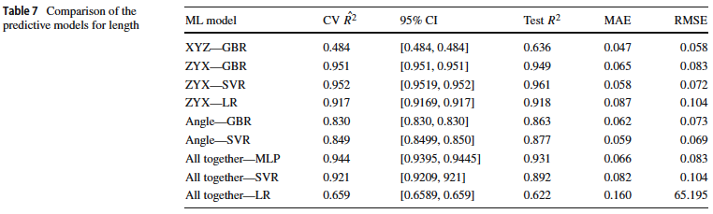
Case Study: Results (Cont’d.)

