Slide 1

ME 599 J, K / IND E 599 A AI/ML for Smart Manufacturing Survey, Outlook and Overview
Professor Ashis G. Banerjee
March 30, 2026

Slide 2
Papers
Rai, R., Tiwari, M.K., Ivanov, D. and Dolgui, A., 2021. Machine learning in manufacturing and industry 4.0 applications. International Journal of Production Research, 59(16), pp.4773-4778.
Dogan, A. and Birant, D., 2021. Machine learning and data mining in manufacturing. Expert Systems with Applications, 166, p.114060.

Slide 3
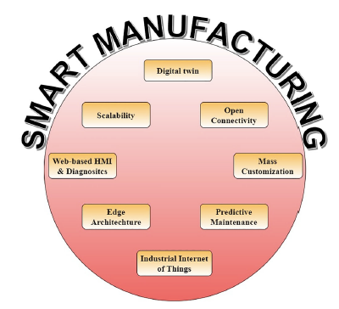

Industry 4.0 $⇒$ Smart Manufacturing [1]
Industry 4.0 is characterized by
Connectivity, intelligence, and flexible automation
What about cybersecurity and embodied AI?

Slide 4
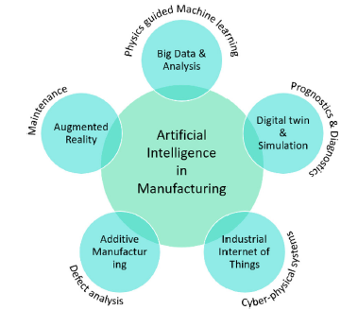
Role of AI & ML [1]
Not always “big data” as data acquisition and labeling can be sometimes difficult and expensive
In addition to AM, defect analysis can be critical in other challenging and important processes such as nanofabrication, automated fiber placement, etc.

Slide 5
Applications [1]
Improved assembly line efficiency
Improved customer experience
Better inventory management
Real-time visibility
Route delivery optimization
Reduced errors and waste during product development
Predictive maintenance
Real-time asset management to minimize losses
Increased visibility into supply chains
What about parts designs selection and materials discovery/selection?

Slide 6
Focus Areas [1]
Computer vision-based inspection and monitoring
Automated inspection of IC wire bonding defects [3]
Soft sensor for floatation froth grade classification [4]
Fault detection
Fault diagnosis of rolling bearing [5]
Fault detection of industrial cold forging [6]
Process improvement and optimization
Utilization of different data sources for injection molding [7]
Process mining in make-to-stock manufacturing [8]
Optimized assembly line feeding mode selection [9]
Cloud manufacturing
Edge-based hybrid scheduling learning model [10]

Slide 7
Conclusions [1]
Manufacturing is undergoing a fundamental paradigm shift
Manufacturing environments are turning into cyber-physical systems where AI is indispensable
Additional applications include geometric processing, material informatics, and control of dynamic systems
Synergy of ML and physics is becoming crucial
Data generation can be difficult and expensive
Anything not discussed?

Slide 8
References
Chen, J., Zhang, Z. and Wu, F., 2021. A data-driven method for enhancing the image-based automatic inspection of IC wire bonding defects. International Journal of Production Research, 59(16), pp.4779-4793.
Zhang, D. and Gao, X., 2021. Soft sensor of flotation froth grade classification based on hybrid deep neural network. International Journal of Production Research, 59(16), pp.4794-4810.
Wang, Z., Liu, Q., Chen, H. and Chu, X., 2021. A deformable CNN-DLSTM based transfer learning method for fault diagnosis of rolling bearing under multiple working conditions. International Journal of Production Research, 59(16), pp.4811-4825.
Glaeser, A., Selvaraj, V., Lee, S., Hwang, Y., Lee, K., Lee, N., Lee, S. and Min, S., 2021. Applications of deep learning for fault detection in industrial cold forging. International Journal of Production Research, 59(16), pp.4826-4835.
Rønsch, G.Ø., Kulahci, M. and Dybdahl, M., 2021. An investigation of the utilisation of different data sources in manufacturing with application in injection moulding. International Journal of Production Research, 59(16), pp.4851-4868.
Lorenz, R., Senoner, J., Sihn, W. and Netland, T., 2021. Using process mining to improve productivity in make-to-stock manufacturing. International Journal of Production Research, 59(16), pp.4869-4880.
Zangaro, F., Minner, S. and Battini, D., 2021. A supervised machine learning approach for the optimisation of the assembly line feeding mode selection. International Journal of Production Research, 59(16), pp.4881-4902.
Jian, C., Ping, J. and Zhang, M., 2021. A cloud edge-based two-level hybrid scheduling learning model in cloud manufacturing. International Journal of Production Research, 59(16), pp.4836-4850.

