Slide 1

3D Human Pose Estimation with 2D Marginal Heatmaps
Aiden Nibali, Zhen He, Staurt Morgan, Luke Predergast
2019 IEEE WCACV
Alberto Fung
Simon Badget
COSC6373
April 15, 2019

Slide 2

Why?
Alberto -
PhD focus in Biomechanics (motion analysis)
Sports performance
Rehabilitation
Simon -
3D Modeling and Animation for Film & Games
Augmented / Virtual / Mixed Reality

Slide 3

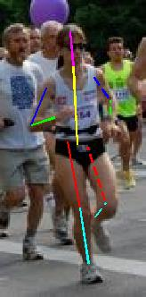
Problem Statement
Input
Image with human(s)
Output
Key joint location in 3D space

Slide 4
Who Cares?
Human Motion Analysis
  Animation
  Video game control
  Physical Rehabilitation
  Sports Biomechanics

Slide 5
Related Work
Volumetric Heatmap Approach
Design a model to produce a volumetric heatmap to represent the estimation of each 3D joint location
Limitations
Representing each joint with a 3D volume takes considerable memory requirements

Slide 6
Proposed Contribution(s)
1) Use Marginal Heatmap
3D pose estimation by predicting three (3) two-dimensional marginal heatmaps per joint
Benefits
More memory efficient than existing heatmap-based 3D estimations with volumetric activations per joint

Slide 7
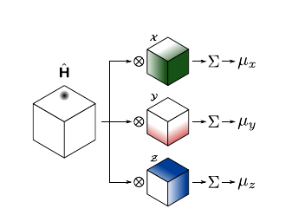
Proposed Contribution(s)
Volumetric Heatmap
depth x height x width tensor
Each element represents the probability that the joint is located in the corresponding spatial location

Slide 8
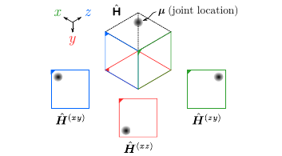
Proposed Contribution(s)
Marginal Heatmap
Multiple 2D “views” from outside the volumetric heatmap can fully describe the location of a joint

Slide 9
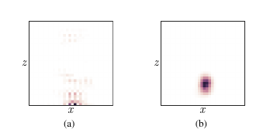
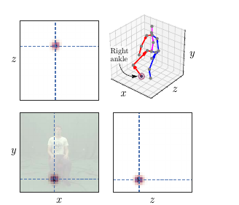
Proposed Contribution(s)
2) Regularization
Add regularization term to soft-argmax loss function
Explicitly guides predicted joint heatmaps to a spherical Gaussian distribution
Benefits
Improves visual coherence of predicted heatmaps

Slide 10
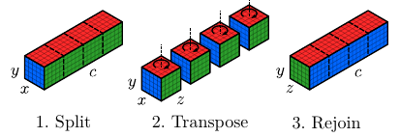
Proposed Contribution(s)
3) Architecture with Axis Permutation
Manipulates activations to account for discrepancy between input and output space
Benefits
Allows the model to aggregate depth cues into feature maps, which will then become pixel values along the z-axis

Slide 11
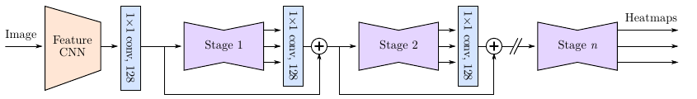
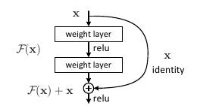
Architecture Overview
256x256 image input
Feature CNN (truncated Inception v4)
ResNet stages

Slide 12
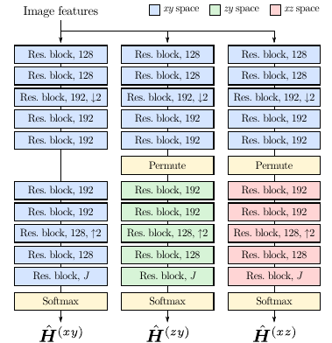
Detailed Architecture

Slide 13
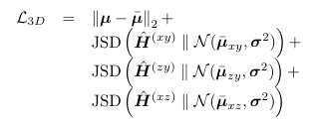
Joint Loss
JSD = Jensen-Shannon divergence

Slide 14
Dataset
Datasets
MPII Human Pose
Human3.6M
MPI-INF-3DHP
Augmentation
Scale
Position
Rotation
Color
Flipping

Slide 15
Training
Separate models for Human3.6 and MPI-INF-3DHP
32 Samples/batch (16 from 3D & 16 from 2D dataset)
Training
SGD
Momentum = 0.9
Learning rate = 1-cycle learning rate
Lrmax = 1.0

Slide 16
Tasks
Running Model
  Run without Docker
  Missing Requirements
  CUDA on Windows
Identify Alternative Data Sets
Analyze Paper for Possible Limitations
Robustness Evaluation
  Replication of reported results
  Evaluate with alternative datasets
  Analyze edge cases and limitations

Slide 17
Timeline
Week 1 - 4/15 - 4/21
Have model running – Identify Alternative Data Sets
Week 2 - 4/22 - 4/29
Run model against data sets
Week 3 - 4/30 - 5/7
Analyze Results – Compile report and presentation

Slide 18
Deliverables
Link to Original Code
  Access to repository with changes
Model Robustness Testing Report
  Quantitative Comparison – Reported Dataset
  Quantitative Comparison – Alternative Dataset
  Qualitative Comparison – Alternative Dataset
  Identified Limitations

Slide 19
Questions?

