Slide 1

3D Human Pose Estimation with 2D Marginal Heatmaps
Aiden Nibali, Zhen He, Staurt Morgan, Luke Predergast
2019 IEEE WCACV
Alberto Fung
Simon Badget
COSC6373
April 15, 2019
Notes:
1

Slide 2

Why?
Alberto -
PhD focus in Biomechanics (motion analysis)
Sports performance
Rehabilitation
Simon -
3D Modeling and Animation for Film & Games
Augmented / Virtual / Mixed Reality
Notes:
2

Slide 3

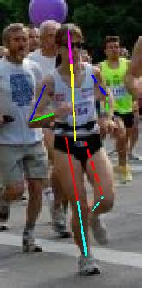
Problem Statement
Input
Image with human(s)
Output
Key joint location in 3D space
Notes:
3

Slide 4
Who Cares?
Human Motion Analysis
Animation
Video game control
Physical Rehabilitation
Sports Biomechanics
Notes:
4

Slide 5
Related Work
Volumetric Heatmap Approach
Design a model to produce a volumetric heatmap to represent the estimation of each 3D joint location
Limitations
Representing each joint with a 3D volume takes considerable memory requirements
Notes:
5

Slide 6
Proposed Contribution(s)
1) Use Marginal Heatmap
3D pose estimation by predicting three (3) two-dimensional marginal heatmaps per joint
Benefits
More memory efficient than existing heatmap-based 3D estimations with volumetric activations per joint
Notes:
6

Slide 7
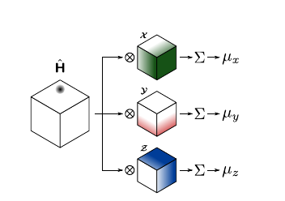
Proposed Contribution(s)
Volumetric Heatmap
depth x height x width tensor
Each element represents the probability that the joint is located in the corresponding spatial location
Notes:
7

Slide 8
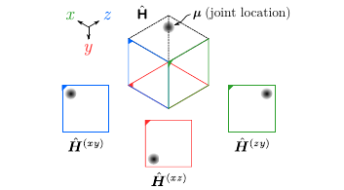
Proposed Contribution(s)
Marginal Heatmap
Multiple 2D “views” from outside the volumetric heatmap can fully describe the location of a joint
Notes:
8

Slide 9
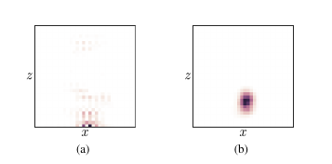
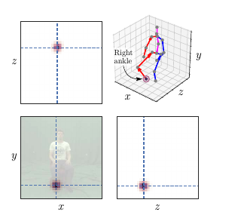
Proposed Contribution(s)
2) Regularization
Add regularization term to soft-argmax loss function
Explicitly guides predicted joint heatmaps to a spherical Gaussian distribution
Benefits
Improves visual coherence of predicted heatmaps
Notes:
9

Slide 10
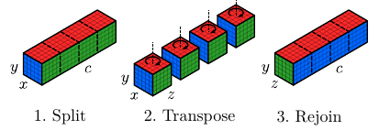
Proposed Contribution(s)
3) Architecture with Axis Permutation
Manipulates activations to account for discrepancy between input and output space
Benefits
Allows the model to aggregate depth cues into feature maps, which will then become pixel values along the z-axis
Notes:
10

Slide 11
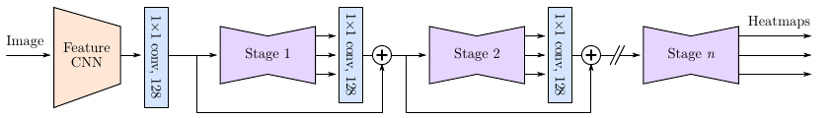
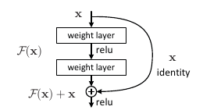
Architecture Overview
256x256 image input
Feature CNN (truncated Inception v4)
ResNet stages
Notes:
11

Slide 12
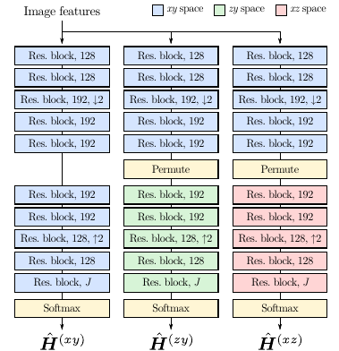
Detailed Architecture
Notes:
12

Slide 13
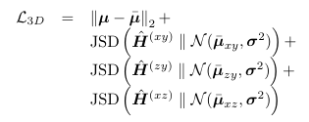
Joint Loss
JSD = Jensen-Shannon divergence
Notes:
13

Slide 14
Dataset
Datasets
MPII Human Pose
Human3.6M
MPI-INF-3DHP
Augmentation
Scale
Position
Rotation
Color
Flipping
Notes:
14

Slide 15
Training
Separate models for Human3.6 and MPI-INF-3DHP
32 Samples/batch (16 from 3D & 16 from 2D dataset)
Training
SGD
Momentum = 0.9
Learning rate = 1-cycle learning rate
Lrmax = 1.0
Notes:
15

Slide 16
Tasks
Running Model
Run without Docker
Missing Requirements
CUDA on Windows
Identify Alternative Data Sets
Analyze Paper for Possible Limitations
Robustness Evaluation
Replication of reported results
Evaluate with alternative datasets
Analyze edge cases and limitations
Notes:
16

Slide 17
Timeline
Week 1 - 4/15 - 4/21
Have model running – Identify Alternative Data Sets
Week 2 - 4/22 - 4/29
Run model against data sets
Week 3 - 4/30 - 5/7
Analyze Results – Compile report and presentation
Notes:
17

Slide 18
Deliverables
Link to Original Code
Access to repository with changes
Model Robustness Testing Report
Quantitative Comparison – Reported Dataset
Quantitative Comparison – Alternative Dataset
Qualitative Comparison – Alternative Dataset
Identified Limitations
Notes:
18

Slide 19
Questions?
Notes:
19

