Slide 1
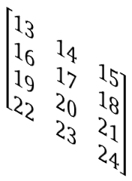
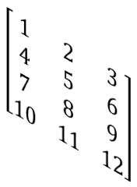
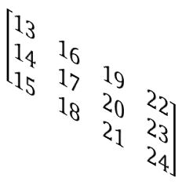
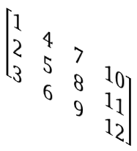
Torch Transpose
tensor.transpose(1, 2):
keeps the batch size constant and flips the tensor between the 2nd and 3rd dimensions.
3
4
$$\left[\begin{matrix}13 & 14 & 15 \\ 16 & 17 & 18 \\ 19 & 20 & 21 \\ 22 & 23 & 24\end{matrix}\right]$$
$$\left[\begin{matrix}13 & 16 & 19 & 22 \\ 14 & 17 & 20 & 23 \\ 15 & 18 & 21 & 24\end{matrix}\right]$$
$$\left[\begin{matrix}1 & 2 & 3 \\ 4 & 5 & 6 \\ 7 & 8 & 9 \\ 10 & 11 & 12\end{matrix}\right]$$
4
$$\left[\begin{matrix}1 & 4 & 7 & 10 \\ 2 & 5 & 8 & 11 \\ 3 & 6 & 9 & 12\end{matrix}\right]$$
3
2 (batch size)
2 (batch size)

Slide 2










$$\frac{∂z}{∂w_{1}}=x_{1}$$
$$z= w_{1}.x_{1}+b$$
$$\frac{∂(Loss)}{∂w_{1}}=−2x_{1}\left(y−z\right)=\left(−2\right)\left(0.16\right)(1.1)= 0.352$$
1
$$Loss= {(y−z)}^{2}$$
$$\frac{∂(Loss)}{∂z}=−2(y−z)$$
$$\frac{∂z}{∂b}=1$$
$$z= w_{1}.x_{1}+b$$
$$\frac{∂(Loss)}{∂b}=−2\left(y−z\right)=\left(−2\right)\left(0.16\right)=−0.32$$
2
$$Loss= {(y−z)}^{2}$$
$$\frac{∂(Loss)}{∂z}=−2(y−z)$$
1
2
W₁
4.84
1
4.4
X
+
Z
0.0256
-
POW
Loss
X₁
b
2
y
1.1
0.0
2
5.0

Slide 3
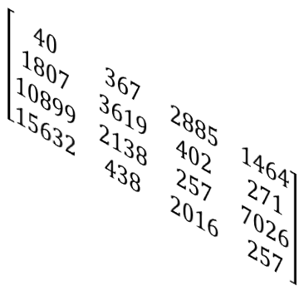
Token Embedding
Embedding size = 6
40
367
2885
1464
$$\left[\begin{matrix}\text{0.3374} & −\text{0.1778} & −\text{0.3035} & −\text{0.5880} & \text{0.3486} & \text{0.6603}\end{matrix}\right]$$
$$\left[\begin{matrix}\text{−}\text{0.2196} & −\text{0.3792} & −\text{0.1606} & −\text{0.4015} & \text{0.6957} & \text{−}\text{1.8061}\end{matrix}\right]$$
$$\left[\begin{matrix}\text{1.8960} & −\text{0.1750} & \text{1.3689} & −\text{1.6033} & \text{−}\text{0.7849} & \text{−}\text{1.4096}\end{matrix}\right]$$
$$\left[\begin{matrix}40 & 367 & 2885 & 1464 \\ 1807 & 3619 & 402 & 271 \\ 10899 & 2138 & 257 & 7026 \\ 15632 & 438 & 2016 & 257\end{matrix}\right]$$
$$\left[\begin{matrix}\text{−}\text{0.4076} & \text{0.7953} & \text{0.9985} & \text{0.2212} & \text{1.8319} & \text{−}\text{0.3378}\end{matrix}\right]$$
embedding size
context size
Shape:
batch size x context size = 4
batch size

Slide 4
Absolute Positional Embedding
Vector element: 4
Vector element: 5
Vector element: 1
Vector element: 2
Vector element: 3
Vector element: 6
Position: 1
40
367
2885
1464
$$\left[\begin{matrix}\begin{matrix}\text{0.3374} & −\text{0.1778} & −\text{0.3035} & −\text{0.5880} & \text{0.3486} & \text{0.6603}\end{matrix} \\ \begin{matrix} 1.1 & 1.2 & 1.3 & 1.4 & \text{1.5 } & \text{1.6}\end{matrix}\end{matrix}\right]$$
$$\left[\begin{matrix}\begin{matrix}\text{ 1}\text{.}\text{4}\text{374} & \text{ 1}\text{.}\text{0}222 & \text{0.9965} & \text{0.812 } & \text{ 1}\text{.}\text{8}\text{486} & \text{2}\text{.}\text{2}\text{603}\end{matrix}\end{matrix}\right]$$
Position: 2
$$\left[\begin{matrix}\text{−}\text{0.2196} & −\text{0.3792} & −\text{0.1606} & −\text{0.4015} & \text{0.6957} & \text{−}\text{1.8061}\end{matrix}\right]$$
Position: 3
$$\left[\begin{matrix}40 & 367 & 2885 & 1464 \\ 1807 & 3619 & 402 & 271 \\ 10899 & 2138 & 257 & 7026 \\ 15632 & 438 & 2016 & 257\end{matrix}\right]$$
$$\left[\begin{matrix}\text{1.8960} & −\text{0.1750} & \text{1.3689} & −\text{1.6033} & \text{−}\text{0.7849} & \text{−}\text{1.4096}\end{matrix}\right]$$
$$\left[\begin{matrix}\text{−}\text{0.4076} & \text{0.7953} & \text{0.9985} & \text{0.2212} & \text{1.8319} & \text{−}\text{0.3378}\end{matrix}\right]$$
Position: 4

Slide 5
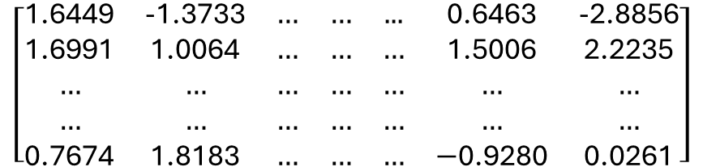
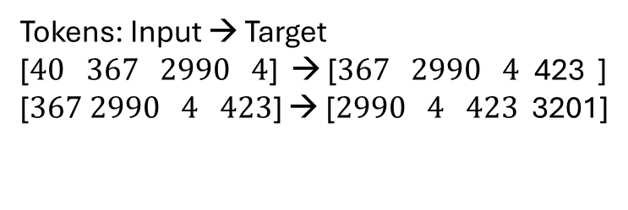
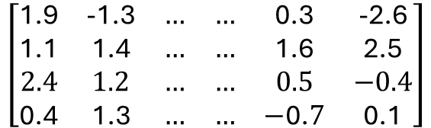
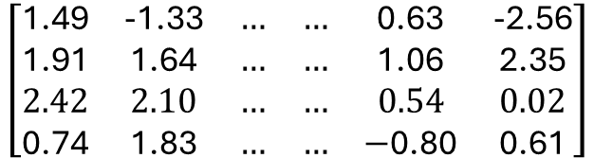
Text processing: from tokenization to embedding
Text input to LLM: I like coding!
LLM
has its own tokenizer
BPE Tokenizer
Tokens: Input → Target
[$40 367 2990 4$] → [$367 2990 4$ 423 ]
[$367 2990 4 423$] → [$2990 4 423$ 3201]
has its own unique token pool. Each token has a vector length of embedding size.
2
(no. of batch)
Tokenizer
Token to embedding vectors
Token Embedding
$$\left[\begin{matrix}\text{1.6449} & \text{-}\text{1.3733} & … & … & \text{...} & \text{0.6463} & \text{-}\text{2.8856} \\ \text{1.6991} & \text{1.0064} & … & … & … & \text{1.5006} & \text{2.2235} \\ … & … & … & … & … & … & … \\ … & … & … & … & … & … & … \\ \text{0.7674} & \text{1.8183} & … & … & … & −\text{0.9280} & \text{0.0261}\end{matrix}\right]$$
$$\left[\begin{matrix}\text{1.49} & \text{-}\text{1.33} & … & … & \text{0.63} & \text{-}\text{2.56} \\ \text{1.91} & \text{1.64} & … & … & \text{1.06} & \text{2.35} \\ 2.42 & 2.10 & … & … & 0.54 & 0.02 \\ \text{0.74} & \text{1.83} & … & … & −\text{0.80} & \text{0.61}\end{matrix}\right]$$
50257
(GPT-2)
4
768
batch #1
768
(GPT-2 Small)
$$\left[\begin{matrix}\text{1.9} & \text{-}\text{1.3} & … & … & \text{0.3} & \text{-}\text{2.6} \\ \text{1.1} & \text{1.4} & … & … & \text{1.6} & \text{2.5} \\ 2.4 & 1.2 & … & … & 0.5 & −0.4 \\ \text{0.4} & \text{1.3} & … & … & −\text{0.}7 & \text{0.1}\end{matrix}\right]$$
batch #2
Input embedding
Each row corresponds to a unique token id.
Positional embedding: shape = 4 x 768

