Slide 1
TERRAFORM PROJECT

Slide 2
What is terraform ?
Terraform is an infrastructure as code tool that lets you build, change, and version cloud and on-prem resources safely and efficiently

Slide 3
Defination of terraform
Terraform is an open-source provisioning tool that allows you to define and manage your infrastructure resources using a simple, human-readable configuration language. With Terraform, you can automate the deployment and management of infrastructure across various cloud providers and on-premises environments.
Here are some important reasons why Terraform should be in any IT professional's toolkit

Slide 4
Terraform commands
Terraform init:
Initializes a new or existing Terraform working directory by downloading the required provider plugins and sets up the backend to store the state. This command must be run before any other Terraform command is executed.
Terraform fmt:
Rewrites terraform Configuration files to a canonical format, Which makes it easier to read and manintain.

Slide 5
Terraform Validates:
Validates the syntax and structure of the Terraform configuration file. This command checks for errors, missing required arguments and other issues.
Terraform plan:
Shows the changes that Terraform will make to the infrastructure to bring it into the desired state,without actually making the changes. This is useful to see what changes terraform will make before actually applying them.
Terraform apply:
Applies the changes to the infrastructure described in the Terraform configuration files. This command will create,modify,or delete resources as needed to bring the infrastructure into the desired state.
Terraform destroy:
Destroys all the infrastructure created by Terraform, freeing up the resources and ensuring that you are not paying for unused infrastructure. This command should be used with caution as it will delete all the resources described in the configuration file.

Slide 6
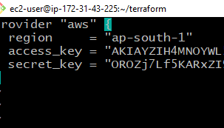
TERRAFORM SCRIPT
STEP-1 CREATE A PROVIDER FILE

Slide 7
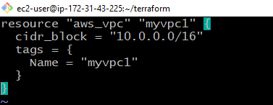
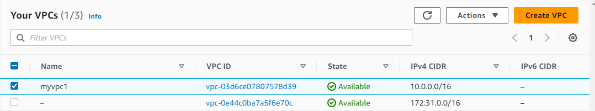
STEP-2 CREATE A FILE FOR VPC

Slide 8
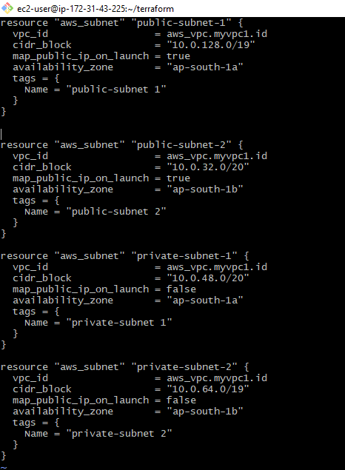
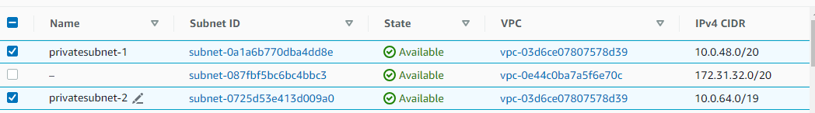
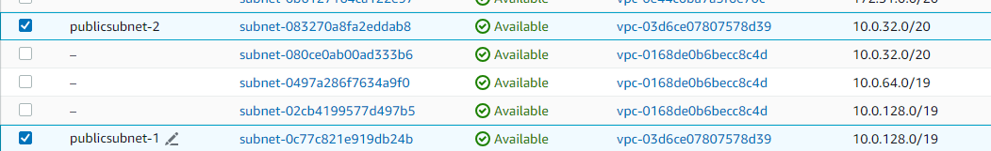
STEP-3 CREATE A FILE FOR THE SUBNET

Slide 9
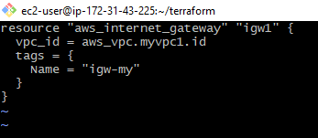
STEP-4 CREATE A FILE FOR THE INTERNET GATEWAY

Slide 10
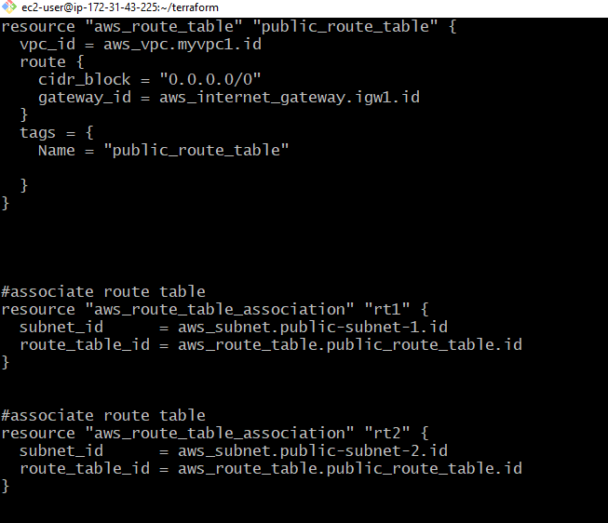
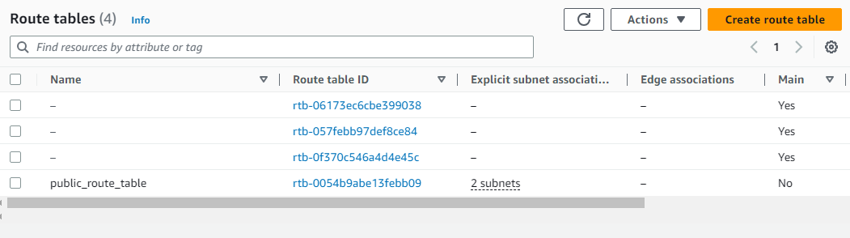
STEP-5 CREATE A FILE FOR ROUTE TABLE

Slide 11
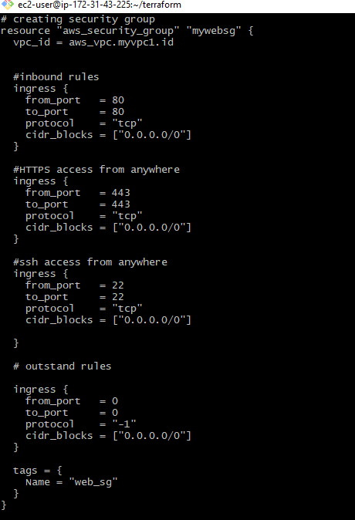
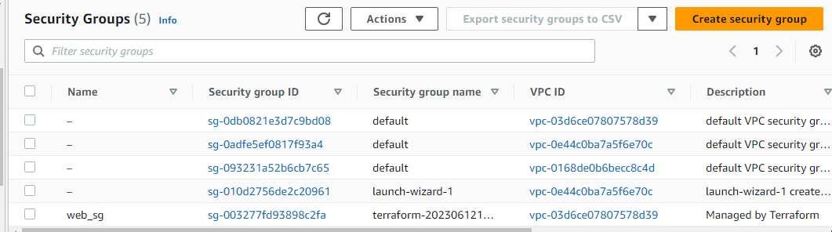
STEP-6 CREATE A FILE FOR SECURITY

Slide 12
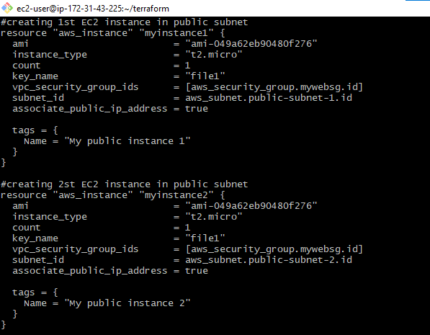
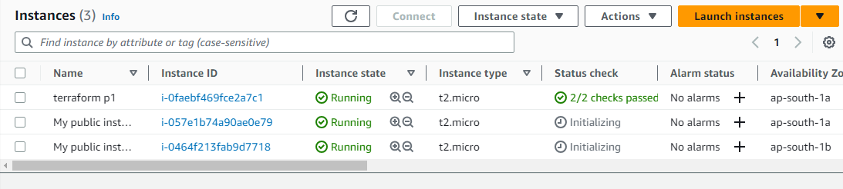
STEP-7 CREATE A FILE FOR EC2

Slide 13
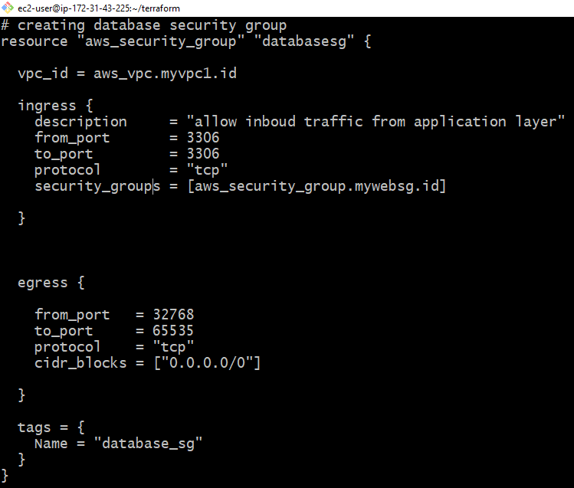
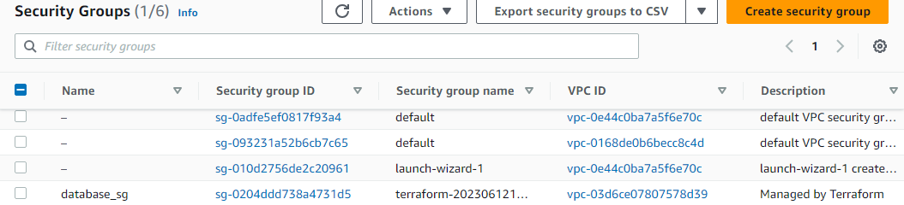
STEP-8 CREATE A FILE FOR THE SECURITY GROUP FOR THE DATABASE TIER

Slide 14
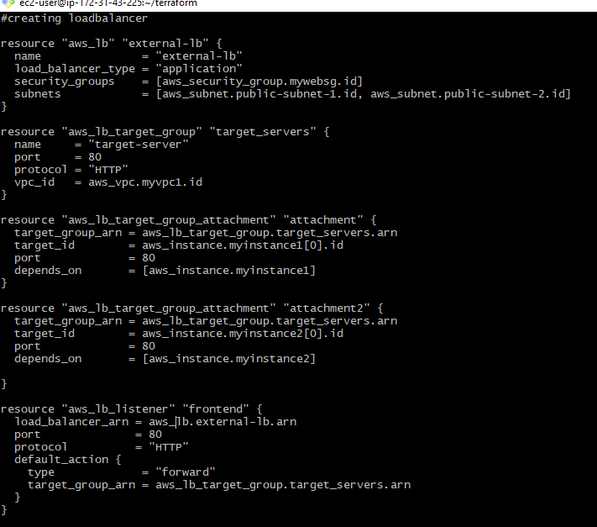
STEP-9 CREATE A FILE FOR LOAD BALANCER

Slide 15
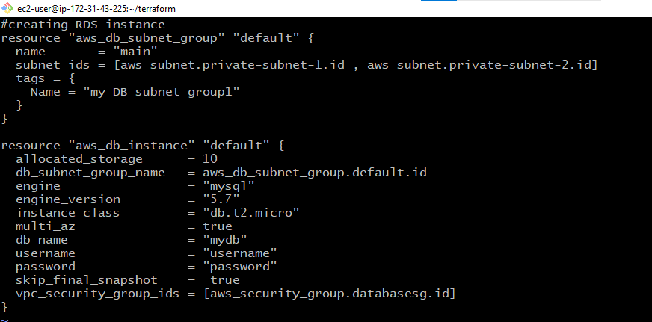
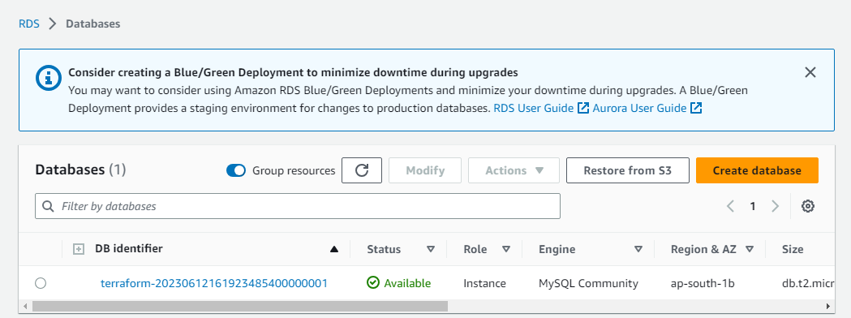
STEP-10 CREATE A FILE FOR RDS INSTANCE

Slide 16
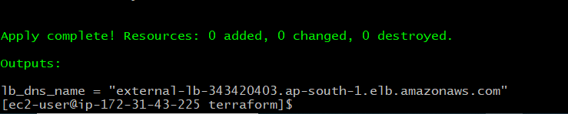
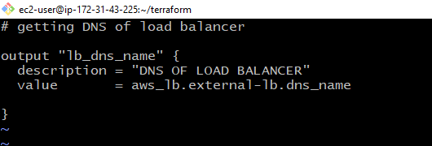
STEP-11 CREATE A FILE FOR OUTPUT

Slide 17
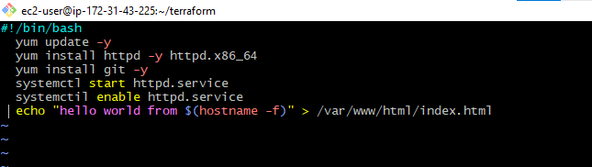
STEP-12 CREATE A FILE FOR USERDATA

