Slide 1

Deployment of the wordpress application by aws services & docker-compose
By :-
MD FIRASAT SAYEED
firasatsayeed99@gmail.com

Slide 2
WORDPRESS:
WordPress is a content management system (CMS) that allows you to host and build websites.
WordPress contains plugin architecture and a template system, so you can customize any website to fit your business, blog, portfolio, or online store.
Wordpress is free open-source software that you can download for free.
There are two types of wordpress.
wordpress.org
wordpress.com

Slide 3
Difference between WORDPRESS.ORG & WORDPRESS.COM :
WWW.Wordpress.org
Use your own domain name
This is used to create website
Upload and install themes & plugins
Edit the code behind your site
No registration with Wordpress.org is required
WordPress.org is free to use, but you have to pay for everything else that goes into having a website.
WWW.Wordpress.com
No hosting costs
This is used to create blog
No managing a web server ,easy to setup
No Customization option
No uploading plugins
No access to your site’s code

Slide 4
ADVANTAGES OF WORDPRESS :
Open source web Application
Superb plugins are available
Create web application in short period
Safe and secure websites
Easy to use
Create Multi-Author sites
SEO friendly
Best blogging platform
Create Responsive websites

Slide 5
DEPLOYING WORDPRESS USING AWS:
PREREQUISITE
Create an IAM user by signing into the AWS console and login to that IAM user.
Create a custom VPC with a sider range og 10.0.0.0/20.
Create two instances in that one is private instance and another one is public instance.
Connect RDS to the private instance and wordpress to the public instance.
While creating a instance you will download a pem file when you create key pair,Give ceratin permissions to that pem file.

Slide 6
Connect private instance through public instance using ssh key, attach RDS to private instance and create a user and exit from the private instance.
Install mariadb, php-mysql and wordpress in public instance.
Extract the files after installing the wordpress.
Copy the files from wp-config-sample.php to wp-config.php .
Install the httpd in public instance and copy the all configuration files of wordpress to root directory of httpd.
Browse the ip address to see the output.

Slide 7
DEPLOYING WORDPRESS by USING Docker-compose:
Docker is a software platform that allows you to build, test, and deploy applications quickly.
Docker packages software into standardized units called containers that have everything the software needs to run including libraries, system tools, code, and runtime.
Docker allows you to instantly create and manage containers with ease, which facilitates faster deployments.
Docker Compose is a tool that was developed to help define and share multi-container applications.
With Compose, we can create a YAML file to define the services and with a single command .

Slide 8
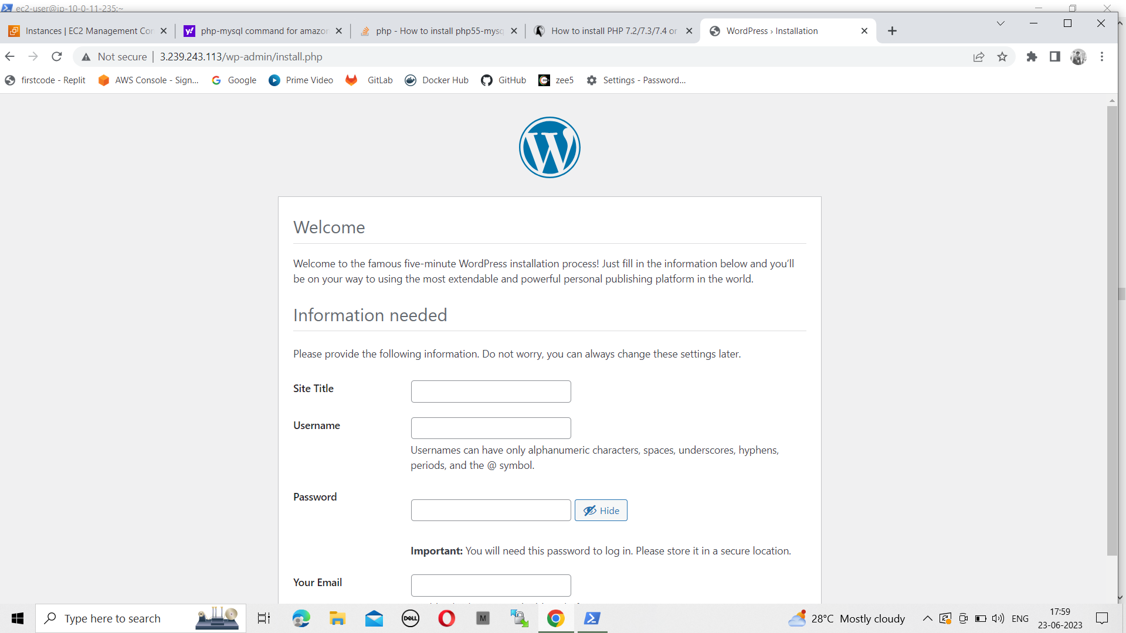
WORDPRESS APPLICATION

Slide 9
THANK YOU

