Slide 1
DESIGN OF COMMON SOURCE AMPLIFIER (REDESIGNED)
As w/l ratio was very high in previous design approach and simulations result were not exactly matching the specification

Slide 2
COMMON SOURCE AMPLIFIER
Using NMOS AND PASSIVE LOAD
Model file : 180n
SPECIFICATIONS
GBW=800MHz , VDD=1.8V , L=0.36u

Slide 3

CALCULATIONS
GBW=800MHz , L=0.36u , Vdd=1.8V, Model file = 180n
Let GAIN (A) = 10
f(-3db) = $\frac{\text{G}BW}{\text{G}ain}$ = 80MHz LET Gm=2mS (Practical value range 1-3 S given by Javed Sir)
USING $\text{C}\text{L}$= $\frac{Gm}{2π GBW}$ $\text{C}\text{L}$ =0.397pF (assume 0.3pF)
Now by Back calculation ,
$Gm$= $2π GBW\text{C}\text{L}$=1.5mS
Assume Vov=0.2V Vgs=0.65V Id= $\frac{Gm Vov}{2}$=150uA
Then , Gm/Id = 10
R=(1.8 – 0.9)/150uA=6 Kohm
W is calculated by sweeping for 150uA current

Slide 4
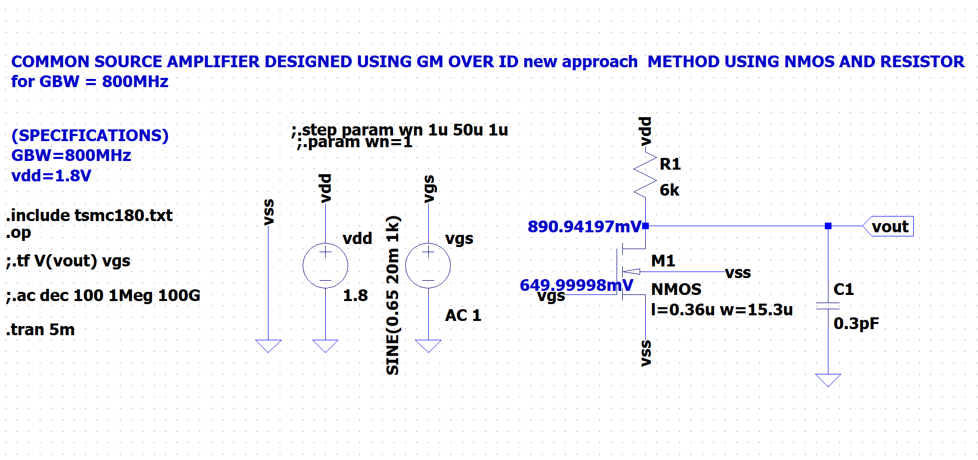
SCHEMATIC IN LT SPICE

Slide 5
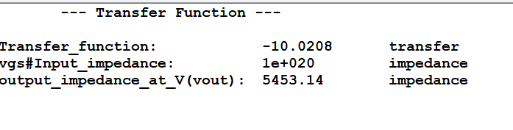
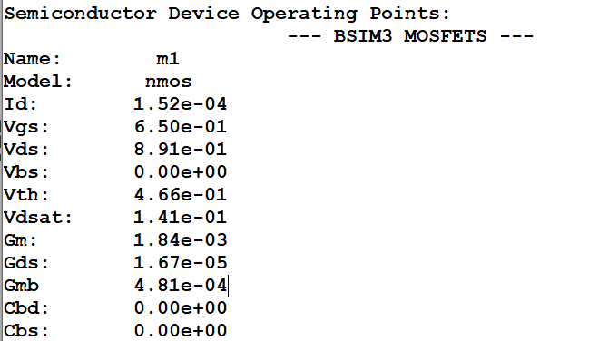
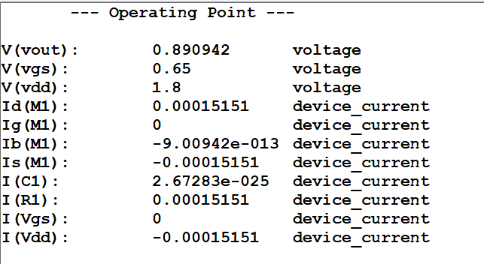

Slide 6
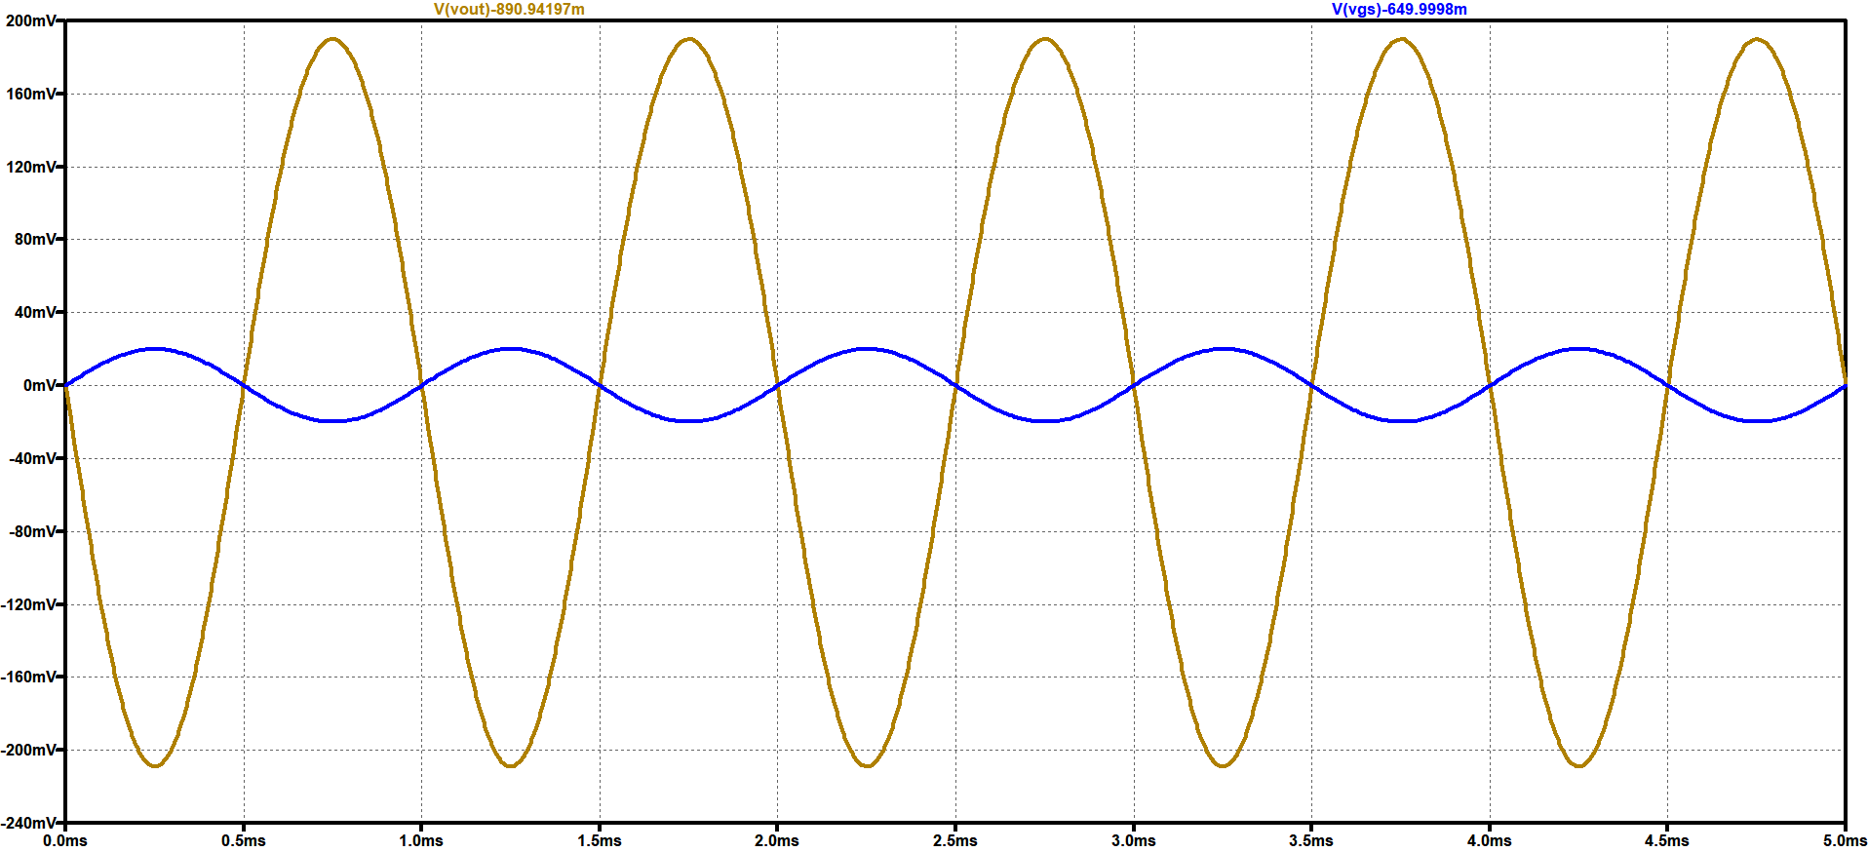
TRANSIENT ANALYSIS IN LT SPICE

Slide 7
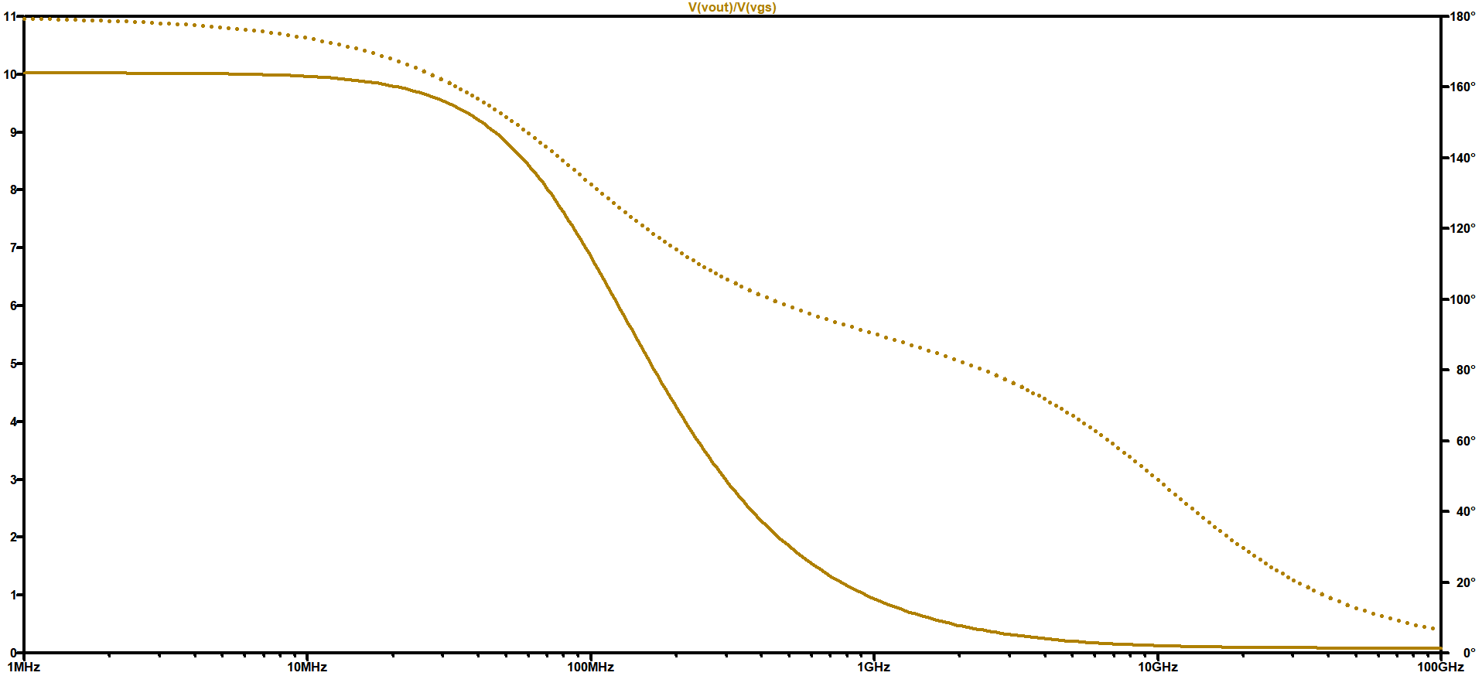
FREQUENCY RESPONSE IN LT SPICE

Slide 8
COMMON SOURCE AMPLIFIER
Using PMOS AND PASSIVE LOAD
Model file : 180n
SPECIFICATIONS
GBW=800MHz , VDD=1.8V , L=0.36u

Slide 9

CALCULATIONS
GBW=800MHz , L=0.36u , Vdd=1.8V, Model file = 180n
LET Gm=3mS (Practical value range 1-3 S given by Javed Sir)
USING $\text{C}\text{L}$= $\frac{Gm}{2π GBW}$ $\text{C}\text{L}$ =0.49pF (assume 0.5pF)
Now by Back calculation ,
$Gm$= $2π GBW\text{C}\text{L}$=2.5mS
Assume Vov=0.2V Vg=1.1V Id= $\frac{Gm Vov}{2}$=312uA
Then , Gm/Id = 8.01
R=(1.8 – 0.9)/312uA= 2.88 Kohm
W is calculated by sweeping for 312uA current

Slide 10
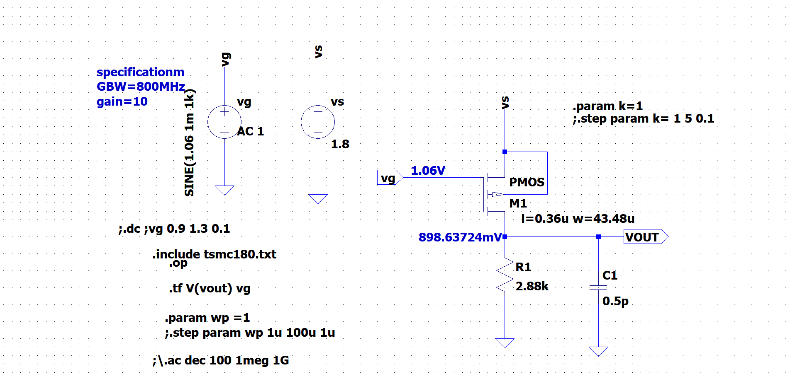
SCHEMATIC IN LT SPICE

Slide 11
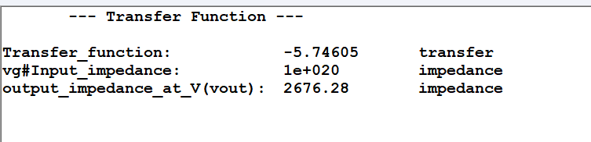
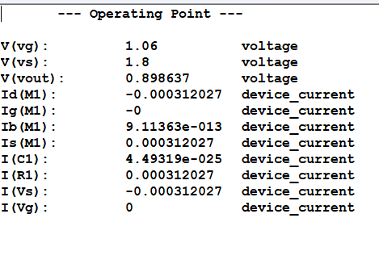
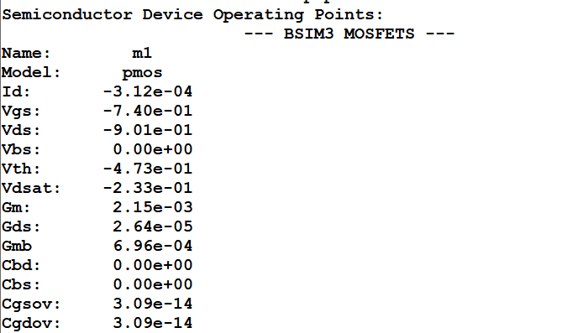

Slide 12
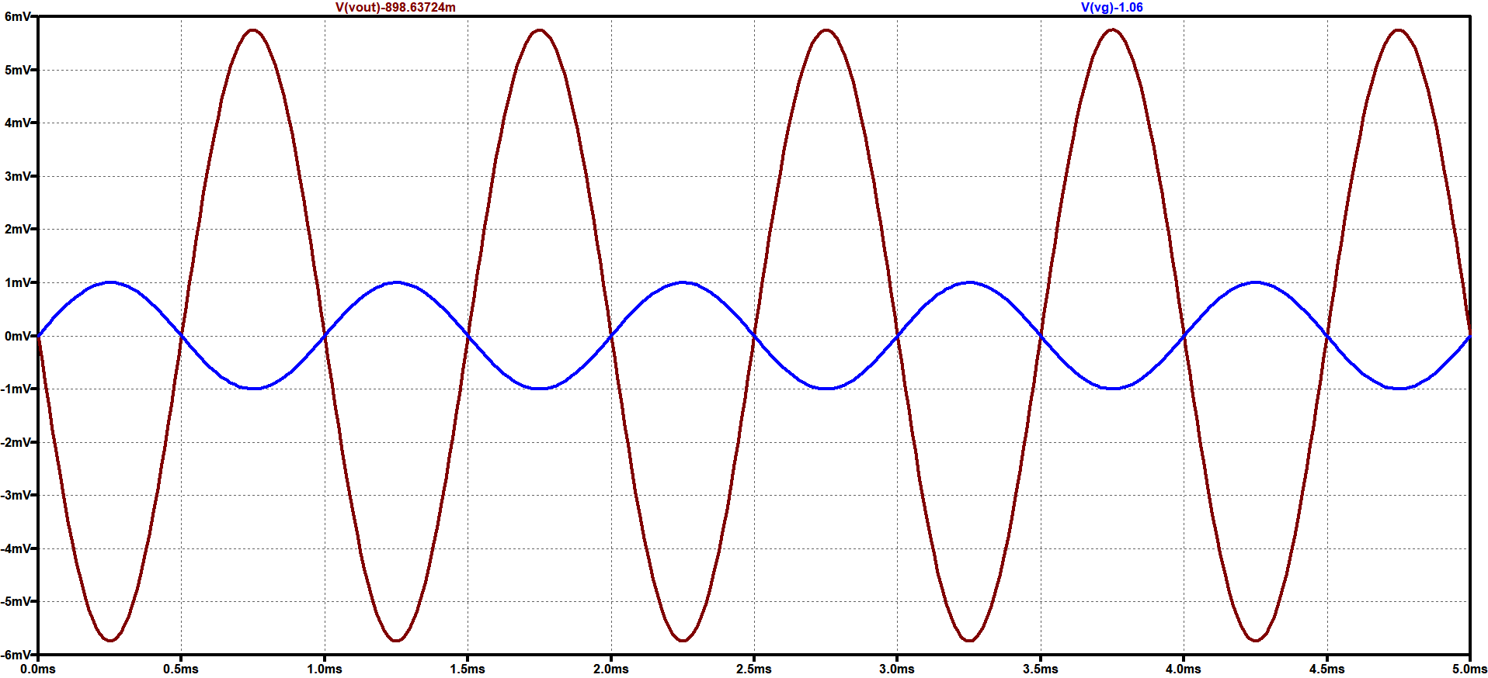
TRANSIENT ANALYSIS IN LT SPICE

Slide 13
COMMON SOURCE AMPLIFIER
Using NMOS AND CURRENT SOURCE LOAD
Model file : 180n
SPECIFICATIONS
GBW=1GHz , Gain = 10 at 100MHz

Slide 14

CALCULATIONS
GBW=1GHz , Gain = 10 at 100MHz
LET Gm=2mS (Practical value range 1-3 S given by Javed Sir)
USING $\text{C}\text{L}$= $\frac{Gm}{2π GBW}$ $\text{C}\text{L}$ =0.318pF (assume 0.3pF)
Now by Back calculation ,
$Gm$= $2π GBW\text{C}\text{L}$ =1.884mS
(For nmos) Vov=0.2V Vgs=0.65V Id= $\frac{Gm Vov}{2}$= 188uA
Then , Gm/Id = 10.021 Id/W = 13.6
W=14u
(For pmos) Vg=1.1V
Width of PMOS is taken twice as that of nmos
W=28u
NOTE : Now some manipulations are done in calculations to meet the specifications

Slide 15
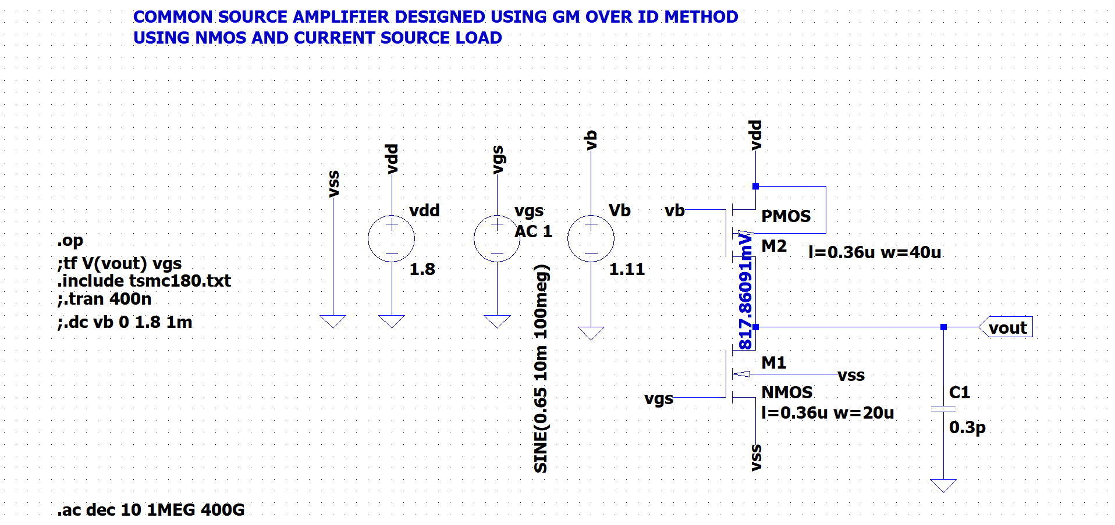
SCHEMATIC IN LT SPICE

Slide 16
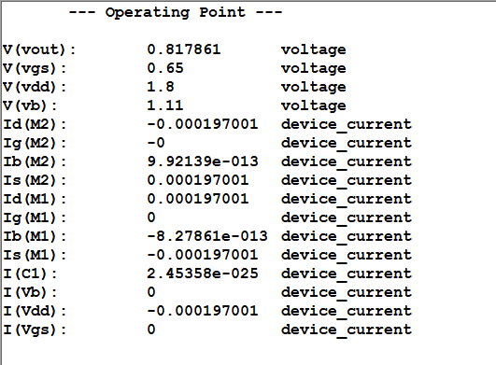
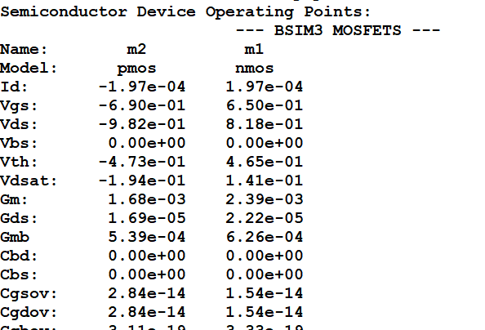
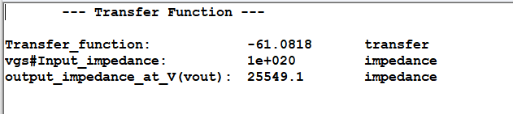

Slide 17
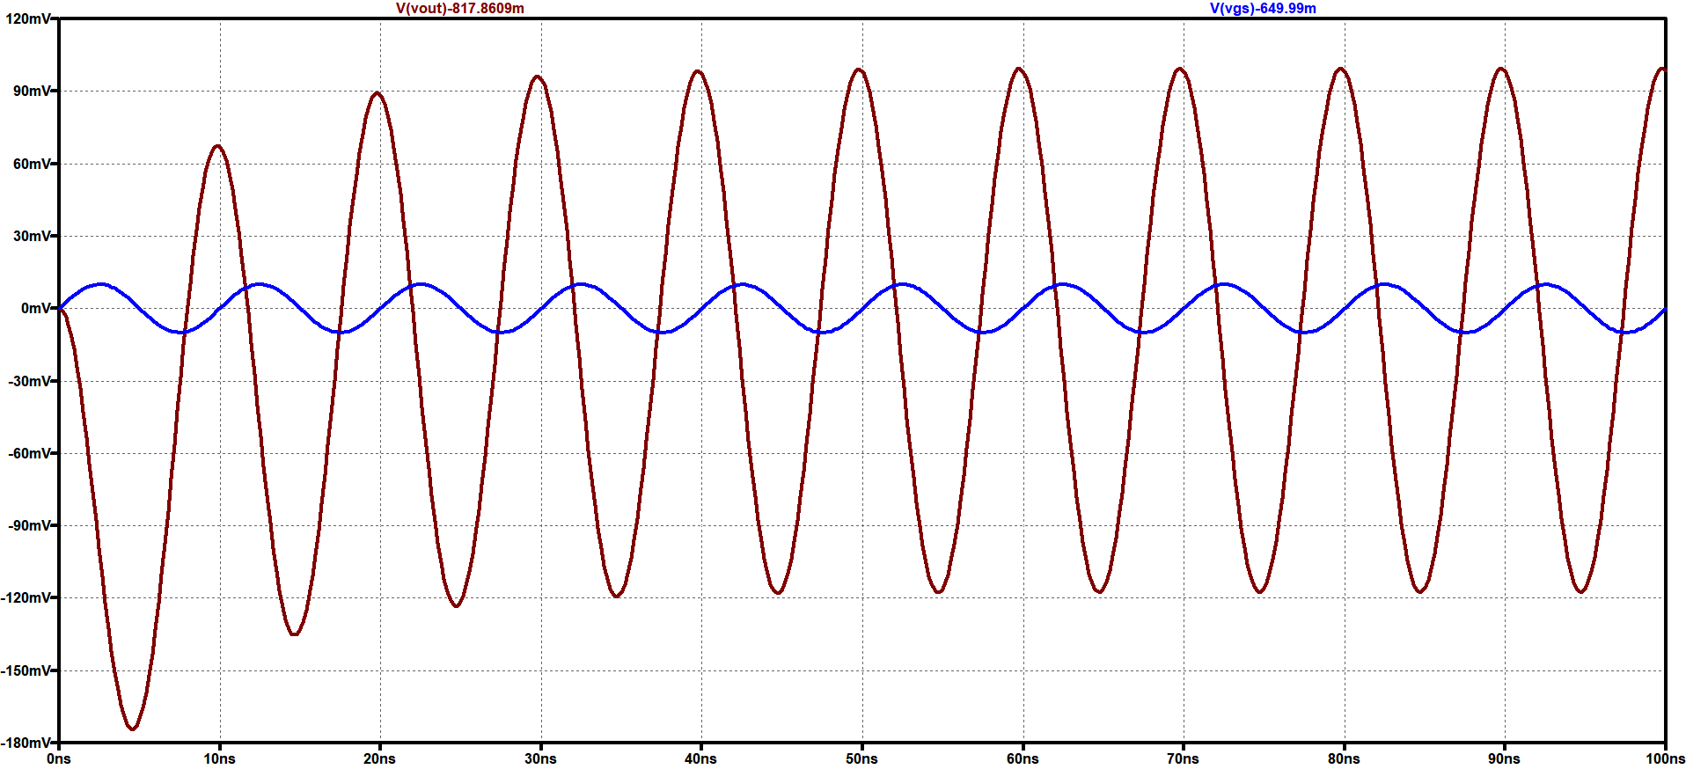
TRANSIENT ANALYSIS IN LT SPICE

Slide 18
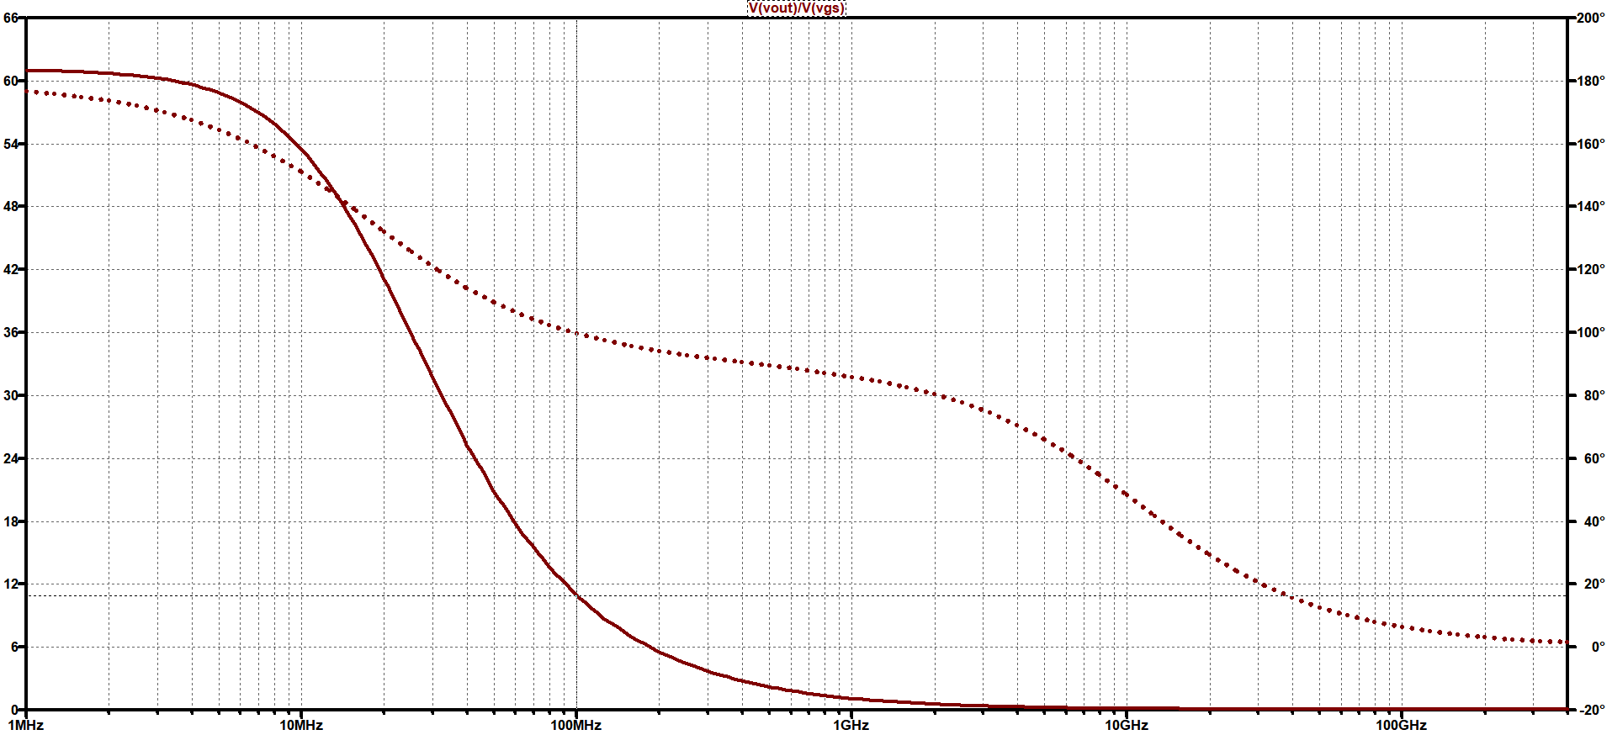
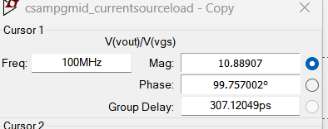
FREQUENCY RESPONSE IN LT SPICE

Slide 19
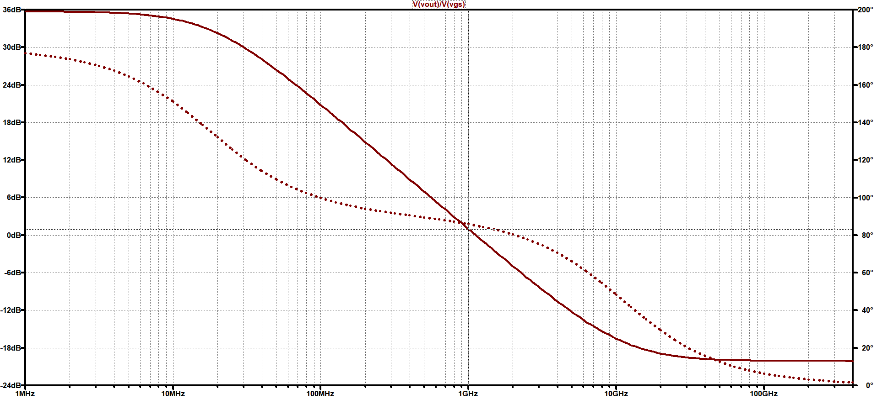
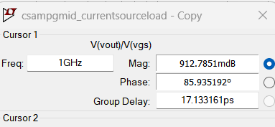

Slide 20
THANK YOU

