Slide 1
Design of Phase-Locked Loop (PLL)
Department of Electronics Engineering, AMU
Problem Presentation of UG Project
Name of student 1: Afzal Malik | Faculty No.: 21ELB173 | Enrolment No.: GM6541
Name of student 2: Mohammed Musayyeb Sherwani | Faculty No.: 21ELB283 | Enrolment No.: GK6347
Date of Presentation: 31.08.2024

Slide 2
Project Details
Project Title: Design of Phase-Locked Loop (PLL)
Project Guide: Prof. Naushad Alam
Nature of the Project : Design & Simulation
- Tools Required: LT Spice & Cadence Virtuoso
- Technology Node: CMOS 180nm

Slide 3
Abstract
This project involves designing a Phase-Locked Loop (PLL) for a 2.4 GHz frequency, targeting applications in wireless communication systems such as Wi-Fi and Bluetooth.
The project emphasizes creating a reliable PLL that ensures consistent frequency generation, crucial for minimizing signal distortion and improving overall system performance.

Slide 4
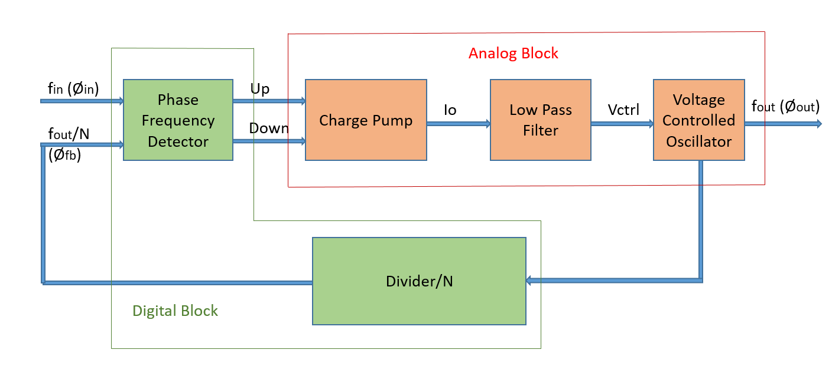
Introduction to PLL
The Phase-Locked Loop (PLL) is a feedback system that creates a frequency from a Voltage Controlled Oscillator (VCO) that is synchronous to the input signal.
It is a Mixed block which uses a Phase Frequency Detector (PFD) and Divide by N network as Digital Block and Charge Pump (CP), Low Pass Filter and Voltage Control Oscillator as Analog Block.
Block Diagram of Phase-Locked Loop

Slide 5
Overview of PLL Blocks
VOLTAGE CONTROLLED OSCILLATOR (VCO) | DIVIDER | PHASE FREQUENCY DETECTOR | CHARGE PUMP & Loop Filter
Generates an oscillating signal whose frequency is variable based on a control voltage. | It is used to scale down the frequency from the output of a Voltage Controlled Oscillator | It compares the reference frequency signal with the signal feedback from output of VCO , generates an output based on phase difference between them. | This combination averages out the voltage given out of the PFD, thus creating the control voltage for VCO.

Slide 6
Project Objectives & Deliverables
Design of VCO for 2.4 GHz frequency at Vcntrl = 0.6 V
Design of Phase Frequency Detector
(PFD)
Integration of All Blocks, Complete PLL system
DESIGN OF DIVIDER
CIRCUIT
Design of Charge Pump & Loop Filter

Slide 7
Gantt Chart
TASKS | AUGUST | SEPTEMBER | OCTOBER | NOVEMBER | JANUARY | FEBRUARY | MARCH | APRIL
LITERATURE SURVEY
DESIGN OF VCO
DESIGN OF DIVIDER
DESIGN OF PFD, CHARGE PUMP & LPF
COMPLETE PLL DESIGN
REPORT WRITING

Slide 8
References
[1]. Santiago, David (2021). ECG 721 – MEMORY CIRCUIT DESIGN, FALL 2021: Design of Analog Phase-Locked Loops (A tutorial).
[2]. Phase Locked Loop - Tutorial. (n.d.). www.electronics-notes.com. https://www.electronics-notes.com/articles/radio/pll-phase-locked-loop/tutorial-primer-basics.php
[3]. S. R. Abdul Rahman, S. H. Md Ali, N. Kamal, A. A. Ahmad and M. Othman, "Design of 2.4 GHz CMOS LC Tank Voltage Controlled Oscillator (VCO) for PLL using 0.18 µm CMOS Technology," 2018 IEEE International Conference on Semiconductor Electronics (ICSE), Kuala Lumpur, Malaysia, 2018.
[4]. Razavi, B. (2020). Design of CMOS Phase-Locked Loops: From Circuit Level to Architecture Level. Cambridge: Cambridge University Press.

