Slide 1
Design of Phase-Locked Loop (PLL)
Department of Electronics Engineering, AMU
Presentation of UG Project
Project Guide: Prof. Naushad Alam
Name of student 1: Afzal Malik | Faculty No.: 21ELB173 | Enrolment No.: GM6541
Name of student 2: Mohammed Musayyeb Sherwani | Faculty No.: 21ELB283 | Enrolment No.: GK6347
Date of Presentation: 16.11.2024

Slide 2
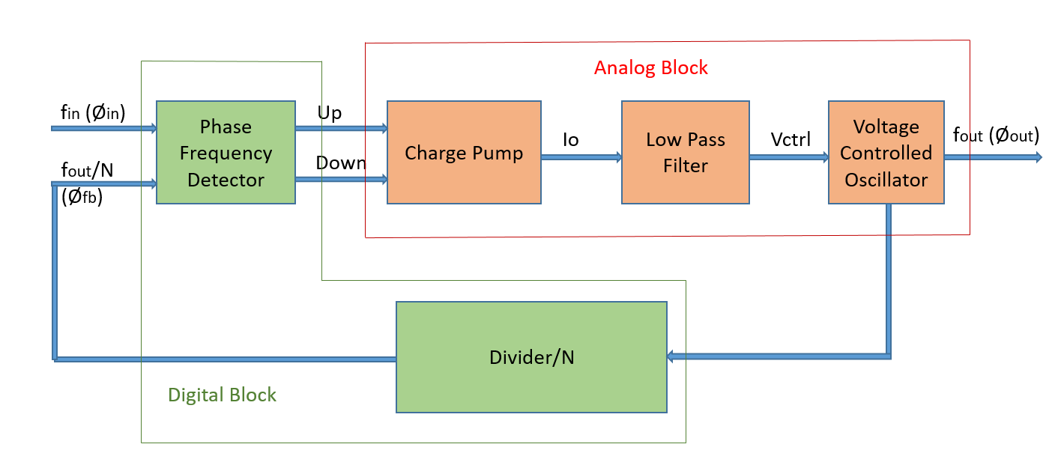
Design of PLL
Technology Node : 180nm | Tools Used : LT Spice
The Phase-Locked Loop (PLL) is a feedback system that creates a frequency from a Voltage Controlled Oscillator (VCO) that is synchronous to the input signal.
It is a Mixed block which uses a Phase Frequency Detector (PFD) and Divide by N network as Digital Block and Charge Pump (CP), Low Pass Filter and Voltage Control Oscillator as Analog Block.
Block Diagram of Phase-Locked Loop

Slide 3
Design of Voltage Controlled Oscillator (VCO)
Generates an oscillating signal whose frequency is variable based on a control voltage.
VCO Type | Pros | Cons
Ring Oscillator | Simple design, small area, high tuning range | Higher phase noise, lower frequency stability
LC Oscillator (LC VCO) | Stable at high frequencies, Lower phase noise | Larger area, complex design
Design of LC VCO for 2.4 GHz frequency at Vcntrl = 0.6 V
Selected Topology | Reasons
NMOS LC VCO with MOS Varactors | 1. Stable frequency at 2.4 GHz 2. Low phase noise for clean signal 3. Efficient power use at high frequencies

Slide 4
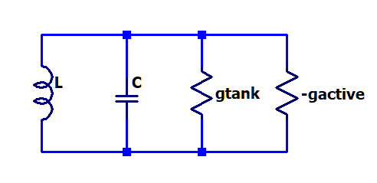
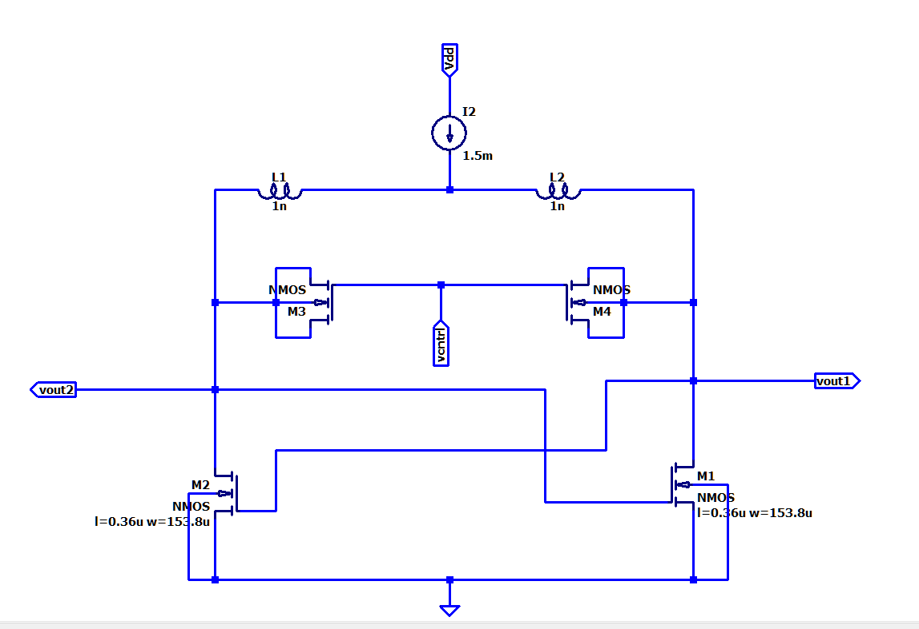

Voltage Controlled Oscillator Analysis and Design
Oscillations can occur when:
i) the negative conductance of the active network cancels out the positive conductance (loss) of the tank
ii) the closed loop gain has zero phase shift
Design Calculations of NMOS LC VCO with MOS Varactors [2]
Assume L = 1nH, using Q (Quality Factor) = $\frac{L ω}{R}$ , Taking Q = 10
R (Series Resistance) = 1.5 ohms
Now, ω = $\frac{1}{\sqrt{LC}}$ $\sqrt{1−\frac{R^{2}C}{L}}$
𝐶=4.3 𝑝𝐹 (𝐹𝑜𝑟 𝑔𝑒𝑡𝑡𝑖𝑛𝑔 𝑓=2.4𝐺ℎ𝑧 𝑎𝑡 𝑉𝑐n𝑡𝑟𝑙=0.6𝑉)
Gm = $\frac{aRC}{L}$ , Taking $α=1, gm>6.45 mS$ (Taken gm = 10mS)
Gm =$\frac{2 Id}{Vov} , Id=750 uA , Then, using sweep technique$
Transistor sizing is done, Length = 0.36u and Width = 153.8u
Then, the capacitors are realized using MOS Varactors.
Negative Resistance Realization

Slide 5
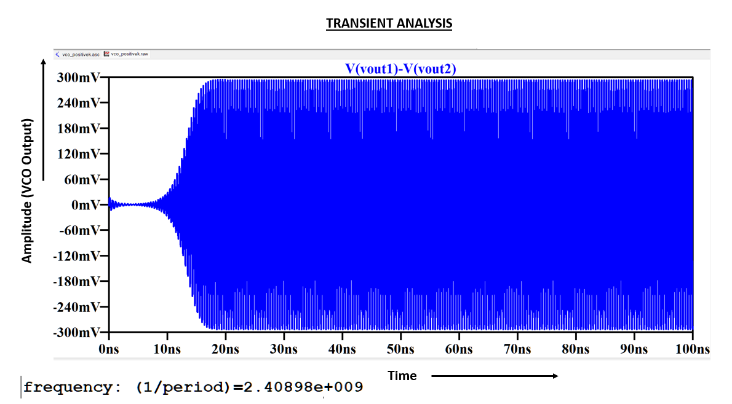
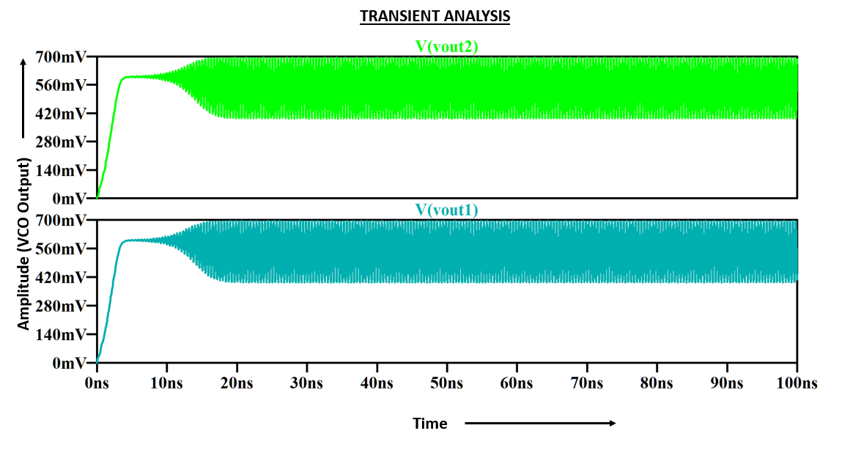
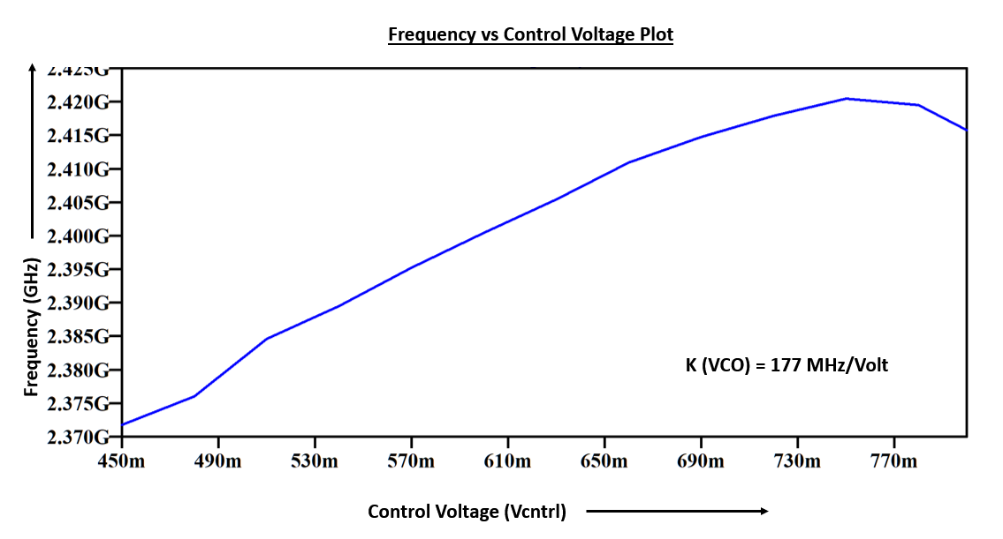
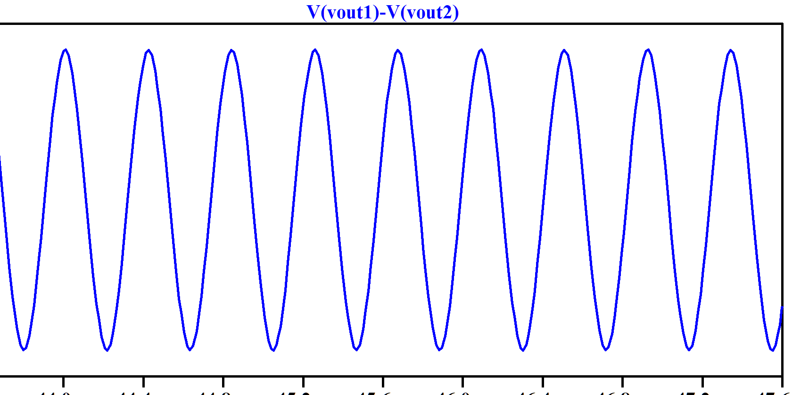
VCO RESULTS:

Slide 6
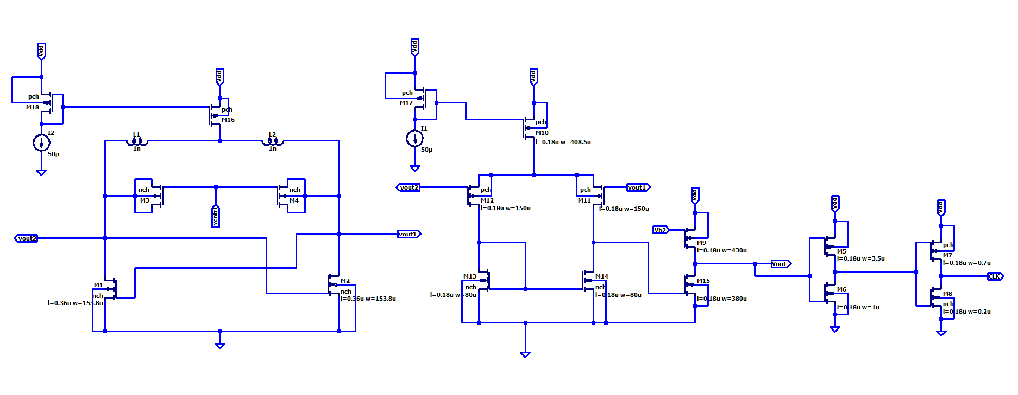
GOAL: DIGITAL PULSE (CLK) OF 2.4 GHZ:
Design of Amplifier :
- To convert the Differential output of VCO (Sinusoidal) to Single ended Output (Sinusoidal) of 2.4GHz frequency .
- To increase the peak to peak Voltage (To drive the Inverters)
Inverters:
- To convert the VCO single ended output (Sinusoidal) to Digital Pulse (CLK) of 2.4 GHZ , In order to give it as Input to the Next Circuit Block “ DIVIDER CIRCUIT”.
Schematic:

Slide 7
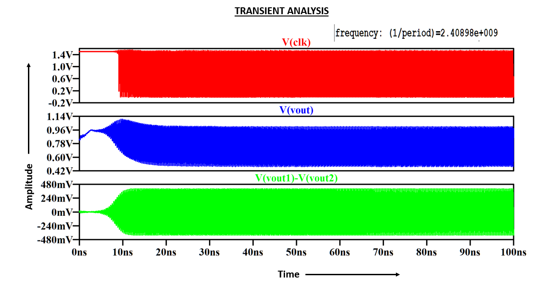
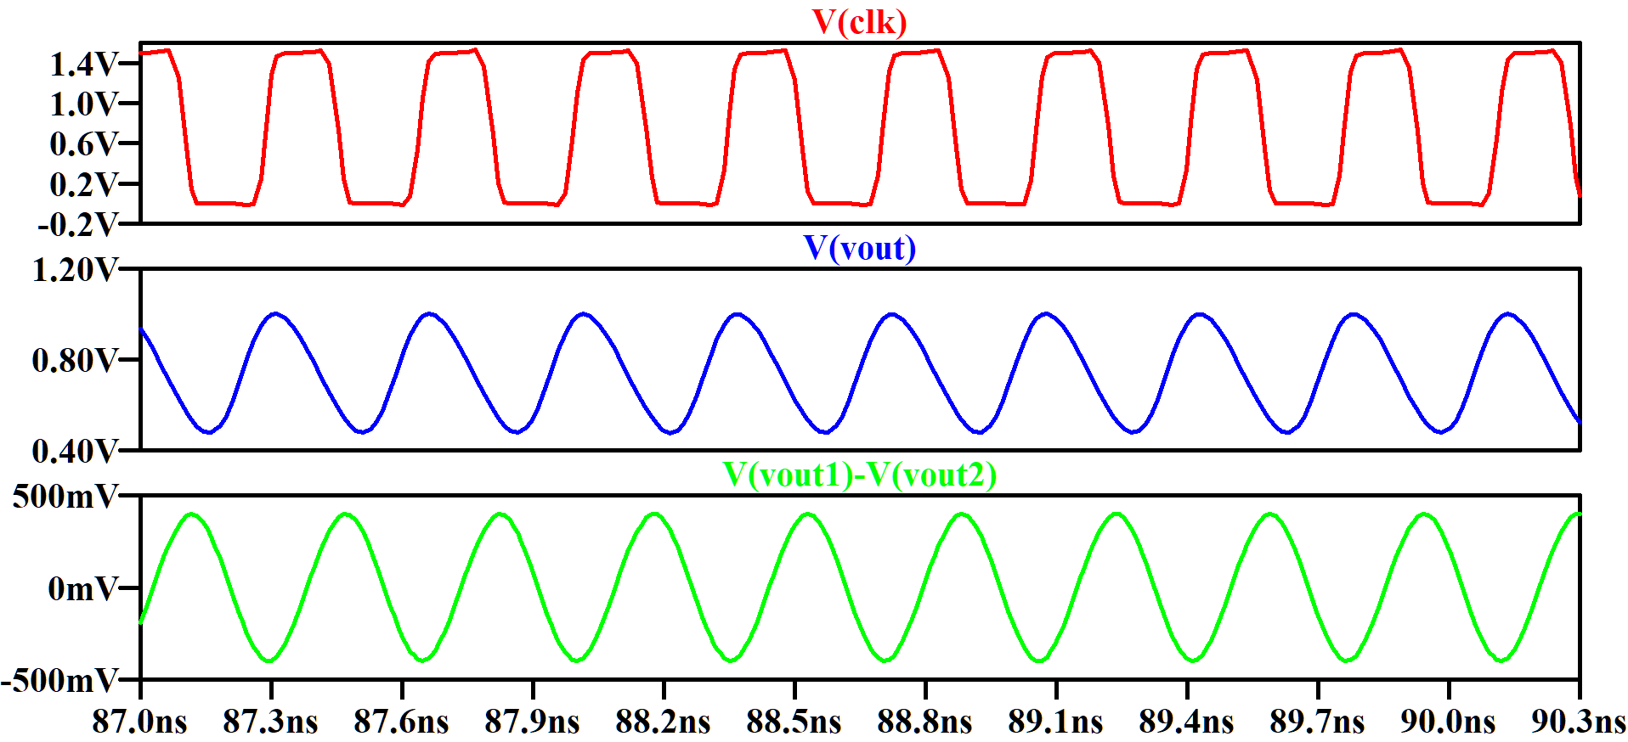
SIMULATION RESULTS:

Slide 8
FUTURE WORK:
Design of VCO for 2.4 GHz frequency at Vcntrl = 0.6 V
Design of Phase Frequency Detector
(PFD)
Integration of All Blocks, Complete PLL system
DESIGN OF DIVIDER
CIRCUIT
Design of Charge Pump & Loop Filter

Slide 9
References
[1]. Santiago, David (2021). ECG 721 – MEMORY CIRCUIT DESIGN, FALL 2021: Design of Analog Phase-Locked Loops (A tutorial).
[2]. LC Tank Voltage Controlled Oscillator tutorial. UW ASIC Analog Group, Waterloo, Ontario, Canada, 2005. https://www.academia.edu/26763368/LC_Tank_Voltage_Controlled_Oscillator_Tutorial
[3]. C. -H. Yen, M. Nasrollahpour and S. Hamedi-Hagh, "Low-power and high-frequency ring oscillator design in 65nm CMOS technology," 2017 IEEE 12th International Conference on ASIC (ASICON), Guiyang, China, 2017, pp. 533-536, doi: 10.1109/ASICON.2017.8252530.
[4]. Razavi, B. (2020). Design of CMOS Phase-Locked Loops: From Circuit Level to Architecture Level. Cambridge: Cambridge University Press.

