Slide 1
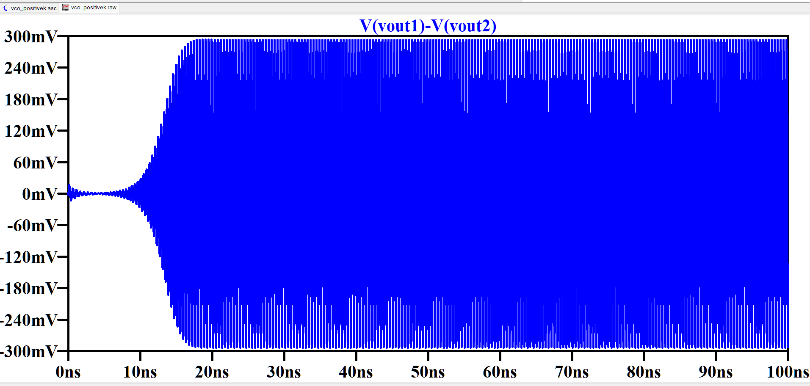
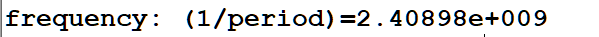
TRANSIENT ANALYSIS
Amplitude (VCO Output)
Time

Slide 2
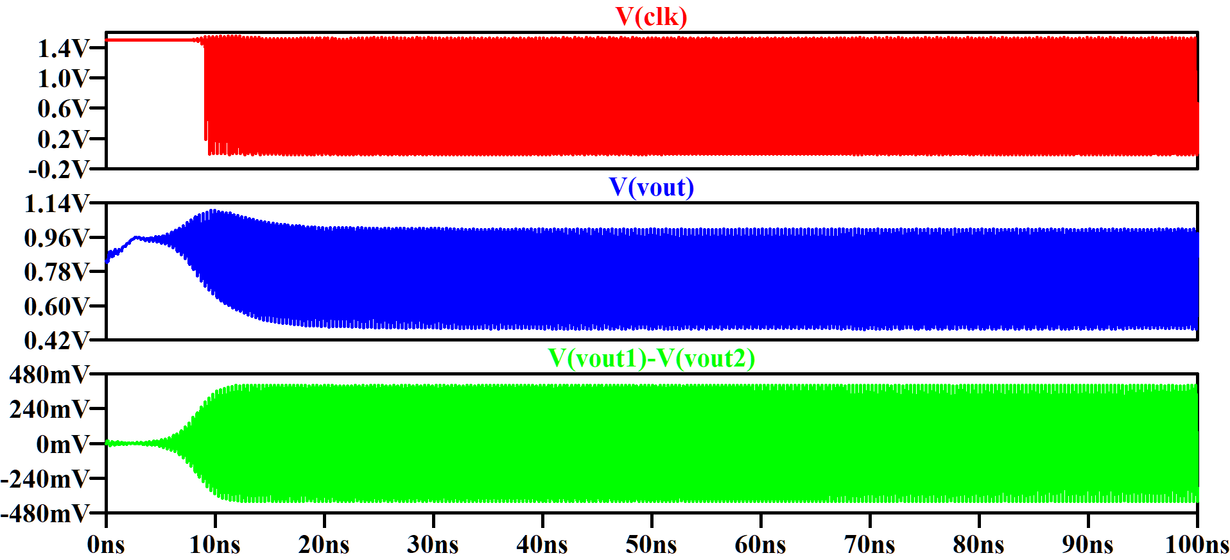
TRANSIENT ANALYSIS
Amplitude
Time

Slide 3
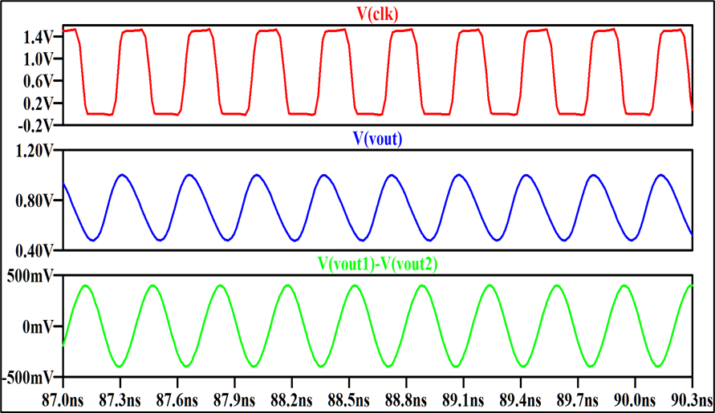
Amplitude
Time

Slide 4
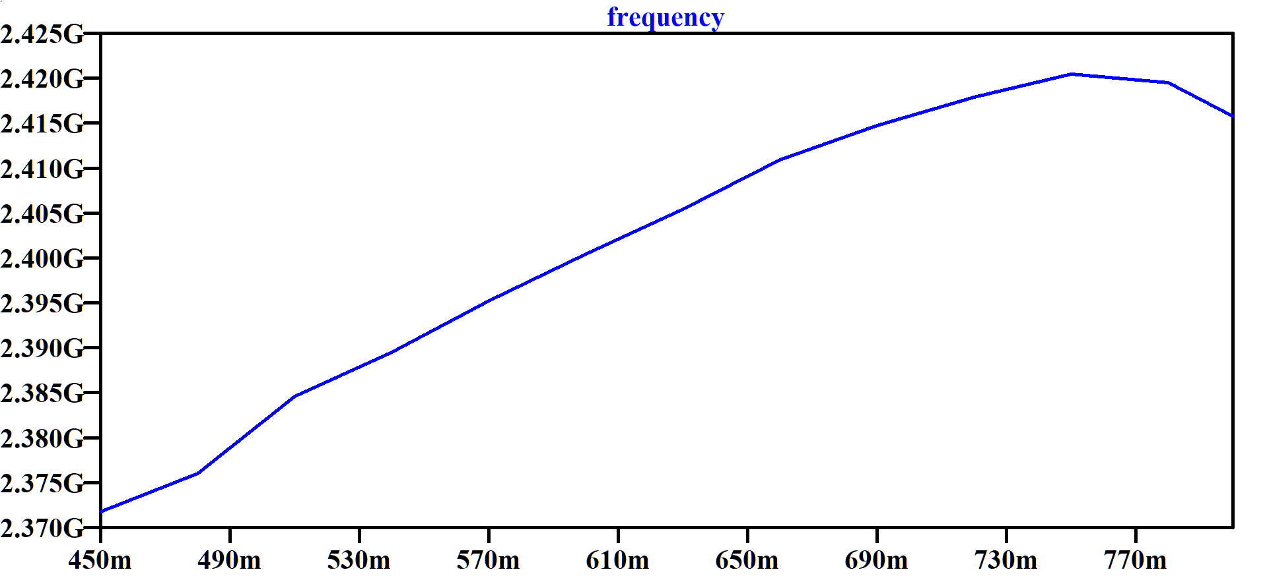
Frequency vs Control Voltage Plot
Frequency (GHz)
K (VCO) = 177 MHz/Volt
Control Voltage (Vcntrl)

