Slide 1
Design of Phase-Locked Loop (PLL)
Department of Electronics Engineering, AMU
Presentation of UG Project (Phase II)
Project Guide: Prof. Naushad Alam
Name of student 1: Afzal Malik | Faculty No.: 21ELB173 | Enrolment No.: GM6541
Name of student 2: Mohammed Musayyeb Sherwani | Faculty No.: 21ELB283 | Enrolment No.: GK6347
Date of Presentation: 0.1.03.2025

Slide 2
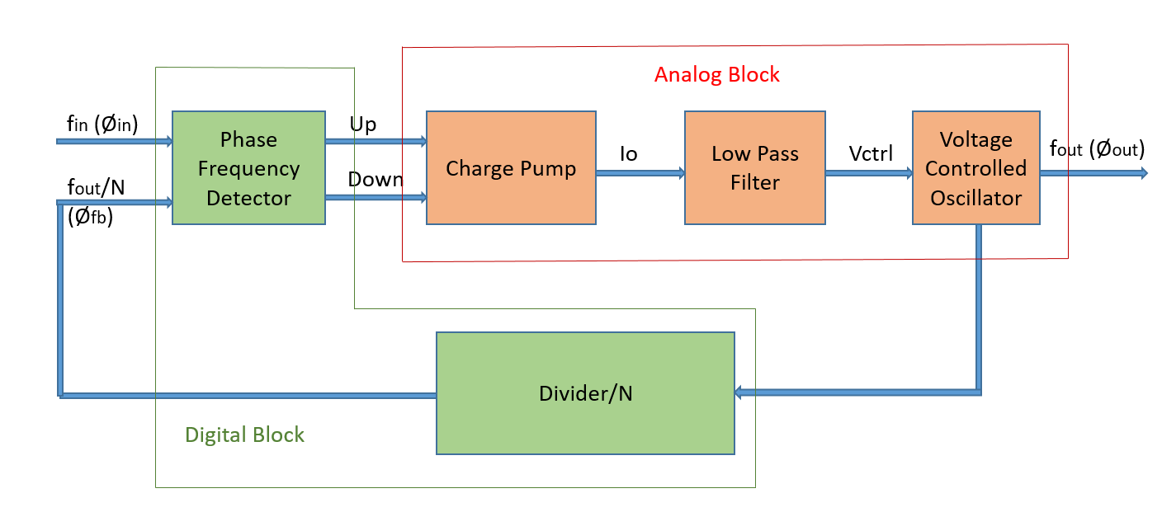
Design of PLL
Technology Node : 180nm | Tools Used : LT Spice
The Phase-Locked Loop (PLL) is a feedback system that creates a frequency from a Voltage Controlled Oscillator (VCO) that is synchronous to the input signal.
It is a Mixed block which uses a Phase Frequency Detector (PFD) and Divide by N network as Digital Block and Charge Pump (CP), Low Pass Filter and Voltage Control Oscillator as Analog Block.
Block Diagram of Phase-Locked Loop

Slide 3
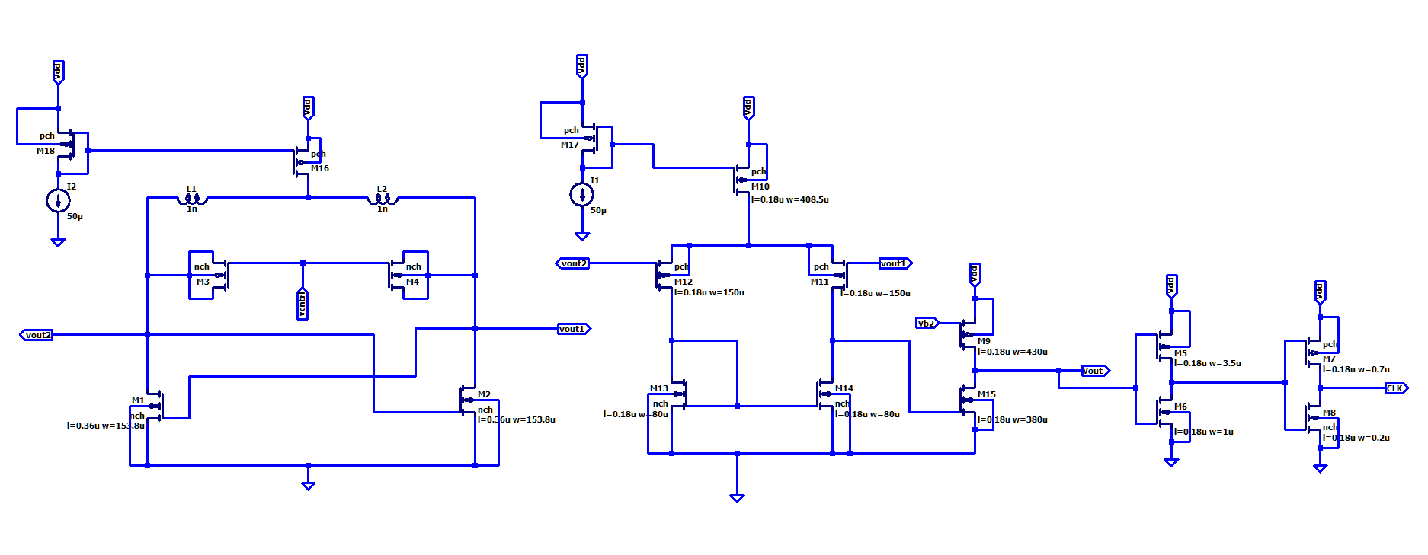
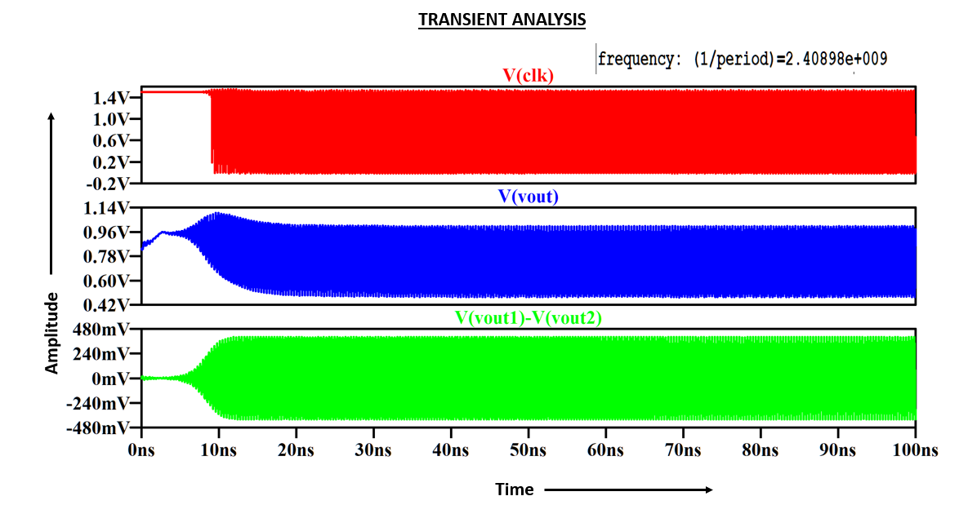
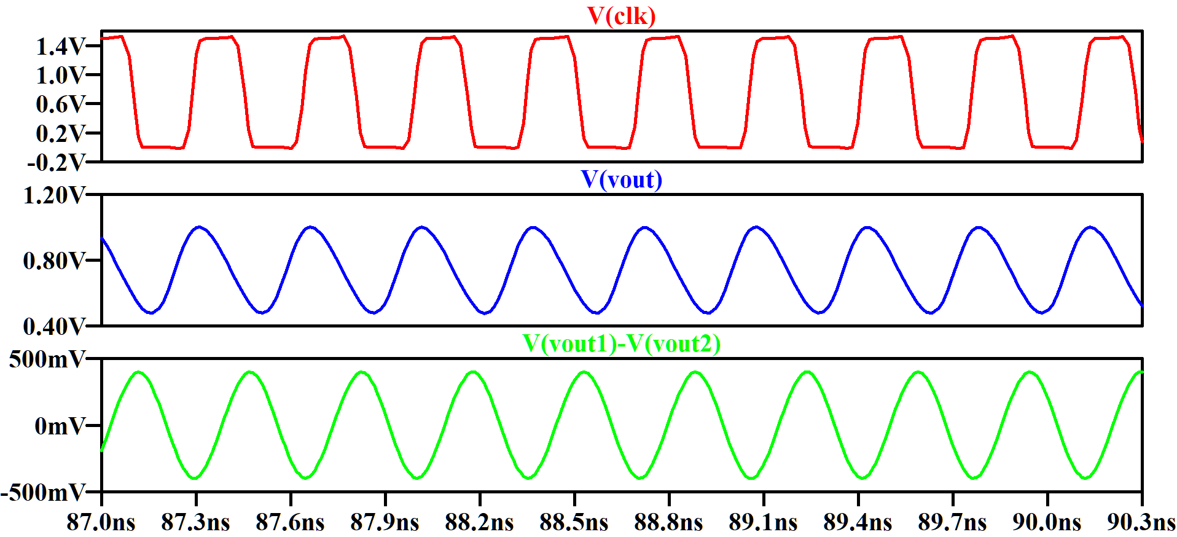
Design of Voltage Controlled Oscillator (VCO)
Schematic:
Design of LC VCO for 2.4 GHz frequency at Vcntrl = 0.6 V

Slide 4
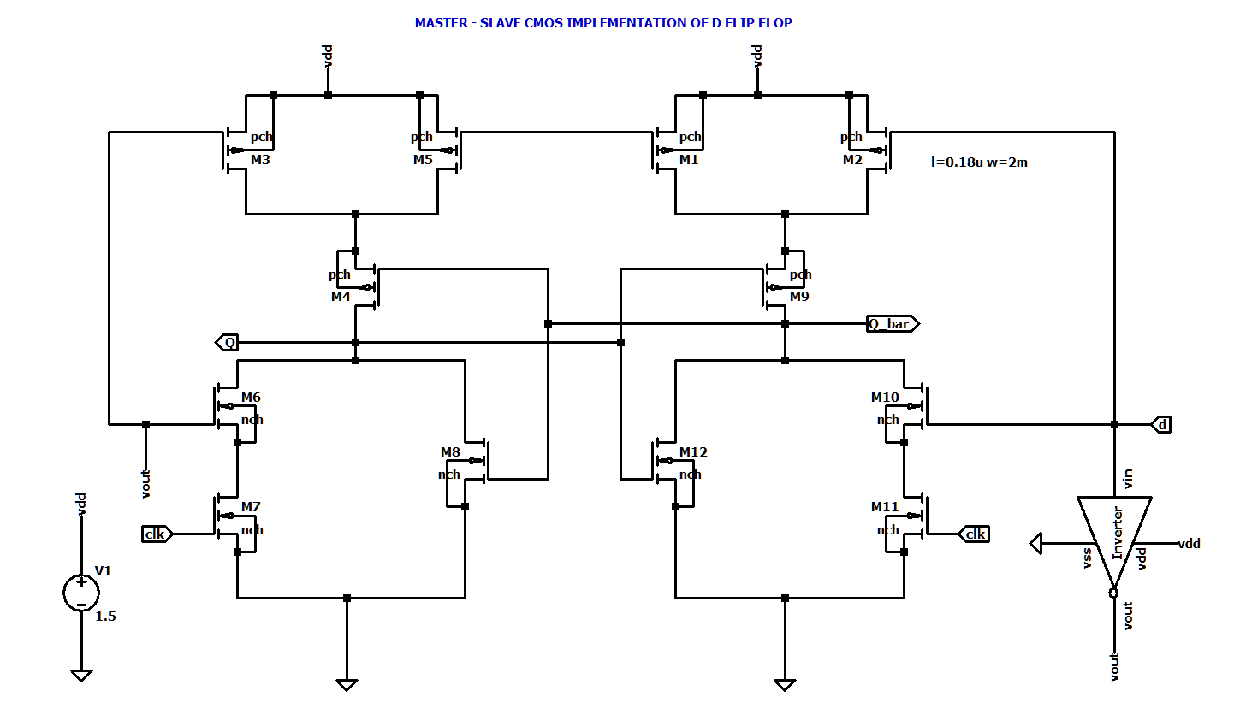
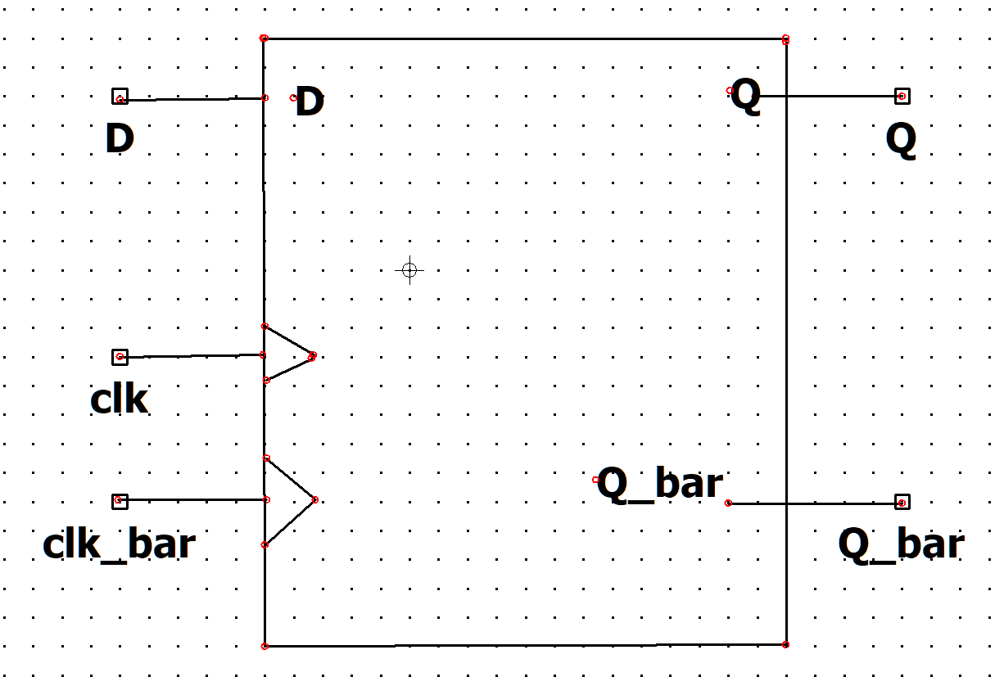
DESIGN OF DIVIDER CIRCUIT
CMOS IMPLEMENTATION OF D FLIP FLOP

Slide 5
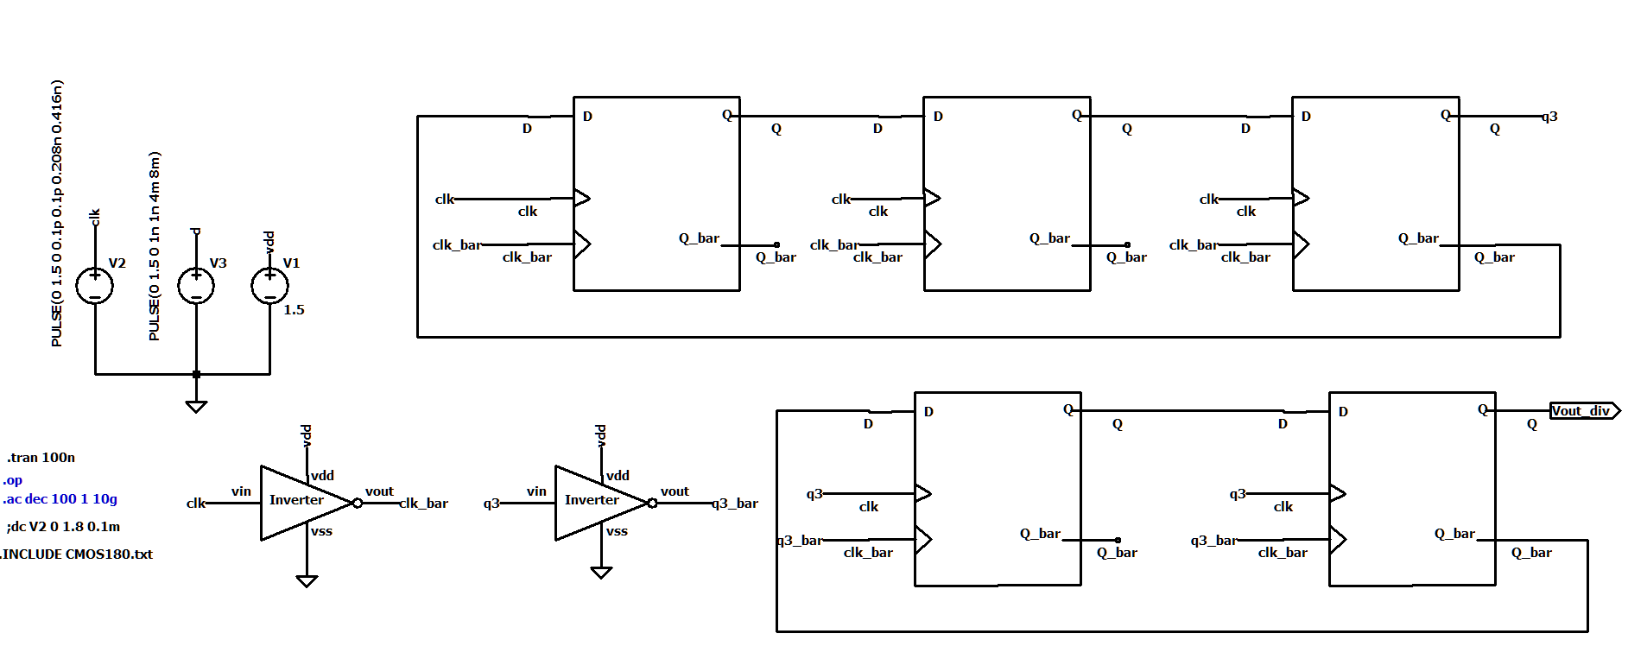
DESIGN OF DIVIDER CIRCUIT
Schematic:
MOD – 6 COUNTER
f(Reference) = 100 MHz
f(desired) = 2.4GHz
MOD No. = f(desired) / f(Reference)
MOD – 4 COUNTER

Slide 6
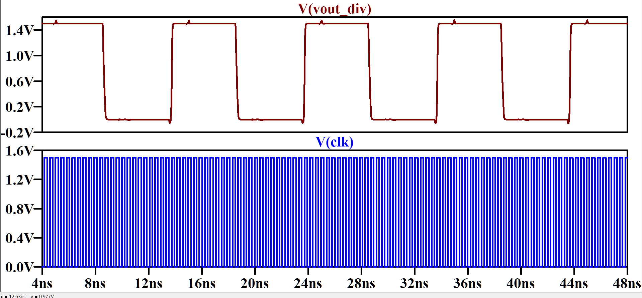
Simulation Results:
Transient Analysis:
F = 100 MHz
F = 2.4 GHz

Slide 7
Project Objectives & Deliverables
Design of VCO for 2.4 GHz frequency at Vcntrl = 0.6 V
Design of Phase Frequency Detector
(PFD)
Integration of All Blocks, Complete PLL system
DESIGN OF DIVIDER
CIRCUIT
Design of Charge Pump & Loop Filter

Slide 8
References
[1]. Santiago, David (2021). ECG 721 – MEMORY CIRCUIT DESIGN, FALL 2021: Design of Analog Phase-Locked Loops (A tutorial).
[2]. LC Tank Voltage Controlled Oscillator tutorial. UW ASIC Analog Group, Waterloo, Ontario, Canada, 2005. https://www.academia.edu/26763368/LC_Tank_Voltage_Controlled_Oscillator_Tutorial
[3]. C. -H. Yen, M. Nasrollahpour and S. Hamedi-Hagh, "Low-power and high-frequency ring oscillator design in 65nm CMOS technology," 2017 IEEE 12th International Conference on ASIC (ASICON), Guiyang, China, 2017, pp. 533-536, doi: 10.1109/ASICON.2017.8252530.
[4]. Razavi, B. (2020). Design of CMOS Phase-Locked Loops: From Circuit Level to Architecture Level. Cambridge: Cambridge University Press.

