Slide 1
Business Annual Report
Here is where your presentation begins

Slide 2
Table of contents
01
04
02
05
03
06
Section
Section
Section
Section
Section
Section

Slide 3
Introduction
You can give a brief description of the topic you want to talk about here. For example, if you want to talk about Mercury, you can say that it’s the smallest planet in the entire Solar System

Slide 4
Do you need a longer text?
Mercury is the closest planet to the Sun and the smallest one in the entire Solar System. This planet's name has nothing to do with the liquid metal, since Mercury was named after the Roman messenger god. Despite being closer to the Sun than Venus, its temperatures aren't as terribly hot as that planet's. Its surface is quite similar to that of Earth's Moon, which means there are a lot of craters and plains
Speaking of craters, many of them were named after artists or authors who made significant contributions to their respective fields. Mercury takes a little more than 58 days to complete its rotation, so try to imagine how long days must be there! Since the temperatures are so extreme and the solar radiation is so high, Mercury has sadly been considered to be non-habitable for humans

Slide 5
The slide title goes here!
Do you know what helps you make your point crystal clear? Lists like this one:
They’re simple
You can organize your ideas clearly
You’ll never forget to buy milk!
And the most important thing: the audience won’t miss the point of your presentation

Slide 6
You can divide the content
Mercury
Venus
Mercury is the closest planet to the Sun and the smallest one in the Solar System—it’s only a bit larger than the Moon. This planet’s name has nothing to do with the liquid metal, since Mercury was named after the Roman messenger god
Venus has a beautiful name and is the second planet from the Sun. It’s terribly hot—even hotter than Mercury—and its atmosphere is extremely poisonous. It’s the second-brightest natural object in the night sky after the Moon

Slide 7
Here are three important ideas
Jupiter
Venus
Saturn
Jupiter is a gas giant and the biggest planet in the Solar System. It's the fourth-brightest object in the night sky and was named after the Roman god of the skies
Venus has a beautiful name and is the second planet from the Sun. It’s terribly hot and its atmosphere is poisonous. It’s the second-brightest natural object in the night sky
Saturn is a gas giant and has several rings. This planet is composed mostly of hydrogen and helium. It’s the sixth planet from the Sun and was named after a Roman god too

Slide 8
Divide the content into four ideas
Mars
Venus
Despite being red, Mars is actually a cold place. It’s full of iron oxide dust, which gives the planet its reddish cast, and it’s made of basalt
Venus has a beautiful name and is the second planet from the Sun. It’s terribly hot and its atmosphere is extremely poisonous
Jupiter
Saturn
Jupiter is a gas giant and the biggest in the Solar System. It’s the fourth-brightest object in the night sky and was named after a god
Saturn is a gas giant and has several rings. It’s composed mostly of hydrogen and helium. It’s the sixth planet from the Sun

Slide 9
Reviewing concepts is a good idea
Mars
Venus
Neptune
Despite being red, Mars is actually a cold place. It’s full of iron oxide dust, which gives the planet its reddish cast
Venus has a beautiful name and is the second planet from the Sun. It’s terribly hot, even hotter than Mercury
Neptune is the farthest planet from the Sun. It’s also the fourth-largest planet by diameter in the Solar System
Earth
Saturn
Jupiter
Earth is the third planet from the Sun and the only one in the Solar System that harbors life. We all live on this planet
Saturn is a gas giant and has rings. It's composed mostly of hydrogen and helium. It’s the sixth planet from the Sun
Jupiter is a gas giant and the biggest in the Solar System. It’s the fourth-brightest object in the night sky

Slide 10
—Someone Famous
“This is a quote, words full of wisdom that someone important said and that can inspire the reader”

Slide 11
Computer mockup
You can replace the image on the screen with your own work. Just right-click on it and select “Replace image”

Slide 12
A timeline always works well
Step 1
Step 2
Step 3
Step 4
Venus has a nice name
Mercury is very small
Mars is made of basalt
Jupiter is a gas giant
Step 5
Step 6
Step 7
Step 8
Saturn has rings
The Sun is a star
Earth harbors life
Neptune is an ice giant

Slide 13
Infographics are useful
Mars
Venus
Despite being red, Mars is a cold place. It’s full of iron oxide dust, which gives the planet its reddish cast
Venus has a beautiful name and is the second planet from the Sun. It’s terribly hot
Jupiter
Saturn
Jupiter is a gas giant and the biggest in the Solar System. It was named after a Roman god
Saturn is a gas giant and has several rings. It’s composed mostly of hydrogen and helium

Slide 14
Financial reporting
Financial statements
Earnings calls
Venus has a beautiful name
Mars is made of basalt
Director’s report
Corporate report
Pluto is considered a dwarf planet
Financial reporting
Saturn has rings
Management discussion
Prospectus
Earth is the planet where we live
Jupiter is a gas giant
Capital structure
Auditors Report
Neptune is an ice giant
Mercury is very small

Slide 15
Key milestones and initiatives
Key initiatives
Key milestones
Mercury is the closest planet to the Sun and the smallest one in the entire Solar System
This planet’s name has nothing to do with the liquid metal, since Mercury was named after the Roman messenger god
Despite being closer to the Sun than Venus, its temperatures aren't as terribly hot as that planet’s
January
Venus has a beautiful name and is the second planet from the Sun
March
Jupiter is a gas giant and the biggest planet in the Solar System
May
Saturn is a gas giant and has several rings. It’s composed mostly of hydrogen and helium

Slide 16
Revenue distribution
35%
40%
25%
Venus
Jupiter
Saturn
Venus has a beautiful name and is the second planet from the Sun. It’s terrible hot
Jupiter is a gas giant and the biggest planet in the Solar System. It's a big object
Saturn is a gas giant and has several rings. It’s composed mostly of hydrogen and helium

Slide 17
Facts
1300
221
+1100
60%
550
Venus has a beautiful name and is the second planet from the Sun. It’s terrible hot
Saturn is a gas giant and has several rings. It’s composed mostly of hydrogen and helium
Saturn is a gas giant and has several rings. It’s composed mostly of hydrogen and helium
Jupiter is a gas giant and the biggest in the Solar System. It’s the fourth-brightest object
Mercury is the closest planet to the Sun and the smallest one in the entire Solar System

Slide 18
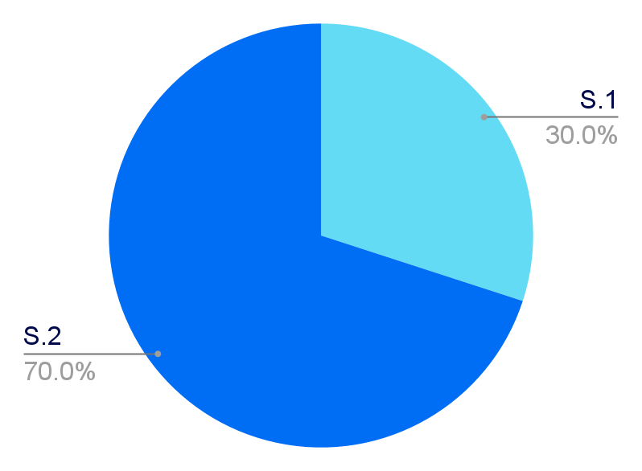
Operating profit margin
Semester 2
Semester 1
Mercury is the closest planet to the Sun and the smallest one in the Solar System—it’s only a bit larger than the Moon. This planet’s name has nothing to do with the liquid metal, since Mercury was named after the Roman messenger god
Venus has a beautiful name and is the second planet from the Sun. It’s terribly hot—even hotter than Mercury—and its atmosphere is extremely poisonous. It’s the second-brightest natural object in the night sky after the Moon

