Slide 1
Analysis and Conclusions Template for High School
Your name

Slide 2
Contents of this template
You can delete this slide when you’re done editing the presentation
Fonts | To view this template correctly in PowerPoint, download and install the fonts we used
Used and alternative resources | An assortment of graphic resources that are suitable for use in this presentation
Thanks slide | You must keep it so that proper credits for our design are given
Colors | All the colors used in this presentation
Icons and infographic resources | These can be used in the template, and their size and color can be edited
Editable presentation theme | You can edit the master slides easily. For more info, click here

Slide 3
Table of contents
01
02
03
04
05
06
Objectives
Methodology
Results
You can describe the topic of the section here
You can describe the topic of the section here
You can describe the topic of the section here
Analysis
Conclusions
Recommendations
You can describe the topic of the section here
You can describe the topic of the section here
You can describe the topic of the section here

Slide 4
Introduction
In this presentation, we will explore a template for analysis and conclusions in the school setting.

Slide 5
General objective of the project
Mercury is the closest planet to the Sun and the smallest one in the entire Solar System. Contrary to popular belief, this planet's name has nothing to do with the liquid metal. Mercury was, instead, named after the famous Roman messenger god Mercurius
Mercury takes a little more than 58 days to complete its rotation, so try to imagine how long days must be there! Since the temperatures are so extreme, albeit not as extreme as in Venus, Mercury has been deemed to be non-habitable for humans

Slide 6

Specific objectives
Do you know what helps you make your point crystal clear? Lists like this one:
They’re simple
You can organize your ideas clearly
You’ll never forget to buy milk!
And the most important thing: the audience won’t miss the point of your presentation

Slide 7
Objective Limitations
Extent
Constraints
Mercury is the closest planet to the Sun and the smallest one in the Solar System—it’s only a bit larger than the Moon
Venus has a beautiful name and is the second planet from the Sun. It’s hot and has a poisonous atmosphere

Slide 8
Objectives' Relevance
Experimental
Observational
Survey
Mercury is the closest planet to the Sun and the smallest of them all
Venus has a beautiful name and is the second planet from the Sun
Despite being red, Mars is actually a cold place. It’s full of iron oxide dust

Slide 9
Study population or sample
Demographics
Selection
Mars is actually a very cold place
Venus has extremely high temperatures
Size
Characteristics
Jupiter is the biggest planet of them all
Saturn is a gas giant and has several rings

Slide 10
Data presentation
Variables
Tables
Mars is actually a very cold place
Mercury is the closest planet to the Sun
Frequency
Charts
Venus has extremely high temperatures
Saturn is a gas giant with several rings
Graphs
Comparisons
Neptune is the farthest planet from the Sun
Jupiter is the biggest planet of them all

Slide 11
—Someone Famous
“This is a quote, words full of wisdom that someone important said and can make the reader get inspired”

Slide 12

A picture is worth a thousand words

Slide 13

A picture always reinforces
the concept
Images reveal large amounts of data, so remember: use an image instead of a long text. Your audience will appreciate it

Slide 14
Computer mockup
You can replace the image on the screen with your own work. Just right-click on it and select “Replace image”

Slide 15
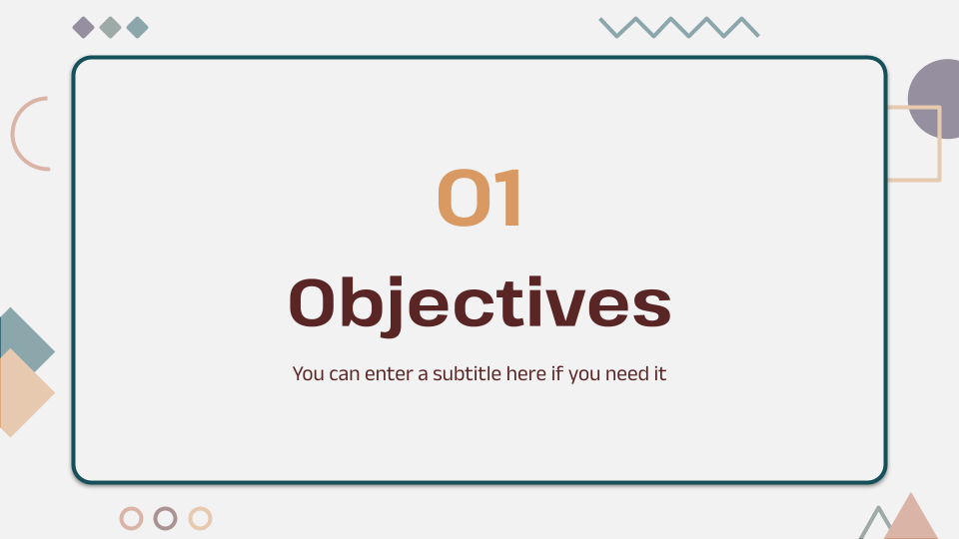
Tablet mockup
You can replace the image on the screen with your own work. Just right-click on it and select “Replace image”

Slide 16
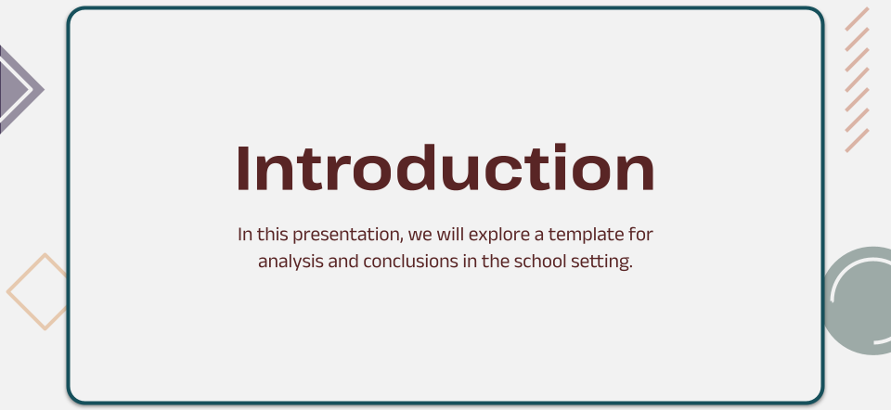
Phone mockup
You can replace the image on the screen with your own work. Just right-click on it and select “Replace image”

Slide 17
Global impact locations
New York City
Venus is the second planet from the Sun
Tokyo
Mercury is the closest planet to the Sun
London
Despite being red, Mars is a very cold place

Slide 18
Key events timeline
Venus is the second planet from the Sun
Despite being red, Mars is a very cold place
Development
Impact
Discovery
Milestones
Future prospects
Mercury is the closest planet to the Sun
Saturn was named after a Roman god
Jupiter is the biggest planet of them all

Slide 19
Unveiling Insights: Semantic Map
Interconnections
Relationships
Insights
Mars is a red planet
Venus is a hot planet
Patterns
Implications
Mercury is very small
Jupiter is a gas giant
Key factors
Neptune is an ice giant

Slide 20
Key findings and results
Aspect | Subject A | Subject B | Subject C
Metric 1 | 0.53 | 0.38 | 0.38
Metric 2 | 9.4 | 0.53 | 0.78
Metric 3 | 1.16 | 9.4 | 1.16
Metric 4 | 0.36 | 0.78 | 1.24

Slide 21
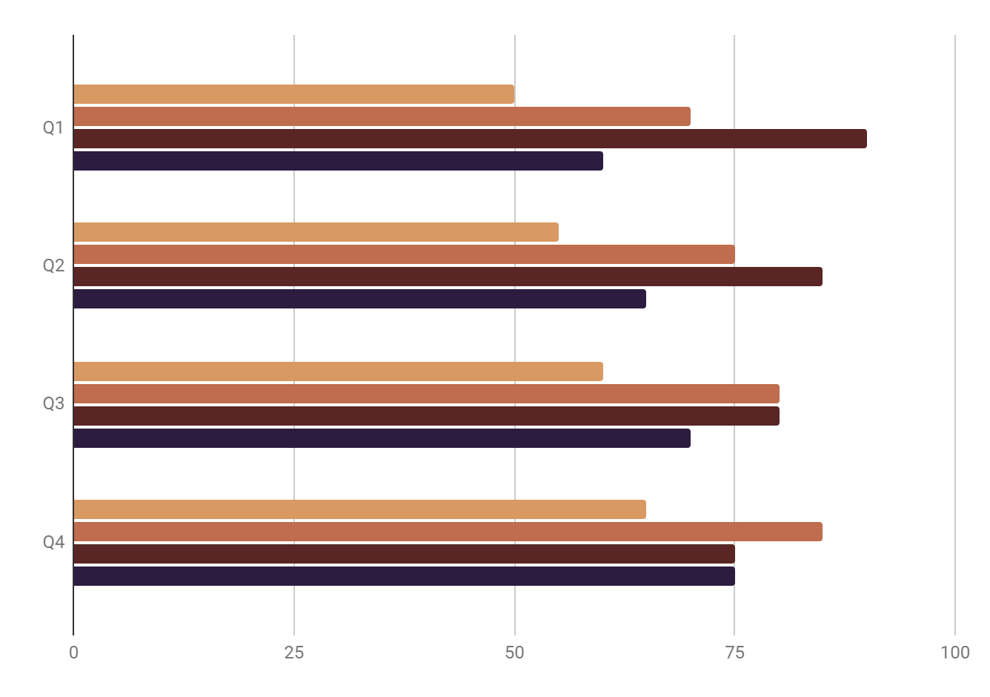
Periodic Analysis
Data A
Data B
Data C
Data D
Mercury is the smallest planet
Venus has very high temperatures
Jupiter is the biggest planet
Saturn is a gas giant with rings
Follow the link in the graph to modify its data and then paste the new one here. For more info, click here

Slide 22
Organize any type of data
Data | Description
Data type | The type of data, such as numerical, text, or visual.
Source | The source of the data, such as a survey, experiment, or observation.
Units | The units of measurement for the data, such as meters, seconds, or dollars.
Range | The range of values for the data, such as from 1 to 100 or from 0 to 100%.
Mean | The average value for the data.

