Slide 1
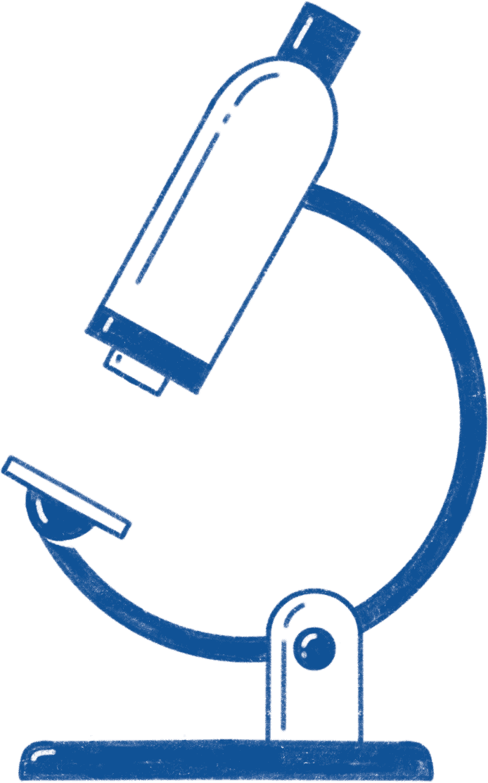
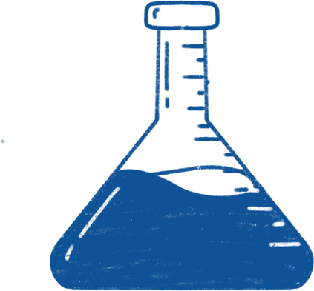
Epidemiology Study on Infectious Diseases Thesis Defense
Here is where your presentation begins

Slide 2
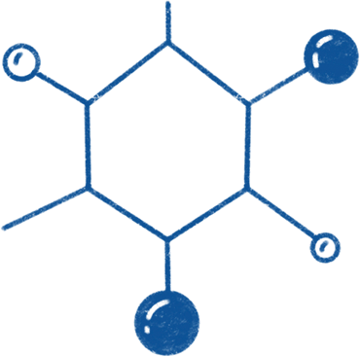
Table of contents
01
04
02
05
03
06
Statement
Methodology
You can describe the topic of the section here
You can describe the topic of the section here
Hypothesis
Analysis
You can describe the topic of the section here
You can describe the topic of the section here
Objectives
Conclusions
You can describe the topic of the section here
You can describe the topic of the section here

Slide 3
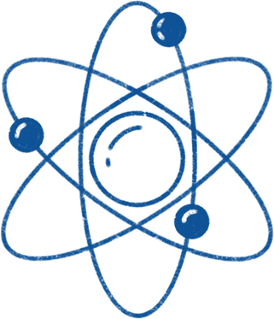

01
Statement
You can describe the topic of the section here

Slide 4
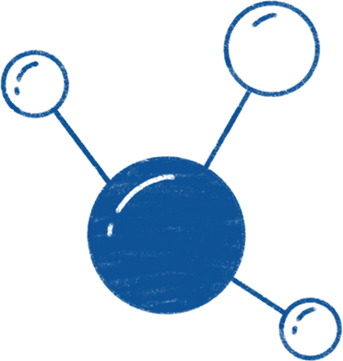

Introduction
You can give a brief description of the topic you want to talk about here. For example, if you want to talk about Mercury, you can say that it’s the smallest planet in the entire Solar System

Slide 5
Purpose statement
What about Mercury?
Mercury is the closest planet to the Sun and the smallest one in the Solar System—it’s only a bit larger than the Moon. The planet’s name has nothing to do with the liquid metal
What about Venus?
Venus has a beautiful name and is the second planet from the Sun. It’s terribly hot—even hotter than Mercury—and its atmosphere is extremely poisonous
What about Jupiter?
Jupiter is a gas giant and the biggest planet in the Solar System. It's the fourth-brightest object in the night sky. It was named after the Roman god of the skies and lightning

Slide 6
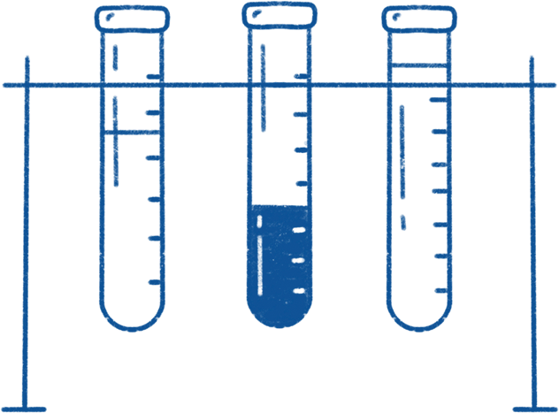
—Someone Famous
“This is a quote. Words full of wisdom that someone important said and that can inspire their reader.”

Slide 7
Current situation & problems
01
02
03
Current situation
Jupiter is a gas giant and the biggest planet in the Solar System. It's the fourth-brightest object in the night sky
Source
Transmission
Control
Earth is the third planet from the Sun and has life
Despite being red, planet Mars is actually a cold place
Mercury is the smallest planet in the entire Solar System
Problems

Slide 8

02
Hypothesis
You can describe the topic of the section here

Slide 9
Hypotheses
01
02
03
Hypothesis 1
Hypothesis 2
Hypothesis 3
Mercury is the closest planet to the Sun and the smallest one in the Solar System—it’s only a bit larger than the Moon. The planet’s name has nothing to do with the liquid metal
Saturn is a gas giant and the second-largest planet in the Solar System. It's composed mostly of hydrogen and helium. It was named after the Roman god of wealth
Jupiter is a gas giant and the biggest planet in the Solar System. It's the fourth-brightest object in the night sky. It was named after the Roman god of the skies and lightning

Slide 10
Study objectives
Prevalence
Dynamics
Mercury is the closest planet to the Sun and the smallest of them all
Venus has a beautiful name and is the second planet from the Sun
Impact
Risk factors
Despite being red, Mars is actually a cold place. It’s full of iron oxide dust
Jupiter is a gas giant and the biggest planet in the Solar System

Slide 11
Reviewing concepts is a good idea
Incidence
Prevalence
Mars is actually a very cold place
Venus has extremely high temperatures
Outbreak
Case control
Intervention
Mercury is the closest planet to the Sun
Saturn is a gas giant with several rings
Jupiter is the biggest planet of them all

Slide 12
Literature review
AUTHOR. (YEAR). Title of the publication. Publisher
Mercury is the closest planet to the Sun and the smallest one
AUTHOR. (YEAR). Title of the publication. Publisher
Mars is full of iron oxide dust, which gives the planet its reddish cast
AUTHOR. (YEAR). Title of the publication. Publisher
Jupiter is a gas giant and the biggest planet in the Solar System
AUTHOR. (YEAR). Title of the publication. Publisher
Venus has a beautiful name and is the second planet from the Sun
AUTHOR. (YEAR). Title of the publication. Publisher
Earth is the third planet from the Sun and harbors life

Slide 13
Theoretical framework
Key terms
Relevant theories
Our framework
Mercury is small
Earth harbors life
Jupiter is quite big
Venus is very hot
Mars is a cold planet
Saturn is a gas giant
Neptune is an ice giant
Theory 1
Venus has a beautiful name and is the second planet from the Sun. It’s terribly hot, even hotter than Mercury, and its atmosphere is extremely poisonous. It’s the second-brightest object in the night sky after the Moon
Saturn is a gas giant and has rings. It’s composed mostly of hydrogen
Theory 2
Neptune is the farthest planet from the Sun and it’s an ice giant

Slide 14
Methodology
Type of data
Data collection
Mercury is the closest planet to the Sun and the smallest one in the Solar System
Despite being red, Mars is actually a cold place. It’s full of iron oxide dust
Epidemiology
Motives
Specific sampling
Venus has a beautiful name and is the second planet from the Sun. It’s terribly hot
Jupiter is a gas giant and the biggest planet in the entire Solar System

Slide 15
Analysis & development
Phase 01
Phase 02
Mercury is the closest planet to the Sun and the smallest one in the Solar System—it’s a bit larger than the Moon
Jupiter is a gas giant, the biggest planet in the Solar System and the fourth-brightest object in the night sky
Neptune is the farthest planet from the Sun. It's also the fourth-largest planet by diameter in the Solar System
Venus has a beautiful name and is the second planet from the Sun. It’s terribly hot—even hotter than Mercury
Saturn is a gas giant and has several rings. This planet is composed mostly of hydrogen and helium
Earth is the third planet from the Sun and the only one that harbors life in the Solar System. This is where we all live

Slide 16
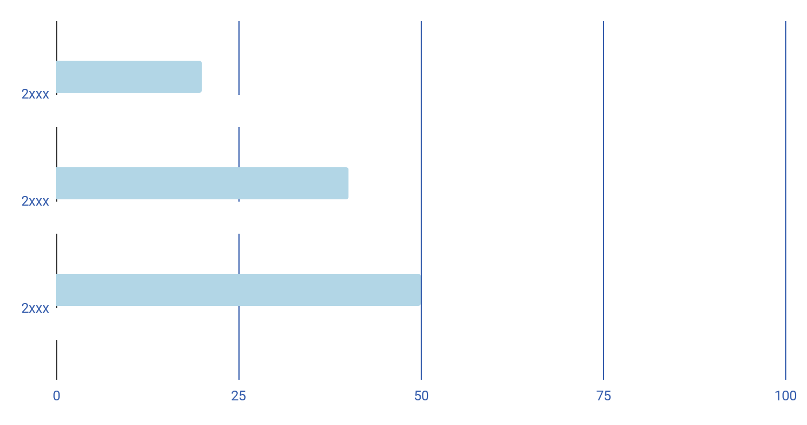
Analysis & development
Mercury is the closest planet to the Sun and the smallest one in the Solar System The planet’s name has nothing to do with the liquid metal
The Sun is the star at the center of the Solar System
Jupiter is the biggest planet in the entire Solar System
Saturn is composed mostly of hydrogen and helium
Mercury
Venus
It’s the closest planet to the Sun
Venus has a beautiful name
Follow the link in the graph to modify its data and then paste the new one here. For more info, click here

Slide 17
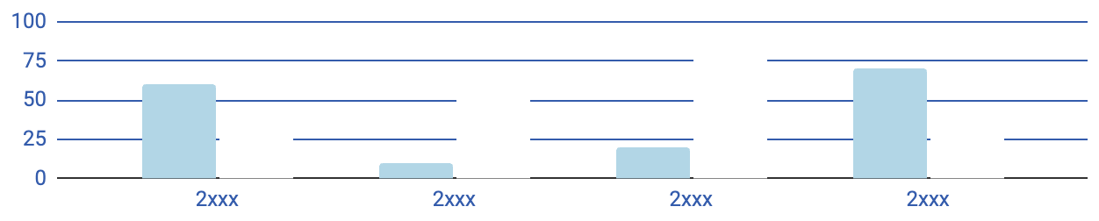
Analysis of the results
Mars
Mercury
Venus
60%
It’s the closest planet to the Sun
Venus has a beautiful name
Mars is full of iron oxide dust
Follow the link in the graph to modify its data and then paste the new one here. For more info, click here

Slide 18
Discussion
01
02
Mars
Despite being red, Mars is actually a cold place. It's full of iron oxide dust, which gives the planet its reddish cast. Earth is the third planet from the Sun and the only one that harbors life in the Solar System. This is where we all live:
Ceres is located in the main asteroid belt
The Moon is Earth’s natural satellite
Neptune is very far away from us
Pluto is now considered a dwarf planet
Discussion 1
Mercury is the closest planet to the Sun and the smallest one in the Solar System—it’s only a bit larger than the Moon
Discussion 2
Venus has a beautiful name and is the second planet from the Sun. It’s terribly hot—even hotter than Mercury

Slide 19
Epidemiology study steps
02
04
01
03
05
Mercury is a very small planet
Mars is full of iron oxide dust
Neptune is far away from us
Identify
Response
Monitor
Caracterize
Develop
Earth is the planet with life
Venus is a very hot planet

Slide 20
Conclusions
Mars
Venus
Despite being red, Mars is actually a cold place. It’s full of iron oxide dust
Venus has a very beautiful name and is the second planet from the Sun
Mercury
Neptune
Mercury is the closest planet to the Sun and the smallest one in the Solar System
Neptune is the fourth-largest planet by diameter in the Solar System

Slide 21

Mockups
You can replace the images on the screen with your own work. Just right-click on it and select “Replace images”

