Slide 1
Unit 4
The Network Layer:

Slide 2
Covered Topics
Design issues
Routing algorithms - shortest path, flooding
Distance Vector Routing
hierarchical, broadcast, multicast
Congestion control algorithms - leaky bucket, token bucket, load shedding
Error detection and correction
Internetworking, IP protocol
Address Resolution Protocol, Reverse Address Resolution Protocol, IP address and classifications.

Slide 3
Design issues
The network layer or layer 3 of the OSI (Open Systems Interconnection) model is concerned delivery of data packets from the source to the destination across multiple hops or links. It is the lowest layer that is concerned with end − to − end transmission. The designers who are concerned with designing this layer needs to cater to certain issues. These issues encompasses the services provided to the upper layers as well as internal design of the layer.
The design issues can be elaborated under four heads −
Store − and − Forward Packet Switching
Services to Transport Layer
Providing Connection Oriented Service
Providing Connectionless Service

Slide 4
Store − and − Forward Packet Switching
The network layer operates in an environment that uses store and forward packet switching. The node which has a packet to send, delivers it to the nearest router. The packet is stored in the router until it has fully arrived and its checksum is verified for error detection. Once, this is done, the packet is forwarded to the next router. Since, each router needs to store the entire packet before it can forward it to the next hop, the mechanism is called store − and − forward switching.

Slide 5
Services to Transport Layer
The network layer provides service its immediate upper layer, namely transport layer, through the network − transport layer interface. The two types of services provided are −
Connection − Oriented Service − In this service, a path is setup between the source and the destination, and all the data packets belonging to a message are routed along this path.
Connectionless Service − In this service, each packet of the message is considered as an independent entity and is individually routed from the source to the destination.
The objectives of the network layer while providing these services are −
The services should not be dependent upon the router technology.
The router configuration details should not be of a concern to the transport layer.
A uniform addressing plan should be made available to the transport layer, whether the network is a LAN, MAN or WAN.

Slide 6
Providing Connection Oriented Service
In connection − oriented services, a path or route called a virtual circuit is setup between the source and the destination nodes before the transmission starts. All the packets in the message are sent along this route. Each packet contains an identifier that denotes the virtual circuit to which it belongs to. When all the packets are transmitted, the virtual circuit is terminated and the connection is released. An example of connection − oriented service is MultiProtocol Label Switching (MPLS).

Slide 7
Providing Connectionless Service
In connectionless service, since each packet is transmitted independently, each packet contains its routing information and is termed as datagram. The network using datagrams for transmission is called datagram networks or datagram subnets. No prior setup of routes are needed before transmitting a message. Each datagram belong to the message follows its own individual route from the source to the destination. An example of connectionless service is Internet Protocol or IP.

Slide 8
Routing algorithms
A routing algorithm is a procedure that lays down the route or path to transfer data packets from source to the destination. They help in directing Internet traffic efficiently. After a data packet leaves its source, it can choose among the many different paths to reach its destination. Routing algorithm mathematically computes the best path, i.e. “least – cost path” that the packet can be routed through.

Slide 9
Shortest path
In this algorithm, to select a route, the algorithm discovers the shortest path between two nodes. It can use multiple hops, the geographical area in kilometres or labelling of arcs for measuring path length.
The labelling of arcs can be done with mean queuing, transmission delay for a standard test packet on an hourly basis, or computed as a function of bandwidth, average distance traffic, communication cost, mean queue length, measured delay or some other factors.
In shortest path routing, the topology communication network is defined using a directed weighted graph. The nodes in the graph define switching components and the directed arcs in the graph define communication connection between switching components. Each arc has a weight that defines the cost of sharing a packet between two nodes in a specific direction.

Slide 10
This cost is usually a positive value that can denote such factors as delay, throughput, error rate, financial costs, etc. A path between two nodes can go through various intermediary nodes and arcs. The goal of shortest path routing is to find a path between two nodes that has the lowest total cost, where the total cost of a path is the sum of arc costs in that path.
For example, Dijikstra uses the nodes labelling with its distance from the source node along the better-known route. Initially, all nodes are labelled with infinity, and as the algorithm proceeds, the label may change. The labelling graph is displayed in the figure.

Slide 11
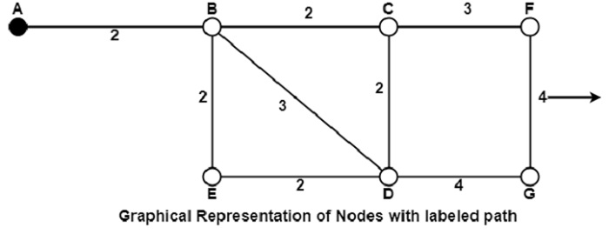

Slide 12
It can be done in various passes as follows, with A as the source.
Pass 1. B (2, A), C(∞,−), F(∞,−), e(∞,−), d(∞,−), G 60
Pass 2. B (2, A), C(4, B), D(5, B), E(4, B), F(∞,−),G(∞,−)
Pass 3. B(2, A), C(4, B), D(5, B), E(4, B), F(7, C), G(9, D)
We can see that there can be two paths between A and G. One follows through ABCFG and the other through ABDG. The first one has a path length of 11, while the second one has 9. Hence, the second one, as G (9, D), is selected. Similarly, Node D has also three paths from A as ABD, ABCD and ABED. The first one has a path length of 5 rest two have 6. So, the first one is selected.
All nodes are searched in various passes, and finally, the routes with the shortest path lengths are made permanent, and the nodes of the path are used as a working node for the next round.

Slide 13
flooding
In computer networking, flooding is a technique for sending a packet of data from a source node to all other nodes in a network. When a node receives a packet through flooding, it forwards it to all its connected neighbors, except the one it received the packet from. The goal of flooding is to ensure that the packet reaches its destination, even if the network topology is unknown or the destination address is not known.
Flooding is often used in situations where a network topology is not well-defined, or when a node does not know the location of the destination node. For example, in a wireless ad-hoc network, where nodes may frequently move and change their location, flooding can be an effective technique for transmitting data to all nodes within range.

Slide 14
However, flooding can also cause problems in a network. If a large number of packets are flooded in a network, it can lead to congestion and network overload. Additionally, if a packet is forwarded repeatedly without being discarded, it can lead to an infinite loop of packet transmission, also known as a broadcast storm.
To prevent these issues, various techniques can be used in conjunction with flooding, such as implementing time-to-live (TTL) values, sequence numbers, and network partitioning.

Slide 15
Distance Vector Routing
Distance Vector Routing is a type of routing algorithm used in computer networking to determine the shortest path for data packets to travel from a source node to a destination node in a network. It is a distributed algorithm that allows each node to calculate the shortest path to every other node in the network based on the distance and direction of neighboring nodes.
In a Distance Vector Routing algorithm, each node maintains a routing table that contains the shortest path to each destination node in the network. The routing table is periodically updated by exchanging routing information with neighboring nodes. The distance to a destination node is measured in hops, or the number of nodes that the packet must pass through to reach the destination.

Slide 16
When a node receives a packet, it checks its routing table to determine the shortest path to the destination node. It then forwards the packet to the next node in the path until it reaches the destination node. If a node detects a change in the network, such as the addition or removal of a node, it updates its routing table and informs its neighbors of the change.
Distance Vector Routing has some advantages, such as simplicity and low computational overhead. However, it can be slow to converge and is susceptible to routing loops and other issues. To address these issues, other routing algorithms such as Link State Routing have been developed.

Slide 17
What is hierarchical routing?
In hierarchical routing, the routers are divided into regions. Each router has complete details about how to route packets to destinations within its own region. But it does not have any idea about the internal structure of other regions.
As we know, in both LS and DV algorithms, every router needs to save some information about other routers. When network size is growing, the number of routers in the network will increase. Therefore, the size of routing table increases, then routers cannot handle network traffic as efficiently. To overcome this problem we are using hierarchical routing.
In hierarchical routing, routers are classified in groups called regions. Each router has information about the routers in its own region and it has no information about routers in other regions. So, routers save one record in their table for every other region.
For huge networks, a two-level hierarchy may be insufficient hence, it may be necessary to group the regions into clusters, the clusters into zones, the zones into groups and so on.

Slide 18
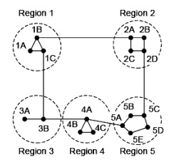
Example
Consider an example of two-level hierarchy with five regions as shown in figure −

Slide 19
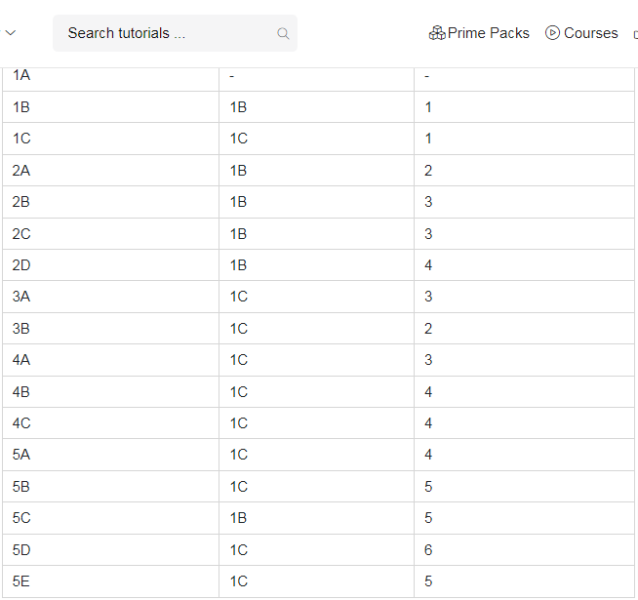
Let see the full routing table for router 1A which has 17 entries, as shown below
−

Slide 20
When routing is done hierarchically then there will be only 7 entries as shown below
Hierarchical Table for 1A
Dest. | Line | Hops
1A | - | -
1B | 1B | 1
1C | 1C | 1
2 | 1B | 2
3 | 1C | 2
4 | 1C | 3
5 | 1C | 4

Slide 21
Explanation
Step 1 − For example, the best path from 1A to 5C is via region 2, but hierarchical routing of all traffic to region 5 goes via region 3 as it is better for most of the other destinations of region 5.
Step 2 − Consider a subnet of 720 routers. If no hierarchy is used, each router will have 720 entries in its routing table.
Step 3 − Now if the subnet is partitioned into 24 regions of 30 routers each, then each router will require 30 local entries and 23 remote entries for a total of 53 entries.
Example
If the same subnet of 720 routers is partitioned into 8 clusters, each containing 9 regions and each region containing 10 routers. Then what will be the total number of table entries in each router.
Solution
10 local entries + 8 remote regions + 7 clusters = 25 entries.

Slide 22
What is congestion?
A state occurring in network layer when the message traffic is so heavy that it slows down network response time.
Effects of Congestion
As delay increases, performance decreases.
If delay increases, retransmission occurs, making situation worse.

Slide 23
Congestion control algorithms
Congestion Control is a mechanism that controls the entry of data packets into the network, enabling a better use of a shared network infrastructure and avoiding congestive collapse.
Congestive-Avoidance Algorithms (CAA) are implemented at the TCP layer as the mechanism to avoid congestive collapse in a network.
There are two congestion control algorithm which are as follows:

Slide 24
Leaky Bucket Algorithm
The leaky bucket algorithm discovers its use in the context of network traffic shaping or rate-limiting.
A leaky bucket execution and a token bucket execution are predominantly used for traffic shaping algorithms.
This algorithm is used to control the rate at which traffic is sent to the network and shape the burst traffic to a steady traffic stream.
The disadvantages compared with the leaky-bucket algorithm are the inefficient use of available network resources.
The large area of network resources such as bandwidth is not being used effectively.

Slide 25
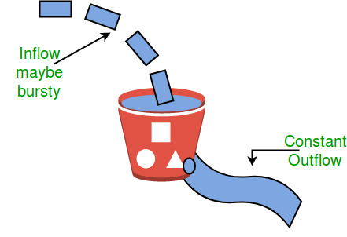
Let us consider an example to understand
Imagine a bucket with a small hole in the bottom.No matter at what rate water enters the bucket, the outflow is at constant rate.When the bucket is full with water additional water entering spills over the sides and is lost.

Slide 26
Similarly, each network interface contains a leaky bucket and the following steps are involved in leaky bucket algorithm:
When host wants to send packet, packet is thrown into the bucket.
The bucket leaks at a constant rate, meaning the network interface transmits packets at a constant rate.
Bursty traffic is converted to a uniform traffic by the leaky bucket.
In practice the bucket is a finite queue that outputs at a finite rate.

Slide 27
Token bucket Algorithm
The leaky bucket algorithm has a rigid output design at an average rate independent of the bursty traffic.
In some applications, when large bursts arrive, the output is allowed to speed up. This calls for a more flexible algorithm, preferably one that never loses information. Therefore, a token bucket algorithm finds its uses in network traffic shaping or rate-limiting.
It is a control algorithm that indicates when traffic should be sent. This order comes based on the display of tokens in the bucket.
The bucket contains tokens. Each of the tokens defines a packet of predetermined size. Tokens in the bucket are deleted for the ability to share a packet.
When tokens are shown, a flow to transmit traffic appears in the display of tokens.
No token means no flow sends its packets. Hence, a flow transfers traffic up to its peak burst rate in good tokens in the bucket.

Slide 28
Need of token bucket Algorithm:-
The leaky bucket algorithm enforces output pattern at the average rate, no matter how bursty the traffic is. So in order to deal with the bursty traffic we need a flexible algorithm so that the data is not lost. One such algorithm is token bucket algorithm.
Steps of this algorithm can be described as follows:
In regular intervals tokens are thrown into the bucket. ƒ
The bucket has a maximum capacity. ƒ
If there is a ready packet, a token is removed from the bucket, and the packet is sent.
If there is no token in the bucket, the packet cannot be sent.

Slide 29
Let’s understand with an example,
In figure (A) we see a bucket holding three tokens, with five packets waiting to be transmitted. For a packet to be transmitted, it must capture and destroy one token. In figure (B) We see that three of the five packets have gotten through, but the other two are stuck waiting for more tokens to be generated.
Ways in which token bucket is superior to leaky bucket: The leaky bucket algorithm controls the rate at which the packets are introduced in the network, but it is very conservative in nature. Some flexibility is introduced in the token bucket algorithm. In the token bucket, algorithm tokens are generated at each tick (up to a certain limit). For an incoming packet to be transmitted, it must capture a token and the transmission takes place at the same rate. Hence some of the busty packets are transmitted at the same rate if tokens are available and thus introduces some amount of flexibility in the system.

Slide 30
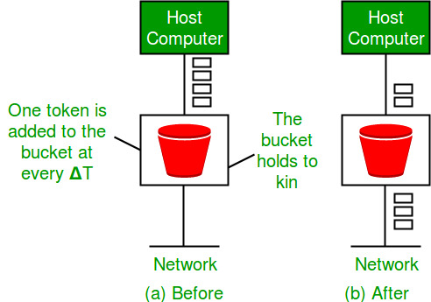
Formula: M * s = C + ρ * s where S – is time taken M – Maximum output rate ρ – Token arrival rate C – Capacity of the token bucket in byte
Let’s understand with an example,

Slide 31
Internetworking, IP protocol
Address Resolution Protocol, Reverse Address Resolution Protocol, IP address and classifications.
Note: for this topics refer supporting material(PPT)

