Slide 1
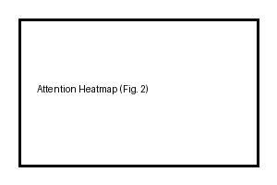
RAG Pipeline Overview

