Slide 1
CS5800 – ALGORITHMS
MODULE 1. REVIEW OF ASYMPTOTIC NOTATION
Lesson 2: Asymptotics & Order Notation
Ravi Sundaram

Slide 2
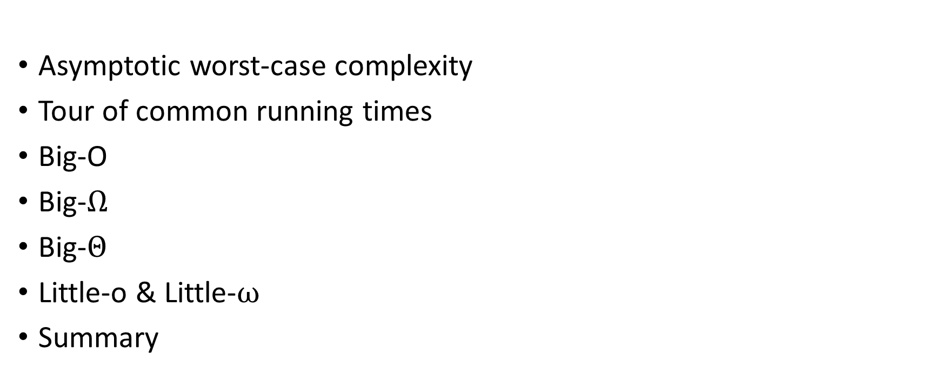
Topics

Slide 3
Worst-case, asymptotic
Why worst-case (for given size/family of inputs)?
  Different algorithms may be better on different instances
  Worst-case gives a uniform way to compare
  Does not require consensus on “average” case
Why asymptotic (as input size goes to infinity)?
  Input parameterized by n
  Care about complexity as n → ∞
  For scalability

Slide 4
Some common runtimes
Linear time
  The algorithm takes time proportional to the size of the input — time taken is Cn for some constant C
  Example: Finding the maximum of a set of numbers — keep the biggest number seen so far
Logarithmic time
  The time taken is proportional to C log₂ n = C lg n for some constant C
  Because different log bases are different only by a constant, we
  typically omit the base: C log n
  Example: Binary search on a sorted list of numbers, throws out half the data at each step

Slide 5
Other common runtimes
Polynomial time
  A broad category that includes constant, linear, logarithmic, and quadratic time, as well as any time bounded by Cn^{k} for some constant k
  Often considered theoretically “efficient” or “tractable”; n¹⁰⁰ would be terrible in practice, but such exponents don’t tend to arise naturally
Exponential time
  The size of the input is in the exponent, for example, 2^{n}
  Is terrible - if n >= 50 or so for all practical purposes same as running forever
  Often arises when you’re trying all possible combinations of things
  Example: try all possible numbers in a sudoku puzzle
  Example: factoring by trying all possible factors
Wealth of other possible running times e.g. n^{log n}, 2^{n!}

Slide 6
Big-O
f = O(g(n)) if, for some positive c and n₀, f(n) ≤ cg(n) for all n ≥ n₀
Core idea: f(n) = O(g(n)) if f(n) ≤ cg(n) as n gets large
f(n) can be greater than g(n) for a little while, as long as g(n) passes it in the long run.
This allows us to perform expensive setups that pay off in the long term. Also constants don’t matter.
g(n)
Time
f(n)
n

Slide 7
Big-O
Upper bound of function relations
Big-O is analogous to ≤.
It holds when two growth rates are essentially equal:
  2n = O(n). (Both linear)
It holds when the first growth rate is asymptotically less than the second:
  2n = O(2^{n}). (Linear vs exponential)
Always put big-O on the right of the equals sign: 5n = O(n) – is saying that the function on the LHS is a member of the category on the RHS.
Most commonly used of the bounds because with algorithms, we usually want an upper bound on the worst case running time.

Slide 8
Big-Omega Ω
Lower bound of function relations
Ω is analogous to ≥.
Used when we may want to say, “This algorithm must take at least this much time”
f = Ω(g(n)) if, for some positive c and n₀, f(n) ≥ cg(n) for all n ≥ n₀
f = Ω(g(n)) iff g = O(f(n))

Slide 9
Theta Θ
Equality of function relations
Θ is analogous to =.
Used when we may want to say, “This is the exact growth rate of the algorithm’s time complexity”
f = Ω(g(n)) and f = O(g(n)) => f = Θ(g(n))

Slide 10
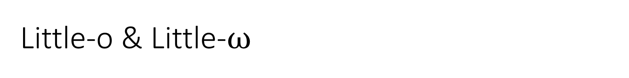
If we want to say one growth rate is strictly faster or slower than another, we use little-o and little-ω:
n = o(n²)
n = ω(log n)
These are analogous to < and > for growth rates.
The technical definition of little-o is f(n) = o(g(n)) if Lim_{n->∞} f(n)/g(n) = 0
Similarly, f(n) = ω(g(n)) if the limit is infinite.

Slide 11
Summary
We describe algorithm speed by the growth in number of operations required as a function of n, the input size. We want that function to grow as slowly as possible!
big-O: an upper bound on a growth rate, ignoring constants
big-Ω: a lower bound on a growth rate, ignoring constants
big-Θ: a tight bound on a growth rate, ignoring constants
o, ω: “strictly less than,” “strictly greater than”
Each polynomial degree Θ(n^{k}) is its own category of growth rate
A problem is efficiently solvable or tractable when it has a polynomial time algorithm

