Slide 1
CS5800 – ALGORITHMS
MODULE 2. COMPLEXITY
(AND COMPUTABILITY &
CRYPTOGRAPHY)
Lesson 5: Diffie-Hellman Key Exchange
Ravi Sundaram

Slide 2
Topics
Fundamental problem of secure Internet
Engagement Ring Puzzle
Diffie-Hellman key exchange protocol
Summary

Slide 3



Fundamental Problem of Secure Internet
Alice and Bob wish to communicate
in the presence of Eve (eavesdropper)
How can they do it?
Historically, they would first meet in private and arrange a codebook

Slide 4
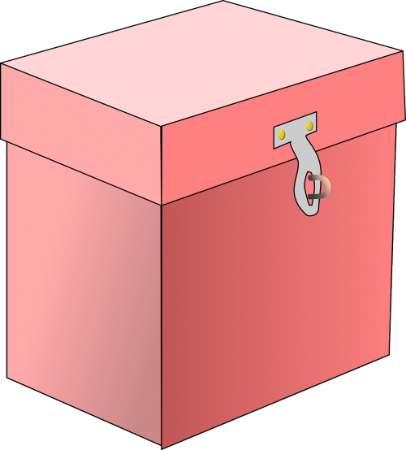
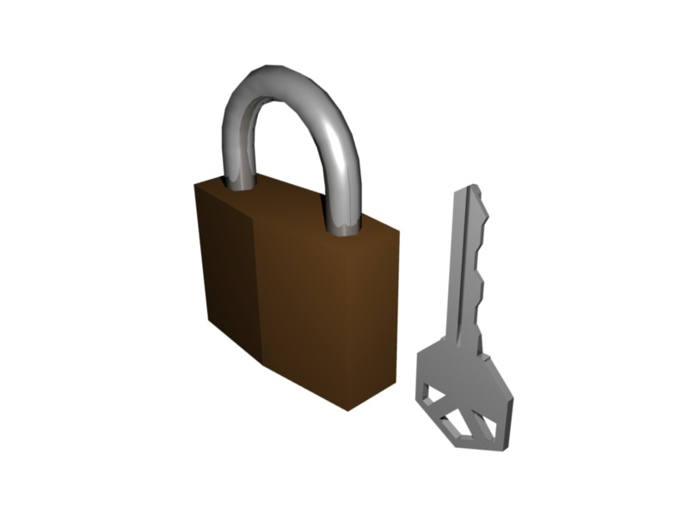
Engagement Ring Puzzle
Alice and Bob meet over the Internet and fall in love
Bob wants to mail Alice a ring, but anything sent in an unlocked box risks getting stolen.
How can Bob send the ring securely?

Slide 5
Engagement Ring Puzzle - Solution
Bob puts the ring in a box, locks it and sends the locked box to Alice
Alice adds her own lock and sends it back
Bob removes his lock and sends it back
Alice removes her lock and puts on the ring

Slide 6
Background
Martin Hellman (Stanford prof) and Whitfield Diffie (PhD
Student) made a revolutionary breakthrough, 1976
Key to the usefulness of the Internet – your browser can communicate securely over public channels with your bank’s web server
Crux of the idea: Modular exponentiation is easy but discrete log is hard i.e., modular exponentiation is one-way
Later, declassified records show it was invented at GCHQ
by Cocks, Ellis and Willamson in 1970.

Slide 7
Diffie-Hellman Key Exchange Protocol
Alice and Bob agree on prime p and
generator g in public (generator means
g mod p, g² mod p, g³ mod p etc.,
are all different)
Alice thinks of a random x and sends g^{x} (mod p) to Bob,
Bob thinks of a random y and responds with g^{y} (mod p)
Note that Alice and Bob can each compute g^{xy} = (g^{x})^{y} = (g^{y})^{x} (mod p) but Eve can’t. Voila!
x
y
p
g
g^{x} (mod p)
g^{y} (mod p)

Slide 8
Summary
Well-defined problems can be divided into two categories
  Those that can be solved quickly, and
  Those that can’t
Cryptography uses this dichotomy to achieve remarkable results
  Alice and Bob can communicate securely over a public channel
Thus cryptography can be seen as an application of algorithmic ideas (fast modular exponentiation enables Diffie-Hellman key exchange)
Main takeaway: algorithmic techniques (over a range of domains including numbers, graphs, strings, etc.,) are the engine of the modern world

