Slide 1
CS5800 – ALGORITHMS
MODULE 3. DIVIDE & CONQUER - I
Lesson 1: Recurrences
Ravi Sundaram

Slide 2
Topics
Divide & Conquer – What is it
Binary Search – example of Divide & Conquer
Recurrences
Guess & Check
Recursion Tree
Summary

Slide 3
Divide & Conquer – What is it?
Political advice often attributed to Alexander the Great’s father Philip, but certainly older
The idea: crush the resistance by dividing it up - ensure they can’t ally with each other against you
In D&C algorithms, the data parts are separated and can’t “talk to each other” until after the subproblems are solved
But you’ve eventually got to get everything under control, provide the “glue” that keeps the empire together - that’s often the hard part in algorithms
Alexander tried to provide “cultural” glue for his conquests, but the empire still fell apart after he died

Slide 4
Divide & Conquer – What is it?
To divide and conquer, think about how you could:
Break the problem into recursive subproblems
Combine the subproblem answers to create the solution to the whole problem.
As with recursion in general, it helps during design to simply imagine what you would do if your algorithm worked for smaller instances.
If base case and “inductive” case both work, the whole thing works.

Slide 5
Binary Search – example of Divide & Conquer
Searching for element in ordered array
BinarySearch(low, high)
If (high < low) Then Return(not-found)
mid = (low + high) / 2
If (A[mid] > x) Then Return(BinarySearch(low, mid-1))
ElseIf (A[mid] < x) Then Return(BinarySearch(mid+1,high))
Else Return(mid)
Divide step – break range (low, high) into (low, mid -1) and (mid + 1, high)
Conquer step - combine subproblems by realizing one range has no solution

Slide 6
Recurrences
Since the Divide & Conquer approach assumes solution to subproblems it naturally gives rise to recurrences.
Binary search gives rise to the recurrence: T(n) = T(n/2) + 1; T(1) = 1
Recurrences can be solved by a) Guess & Check, b) Recursion Tree method and c) Master Theorem.
Guess and Check for Binary Search:
guess T(n) = lg n
check T(n/2) + 1 = lg(n/2) + 1 = lg n – 1 + 1 = lg n.
Requires rigorous proof by induction

Slide 7
Example of recursion tree
Solve T(n) = T(n/4) + T(n/2) + n²:

Slide 8
Example of recursion tree
Solve T(n) = T(n/4) + T(n/2) + n²:
T(n)

Slide 9
Example of recursion tree
Solve T(n) = T(n/4) + T(n/2) + n²:
n²
T(n/4)
T(n/2)

Slide 10
Example of recursion tree
Solve T(n) = T(n/4) + T(n/2) + n²:
n²
(n/4)²
(n/2)²
T(n/16)
T(n/8)
T(n/8)
T(n/4)

Slide 11
Example of recursion tree
Solve T(n) = T(n/4) + T(n/2) + n²:
n²
(n/4)²
(n/2)²
(n/16)²
(n/8)²
(n/8)²
(n/4)²
…
Θ(1)

Slide 12

Example of recursion tree
Solve T(n) = T(n/4) + T(n/2) + n²:
n²
(n/4)²
(n/2)²
(n/16)²
(n/8)²
(n/8)²
(n/4)²
…
Θ(1)

Slide 13

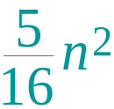
Example of recursion tree
Solve T(n) = T(n/4) + T(n/2) + n²:
n²
(n/4)²
(n/2)²
(n/16)²
(n/8)²
(n/8)²
(n/4)²
…
Θ(1)

Slide 14

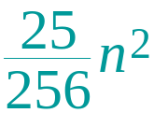
Example of recursion tree
Solve T(n) = T(n/4) + T(n/2) + n²:
n²
(n/4)²
(n/2)²
(n/16)²
(n/8)²
(n/8)²
(n/4)²
…
…
Θ(1)

Slide 15

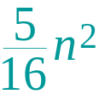
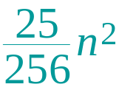
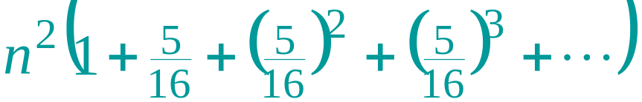
Example of recursion tree
Solve T(n) = T(n/4) + T(n/2) + n²:
n²
(n/4)²
(n/2)²
(n/16)²
(n/8)²
(n/8)²
(n/4)²
…
…
Θ(1)
Total =
geometric series
= Θ(n²)

Slide 16
Summary
Divide & Conquer is a recursive approach that assumes we can solve subproblems then asks how to combine the answers
Because it assumes the solution for subproblems the analysis of the time complexity of Divide & Conquer algorithms naturally gives rise to recurrences
Main takeaway: Recurrences can be solved using:
  Guess & Check
  Recursion tree
  Master Theorem

