Slide 1
CS5800 – ALGORITHMS
MODULE 3. DIVIDE & CONQUER - I
Lesson 3: Integer Multiplication
Ravi Sundaram

Slide 2
Topics
Integer multiplication – grade school
Naïve Divide & Conquer
Karatsuba’s algorithm
Summary

Slide 3
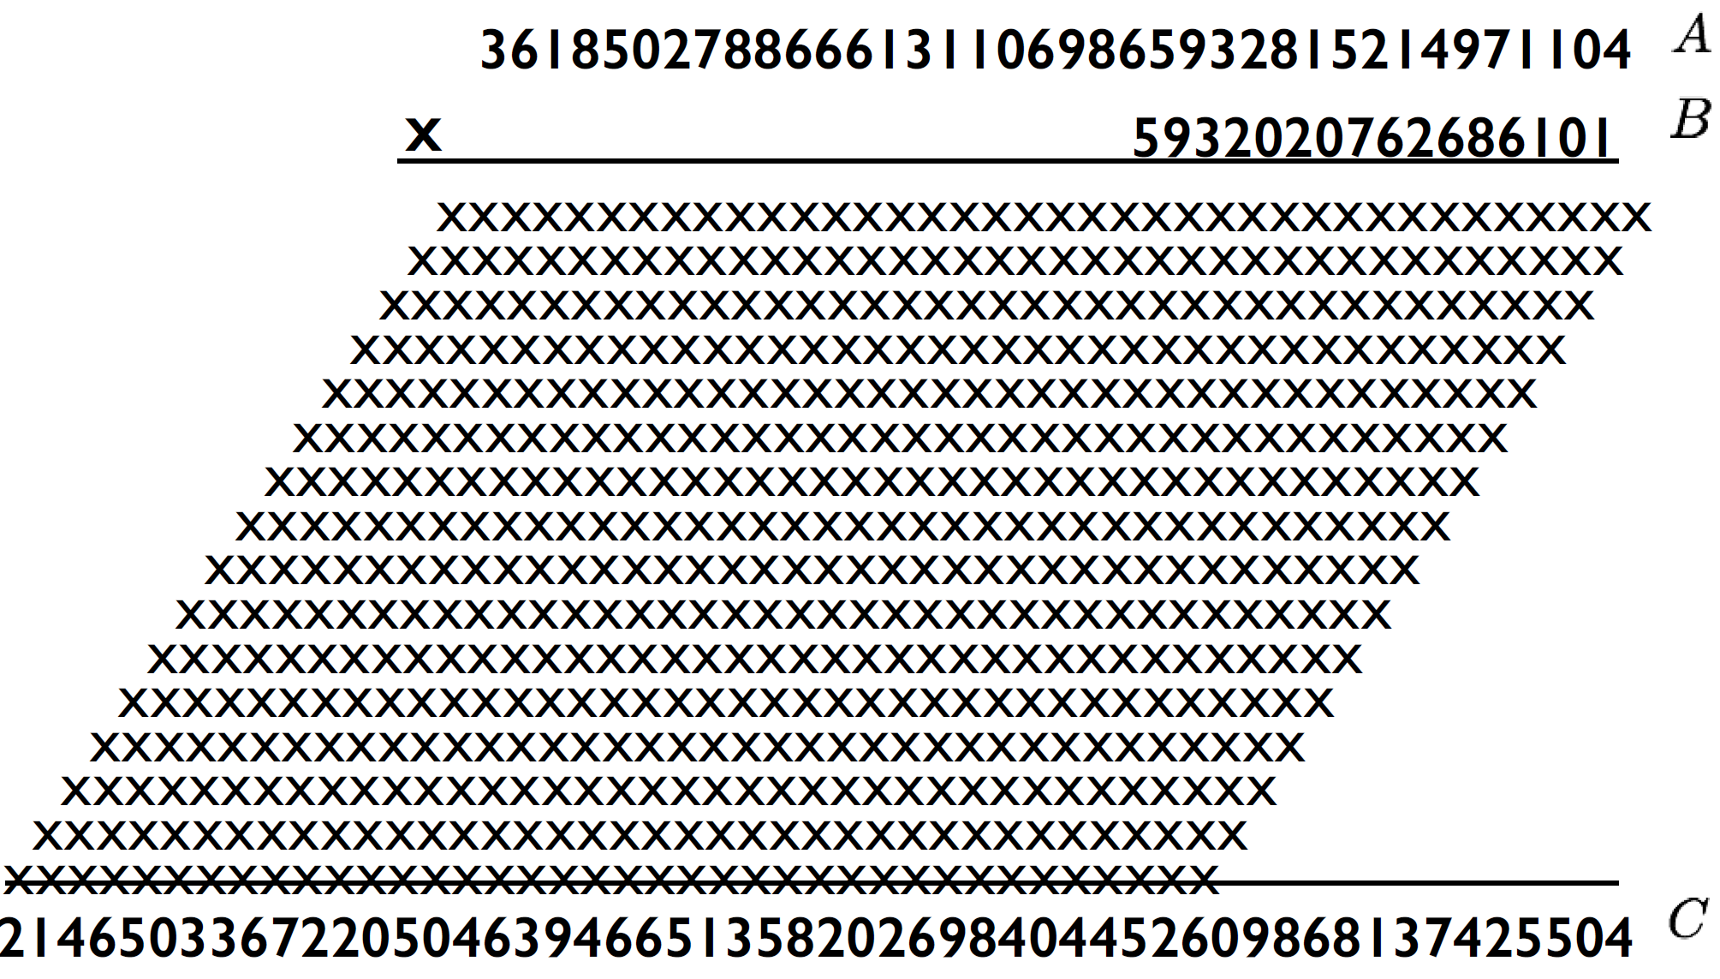
3. Multiplication over the integers
Naïve (grade school) multiplication is quadratic time Θ(lg A * lg B)
If both A and B are n-bit numbers then (naïve) multiplication is Θ(n²)

Slide 4
Naïve Divide & Conquer
Let X = A B and Y = C D where A,B,C and D are n/2 bit integers
Simple Method: XY = (2^{n/2}A+B)(2^{n/2}C+D)
= 2^{n}A*C + 2^{n/2}(A*D+B*C) + B*D
Running Time Recurrence
T(n) < 4T(n/2) + 100n
Solution T(n) = θ(n²)

Slide 5
Karatsuba’s Algorithm
Famous Russian mathematician Andrey Kolmogorov conjectured that the grade school algorithm was asymptotically optimal
Posed it as a conjecture in his seminar at Moscow State Univ in 1960
23 yr old Karatsuba solved it within a week and the seminar was terminated!

Slide 6
Karatsuba’s Algorithm
Let X = A B and Y = C D where A,B,C and D are n/2 bit integers
Karatsuba:
Compute A*C, B*D and use AD + BC = (A+B)*(C+D) – AC – BD
XY = 2^{n}AC + 2^{n/2}(AD + BC) + BD
Reduced from 4 to 3 multiplications.
Remember - addition and subtraction are linear

Slide 7
Karatsuba’s Algorithm
Running Time Recurrence
T(n) < 3T(n/2) + 100n
Solution: Τ(n) = O(n ^{lg 3})= O(n^{1.58})

Slide 8
Summary
Divide & Conquer is only an approach.
Cleverness continues to play a very important role in how to realize the Divide and Conquer steps
In a recent breakthrough (Harvey, van der Hoeven 2019) the complexity of integer multiplication and division of n-bit numbers is now at O(n log n)
Main takeaway: An understanding of recurrence equations (Master Theorem) is crucial for designing fast algorithms.

