Slide 1
CS5800 – ALGORITHMS
MODULE 6. GREEDY ALGORITHMS - I
Lesson 1: Change Making
Ravi Sundaram

Slide 2
Topics
Greedy Algorithms – what, why & examples
Change-making
  Problem
  Algorithm
  Proof
  Efficiency
  Counter-example
Greedy Strategy – some tips
Summary

Slide 3
Greedy – what, why & examples
A greedy algorithm is one that tries to produce an optimal solution by choosing whatever piece of a solution looks best in the moment, without calculating consequences. The algorithm is myopic – it does not look at the long term.
The “greed” may be trying to maximize or minimize something with each decision
Example greedy rules that we’ll talk about in more depth:
  Schedule the request that ﬁnishes earliest (Interval Scheduling)
  Add the cheapest edge to our tree (Prim’s minimal spanning tree algorithm)
  Explore the closest unexplored vertex (Dijkstra’s shortest paths algorithm)

Slide 4





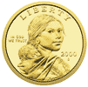

The change-making problem
Goal. Given currency denominations: 1, 5, 10, 25, 100, devise a method to pay amount to customer using fewest number of coins.
Ex: 34¢.
Cashier's algorithm. At each iteration, add coin of the largest value that does not take us past the amount to be paid.
Ex: $2.89.
Notes:
most of us solve this kind of problem every day without thinking twice, unconsciously using an obvious greedy algorithm
http://www.frbatlanta.org/publica/brochure/fundfac/html/coinfaces.html

Slide 5
Greedy Algorithm aka Cashier’s Algorithm
At each iteration, add coin of the largest value that does not take us past the amount to be paid.
Sort coins denominations by value: c₁ < c₂ < … < c_{n}.
S ← φ
while (x ≠ 0) {
let k be largest integer such that c_{k} ≤ x
if (k = 0)
return "no solution found"
x ← x - c_{k}
S ← S ∪ {k}
}
return S
coins selected
Notes:
takes O(n log n) + |S| where S is the number of coins taken by greedy
Note: can be sped up somewhat by using integer division

Slide 6
Change-making: Analysis of Greedy Algorithm
Theorem. Greed is optimal for U.S. coinage: 1, 5, 10, 25, 100.
Pf. (by induction on x)
  Consider optimal way to change c_{k} ≤ x < c_{k+1} : greedy takes coin k.
  We claim that any optimal solution must also take coin k.
    if not, it needs enough coins of type c₁, …, c_{k-1} to add up to x
    table below indicates no optimal solution can do this
  Problem reduces to coin-changing x - c_{k} cents, which, by induction, is optimally solved by greedy algorithm. ▪
k
c_{k}
All optimal solutions
must satisfy
Max value of coins
1, 2, …, k-1 in any OPT
1
1
P ≤ 4
-
2
5
N ≤ 1
4
3
10
N + D ≤ 2
4 + 5 = 9
4
25
Q ≤ 3
20 + 4 = 24
5
100
no limit
75 + 24 = 99
Notes:
P = pennies, N = nickels, D = dimes, Q = quarters

Slide 7
Change-making algorithm: complexity
Assumption: the denominations are fixed, and the amount is specified in binary using n bits.
The complexity is O(2n) since the amount can be exponentially large in the number of bits.
Notes:
note: may not even lead to *feasible* solution if c_1 > 1!
Ex. C = {7, 8, 9}, x = 15

Slide 8
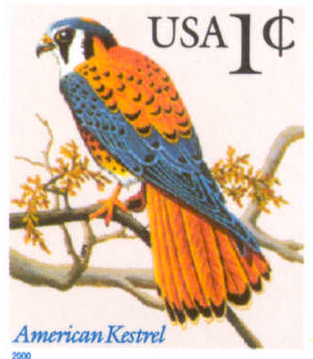
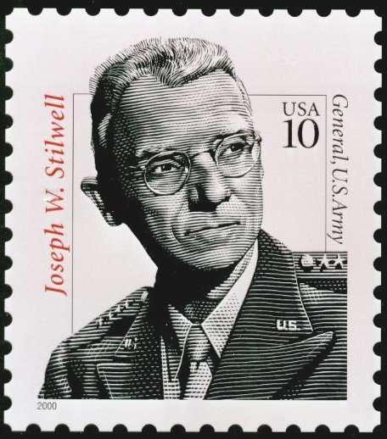
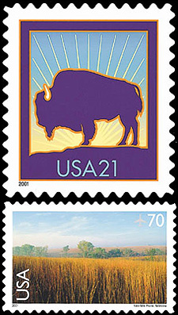
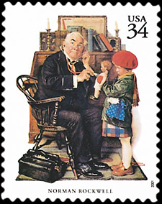

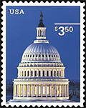
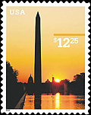
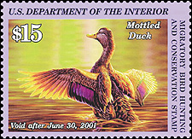
Change-making: counterexample
Observation. Greedy algorithm is sub-optimal for US postal denominations: 1, 10, 21, 34, 70, 100, 350, 1225, 1500.
Counterexample. 140¢.
  Greedy: 100, 34, 1, 1, 1, 1, 1, 1.
  Optimal: 70, 70.
Notes:
note: may not even lead to *feasible* solution if c_1 > 1!
Ex. C = {7, 8, 9}, x = 15

Slide 9
Greedy Strategy: some tips
Figure out some metric to be greedy about, where it seems like it’s always best to choose that option.
Consider plugging in some corner cases to see if it always works
Your algorithm can consist of sorting by this metric ahead of time or putting things in a priority queue where the keys are the greedy metric values.
  The latter is better if you would otherwise need to re-sort.
If there’s no obvious lower bound your algorithm matches, consider these proof techniques:
  Greedy-stays-ahead: prove by induction that you start “ahead” and remain “ahead” (we will see this argument in Interval Scheduling)
  Exchange argument: Why is it never a bad idea to make a solution look more like your solution?

Slide 10
Summary
Greedy – algorithmic design paradigm, involves choosing one by one myopically to construct solution
Typically, many greedy choices; art to select the right one
Need to prove correctness. Not always guaranteed to work
Main Takeaway: for some problems building the solution incrementally in myopic fashion works. Short-term greedy is, sometimes, long-term optimal

