Slide 1
CS5800 – ALGORITHMS
MODULE 6. GREEDY ALGORITHMS - I
Lesson 3: Shortest Paths
Ravi Sundaram

Slide 2
Topics
Shortest Paths problem
Dijkstra’s algorithm
Proof of Correctness
Implementation
Demo
Summary

Slide 3
Shortest Path Problem
Shortest path network.
  Directed graph G = (V, E).
  Source s, destination t.
  Length l_{e} = length of edge e.
Shortest path problem: find shortest directed path from s to t.
cost of path = sum of edge costs in path
2
23
3
9
s
18
Cost of path s-2-3-5-t
= 9 + 23 + 2 + 16
= 50.
14
2
6
6
30
11
4
19
15
5
5
20
16
6
7
44
t

Slide 4
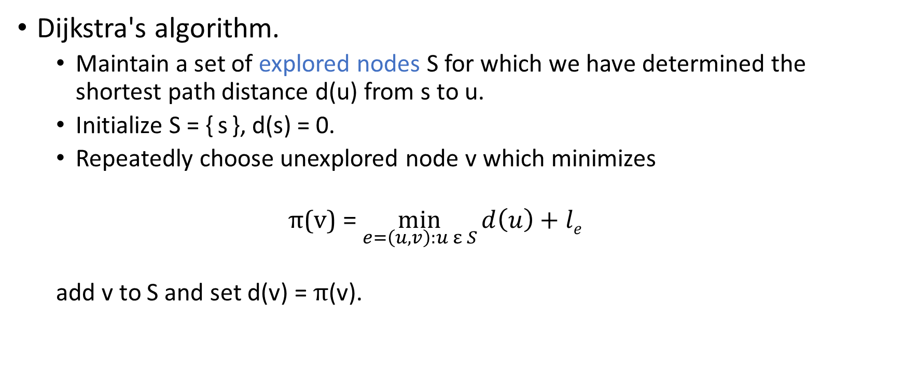
Dijkstra's Algorithm
Dijkstra's algorithm.
  Maintain a set of explored nodes S for which we have determined the shortest path distance d(u) from s to u.
  Initialize S = { s }, d(s) = 0.
  Repeatedly choose unexplored node v which minimizes
  π(v) = $\min_{e=\left(u,v\right):u ε S}{d\left(u\right)+le}$
  add v to S and set d(v) = π(v).
shortest path to some u in explored part, followed by a single edge (u, v)
l_{e}
v
d(u)
u
S
s

Slide 5

Dijkstra's Algorithm
Dijkstra's algorithm.
  Maintain a set of explored nodes S for which we have determined the shortest path distance d(u) from s to u.
  Initialize S = { s }, d(s) = 0.
  Repeatedly choose unexplored node v which minimizes
  π(v) = $\min_{e=\left(u,v\right):u ε S}{d\left(u\right)+le}$
  add v to S and set d(v) = π(v).
shortest path to some u in explored part, followed by a single edge (u, v)
l_{e}
v
d(u)
u
S
s
Notes:
S is only needed for the proof of correctness, not the algorithm itself

Slide 6
Dijkstra's Algorithm: Proof of Correctness
Invariant. For each node u ∈ S, d(u) is the length of the shortest s-u path.
Pf. (by induction on |S|)
Base case: |S| = 1 is trivial.
Inductive hypothesis: Assume true for |S| = k ≥ 1.
  Let v be next node added to S and let u-v be the chosen edge.
  The shortest s-u path plus (u, v) is an s-v path of length π(v).
  Consider any s-v path P. We'll see that it's no shorter than π(v).
  Let x-y be the first edge in P that leaves S,
  and let P' be the sub-path to x.
  P is already too long as soon as it leaves S.
P
P'
x
y
s
S
u
v
l(P) ≥ l(P') + l(x,y) ≥ d(x) + l(x, y) ≥ π(y) ≥ π(v)
Dijkstra chose v
instead of y
nonnegative
weights
inductive
hypothesis
defn of π(y)
Notes:
Consider any path P from s to v. It is already at least as long as π(v) by the time it leaves S.

Slide 7
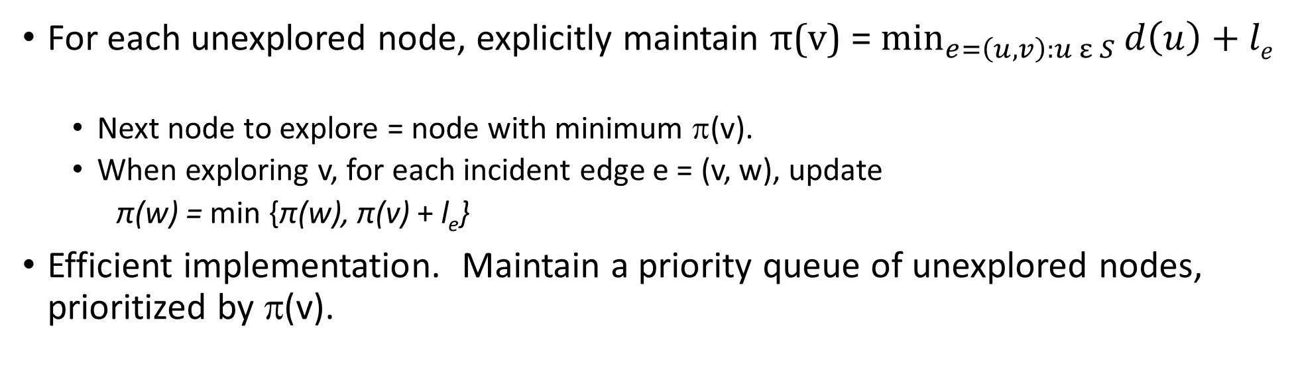
Dijkstra's Algorithm: Implementation
For each unexplored node, explicitly maintain π(v) = $\min_{e=\left(u,v\right):u ε S}{d\left(u\right)+le}$
  Next node to explore = node with minimum π(v).
  When exploring v, for each incident edge e = (v, w), update
  π(w) = min {π(w), π(v) + l_{e}}
Efficient implementation. Maintain a priority queue of unexplored nodes, prioritized by π(v).
Priority Queue
PQ Operation
Dijkstra
Array
Binary heap
d-way Heap
Fib heap †
Insert
n
n
log n
d log _{d} n
1
ExtractMin
n
n
log n
d log _{d} n
log n
ChangeKey
m
1
log n
log _{d} n
1
IsEmpty
n
1
1
1
1
Total
n²
m log n
m log _{m/n} n
m + n log n
† Individual ops are amortized bounds

Slide 8
Dijkstra's Shortest Path Algorithm
Find shortest path from s to t.
2
24
3
9
s
18
14
6
6
2
30
4
19
11
15
5
5
6
20
16
7
t
44

Slide 9
Dijkstra's Shortest Path Algorithm
S = { }
PQ = { s, 2, 3, 4, 5, 6, 7, t }
∞
∞
2
24
3
0
9
s
∞
18
14
6
6
2
∞
30
∞
4
19
11
15
5
5
6
20
16
7
t
44
distance label
∞
∞

Slide 10
Dijkstra's Shortest Path Algorithm
S = { }
PQ = { s, 2, 3, 4, 5, 6, 7, t }
delmin
∞
∞
2
24
3
0
9
s
∞
18
14
6
6
2
∞
30
∞
4
19
11
15
5
5
6
20
16
7
t
44
distance label
∞
∞

Slide 11
Dijkstra's Shortest Path Algorithm
S = { s }
PQ = { 2, 3, 4, 5, 6, 7, t }
decrease key
∞
∞
9
X
2
24
3
0
9
s
∞
14
18
14
X
6
6
2
∞
30
∞
4
19
11
15
5
5
6
20
16
7
t
44
distance label
∞
15
∞
X

Slide 12
Dijkstra's Shortest Path Algorithm
S = { s }
PQ = { 2, 3, 4, 5, 6, 7, t }
delmin
∞
∞
9
X
2
24
3
0
9
s
∞
14
18
14
X
6
6
2
∞
30
∞
4
19
11
15
5
5
6
20
16
7
t
44
distance label
∞
15
∞
X

Slide 13
Dijkstra's Shortest Path Algorithm
S = { s, 2 }
PQ = { 3, 4, 5, 6, 7, t }
∞
∞
9
X
2
24
3
0
9
s
∞
14
18
14
X
6
6
2
∞
30
∞
4
19
11
15
5
5
6
20
16
7
t
44
∞
15
∞
X

Slide 14
Dijkstra's Shortest Path Algorithm
S = { s, 2 }
PQ = { 3, 4, 5, 6, 7, t }
decrease key
∞
33
∞
X
9
X
2
24
3
0
9
s
∞
14
18
14
X
6
6
2
∞
30
∞
4
19
11
15
5
5
6
20
16
7
t
44
∞
15
∞
X

Slide 15
Dijkstra's Shortest Path Algorithm
S = { s, 2 }
PQ = { 3, 4, 5, 6, 7, t }
∞
33
∞
X
9
X
2
24
3
0
9
delmin
s
∞
14
18
14
X
6
6
2
∞
30
∞
4
19
11
15
5
5
6
20
16
7
t
44
∞
15
∞
X

Slide 16
Dijkstra's Shortest Path Algorithm
S = { s, 2, 6 }
PQ = { 3, 4, 5, 7, t }
32
∞
33
∞
X
X
9
X
2
24
3
0
9
s
∞
14
18
14
X
6
6
2
44
∞
∞
4
30
X
19
11
15
5
5
6
20
16
7
t
44
∞
15
∞
X

Slide 17
Dijkstra's Shortest Path Algorithm
S = { s, 2, 6 }
PQ = { 3, 4, 5, 7, t }
32
∞
33
∞
X
X
9
X
2
24
3
0
9
s
∞
14
18
14
X
6
6
2
44
∞
∞
4
30
X
19
11
15
5
5
6
20
16
7
t
44
∞
15
delmin
∞
X

Slide 18
Dijkstra's Shortest Path Algorithm
S = { s, 2, 6, 7 }
PQ = { 3, 4, 5, t }
32
∞
33
∞
X
X
9
X
2
24
3
0
9
s
∞
14
18
14
X
6
6
2
44
35
∞
X
∞
4
30
X
19
11
15
5
5
6
20
16
7
t
44
59
∞
∞
15
X
X

Slide 19
Dijkstra's Shortest Path Algorithm
S = { s, 2, 6, 7 }
PQ = { 3, 4, 5, t }
delmin
32
∞
33
∞
X
X
9
X
2
24
3
0
9
s
∞
14
18
14
X
6
6
2
44
35
∞
X
∞
4
30
X
19
11
15
5
5
6
20
16
7
t
44
59
∞
∞
15
X
X

Slide 20
Dijkstra's Shortest Path Algorithm
S = { s, 2, 3, 6, 7 }
PQ = { 4, 5, t }
32
∞
33
∞
X
X
9
X
2
24
3
0
9
s
∞
14
18
14
X
6
6
2
44
35
34
∞
X
X
∞
4
30
X
19
11
15
5
5
6
20
16
7
t
44
51
59
∞
∞
15
X
X
X

Slide 21
Dijkstra's Shortest Path Algorithm
S = { s, 2, 3, 6, 7 }
PQ = { 4, 5, t }
32
∞
33
∞
X
X
9
X
2
24
3
0
9
s
∞
14
18
14
X
6
6
2
44
35
34
∞
X
X
∞
4
30
X
19
11
15
5
5
6
20
delmin
16
7
t
44
51
59
∞
∞
15
X
X
X

Slide 22
Dijkstra's Shortest Path Algorithm
S = { s, 2, 3, 5, 6, 7 }
PQ = { 4, t }
32
∞
33
∞
X
X
9
X
2
24
3
0
9
s
∞
14
18
14
X
6
6
2
35
34
45
∞
44
X
X
X
∞
4
30
X
19
11
15
5
5
6
20
16
7
t
44
50
51
59
∞
∞
15
X
X
X
X

Slide 23
Dijkstra's Shortest Path Algorithm
S = { s, 2, 3, 5, 6, 7 }
PQ = { 4, t }
32
∞
33
∞
X
X
9
X
2
24
3
0
9
s
∞
14
18
14
X
6
6
2
35
34
45
∞
44
X
X
X
∞
4
30
X
19
11
15
5
delmin
5
6
20
16
7
t
44
50
51
59
∞
∞
15
X
X
X
X

Slide 24
Dijkstra's Shortest Path Algorithm
S = { s, 2, 3, 4, 5, 6, 7 }
PQ = { t }
32
∞
33
∞
X
X
9
X
2
24
3
0
9
s
∞
14
18
14
X
6
6
2
35
34
45
∞
44
X
X
X
∞
4
30
X
19
11
15
5
5
6
20
16
7
t
44
50
51
59
∞
∞
15
X
X
X
X

Slide 25
Dijkstra's Shortest Path Algorithm
S = { s, 2, 3, 4, 5, 6, 7 }
PQ = { t }
32
∞
33
∞
X
X
9
X
2
24
3
0
9
s
∞
14
18
14
X
6
6
2
35
34
45
∞
44
X
X
X
∞
4
30
X
19
11
15
5
5
6
20
16
7
t
44
delmin
50
51
59
∞
∞
15
X
X
X
X

Slide 26
Dijkstra's Shortest Path Algorithm
S = { s, 2, 3, 4, 5, 6, 7, t }
PQ = { }
32
∞
33
∞
X
X
9
X
2
24
3
0
9
s
∞
14
18
14
X
6
6
2
35
34
45
∞
44
X
X
X
∞
4
30
X
19
11
15
5
5
6
20
16
7
t
44
50
51
59
∞
∞
15
X
X
X
X

Slide 27
Dijkstra's Shortest Path Algorithm
S = { s, 2, 3, 4, 5, 6, 7, t }
PQ = { }
32
∞
33
∞
X
X
9
X
2
24
3
0
9
s
∞
14
18
14
X
6
6
2
35
34
45
∞
44
X
X
X
∞
4
30
X
19
11
15
5
5
6
20
16
7
t
44
50
51
59
∞
∞
15
X
X
X
X

Slide 28
Summary
Just as BFS finds the shortest path in unweighted graphs, Dijkstra’s algorithm works for graphs with nonnegative edge weights
Dijkstra’s algorithm is a greedy algorithm that, in each iteration, explores the closest unexplored vertex
Dijkstra’s algorithm implemented using binary heaps takes O(mlogn) time
Main Takeaway: Dijkstra’s algorithm is a greedy approach that works for weighted shortest paths and heaps help speed up the implementation.

