Slide 1
CS5800 – ALGORITHMS
MODULE 8. DYNAMIC PROGRAMMING - I
Lesson 1: Fibonacci Series
Ravi Sundaram

Slide 2
Topics
What is Dynamic Programming
What is the Fibonacci sequence
Top-down approach
  How is it inefficient?
Bottom-up approach
  Memoization or table building
Summary

Slide 3
Dynamic Programming
Dynamic Programming is an algorithm design technique for optimization problems: often minimizing or maximizing.
Like divide and conquer, DP solves problems by combining solutions to sub-problems.
Unlike divide and conquer, sub-problems are not independent.
  Sub-problems may share sub-sub-problems,

Slide 4
What is the Fibonacci sequence?
The sequence begins with one. Each subsequent
number is the sum of the two preceding numbers.
Fib(n) = Fib(n-1) + Fib(n-2)
Thus the sequence begins as follows:
1, 1, 2, 3, 5, 8, 13, 21, 34, 55, 89, 144….
Introduced to Western Europe in the 1200s by
Fibonacci
Appeared earlier in 200BC in a treatise
on Sanskrit poetry by Pingala

Slide 5
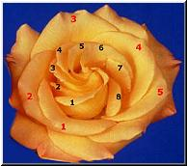
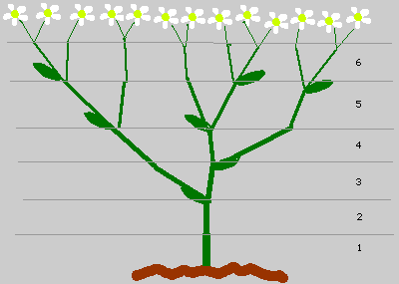
Fibonacci numbers in nature
Many aspects of nature are grouped in bunches equaling Fibonacci numbers.
For example, the number of petals on a flower tend to be a Fibonacci number.
Leaves and branches are also found in groups of Fibonacci numbers.

Slide 6
Computing the Fibonacci Numbers
Computing the n^{th} Fibonacci number recursively:
  F(n) = F(n-1) + F(n-2)
  F(0) = 0
  F(1) = 1
  Top-down approach
int Fib(int n)
{
if (n <= 1)
return 1;
else
return Fib(n - 1) + Fib(n - 2);
}
  F(n)
  F(n-1) + F(n-2)
  F(n-2) + F(n-3) F(n-3) + F(n-4)

Slide 7
Time complexity of top-down approach
What is the Recurrence relationship?
  T(n) = T(n-1) + T(n-2) + 1
What is the solution to this?
  Since T(n) < 2T(n-1) an upper bound is O(2^{n}).
  Since T(n) > 2T(n-2) A lower bound is Ω(2^{n/2}).
  In fact T(n) = Θ(F(n)), since T(n) grows very similarly to F(n),
This is exponential in n; can we do better?

Slide 8
Why is the top-down approach so inefficient
Fib(5)
+
Recomputes the same sub-problem multiple times
Fib(4)
+
Fib(3)
+
Fib(3)
+
Fib(2)
+
Fib(2)
+
Fib(1)
Fib(2)
+
Fib(1)
Fib(1)
Fib(0)
Fib(1)
Fib(0)
Fib(1)
Fib(0)

Slide 9
Computing Fibonacci Numbers – bottom up
  Computing the n^{th} Fibonacci number using a bottom-up approach:
  F(0) = 0
  F(1) = 1
  F(2) = 1+0 = 1
  …
  F(n-2) =
  F(n-1) =
  F(n) = F(n-1) + F(n-2)
Efficiency:
  Time – O(n) word operations
  Space – O(n), actually O(1) since only last terms need remembering
  [will consider space again when studying edit distance and sequence alignment

Slide 10
Some technical issues
Taking a precise bit-complexity viewpoint
  Input is specified using log n bits
  Output is Ω(n) bits or exponential
Time complexity of bottom-up is O(n²)
Using a matrix powering approach can do O(nlogn)

Slide 11
Dynamic Programming
The term Dynamic Programming comes from Control Theory, not computer science. Programming refers to the use of tables (arrays) to construct a solution.
In dynamic programming we usually reduce time by increasing the amount of space
We solve the problem by solving sub-problems of increasing size and saving each optimal solution in a table (usually).
The table is then used for finding the optimal solution to larger problems.
Time is saved since each sub-problem is solved only once.

Slide 12
Summary
Dynamic programming refers to a strategy of solving (and remembering) solutions to subproblems that can be used to compute larger solutions
  Typically this involves filling in a table of problem solutions
  Should be polynomial number of subproblems and a recurrence that describes how to combine the answers
  Good fit when Divide and Conquer can’t neatly divide up the work
When solving problems recursively, memoization can ensure values aren’t recomputed by remembering function call results directly
  Without this, we may end up redoing a lot of work even while using the same basic recurrence as iterative approach
Main Takeaway: Remember solutions to smaller sub-problems and reuse to solve the larger problem. Often beats divide & conquer and greedy

