Slide 1
Using LLMs for
UVM Testbench Generation
Archie Gupta
Net ID: ag10276
ECE 9953 · Spring 2026
NYU Tandon School of Engineering

Slide 2
Problem Definition
UVM Verification is one of the most important steps in hardware design
What is the motivation behind UVM Testbenches?
A modern SoC verification environment uses the Universal Verification Methodology (UVM) — a SystemVerilog class library for building reusable, layered testbenches.
UVM is a framework of SystemVerilog classes from which fully functional testbenches can be built.
The primary advantage is that the methodology specifies and lays out a set of guidelines to be followed for creation of verification testbenches.
This will ensure testbench uniformity between different verification teams, cross-compatibility between IP and standalone environment integration, flexibility and ease of maintaining testbenches.
A UVM testbench is built in layers, not as one large block of code
Each layer has a clear responsibility, which makes the testbench easier to understand and maintain
The structure separates:
What to test (test and sequences)
How to drive signals (driver)
What actually happened (monitor)
Is the behavior correct (scoreboard)
How much is tested (functional coverage)
This separation allows reuse of components across different designs

Slide 3
Problem Statement
60–70% of ASIC project effort is spent in verification.
The time and effort needed to build the UVM testbench is large.
Targeted areas of the UVM flow:
Spec → UVM Skeleton: agents, interfaces, transactions
Transaction & Sequence Generation
Driver / Monitor Generation
Assertions & Functional Coverage
Debug & Iteration Support

Slide 4
Motivation
Using LLMs for Initial TB Generation to focus human effort
on
Complex Targeted Testing
The opportunity
LLMs are strong at
Converting structured specifications into structured code
Recognizing repeated boilerplate patterns.
Evaluate LLM generated TBs on below parameters
coverage closure
assertion firing
protocol-aware corner cases

Slide 5
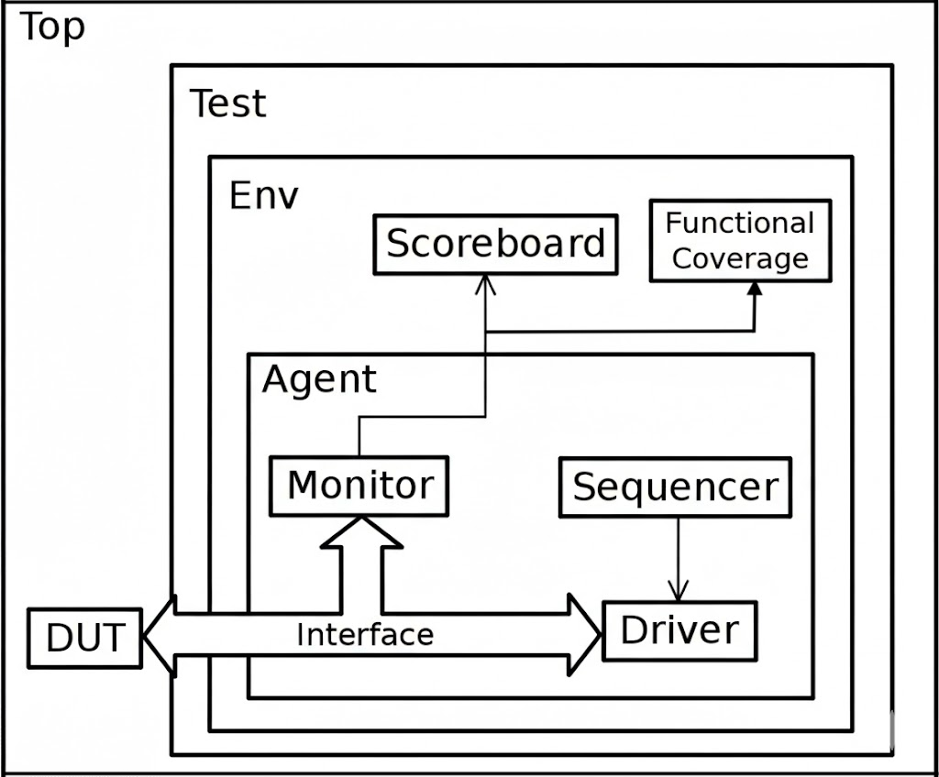
Framework: Standard UVM Testbench
Layered and Reusable
Sequences generate high-level transactions (not signals)
The sequencer controls the order and flow of these transactions
The driver converts transactions into signal-level activity on the DUT interface
The interface defines how signals are driven and sampled
This flow allows stimulus to change without modifying low-level signal code
The monitor passively observes DUT signals and reconstructs transactions
Observed transactions are sent to the scoreboard
The scoreboard compares actual behavior against expected behavior
Functional coverage tracks which states, transitions, and cases have been exercised

Slide 6
Framework: LLM-Assisted TB Generation
RTL/Specification Input
Prompt Builder
LLM API Call
Section Parser
Generated TB
design.sv / txt file
structured spec + UVM
section contract
o4-mini
Gemini 3.1
Claude Opus 4.6
split into 11 UVM
files, validate
*_uvm_tb_all.sv
+ supporting files
All four LLM outputs and the hand-written TB run through the same VCS pipeline:
Structural
Compile + Run
Functional Coverage
Assertion Coverage
Did the LLM produce all 11 required UVM sections?
Does it elaborate and simulate cleanly without manual fixes?
Do covergroups and crosses reach closure on declared bins?
Are bound SVAs and cover properties exercised by stimulus?
Identical Specification · Identical prompts · Identical simulator (VCS) · Identical assertions bound to the DUT
The only variable across runs is the LLM (or the human, for the reference).

Slide 7
Methodology
1
Build the baseline reference
Hand-write fully working UVM TBs for 14 designs (mux → AXI4). Each TB compiles, simulates, has functional coverage and bound SVAs.
2
Write the generation script
Python tool (UVM_TestBench_Gen.py) that loads RTL/Specifications, builds a structured prompt with required UVM sections, calls the LLM via Portkey AI Gateway, and parses the response into 15 files.
3
Run all 3 LLMs over all 14 designs
o4-mini · Gemini Pro 3.1 · Claude Opus 4.6. One attempt per (LLM × design); failing designs retried with up to 3 attempts.
4
Compile, debug, simulate in VCS
Failures are logged with the manual fix(es) needed. Successes are simulated to produce coverage and assertion reports.
5
Compare each LLM TB against the reference
On every design, compare the original TB and three LLM TBs (o4-mini, Gemini 3.1, Claude Opus 4.6) on score, bins covered, stimulus density, and modelling discipline.

Slide 8
Part II
Results
1. Original Testbenches and results
2. LLM Evaluation — Structural Conformance
3. LLM Evaluation — Compile & Runtime
4. Original vs LLM — Functional & Assertion Coverage

Slide 9
Designs Chosen
Combinational
Sequential
Bus Protocols
Mux
Decoder
Comparator
Adder
Alu
Barrel shifter
Counter
USR
FSM
Sync FIFO
Round-Robin Arbiter
APB
AHB
AXI
Each original TB provides
✓ All 11 UVM components, factory-registered, phase-correct
✓ Compiles + simulates cleanly in VCS
✓ Functional covergroup with explicit bins
✓ Bound SVA assertion module + cover properties
✓ Both directed and randomized stimulus

Slide 10
Original Testbench Results — Combinational
Design | Covergroup model | Score | Stim. attempts | Notes
mux | 5 cps + 4 crosses (sel × inX, brute-force enum.) | 100.00 % | 2,116 | Highest stimulus volume
decoder | 1 cp on cp_a only | 100.00 % | 1,292 | Only input coverage
comparator | cp_a × cp_b (16 bins) | 100.00 % | 24,412 | Large stimulus volume
adder | 3 cps + 1 cross (3-way), directed seq | 95.02 % | 7,439 | needed 102 directed sequences
alu | 1 cp on cp_opcode only | 100.00 % | ~480 | No operand coverage
barrel shifter | 1 cp on cp_s only | 100.00 % | 198 | No output coverage
Observation
Most original TBs reach 100 % coverage but on shallow models. Decoder, ALU, and barrel-shifter cover only one input-side coverpoint each — outputs and operand corners are never sampled. Adder requires a hard-coded 102-bin directed sequence to close the 3-way cross. Stimulus density is the original's main strength — comparator hits 24K assertion attempts.

Slide 11
Original Testbench Results — Sequential & Protocol
Design | Covergroup model | Score | Stim. attempts | Notes
counter | (none — subscriber commented out) | N/A | 3,840 | No functional coverage at all; 2 dead sequences
USR | 1 cp on cp_control | 100.00 % | 390 | No operand or output coverage
FSM | 3 cps; no cross | 100.00 % | 315 | Reset exercised only 2× (vs claude's 24×)
sync FIFO | 5 cps; no cross | 100.00 % | 1,350 | Best stimulus on no-write-when-full corner
APB | 3 covergroups w/ back-to-back R/W cross | 100.00 % | 1,110 | Strongest FSM-traversal stimulus of any TB
AHB | 3 CGs (HBURST, HTRANS-trans, ignore_bins) | ~87 % | 240+ | Only TB to cover HBURST + HTRANS transitions
AXI | 5 CGs incl. cg_protocol_errors | ~97.78 % | 1,023 | Per-channel coverage + byte-error ignore_bins
Arbiter | 21 vars + 32 crosses, ignore_bins | 100.00 % | 1,497 | Caught 10 real assertion failures — only TB to do so

Slide 12
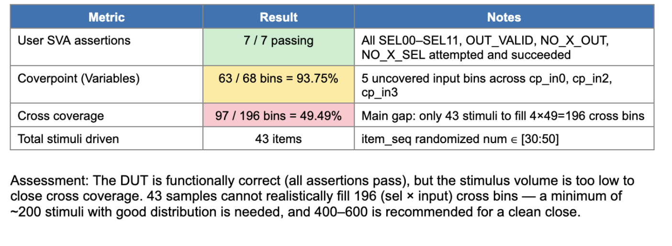
Using LLMs to Generate Directed Tests for Better Coverage
Mux - Coverage Analysis (Original Results)

Slide 13
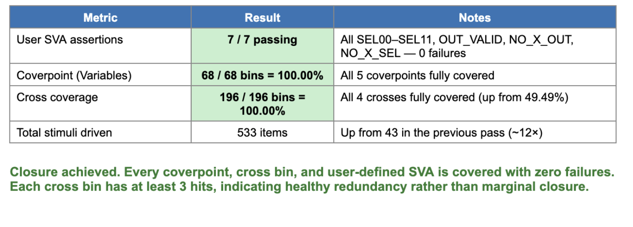
Using LLMs to Generate Directed Tests for Better Coverage
Mux - Coverage Analysis (Addition of LLM Generated Tests)

Slide 14
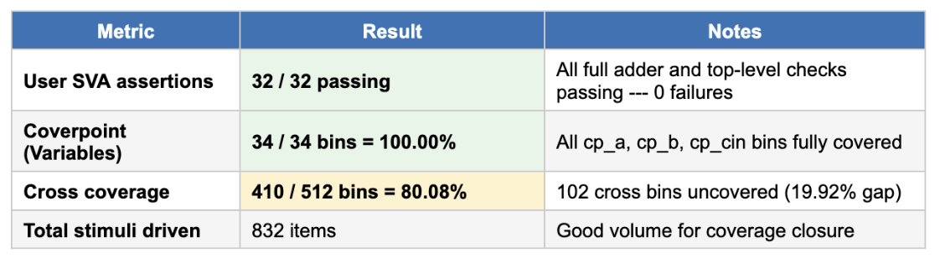
Using LLMs to Generate Directed Tests for Better Coverage
Adder - Coverage Analysis (Original Results)

Slide 15
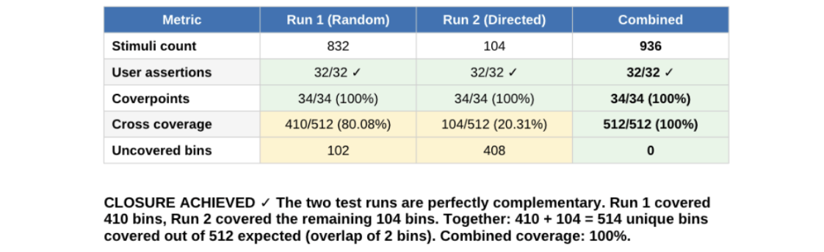
Using LLMs to Generate Directed Tests for Better Coverage
Adder - Coverage Analysis (Addition of LLM Generated Tests)

Slide 16
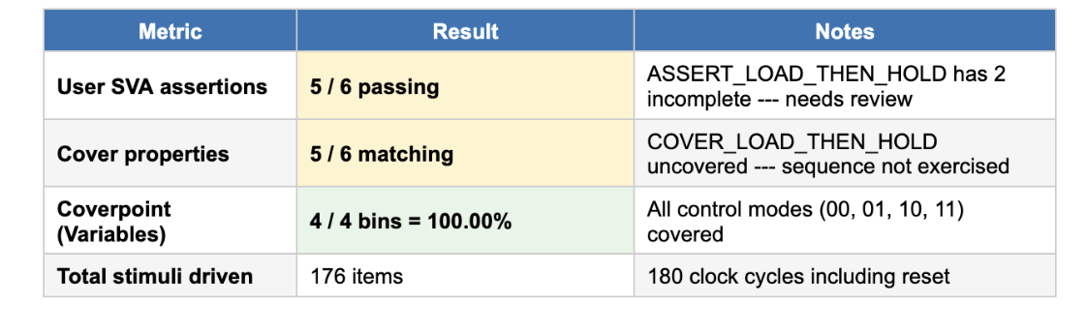
Using LLMs to Generate Directed Tests for Better Coverage
USR - Coverage Analysis (Original Results)

Slide 17
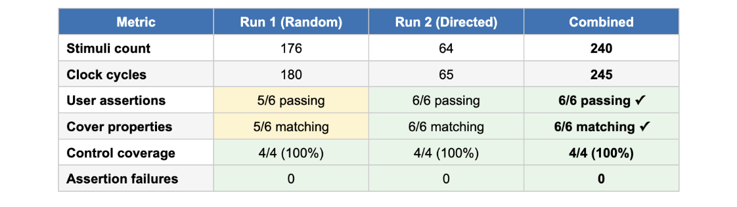
Using LLMs to Generate Directed Tests for Better Coverage
USR - Coverage Analysis (Addition of LLM Generated Tests)

Slide 18
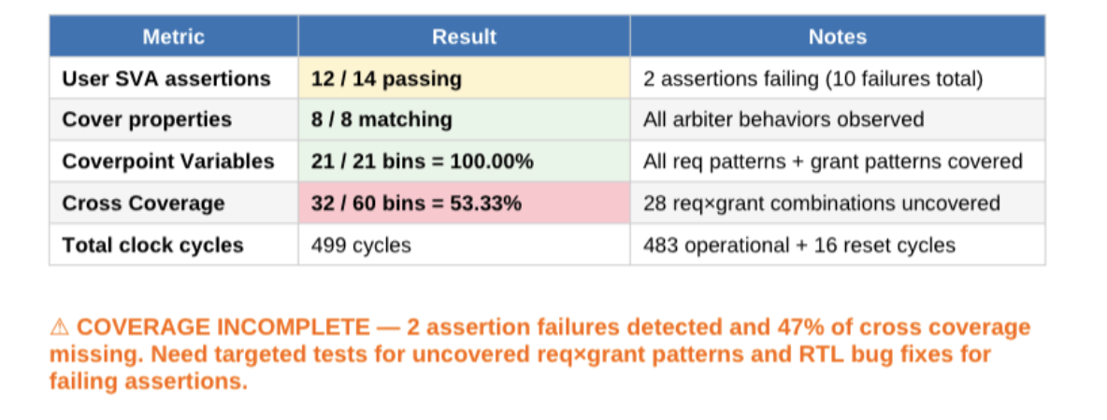
Using LLMs to Generate Directed Tests for Better Coverage
Round Robin Arbiter - (Original Results)

Slide 19
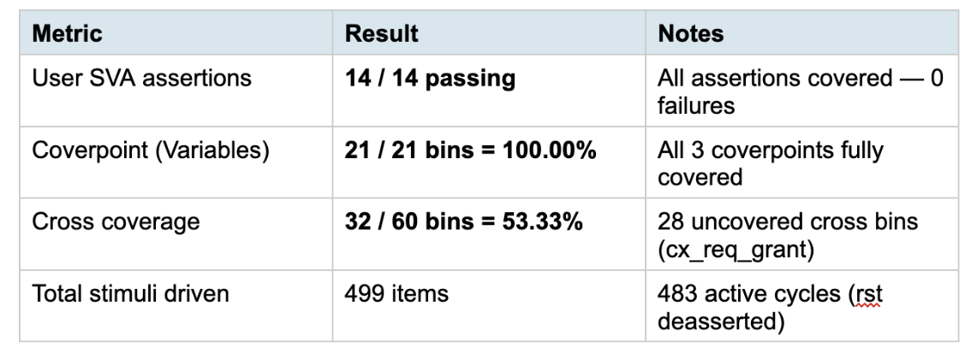
Using LLMs to Generate Directed Tests for Better Coverage
Round Robin Arbiter - (Addition of LLM Generated Tests)

Slide 20
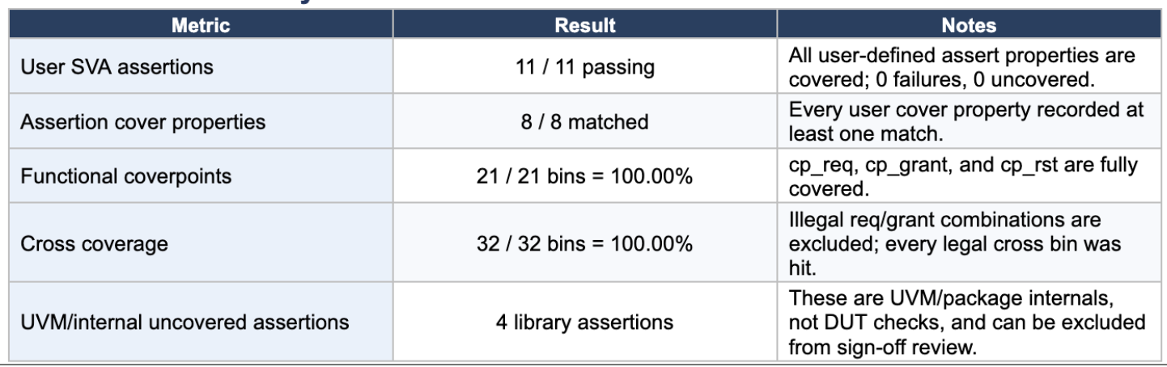
Using LLMs to Generate Directed Tests for Better Coverage
Round Robin Arbiter - (Addition of LLM Generated Tests)

Slide 21
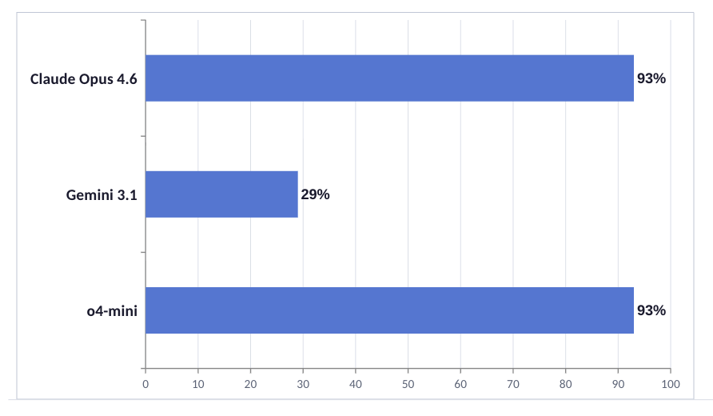
LLM Evaluation — Structural Conformance
Key Takeaways
Claude & o4-mini tied at 93%
on first attempt — 13 of 14 designs each.
Gemini 3.1 Preview truncated outputs heavily, leaving entire sections empty (29% pass).
Model size is not a reliable predictor of structural quality.

Slide 22
LLM Success — Per-Design Pass/Fail
 | adder | ahb | alu | apb | arbiter | axi | barrel | comp | counter | decoder | fifo | fsm | mux | syncfifo
o4-mini | ✓ | ✗ | ✓ | ✓ | ✓ | ✓ | ✓ | ✓ | ✓ | ✓ | ✓ | ✓ | ✓ | ✓
Gemini 3.1 | ✓ | ✗ | ✗ | ✗ | ✓ | ✗ | ✓ | ✗ | ✗ | ✗ | ✓ | ✗ | ✗ | ✗
Claude Opus 4.6 | ✓ | ✓ | ✓ | ✓ | ✓ | ✗ | ✓ | ✓ | ✓ | ✓ | ✓ | ✓ | ✓ | ✓
Hardest design
Failure-mode signatures
AXI and decoder fail across 2 of 3 models. AXI's complexity overwhelms output budgets;
Gemini 3.1 fails by truncation (output cap < 16 KB tokens). Claude only fails AXI.

Slide 23
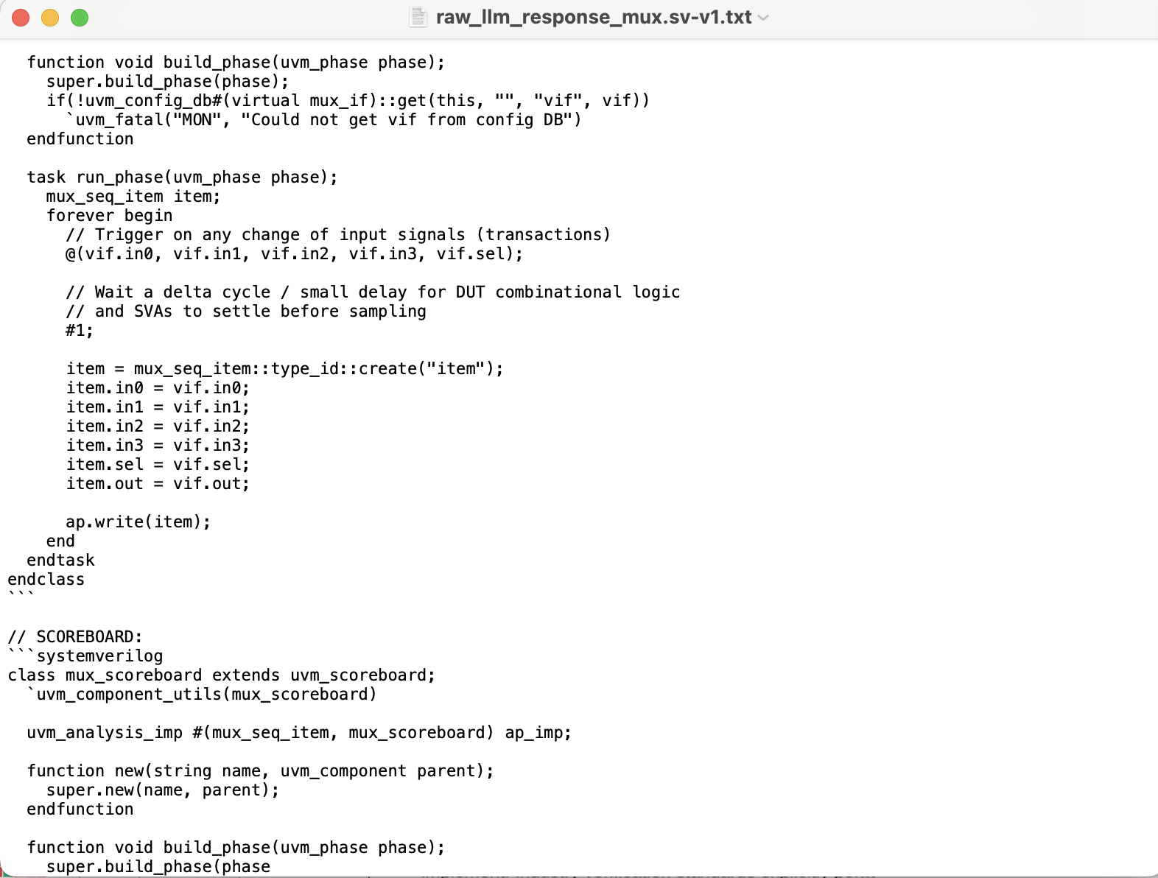
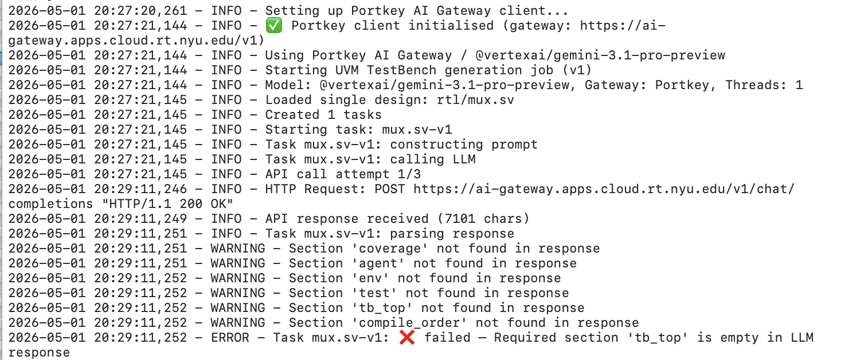
LLM Failure — Gemini 3.1 Deepdive
LLM response truncated at the scoreboard class
Script logs show that the subsequent classes were not present during the parsing
-------------------------------------------------------------------
This was mitigated by increasing number of tokens per API Call

Slide 24
LLM Evaluation — Compile & Runtime
0 / 3
The structural–functional gap
Producing 11 files in the right format ≠ a working VCS-elaborable testbench.
Even the LLMs that score 93 % on structural conformance produce code that fails to elaborate, simulates with null-pointer dereferences, or hangs because objections are never dropped.
Every model's output required manual debug to reach a runnable simulation.
models produced testbenches that compiled and ran cleanly without manual fixes.
Universal errors
Model-specific
Design-specific
Missing uvm_macros.svh, no virtual interface, wrong UVM phases — present in every model on at least one design.
Claude: leftover prose · Gemini 3.1: truncation · o4-mini: bad clocking-block writes and incomplete sections
AXI overwhelms every model. Decoder coverage cross is mis-modelled across all four LLMs.

Slide 25
Compile & Runtime — Categories of Errors
Category | Count | Primary cause | Recommended action
A - Prompt-Fixable | 15 issue classes (100s of instances) | Boilerplate forgetfulness — recurring scaffolding mistakes | Tighten the prompt with templates, checklists, and a do/don't reference card
B - Architectural (Partial) | 6 issue classes | UVM phase / connection model not fully internalised | Provide a worked-out skeleton testbench in the prompt
C - Model-Inherent | 9 issue classes | Reasoning, hallucination, design-comprehension limits | Needs better models or manual correction

Slide 26
Compile & Runtime — A Bucket Errors
ID | Error / Issue | Description | Models affected
A1 | Missing UVM imports / macros / `timescale | Output omits required header lines, causing 'uvm_sequence_item should be a valid type' on every design. | o4-mini, Gemini 3.1, Claude (every design)
A2 | Missing UVM factory registration macros | Classes not registered with `uvm_object_utils` / `uvm_component_utils`, breaking type_id::create(). | o4-mini (most), Claude
A3 | Concrete (non-virtual) interface inside class | Driver/monitor declares `apb_if vif;` instead of `virtual apb_if vif;` — fails to compile. | o4-mini
A4 | run_phase declared as function (not task) | Sequence start cannot block; or task body declared as function — illegal class assignment. | o4-mini, Claude
A5 | Coverpoints reference vif / external signals | Covergroup samples vif.cb.* instead of class transaction fields → compile error. | o4-mini, Claude

Slide 27
Compile & Runtime — B & C Bucket Errors
Category B — Architectural (Partial)
Category C — Model-Inherent
B1 UVM phase usage errors — env created in build_phase but child components in connect_phase; run_test() called after a #20 delay.
B2 Missing connect_phase wiring — driver→sequencer or monitor→scoreboard never connected; null-object accesses at runtime.
B4 Missing/incorrect component constructors — classes lack the canonical new(string name, uvm_component parent) or fail to call super.new().
B5 Forgotten / never-dropped objections — either omitted (causing PH_TIMEOUT) or raised in the driver and never dropped (sim hangs).
C2 Missing transaction output fields — sequence item omits the DUT's output signals; monitor and scoreboard then reference fields that don't exist.
C3 Hallucinated UVM APIs — sequencer.start(), driver.start(), monitor.start() — fabricated component methods that don't exist in UVM.
C4 Wrong scoreboard reference model — compiles cleanly, simulates, but [SCB_FAIL] mismatches because the predicted output is wrong.
Especially Gemini 3.1 (FSM, sync FIFO, arbiter, AHB, APB) — the hardest class of bug to catch: the TB looks right, runs cleanly, but checks the wrong thing.

Slide 28
Compile & Runtime — Counter Deepdive
Issue | Error Category | Fix
missing `uvm_object_utils(counter_seq_item) and logic [3:0] dout; | A | Add factory macro + output field
body declared as function | A | Change to virtual task body()
start(item) used incorrectly | C | Replace with start_item(item) / finish_item(item)
invalid uvm_test_top.clock cross-module reference | A | Removed
coverage class samples vif.cb_mon.* (compile fail) | A | Replace with transaction-based coverage
argument name mismatch in coverage write() | C | Rename item to t
sequence declaration / assignment combined → syntax error | C | Split into two statements
run declared as function | A | Change to virtual task run_phase(uvm_phase phase)
starting sequence inside function | B | Move into run_phase task
driver's seq_item_port not connected to sequencer | B | Add driver.seq_item_port.connect(sequencer.seq_item_export)

Slide 29
Part III
Original vs LLM
Functional & Assertion Coverage
All 14 designs · 4 testbenches per design (Original / o4-mini / Gemini 3.1 Pro / Claude Opus 4.6)
Compared on score, bins covered, stimulus density, and modelling discipline.

Slide 30
Coverage Comparison — Methodology
Six metrics, every design
Cell-shading legend
Overall coverage score
Composite of variable-bin closure × cross-bin closure across all covergroups.
User SVA assertions
Pass / total of bound design-level assertions.
Cover properties hit
Did each cover property fire at least once?
Coverpoint variable closure
Variable bins covered / total declared.
Cross coverage closure
Cross-product bins covered / total declared.
Total clock cycles per assertion
A proxy for stimulus density.
Good
Strong coverage / high stimulus / proper modelling discipline
OK
Acceptable / baseline (e.g. standard UVM register-map asserts uncovered)
Warning
Notable gap, modelling oversight, hollow score, or reachability problem
Bad
Severe defect, catastrophic stimulus weakness, or broken coverage wiring

Slide 31
Design 1 — Mux (4:1 Multiplexer)
Metric | Original | o4-mini | Gemini 3.1 Pro | Claude Opus 4.6
Overall coverage score | 100.00 % | 100.00 % | 65.28 % | 100.00 %
User SVA assertions | 9 / 11 passing | 8 / 10 passing | 8 / 11 passing | 16 / 18 passing
Cover properties | 7 SVA props ✓ | 7 SVA props ✓ | 7 SVA props ✓ | 7 SVA props ✓
Coverpoint variables | 68 / 68 = 100 % | 6 / 6 = 100 % | 12 / 12 = 100 % | 34 / 34 = 100 %
Cross coverage | 196 / 196 = 100 % | 8 / 8 = 100 % | 7 / 32 = 21.88 % | 80 / 80 = 100 %
Total clock cycles / assert | 2,116 | 88 | 414 | 877
Notes
Original: brute-force enumeration of all 4-bit inputs; massive stimulus density but no output coverage.
o4-mini: only in0 covered (in1 / in2 / in3 ignored); coverage model is hollow despite 100 % score.
Gemini 3.1: iff-guarded crosses make 24 of 32 cross-bins unreachable by construction; one declared sequence never executed.
Claude: only TB to cover the output, transitions, and data patterns; 7 sequence-body asserts all succeed.

Slide 32
Design 2 — Decoder (3-to-8 One-Hot)
Metric | Original | o4-mini | Gemini 3.1 Pro | Claude Opus 4.6
Overall coverage score | 100.00 % | 7.03 % | 70.83 % | 78.41 %
User SVA assertions | 16 / 18 passing | 8 / 17 passing | 15 / 17 passing | 15 / 17 passing
Cover properties | all 14 SVA props attempted | 7 / 14 unfired | all attempted | all attempted
Coverpoint variables | 8 / 8 = 100 % | 2 / 72 = 2.78 % | 16 / 16 = 100 % | 35 / 35 = 100 %
Cross coverage | — (no cross) | — (no cross) | 8 / 64 = 12.50 % | 12 / 88 = 13.64 %
Total clock cycles / assert | 1,292 | 34 | 918 | 3,638
Notes
Original: 1 cp on cp_a — closes 100 % trivially; no output coverage at all.
o4-mini: 64 auto-bins on 8-bit output, of which only 8 are legal — 7 of 8 case assertions never attempted.
Gemini 3.1: cross score depressed by auto-generated input-output combinations that are unreachable by design (should have used illegal_bins).
Claude: largest meaningful bin space; only TB with transition coverage on cp_a and illegal_bins on cp_d to flag non-one-hot outputs.

Slide 33
Design 3 — Adder (4-bit Ripple-Carry)
Metric | Original | o4-mini | Gemini 3.1 Pro | Claude Opus 4.6
Overall coverage score | 100 % (random-only: 80.08) | ~70.83 % | 95.24 % | 100.00 %
User SVA assertions | 34 / 36 passing | 34 / 36 passing | 34 / 36 passing | 34 / 36 passing
Cover properties | all attempted | all attempted | all attempted | all attempted
Coverpoint variables | 34 / 34 = 100 % | 10 / 38 (split CGs) | 13 / 13 = 100 % | 18 / 18 = 100 %
Cross coverage | 512/ 512 = 80.08 % | 0 / 0 (no cross) | 10 / 13 = 76.92 % | 107 / 107 = 100 %
Total clock cycles / assert | 7,439 | 89 | 933 | 9,092
Notes
Original: 102-line hard-coded directed-closure sequence inflates score; per-FA stimulus is uniform (~720 attempts each).
o4-mini: 10 transactions hit the top adder; upper full-adders fire only 9 times; no cross coverage.
Gemini 3.1: clean 3-bin operand model but cross only covers (a × b) and (cin × cout) — no input-output cross.
Claude: only TB to close all 125 bins organically (no directed hacks); 6 cross-coverpoints incl. output-side crosses.

Slide 34
Design 4 — Comparator (2-bit)
Metric | Original | o4-mini | Gemini 3.1 Pro | Claude Opus 4.6
Overall coverage score | 100.00 % | 68.75 % | 97.92 % | 90.91 %
User SVA assertions | 19 / 21 passing | 17 / 22 passing | 18 / 20 passing | 18 / 20 passing
Cover properties | all 17 attempted | GT_* never attempted | all attempted | all attempted
Coverpoint variables | 8 / 8 = 100 % | 5 / 6 = 83.33 % | 14 / 14 = 100 % | 23 / 23 = 100 %
Cross coverage | 16 / 16 = 100 % | 2 / 8 = 25 % | 14 / 16 = 87.50 % | 52 / 88 = 75.00 %
Total clock cycles / assert | 24,412 | 30 | 332 | 1,125
Notes
Original: dominant stimulus density (24K attempts); cp_a × cp_b cross saturates with random.
o4-mini: never produced a > b case — 3 case asserts (GT_HIGH, GT_EQ, GT_LT) never attempted; agreaterb output bin uncovered.
Gemini 3.1: 2 missing cross bins are random-stimulus gaps; clean overall.
Claude: composite cp_result with illegal_bins for non-one-hot outputs; 3-way cx_full cross has unreachable bins (should have been illegal_bins).

Slide 35
Design 5 — ALU (8-bit, 8 opcodes)
Metric | Original | o4-mini | Gemini 3.1 Pro | Claude Opus 4.6
Overall coverage score | 100.00 % | 77.78 % | 91.38 % | 92.75 %
User SVA assertions | 22 / 24 passing | 22 / 24 passing | 22 / 24 passing | 22 / 24 passing
Cover properties | all attempted | low SUB / SHR (1–2×) | all attempted | all attempted
Coverpoint variables | 8 / 8 = 100 % | 12 / 14 = 85.71 % | 26 / 26 = 100 % | 35 / 35 = 100 %
Cross coverage | — (no cross) | — (no cross) | 62 / 200 = 31.00 % | 160 / 192 = 83.07 %
Total clock cycles / assert | ~480 | ~210 | ~2,700 | ~5,640
Notes
Original: 1 cp on cp_opcode only — score is hollow; no operand or flag coverage; SUB / SHR fired only 2–3×.
o4-mini: cp_a / cp_b high bin (255) never hit; SUB_RESULT fired only 2× — 1-bit-flip bug could go undetected.
Gemini 3.1: signed-arithmetic-aware operand bins (zeros / ones / pos_max=0x7F / neg_min=0x80); 1 cross drops to 31 % from over-expansion.
Claude: only TB with output coverage and 4 flag×opcode crosses; finer 8-bin operand model targets every signed corner.

Slide 36
Design 6 — Barrel Shifter (8-bit Right)
Metric | Original | o4-mini | Gemini 3.1 Pro | Claude Opus 4.6
Overall coverage score | 100.00 % | 66.67 % | 61.67 % | ~95.7 %
User SVA assertions | 7 / 9 passing | 7 / 9 passing | 7 / 9 passing | 7 / 9 passing
Cover properties | all attempted | ZERO / MAX fired 1× | ZERO / MAX 7× | ZERO / MAX 91–92×
Coverpoint variables | 8 / 8 = 100 % | 4 / 5 = 80 % | 11 / 13 = 84.6 % | 35 / 35 = 100 %
Cross coverage | — (no cross) | 2 / 6 = 33.3 % | 10 / 40 = 25 % | 136 / 152 = 89.5 %
Total clock cycles / assert | 198 | 50 | 260 | 2,523
Notes
Original: 1 cp on cp_s only — hollow 100 %; data input x and output y are never sampled.
o4-mini: only 2 of 8 shift values declared as bins; x=0x00 corner never hit; lowest stimulus.
Gemini 3.1: declared corner-pattern bins (0xA5, 0x5A) never organically hit by random; lowest score.
Claude: dedicated walking-1 covergroup crosses every single-bit input × every shift amount (64 bins, all closed) — gold-standard barrel-shifter test.

Slide 37
Design 7 — Counter (4-bit Up/Down)
Metric | Original | o4-mini | Gemini 3.1 Pro | Claude Opus 4.6
Overall coverage score | N/A (no covergroup) | 100.00 % | 99.31 % | 100.00 %
User SVA assertions | 8 / 12 passing | 7 / 9 passing | 7 / 9 passing | 7 / 9 passing
Cover properties | all 6 hit | all 6 hit (1-2× each) | all 6 hit | all 6 hit (high density)
Coverpoint variables | 0 (no covergroup) | 20 / 20 = 100 % | 22 / 22 = 100 % | 14 / 14 = 100 %
Cross coverage | — | — (no cross) | 35 / 36 = 97.22 % | 24 / 24 = 100 %
Total clock cycles / assert | 3,840 | 258 | 576 | 1,368
Notes
Original: functional coverage subscriber commented out; 2 declared sequence-body asserts never executed (drag success rate to 66.67 %).
o4-mini: brute-force enumeration of all 16 dout values — captures no verification intent; WRAP_UP / WRAP_DOWN fired only once each.
Gemini 3.1: only TB with transition bins (15→0 wrap up, 0→15 wrap down) — most temporally-aware coverage model on this design.
Claude: separate boundary coverpoint (val_0 / val_1 / val_14 / val_15) + 3 crosses; highest cover-property match density (35× SYNC_RESET).

Slide 38
Design 8 — Universal Shift Register (USR)
Metric | Original | o4-mini | Gemini 3.1 Pro | Claude Opus 4.6
Overall coverage score | 100.00 % | 78.91 % | 57.14 % | 100.00 %
User SVA assertions | 7 / 9 passing | 7 / 9 passing | 7 / 9 passing (1 incomplete) | 7 / 9 passing
Cover properties | all 6 hit | all 6 hit (low density) | all 6 hit | all 6 hit (5–80× more)
Coverpoint variables | 4 / 4 = 100 % | 18 / 72 = 25 % | 10 / 13 = 75 % | 37 / 37 = 100 %
Cross coverage | — (no cross) | — (no cross) | 1 / 28 = 3.57 % | 19 / 19 = 100 %
Total clock cycles / assert | 390 | 78 | 696 | 3,384
Notes
Original: 1 cp on cp_control — score is hollow; no clr / parallel_in / serial_in / output coverage.
o4-mini: 64 auto-bins on parallel_in only 16 % closed; LOAD_THEN_HOLD fired only once.
Gemini 3.1: corner-pattern parallel_in bins (0xAA, 0x55) declared but never hit organically; cross has element-holes for non-load × parallel_in (no ignore_bins).
Claude: only TB to use ignore_bins properly (excludes irrelevant control × serial_in pairings); dedicated 12-transition covergroup; output observability.

Slide 39
Design 9 — FSM (Traffic Light Controller)
Metric | Original | o4-mini | Gemini 3.1 Pro | Claude Opus 4.6
Overall coverage score | 100.00 % | 85.19 % | 0.00 % | 60.00 % main (100 % outputs)
User SVA assertions | 8 / 10 passing | 9 / 11 passing | 8 / 10 passing | 8 / 10 passing
Cover properties | all 6 hit | all 6 hit | all 6 hit | all 6 hit (highest density)
Coverpoint variables | 8 / 8 = 100 % | 6 / 6 = 100 % | 0 / 10 = 0 % | 14 / 16 (multi-CG)
Cross coverage | — (no cross) | 5 / 9 = 55.56 % | 0 / 7 = 0 % | 11 / 48 = 22.92 %
Total clock cycles / assert | 315 | 154 | 539 | 707
Notes
Original: 100 % on a 3-cp model with no cross — reset exercised only 2× (vs claude's 24×).
o4-mini: cross has 4 unreachable green/yellow × green/yellow combinations — no ignore_bins → score drops to 55.56 %.
Gemini 3.1: total coverage failure due to TB wiring defect (analysis_port + clone() not delivering valid samples) — but assertions fire correctly.
Claude: only TB to verify entire FSM cycle as a single sequence (cp_full_cycle: s0 → s1 → s2 → s3 → s0); illegal=2'b11 bin to detect bad encodings.

Slide 40
Design 10 — Sync FIFO
Metric | Original | o4-mini | Gemini 3.1 Pro | Claude Opus 4.6
Overall coverage score | 100.00 % | 72.40 % | 100.00 % | 97.50 %
User SVA assertions | 11 / 13 passing | 10 / 13 passing | 11 / 13 passing | 11 / 13 passing
Cover properties | 6 / 6 hit | 5 / 6 hit (NO_WRITE_WHEN_FULL=0) | 6 / 6 hit | 6 / 6 hit
Coverpoint variables | 10 / 10 = 100 % | 15 / 68 = 22 % | 8 / 8 = 100 % | 23 / 23 = 100 %
Cross coverage | — (no cross) | — (no cross) | 18 / 18 = 100 % | 27 / 33 = 81.82 %
Total clock cycles / assert | 1,350 | 200 | 1,760 | 3,060
Notes
Original: best stimulus on safety-critical guard-band corners — NO_WRITE_WHEN_FULL fired 33× (vs claude's 5×).
o4-mini: never drove FIFO into the write-when-full corner — that cover property has 0 matches.
Gemini 3.1: declared ignore_bins on the very corner that should be covered (cross_rw_full / write_at_full) — coverage-model misjudgment.
Claude: only TB to cover internal count + both wr_data and rd_data; user-defined cross-bins (write_at_full / read_at_empty) explicitly target what gem31 ignored; illegal_bins on full+empty mutex.

Slide 41
Design 11 — APB (APB3 Memory Slave)
Metric | Original | o4-mini | Gemini 3.1 Pro | Claude Opus 4.6
Overall coverage score | 100.00 % | 40.62 % | 100.00 % | 97.78 %
User SVA assertions | 11 / 14 passing | 9 / 14 passing | 10 / 14 passing | 26 / 29 passing
Cover properties | 7 / 7 hit | 5 / 7 hit | 6 / 7 hit | 7 / 7 hit
Coverpoint variables | 19 / 19 = 100 % | 7 / 68 = 10.29 % | 9 / 9 = 100 % | 15 / 16 = 96 %
Cross coverage | 4 / 4 = 100 % | 8 / 128 = 6.25 % | 10 / 10 = 100 % | 20 / 20 = 100 %
Total clock cycles / assert | 1,110 | 20 | 126 | 1,162
Notes
Original: only TB w/ back-to-back R/W transition cross (cx_b2b); strongest FSM-traversal stimulus (IDLE→SETUP 220×, ACCESS→IDLE 215×).
o4-mini: 32-bit auto-bins on cp_addr (4/64 hit); 2 cover properties + 2 asserts entirely unexercised; only 20 attempts total.
Gemini 3.1: clean paddr[5] validity model but FSM never exited ACCESS → IDLE (1 cover property + 1 assert unfired).
Claude: 5 coverpoints incl. cp_wdata; 4 crosses with user-defined named bins AND illegal_bins for protocol invariants.

Slide 42
Design 12 — Round-Robin Arbiter
Metric | Original (3 runs) | o4-mini | Gemini 3.1 Pro | Claude Opus 4.6
Overall coverage score | 100.00 % (run-3) | 21.74 % | 88.39 % | 92.45 %
User SVA assertions | passing (caught real fails) | low pass rate | passing | 85.71 % (best LLM)
Cover properties | all hit (1428×) | 4 cover-props unfired | all hit | all hit (281×)
Coverpoint variables | 21 vars + 32 crosses | low closure | good w/ illegal_bins | 13 cps incl. per-bit + cg_sva
Cross coverage | 32 / 32 = 100 % w/ ignore_bins | very low | no ignore_bins on impossible pairs | no ignore_bins on impossible pairs
Total clock cycles / assert | 1,497 | 9 | 107 | 290
Notes
Original: only TB with protocol-correct ignore_bins for all 14 physically impossible req-grant combinations; 3× the stimulus volume of any LLM TB.
o4-mini: catastrophic — 21.74 % coverage, only 9 stimulus attempts per assertion, 4 cover-props + 4 asserts completely unexercised.
Gemini 3.1: shows protocol awareness (illegal_bins on cp_grant, 7-bin transition coverage) but cross-model gap drops to 88.39 %.
Claude: structurally richest model (per-bit coverage, auxiliary cg_sva_scenarios CG); first design where original sweeps all categories.

Slide 43
Design 13 — AHB (AHB-Lite Memory Slave)
Metric | Original | o4-mini | Gemini 3.1 Pro | Claude Opus 4.6
Overall coverage score | ~87 % | 80.00 % | 91.67 % | 78.72 %
User SVA assertions | 11 / 14 passing | 15 / 19 passing | 11 / 14 passing | 33 / 36 passing (best %)
Cover properties | 9 / 9 hit | 8 / 9 hit | 9 / 9 hit | 9 / 9 hit (16× err-paths)
Coverpoint variables | ~38 bins (3 CGs) | 8 / 10 = 80 % | 10 / 10 ≈ 100 % | 61 bins (word_idx, alignment)
Cross coverage | ~33 cross bins | 6 cross bins | 12 cross bins | 30 cross bins
Total clock cycles / assert | 240 max / 720 sum (3 runs) | 57 | 64 | 231
Notes
Original: only TB to cover HBURST (6 burst types) + HTRANS state-transition cross; extensive ignore_bins discipline.
o4-mini: never exercised IDLE/BUSY HTRANS or deselected slave; lowest stimulus.
Gemini 3.1: compact size/write/trans/resp model; missing illegal_bins for err_sz × okay (impossible).
Claude: 21 sequence-body asserts (highest success rate); 32-bin word_idx + 12-bin alignment (richest model).

Slide 44
Design 14 — AXI (AXI4 Memory Slave)
Metric | Original | o4-mini | Gemini 3.1 Pro | Claude Opus 4.6
Overall coverage score | ~97.78 % | 88.54 % | 95.24 % | ~86.16 %
User SVA assertions | 19 / 29 passing | 27 / 37 passing | 23 / 33 passing | 22 / 30 passing
Cover properties | 9 / 9 hit | 9 / 9 hit | 9 / 9 hit (BVALID 6476×) | 9 / 9 hit
Coverpoint variables | 39 bins (5 CGs) | 12 bins ≈ 88.54 % | 13 bins ≈ 95.24 % | 64 bins ≈ 88 %
Cross coverage | ~25 cross bins | 14 cross bins | 12 cross bins | 36 cross bins
Total clock cycles / assert | 1,023 | 267 | 6,509 | 1,036
Notes
Original: only TB w/ per-channel coverage + dedicated cg_protocol_errors covergroup; ignore_bins for byte-error impossibilities.
o4-mini: has ignore_bins discipline (fixed_unused, ig_rsvd_size); size_2B never driven.
Gemini 3.1: highest stimulus volume by far (BVALID_ONLY_RESP fired 6,476×).
Claude: 13 coverpoints across 3 CGs; 20 missed cross-bins are reserved-burst impossibilities (needed illegal_bins).

Slide 45
Coverage — Summary
Design | Best by score | Best from a testing point of view | Best assertion coverage
Mux | tied: orig / mini / claude | Claude | Claude
Decoder | Original | Claude | Claude (close to Original)
Adder | Claude (organic) | Claude | Claude
Comparator | Original | Claude | Original (24K attempts)
ALU | Original (hollow) | Claude | Claude
Barrel shifter | Original (hollow) | Claude | Claude
Counter | tied: mini / claude | Gemini 3.1 (transition bins) | Claude
USR | tied: orig / claude | Claude | Claude
FSM | Original | Claude (full-cycle seq.) | Claude
Sync FIFO | tied: orig / gem31 | Claude | Original (corner stimulus)
APB | tied: orig / gem31 | Claude | Original (FSM transitions)
Arbiter | Original (3 runs) | Original | Original
AHB | Gemini 3.1 | Original | Claude
AXI | Original | Original | Original

Slide 46
Future Work
01
Skeleton-based prompt engineering
Provide a worked-out UVM testbench skeleton in the prompt (with all 11 sections stubbed and TLM hookups pre-wired). Expected to close most of the Category-A bucket — measurable on the same benchmark.
02
Coverage-driven feedback loops
Pass functional and assertion coverage reports back into the LLM and ask for new sequences to close uncovered bins. Already prototyped on AHB and Arbiter (Pass 2 and 3 in the weekly updates).
03
Integration with LLM4Assertions
Combine TB generation with LLM-generated bound SVAs. The current evaluation uses a fixed assertion set per DUT — letting the LLM propose the assertions opens a new, higher-stakes question.
04
Localized Training of LLMs
Provide industry-level UVM Testbenches to locally train the LLM conversation before prompting the spec-based UVM testbench generation. Example: Opentitan Testbench Repository

Slide 47
Conclusion
LLMs are good first drafts but none compile cleanly - improving the prompt and localizing training would provide a much more dependable starting point
Coverage models are surprisingly thoughtful - LLMs can analyze testbenches and specification to suggest more comprehensive crosses and assertions. Valuable for a novice verification engineer in terms of learning curves
1st
+ Richest covergroups (output observability, transitions, illegal_bins) · highest stimulus density on most designs
Claude Opus 4.6
2rd
+ Good when it works (compact, occasionally protocol-aware coverage models).
− 29 % structural pass
− Scoreboard model defects
Gemini Pro 3.1
3nd
+ Much faster + cheaper
+ Acceptable coverage on simple designs.
− Stimulus density 10–100× below Claude ·
− Missing critical corner stimulus.
o4-mini

Slide 48
Thank you
Questions?

