Slide 1
Sources & Datasets
Energy Information Administration (EIA)
Bureau of Economic Analysis (BEA)
One-time data import
One-time data import
Emissions (metric tons) row = 1378, col = 3
Real gdp (million dollars) row = 851, col = 5
id | state | year | emissions
id | state | year | real_gdp
Emissions by sector (metric tons) row = 1888, col = 7
Income (million dollars) & population (persons)
id | state | year | Emis_transportation | Emis_industrial | Emis_residential
id | state | year | income | population
row = 851,
col = 5
Energy production (bn btu) row = 2959, col = 26
id | state | year | Prod_total | Prod_fossil | Prod_nuclear | Prod_renew
Energy consumption (bn btu) row = 2959, col = 14
id | state | year | Cons_total | Cons_fossil | Cons_nuclear | Cons_renew

Slide 2
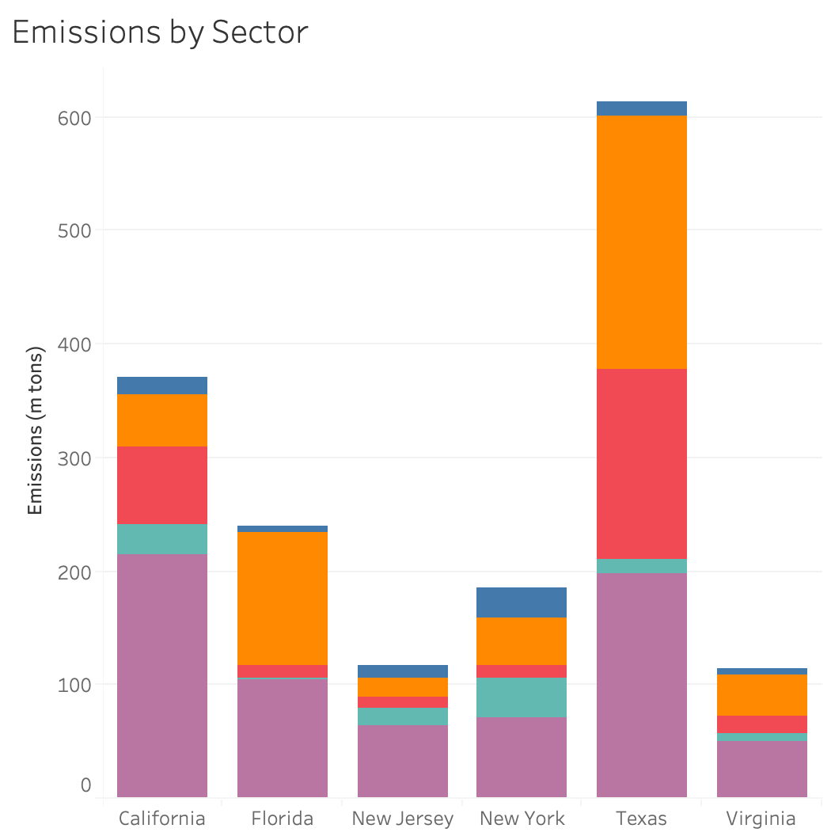
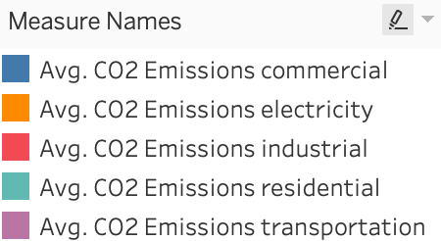

Slide 3
Energy Consumption
consumption
fossil
petroleum
natural gas
renewable
nuclear
coal

Slide 4
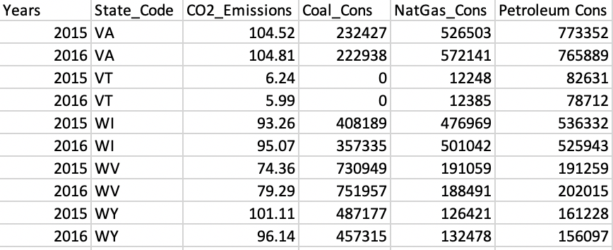
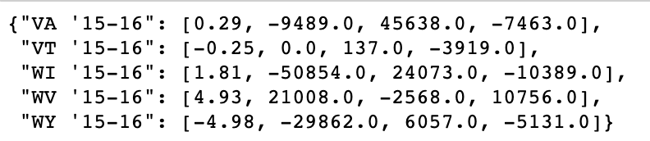
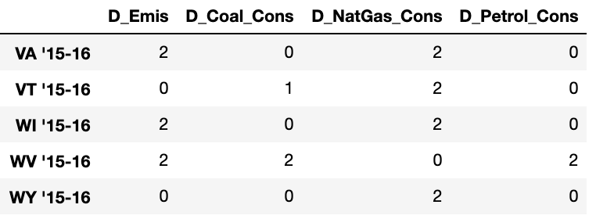
Decision Tree Data Transformation
DECISION TREE GOAL: Understand the likelihood that
emissions will increase, given fuel type
consumption increases or decreases.
STEP 1: Convert per-year to yearly change amount
STEP 2: Categorically encode the changes
0 = Decrease
1 = No Change
2 = Increase
STEP 3: Generate a decision tree

Slide 5
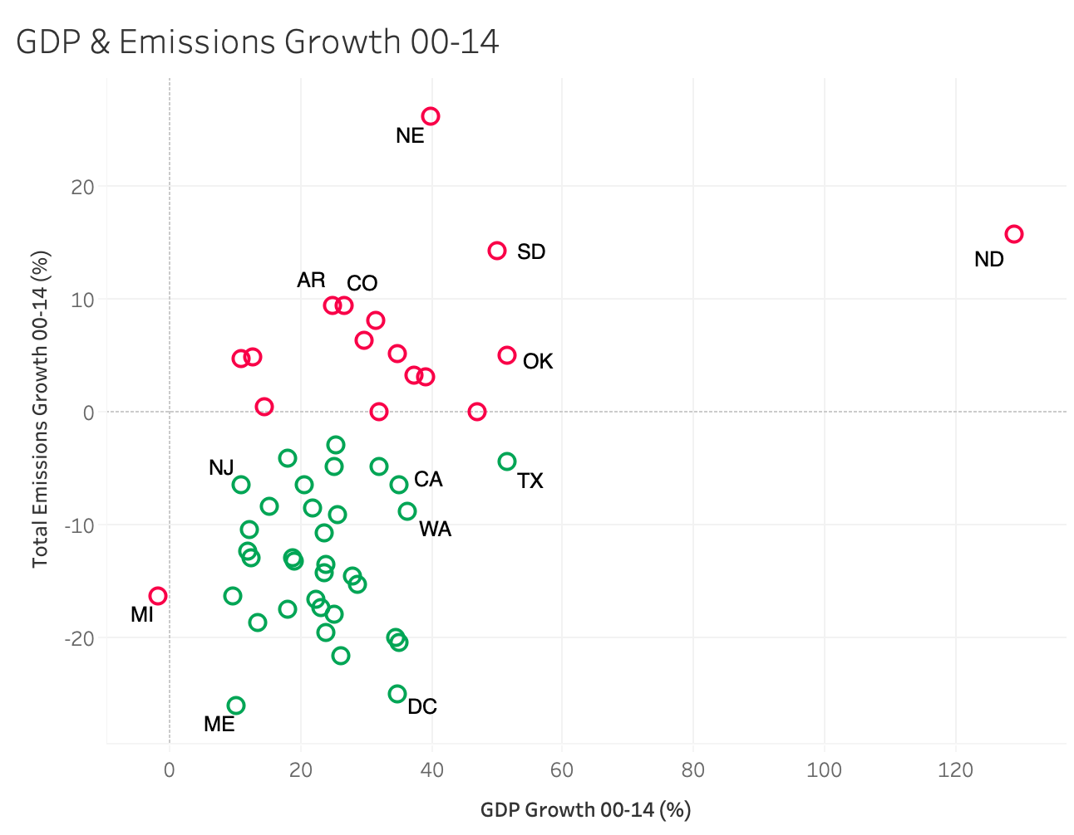
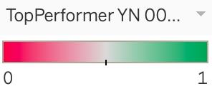

Slide 6
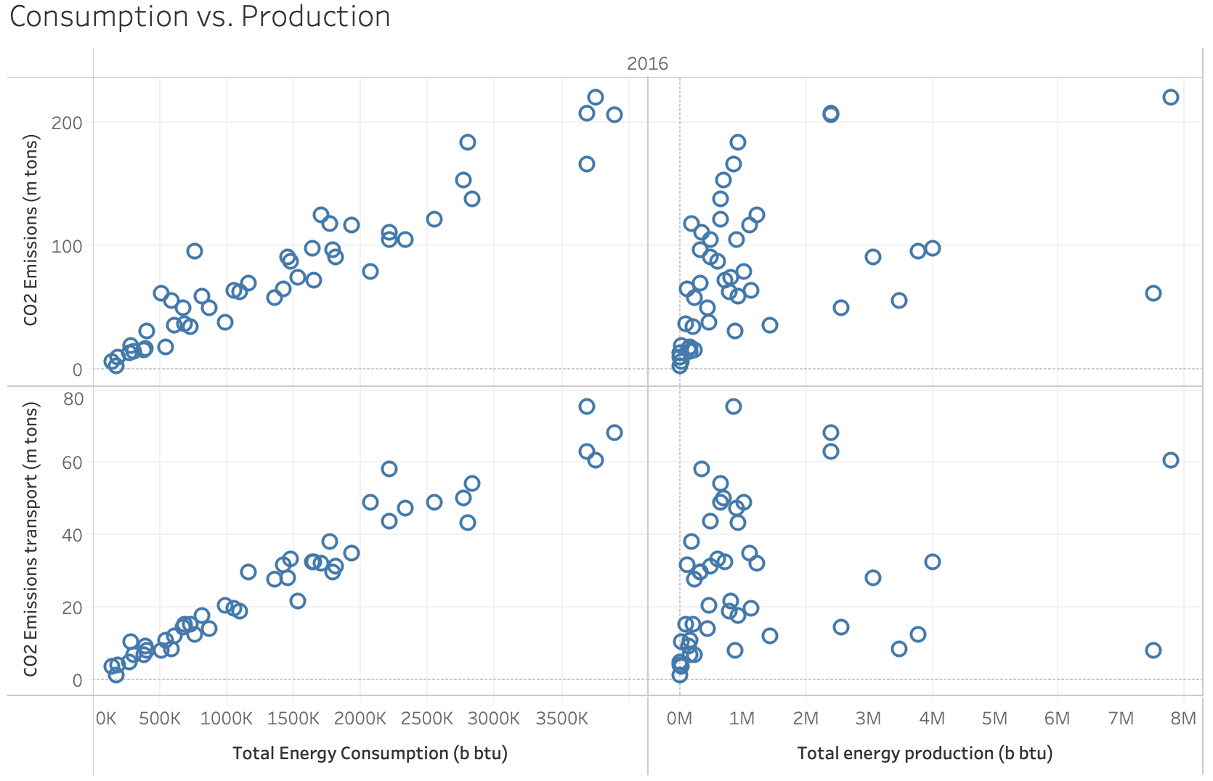

Slide 7
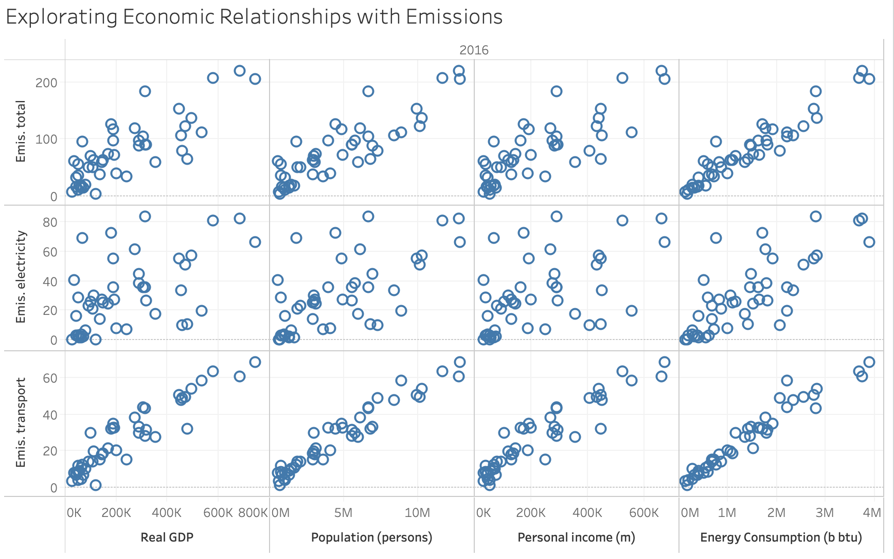

Slide 8
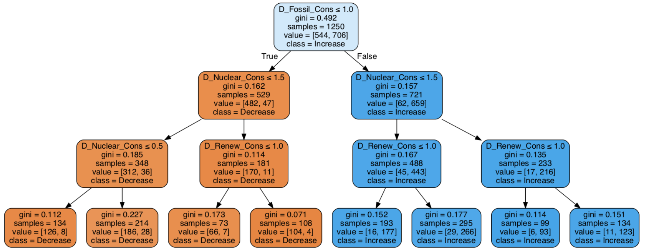


Question: From 1990-2015, what types of year-over-year Fuel Consumption Increases are most associated with Emissions increases?
Of the 721 times that fossil fuel consumption increased within one state (D_Fossil_Cons > 1), total emissions increased 91% of the time (659).
Class: △ emissions
Feature 1: △ fossil fuel consumption
Feature 2: △ nuclear consumption
Feature 3: △ renewable consumption
Feature Values
0 – Decrease
1 – No change
2 - Increase

Slide 9
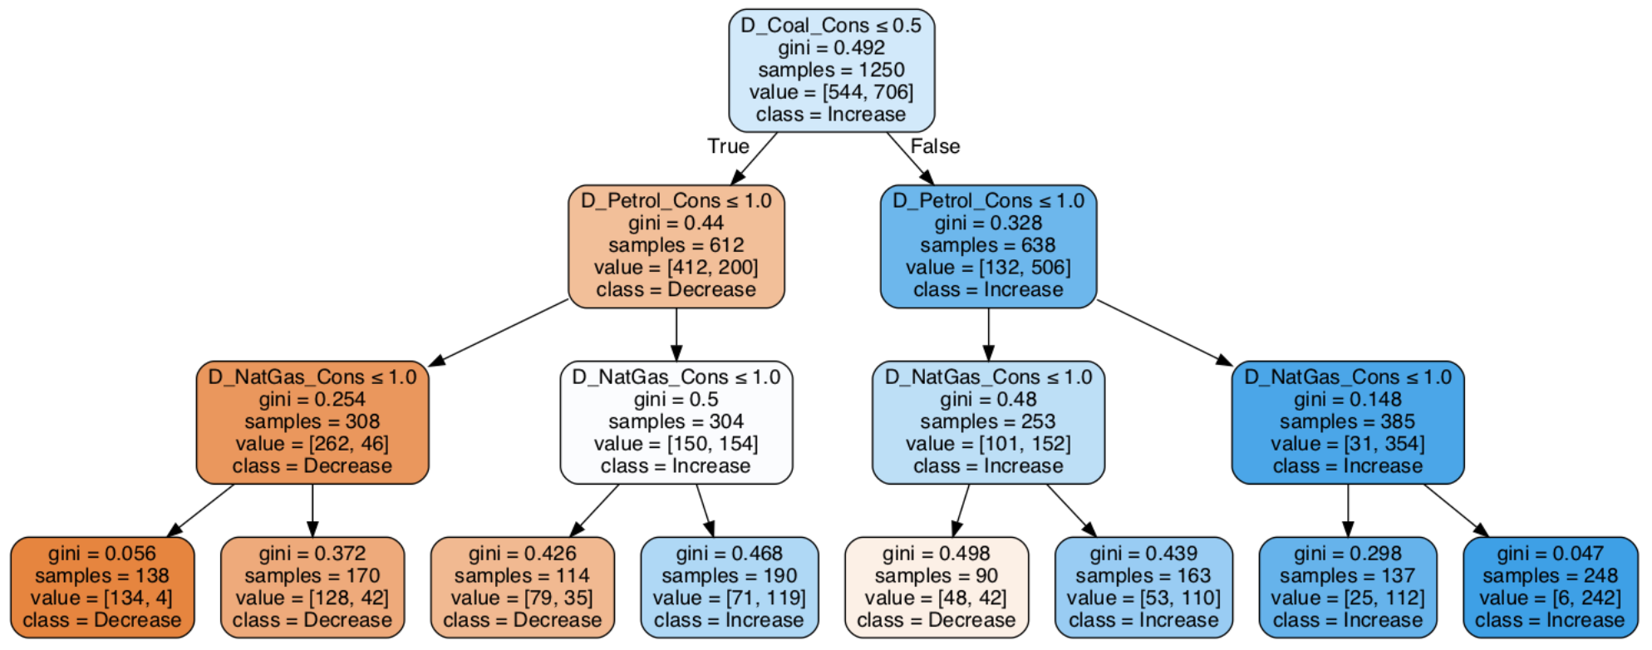
Question: From 1990-2015, what types of year-over-year Fossil Fuel Consumption Increases are most associated with Emissions increases?
Of the 638 times that coal consumption increased within one state (D_Coal_Cons > 0.5), total emissions increased 79% of the time (506).
Class: △ emissions
Feature 1: △ coal consumption
Feature 2: △ natural gas consumption
Feature 3: △ petroleum consumption
Feature Values
0 – Decrease
1 – No change
2 - Increase

