Slide 1
Churn prediction model in telecom industry
Team 9:
Akhilesh Yadav,
Jinesha Jain

Slide 2

Objective
Improve customer loyalty and reduce churn:
The business goal of this project is to develop a churn prediction model in the Telecom Industry by identifying the major factors leading to it.

Slide 3
importance
The subject of customer retention, loyalty and churn is receiving attention in many industries especially, the telecom providers.
The unceasing competition in the market has caused telecom operators to divert their focus more towards customer retention rather than customer acquisition.
Research has repeatedly shown that existing customers spend more, purchase higher margin products and services, and are more likely to refer additional customers.
So, how do you avoid the high price of constantly replacing existing customers with new ones? Thus, it becomes extremely essential to identify the factors causing a customer to switch and take proactive actions in order to retain them.

Slide 4
challenges
Identify the righteous data set
Many highly correlated variables
Missing values
Identifying the significant variables for building model

Slide 5
Methodology
Identifying the upright data set
Replacing the missing values and checking the variance of the data
Creating dummy variables
Finding the correlation between the variables and eliminating highly correlated variables
Feature selection using Recursive Feature Elimination (RFE)
Splitting the data set into training: testing – 70:30
Applying logistic regression and decision tree on features selected
Analysis, results and recommendations

Slide 6
Data description
The data is a real world set collected from Kaggle, consisting of 7034 observations and 21 variables.
The data set has 4 numerical variables and 16 categorical variables.
The last column is churn - representing the customers who left in the last month, yes (27%) and those who did not leave, no (73%) is the output variable (y).
There are 11 missing values, all of them for the TotalCharges column. Moreover, these are exclusive for the customers whose tenure = 0. So, we can conclude and replace this missing values with 0

Slide 7
Feature selection
The 16 categorical variables were converted into numerical variables(binary) by creating dummy variables which gives a total of 31 variables.
1
The correlation map presented that many variables were highly correlated, thus, they were eliminated for model building.
2
RFE was performed on the remaining variables and depending upon their rank, the best features were selected.
3

Slide 8
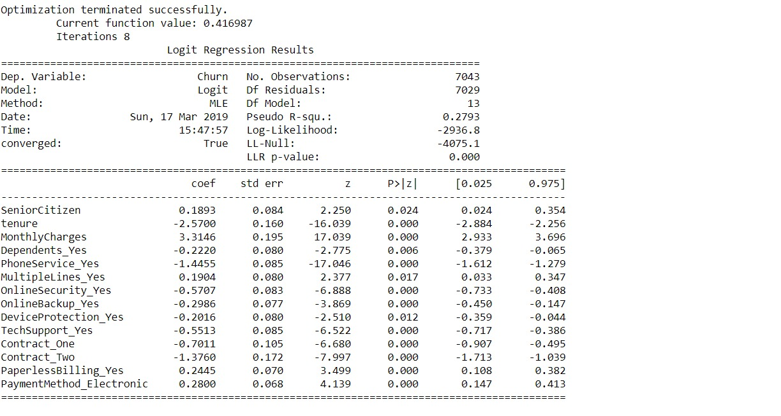
Logistic regression model
After selecting the features and splitting the data set to 70:30, logistic regression was performed using Sklearn package.
Interestingly all the variables proved to be significant as p-value for all of them was less than 0.05.
This suggests that the model is a good fit i.e. it shows good convergence.

Slide 9
Decision tree
Decision tree algorithm was applied on the data set using the same significant variables
The accuracy resulted was 73%
Decision Trees

Slide 10
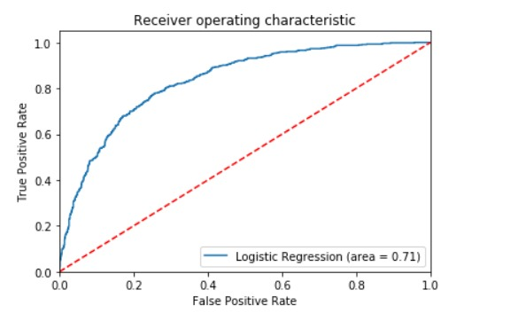
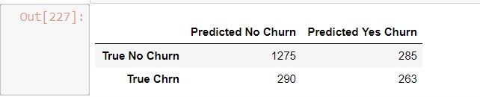
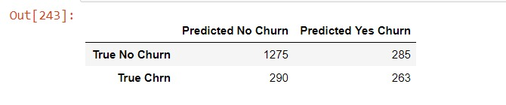
Analysis
As shown in the confusion matrix, the logistic regression model gives us an accuracy of 72.7% , an average precision rate of 79% and f1-score of 0.79
The ROC rate(area under the ROC curve ) is around 71% which proves that the model is a good fit.
The decision tree model also gave an accuracy of 73%, which is quite similar to that of the logistic model.
So, both of the models are a good fit for this data.
Decision Tree
Logistic regression

Slide 11
Results & recommendations
Out of the given 20 variables, we have screened these variables as the most significant:
SeniorCitizen
Tenure
MonthlyCharges
Dependents
PhoneService
MultipleLines
OnlineSecurity
OnlineBackup
DeviceProtection
TechSupport
Contract
PaperlessBilling
PaymentMethod

Slide 12
RESULTS
The variable tenure and contract have a very high negative coefficient in the regression model which suggests that our long term customers are more likely to be retained
On the other hand, monthly charges has a very positive coefficient which suggests that the customers having high monthly charges are on the verge of churning.
Other variables like online security, online backup, device protection, streaming tv,, tech support ,phone services have negative coefficients which suggests that people subscribed to these services are less likely to get churned

Slide 13
recommendations
The customers having high monthly charges should be offered some promotional coupons or vouchers in order to reduce their charges
As the variable contract has high significance, proper marketing campaigns should be performed to entice the customers to purchase contracts
Tech support also shows a huge impact in customer retention. So, online or telephonic customer service and other tech support services needed to be properly maintained
As the customers subscribed to other auxiliary services like device protection, online security are less likely to be churned, the telecom services companies should make sure that the customers are aware of all their services and attract them to subscribe to these services to increase the customer attrition

Slide 14
Thank you

