Slide 1



Chronic Kidney disease Screening Tool
Group 9-
Akhilesh Yadav
Jinesha Jain

Slide 2
Index
Introduction
Methodology
Analysis
Result

Slide 3

Introduction
Chronic Kidney Disease (CKD) is one of the most widespread illnesses in the United States. It is the gradual loss of kidney function over time. According to the National Kidney Foundation, there are twenty-six million adults in the United States who have CKD and million others are at increased risk.
It can be caused by several factors like
Ageing
Diabetes
High blood pressure
Presence of Heart diseases
Hereditary reasons

Slide 4

Objective
To develop a easy to use screening tool which can be used to identify patients who are at higher risk of developing CKD based on various factors which affect the presence of CKD.

Slide 5
Methodology
Understanding the case study data
Missing data treatment
Variable Selection
Model Construction

Slide 6
Understanding the Case Study data
The data was partitioned into training data and testing data.
It was split in such a way that the training data included 50% of CKD affected patients and the testing data set included the rest of the 50% of patients with CKD.
Variables:
33 input variables
2 Dummy variables
By observation, we see that there is some missing data.

Slide 7
Data Mining Framework
Raw Data
Data coding
Pre-processing
Missing Data >15%
Yes
Remove variable
No
Fixed (mean)
Predictive Analytics
Data Partitioning
Feature Selection
Logistic Regression
Model Evaluation
Model Testing
Results and Analysis

Slide 8
Missing data treatment
The raw data is first analyzed and then preprocessed to identify outliers and missing data.
01
To deal with the missing data, mean imputation has been used so that the overall mean will not be affected.
02
If more than 15% of the values in a row were missing, the row has been entirely removed.
03
The data is then standardized.
04

Slide 9
Variable selection
The actual set of predictor variables used in the final regression model must be determined by analysis of the data.
Stepwise selection is performed to eliminate insignificant variables.
9 significant variables were observed:
Age
Gender
Insured
Diabetes
CHF
Hypertension
CVD
Activity
PVD

Slide 10
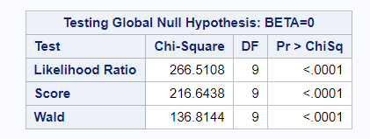
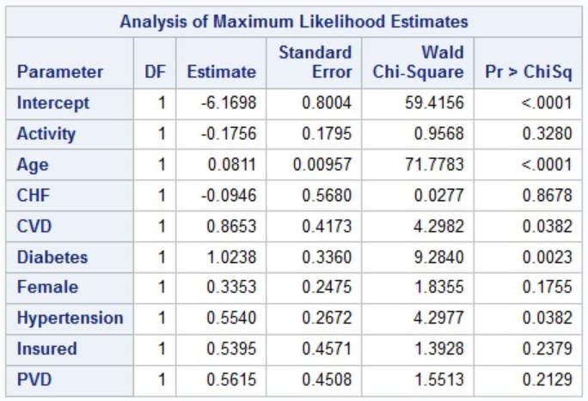
Model construction
The likelihood ratio chi-square of 266.5108 with a p-value of less than 0.001 tells us that our model as a whole fits significantly better than an empty model.

Slide 11
ANalysis
Our confusion matrix on testing data is shown
Outcome | Predicted Negative | Predicted Positive
Actual Negative | 4157 | 1107
Actual Positive | 31 | 201

Slide 12
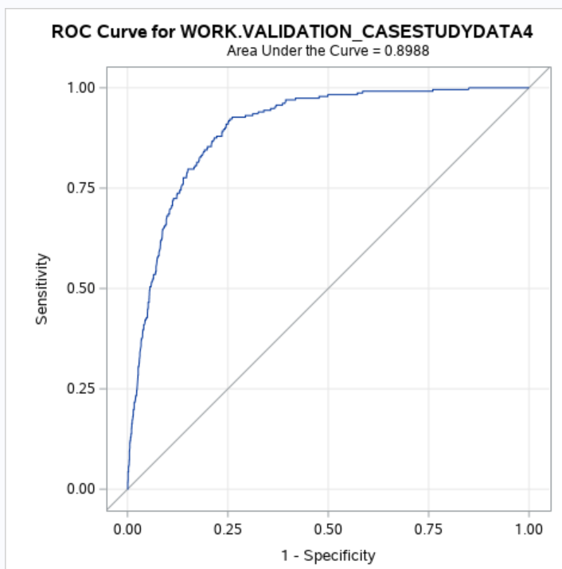
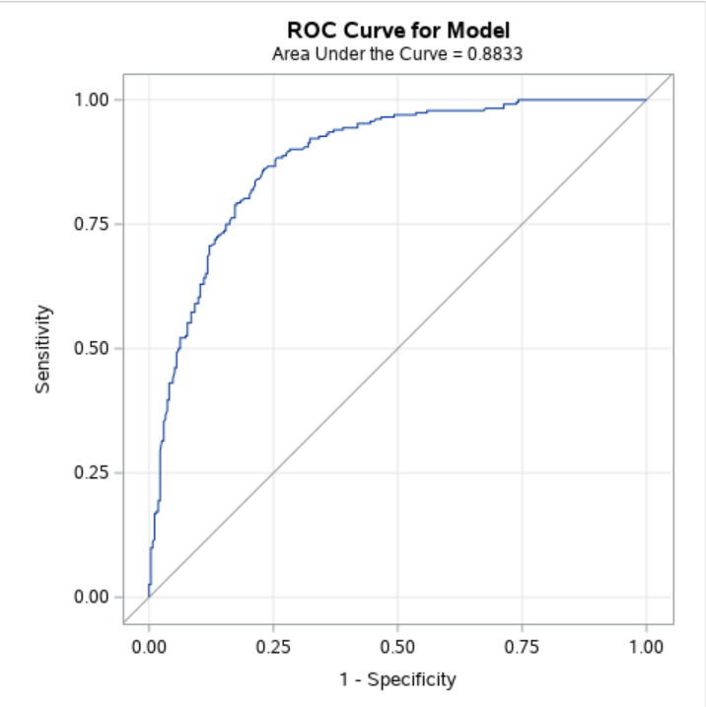
analysis
After implementing our model on validation data set, the ROC curve on the left shows that the prediction rate of our model is 89.88%
More models were created after increasing the significant variables which delivered better prediction rate but were not chosen due to overfitting.

Slide 13
Screening tool
Variable | Weightage
Age | 0 if it is less than 40
 | 20 if it is more than 40 and less than 60
 | 40 if it is more than 60
Gender | 0 if it is male
 | 5 if it is female
Insurance | 0 if not insured
 | 5 if insured
Physical activity | Range: 0-5
 | 0 being highly physically active
 | 5 being very less physically active
Presence of CVD | 0 if not present
 | 10 if present
Presence of PVD | 0 if not present
 | 5 if present
Presence of Diabetes | 0 if not present
 | 20 if present
Presence of Hypertension | 0 if not present
 | 15 if present
Presence of CHF | 0 if not present
 | 15 if present
A screening tool has been created after interpreting the results of our logistic regression model.
It is a checklist or questionnaire which can be used by healthcare professionals in predicting the presence of CKD in patients.
The table below depicts the weightage of each significant variable.
If the weighted score of a patient is more than 50, he is predicted to be having risk of having CKD

Slide 14
Thank You

