Slide 1
Understanding Hierarchies in Computer Science Conferences
Aditya Garg
Aashutosh Trivedi
Ansa Ephraim

Slide 2
Motivation
Different conferences are rated differently
We attempt to understand the structure of the community associated with conferences at different tiers of rating
We find various trends of
Co-authorship
Measure of research carried out
Measure of people getting into research
These metrics are evaluated year on year as well as tier wise
Notes:
Should we mention the things we thought of, but didn’t get working.. like related work/future work?

Slide 3
Motivation
Our data-set and associated techniques can also be used for further predictions like
What makes a paper acceptable
What gets a paper cited more often than others
Do people who get published, work in groups or alone?
Notes:
Should we mention the things we thought of, but didn’t get working.. like related work/future work?

Slide 4
The data
Initial hurdles
SNAP databse : very small dataset, for Physic papers not in interest set and very less data.
Google Scholar : Used Scrapy to start building a web scraper. Involved sharp learning curve, limit on downloads. Required restarts, cleaning and manipulation.
DBLP : 1.3 Gb of clean annotated metadata for papers published in Computer Science. Missing citation and keyword information.
Citeseer from the website : <xml> data, unusable citation information.
Citeseer directly from Penn State : Over 40 Gb of data in XML and over 60 Gb MYSQL dump stored in Amazon S3. HPC didn’t have mySQL. Tried parsing using Perl and Python scripts one line at a time. Data no direct indexing.
Notes:
Need to add more colums to include Google Scholar, ResearchIndex and whatever is there in Diablo’s paper
What was the size of the Citeseer data first downloaded ?
We tried a few things that didn’t work for us, when you see the # our ppt it’s for an approach we tried but didn’t work

Slide 5
The data
 | ACM | DBLP | CiteSeer | Web of Science
Free | partly | yes | yes | no
Downloadable | no | yes | yes | yes
Citation info | yes | Few records | yes | yes
# records | 1.59 mil | 1.46 mil | 32.23 mil | 45.68 mil
Notes:
Need to add more colums to include Google Scholar, ResearchIndex and whatever is there in Diablo’s paper
What was the size of the Citeseer data first downloaded ?
We tried a few things that didn’t work for us, when you see the # our ppt it’s for an approach we tried but didn’t work

Slide 6
Design
Similarity between authors across conferences
Paper based Statistics
Author based Statistics
Notes:
Need to put in the chart

Slide 7
Design
Filter only the most popular conferences and journals using unique keys.
Chop data tier wise.
Transform data for Map Reduce processing and HIVE processing.
HIVE for ‘Similarity between authors across conferences’ and ‘Paper based’ metrics.
Map Reduce for ‘author based’ metrics.
Notes:
Need to put in the chart

Slide 8
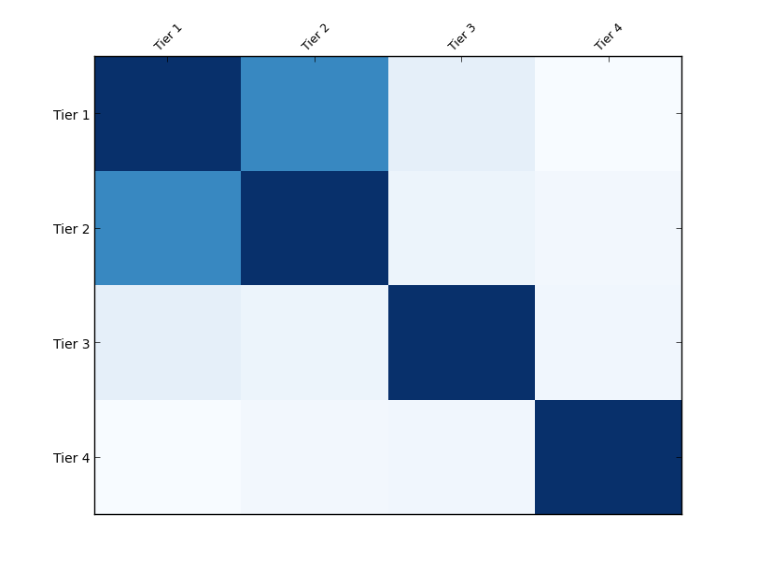
Similarity between authors across conferences
Focused on the Database community in DBLP
Similarity measured using Jaccard distance on the author sets
STEPS
#1 Hive partitioning by conference.
# 2 Hive streaming with Python map reduce functions.
# 3 Pig followed by Java
Jaccard distance = A<intersection> B/ A <union> B
Notes:
Replace intersection and union with correct signs
Colour of the boxes represent degree of similarity. This has been normalized to 0.3 to highlight similarities.

Slide 9
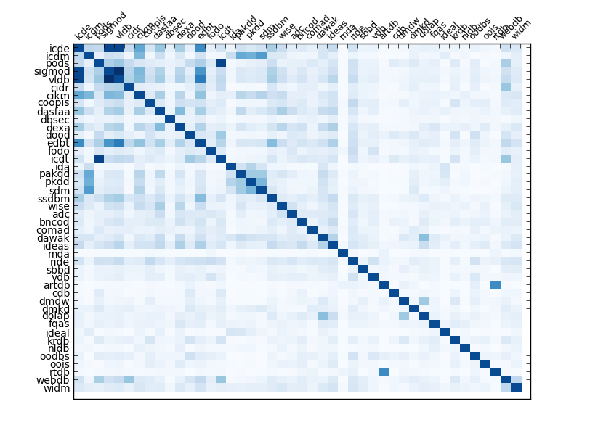
Notes:
Replace intersection and union with correct signs
Colour of the boxes represent degree of similarity. This has been normalized to 0.3 to highlight similarities.

Slide 10
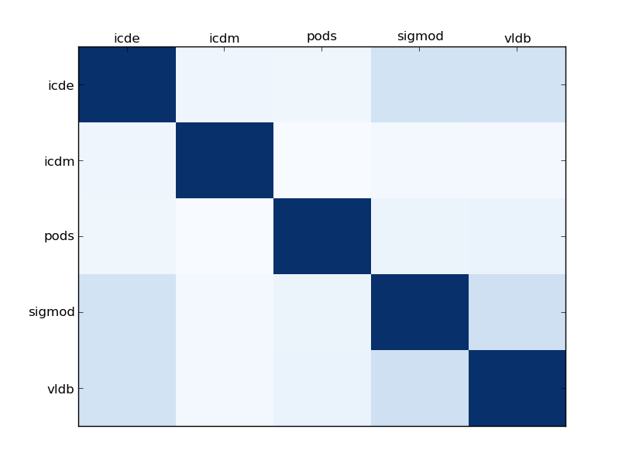
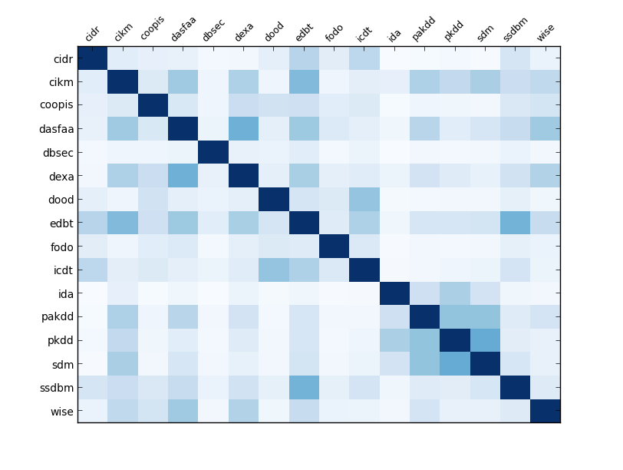
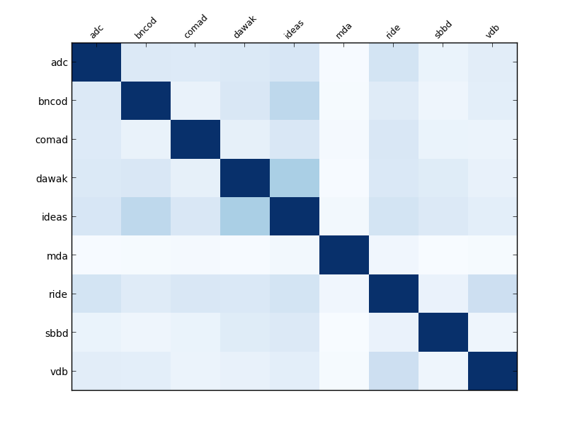
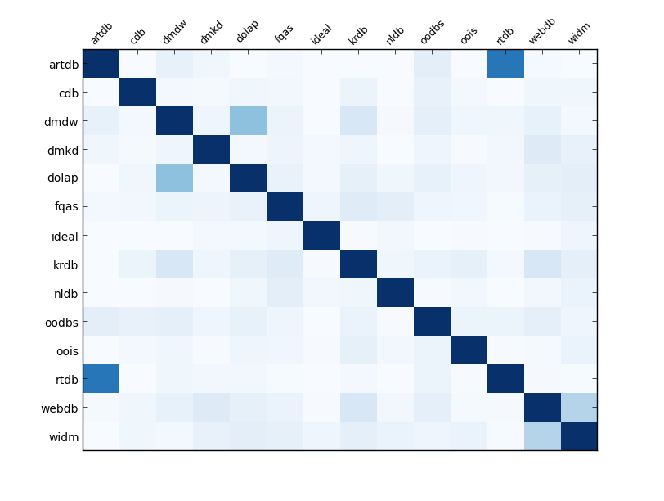
Tier 2
Tier 1
Tier 3
Tier 4

Slide 11
Author based statistics
Description of tiers
We decided to split the data into 4 different tiers as per ranking of the conference/journal.
This gave us a better picture about the kind/measure of research at what level.
Hadoop MR
Selected <xml> data was transformed and flattened to get each record into a single line for easier implementation of MR.
E.g. inproceedings author:Roberto Brunelli|Ornella Mich
title:Efficient Image Retrieval by Examples. year:2000 pages:145-162 crossref:conf/vdb/2000 booktitle:VDB url:db/conf/vdb/vdb2000.html#BrunelliM00

Slide 12
Author based statistics - results

Slide 13
Paper based statistics
<Refer to 6 degrees of freedom paper >
Also data processing details, Hive etc etc

Slide 14
Author based statistics - results

Slide 15
Backup

Slide 16
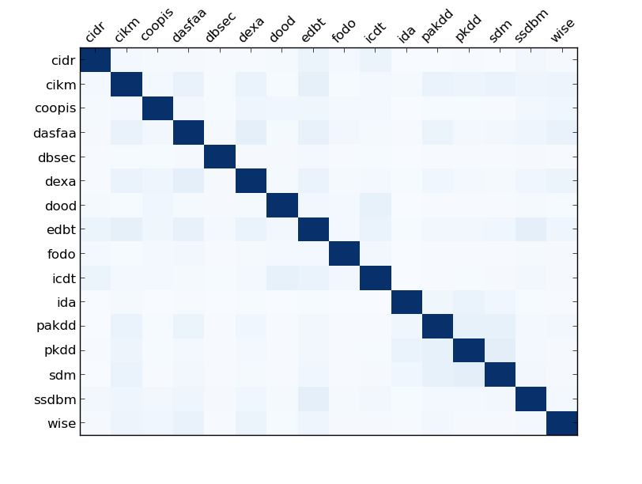
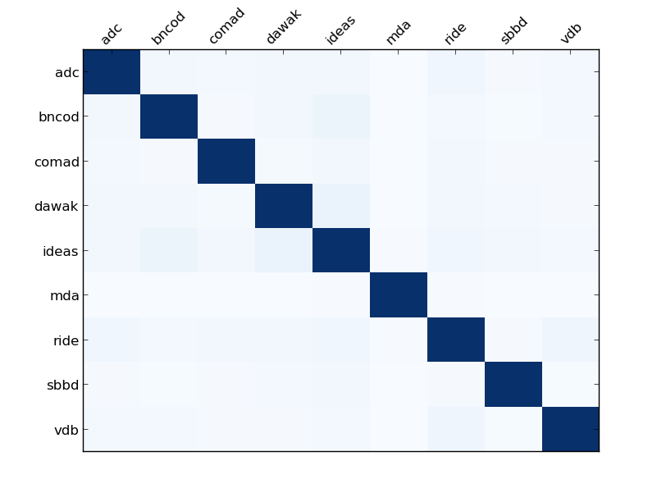

Tier 2
Tier 1
Tier 3
Tier 4
Notes:
Non normalized similarities

