Slide 1
Understanding Hierarchies in Computer Science Conferences
Aditya Garg
Aashutosh Trivedi
Ansa Mary Ephraim

Slide 2
Motivation
Different conferences are rated differently
We attempt to understand the structure of the community associated with conferences at different tiers of rating
We find various trends of
Similarity between venues/conferences
Measure of research carried out
Measure of people getting into research
These metrics are evaluated year on year as well as tier wise
Notes:
Should we mention the things we thought of, but didn’t get working.. like related work/future work?

Slide 3
The data
 | ACM | DBLP | CiteSeerX | Google Scholar | Web of Science
Free | Partly | Yes | Yes | Yes | No
Downloadable | No | Yes | Yes | No | Yes
Citation info | Yes | Few records | Yes | Yes | Yes
# records | 1.59 mil | 1.46 mil | 32.23 mil | NA | 45.68 mil
Notes:
Need to add more colums to include Google Scholar, ResearchIndex and whatever is there in Diablo’s paper
What was the size of the Citeseer data first downloaded ?
We tried a few things that didn’t work for us, when you see the # our ppt it’s for an approach we tried but didn’t work

Slide 4
The data
Initial hurdles – 5 datasets but still couldn’t get the data we were looking for
SNAP database : very small dataset, for Physic papers not in interest set.
Google Scholar : Used Scrapy to start building a web scraper. Involved sharp learning curve, limit on downloads. Required restarts, cleaning and manipulation.
DBLP : 1.3 Gb of clean annotated metadata for papers published in Computer Science. Missing citation and keyword information.
CiteseerX from the website : <xml> data, no citation information present.
Notes:
Need to add more colums to include Google Scholar, ResearchIndex and whatever is there in Diablo’s paper
What was the size of the Citeseer data first downloaded ?
We tried a few things that didn’t work for us, when you see the # our ppt it’s for an approach we tried but didn’t work

Slide 5
The data
Initial hurdles – 5 datasets but still couldn’t get the data we were looking for
CiteseerX directly from Penn State :
Over 40 Gb of data in XML and over 60 Gb MYSQL dump stored in Amazon S3.
Stored on HPC.
No mySQL on HPC.
Tried parsing using Perl, Python and Bash scripts one line at a time.
Data not indexed.
Cleaning and clustering required due to data being automatically scraped by a crawler.
Notes:
Need to add more colums to include Google Scholar, ResearchIndex and whatever is there in Diablo’s paper
What was the size of the Citeseer data first downloaded ?
We tried a few things that didn’t work for us, when you see the # our ppt it’s for an approach we tried but didn’t work

Slide 6
Design
Legend
Worked on Google Scholar, Web of Science, SNAP and CiteseerX
Data Source
Data Collection & analyzing
Decided on DBLP & changes on metrics | 1.46 mil records | 1.29 GB
Process
Filter only database related conferences and journals using unique keys – JAVA and XML
CORE Ranking
Chop data tier wise.
Transform data for Map Reduce, HIVE, pig processing
PIG/Java used for ‘Similarity between authors across conferences’
HIVE used for ‘Paper based’ metrics
Map Reduce for ‘author based’ metrics.
Notes:
Need to put in the chart

Slide 7
Design
Tiers
CORE – Computing Research & Education – computer science rankings
We decided to split the data into 4 different tiers as per ranking of the conference/journal.
This gave us a better picture about the kind/measure of research at what level.
Tier 1 - flagship conferences
Tier 2 – excellent conferences
Tier 3 – good conferences
Tier 4 – other honorable conferences
Notes:
Need to put in the chart

Slide 8
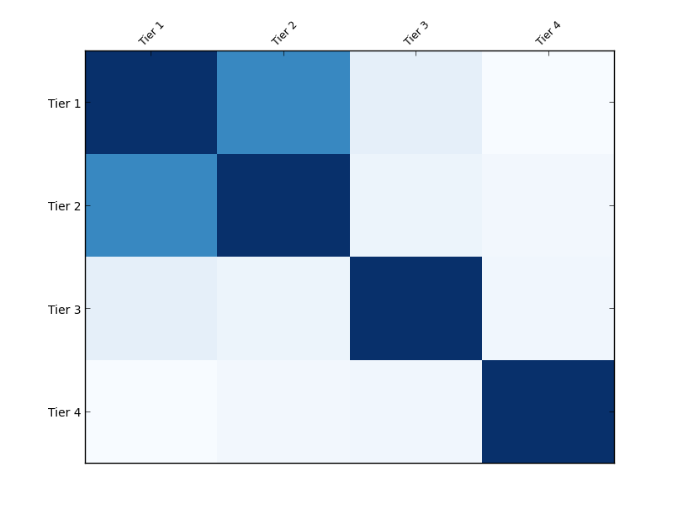
Similarity between authors across conferences
Focused on the Database community in DBLP
Similarity measured using Jaccard distance on the author sets
#1 Hive partitioning by conference.
# 2 Hive streaming with Python map reduce functions.
# 3 Pig followed by Java
Jaccard distance = A ∩ B/ A ∪ B
Notes:
Replace intersection and union with correct signs
Colour of the boxes represent degree of similarity. This has been normalized to 0.3 to highlight similarities.

Slide 9
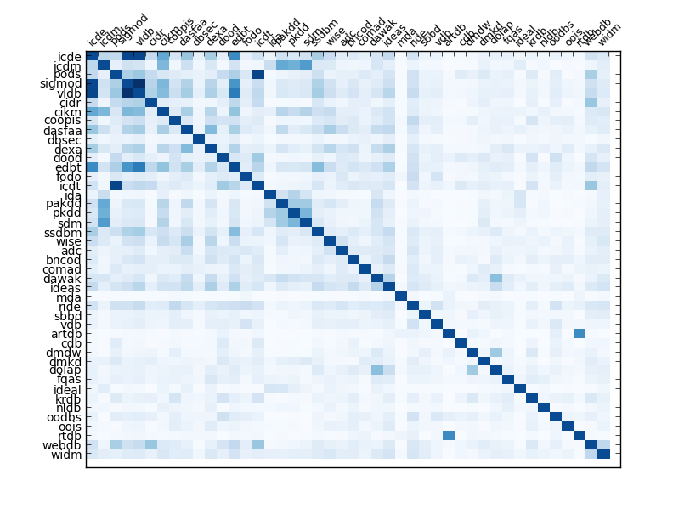
Notes:
Replace intersection and union with correct signs
Colour of the boxes represent degree of similarity. This has been normalized to 0.3 to highlight similarities.

Slide 10
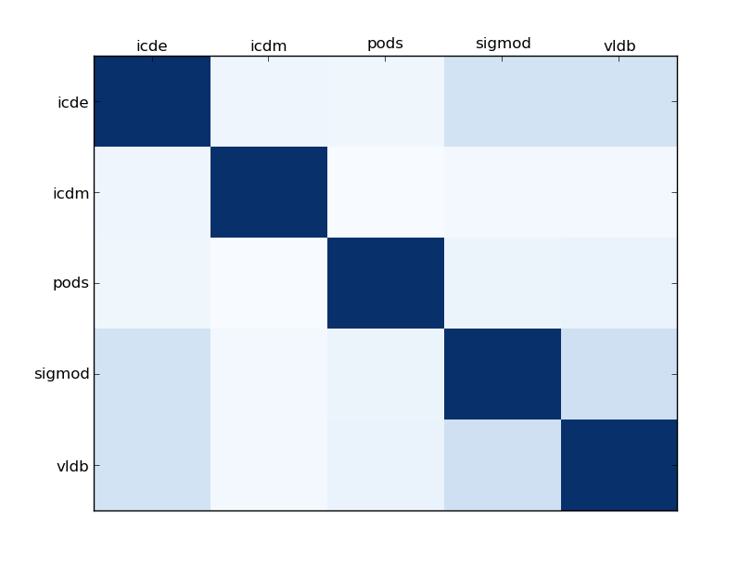
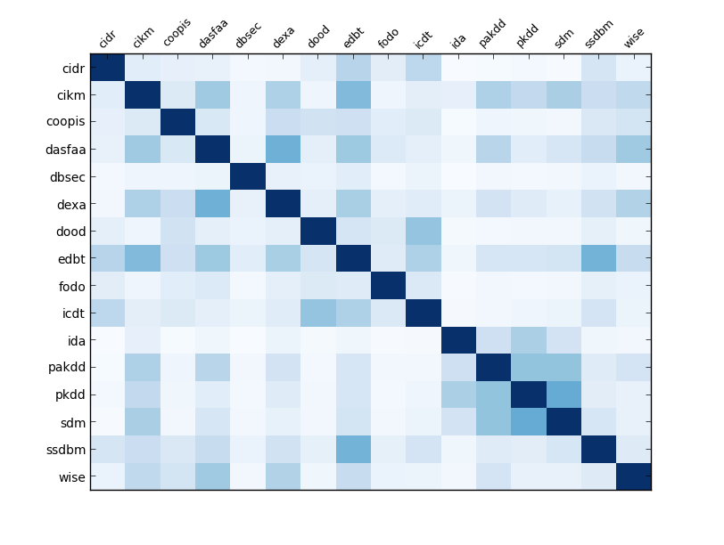
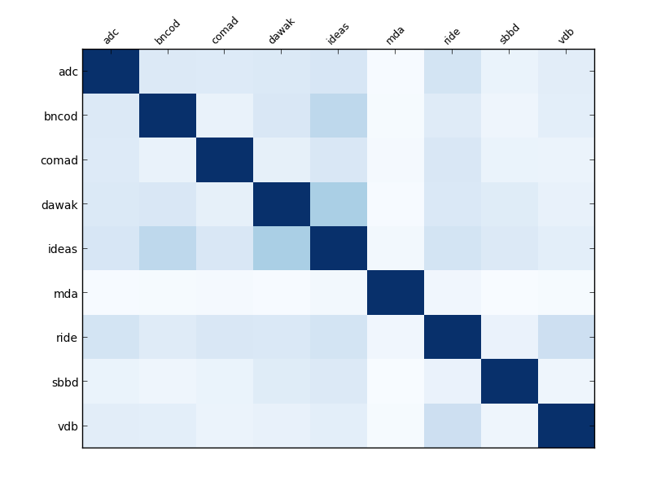
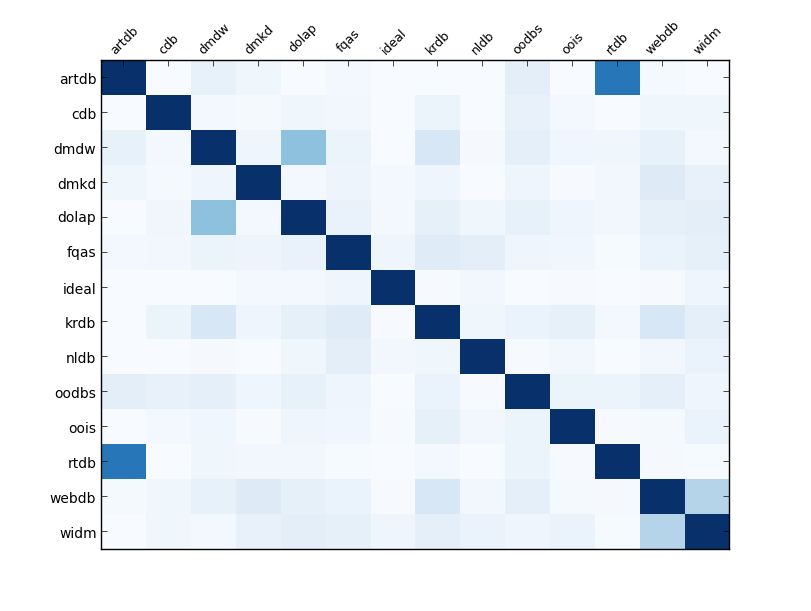
Tier 2
Tier 1
Tier 3
Tier 4

Slide 11
Author based statistics
Hadoop MR
Selected <xml> data was transformed and flattened to get each record into a single line for easier implementation of MR.
E.g.
Inproceedings author:Roberto Brunelli|Ornella Mich title:Efficient Image Retrieval by Examples.
year:2000 pages:145-162 crossref:conf/vdb/2000 booktitle:VDB
url:db/conf/vdb/vdb2000.html#BrunelliM00

Slide 12
Author based statistics
More people getting into research
Healthy increase of top tier conferences instead of lower tier

Slide 13
Author based statistics
Steady amount of research per author, good as number of authors increasing
Top tier conferences performing better than lower tier
Lotka Law of 60%

Slide 14
Author based statistics
Steady number of collaborators
Many conferences also have limit on maximum number of collaborators

Slide 15
Author based statistics
Number of single authored papers reducing over time. Better networking & collaboration opportunity.
Good as collaborators allow different perspective and usually allow deeper research

Slide 16
Author based statistics
New people coming into research more or less stable
Higher in lower ranked conferences. Makes sense since usually people will enter with lower ranked conferences

Slide 17
Paper based statistics
Hive:
As only certain fields were required for Hive analytics, the files were transformed into a tab delimited file having the following format
key year conference authors-array
Then these were put in the tables through Hive
The configured file was also split according to the Tiers and the analytics were also found on the tier files

Slide 18
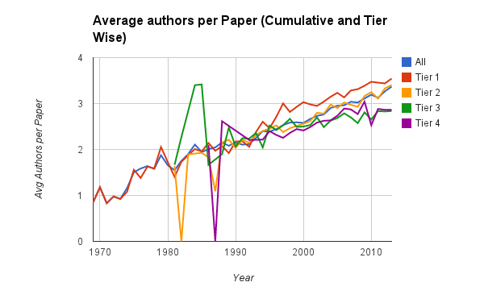
Paper based statistics
Steady increase shows increasing trend of collaboration amongst authors.
Publish or Perish Theory

Slide 19
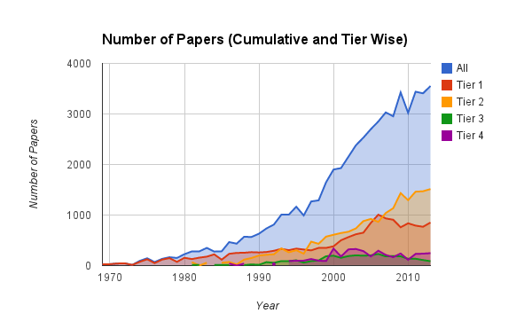
Paper based statistics
Healthy and steady increase in number of papers published
More papers published in top tier conferences.

Slide 20
Future Work
Our data-set and associated techniques can also be used for further predictions like
What makes a paper acceptable
What gets a paper cited more often than others
Do people who get published, work in groups or alone?
What are the likely venues to publish given the authors one has worked with
Keyword analysis to identify what gets a paper cited more often
Structure of collaboration network/degrees of separation
Notes:
Should we mention the things we thought of, but didn’t get working.. like related work/future work?

Slide 21
References
T. White. Hadoop: The Definitive Guide. O’Reilly Media Inc., Sebastopol, CA, May 2012.
J. Dean and S. Ghemawat. MapReduce: Simplified data processing on large clusters. In proceedings of 6th Symposium on Operating Systems Design and Implemenation, 2004.
S. Ghemawat, H. Gobioff, S. T. Leung. The Google File System. In Proceedings of the nineteenth ACM Symposium on Operating Systems Principles – SOSP ‘03, 2003.
Mario A. Nascimento, Jorg Sander and Jeffrey Pound. Analysis of SIGMOD’s Co-Authorship Graph
Vladimir Batagelj and Andrew Mrvar. Some Analyses of Erdos˝ Collaboration Graph.
Michal Jacovi, Vladimir Soroka, Gail Gilboa-Freedman, Sigalit Ur, Elad Shahar, Natalia Marmasse. The Chasms of CSCW : A Citation Graph Analysis of the CSCW Conference.
Yi Han, Bin Zhou, Jian Pei, Yan Jia. Understanding Importance of Collaborations in Co-authorship Networks: A Supportiveness Analysis Approach.
M.E.J. Newman. The structure of scientific collaboration networks.
Alan F. Smeaton, Gary Keogh, Cathal Gurrin, Kieran McDonald and Tom Sodring. Analysis of Papers from Twenty-Five Years of SIGIR Conferences: What Have We Been Doing for the Last Quarter of a Century ?
Notes:
Should we mention the things we thought of, but didn’t get working.. like related work/future work?

Slide 22
Special Thanks
Professor McIntosh for her continuous support in providing guidance and data options.
Penn State University
Notes:
Should we mention the things we thought of, but didn’t get working.. like related work/future work?

