Slide 1
Early Detection of Heart Disease using Machine Learning
Astha Gupta ( ag7982 )
Snehil Keshari ( sk9603 )
Gurmehr Sohi (gs3541)
06.12.2022

Slide 2
Introduction
METHODOLOGY
Heart Disease is one of the most fatal diseases in the world.
Early detection of heart disease is key in recovery.
The current methods for diagnosis is invasive, costly and requires highly skilled professionals.
With the advent of machine learning, it can be possible to develop inexpensive screening tools for heart disease.

Slide 3
Methodology
METHODOLOGY
DATASET
DATA WRANGLING
DATA ANALYSIS AND VISUALIZATIONS ( TABLEAU )
TRAINING THE MODEL
TESTING THE MODEL

Slide 4
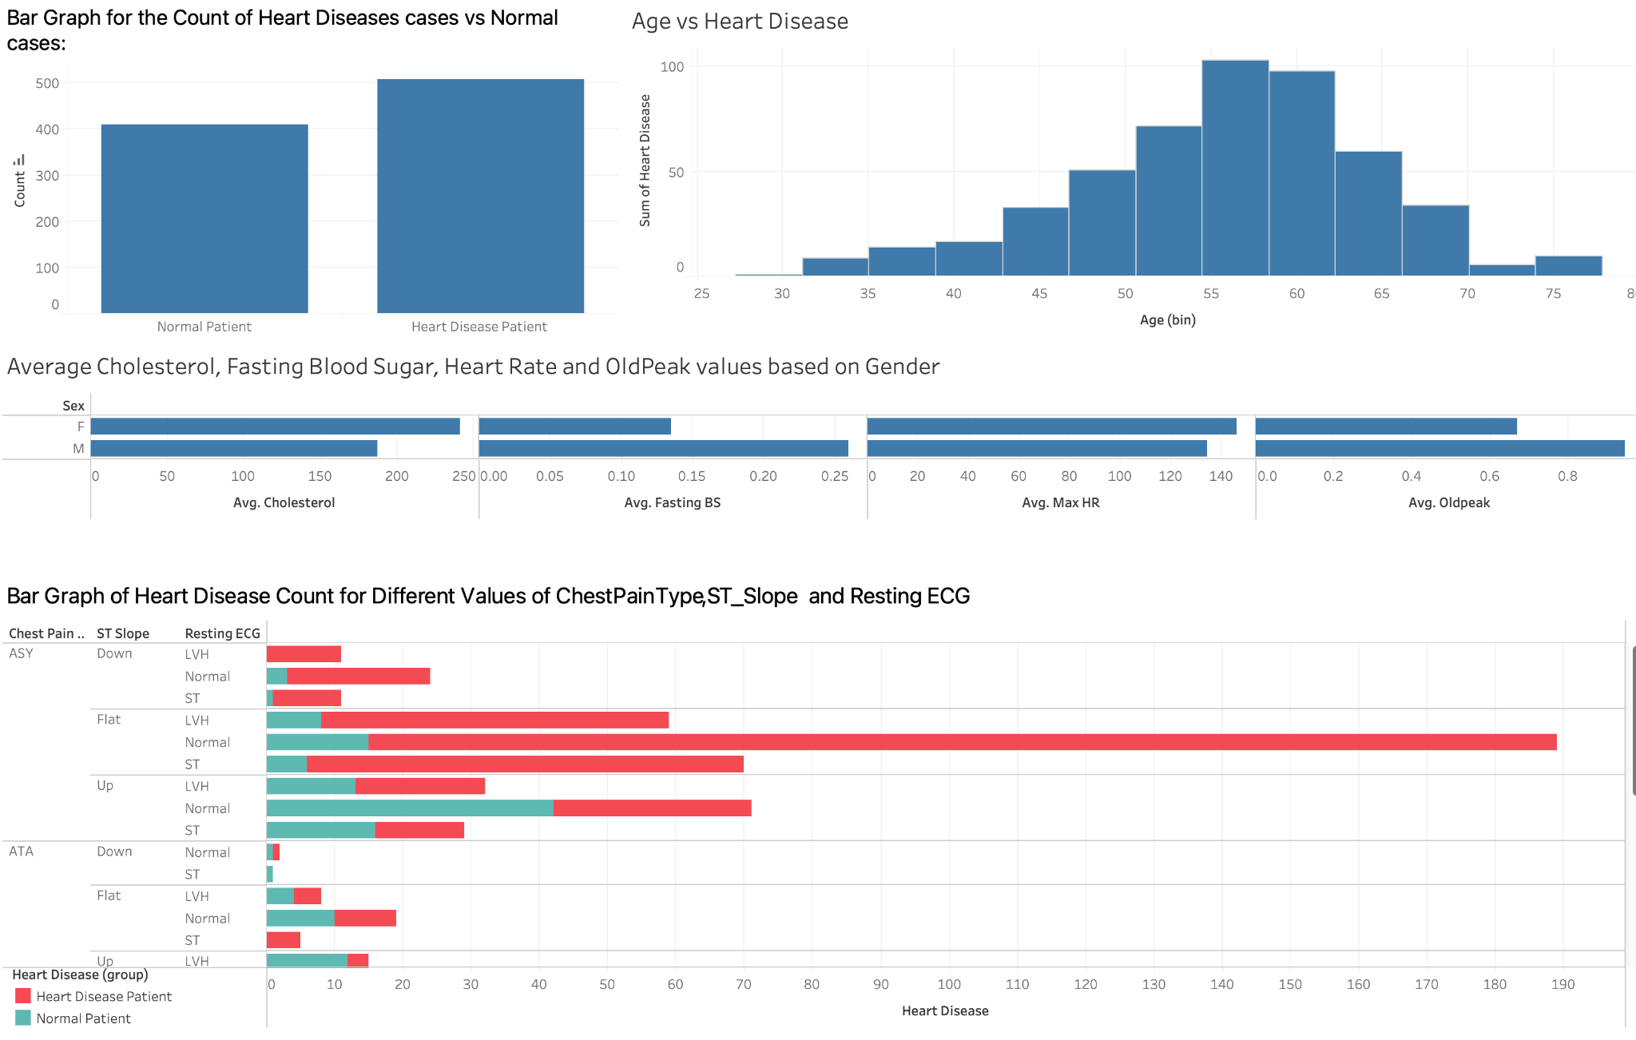
Graphs in
Tableau Dashboard

Slide 5
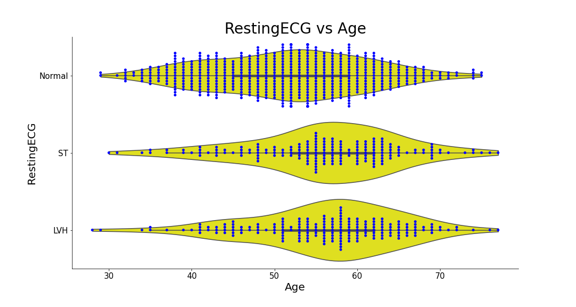
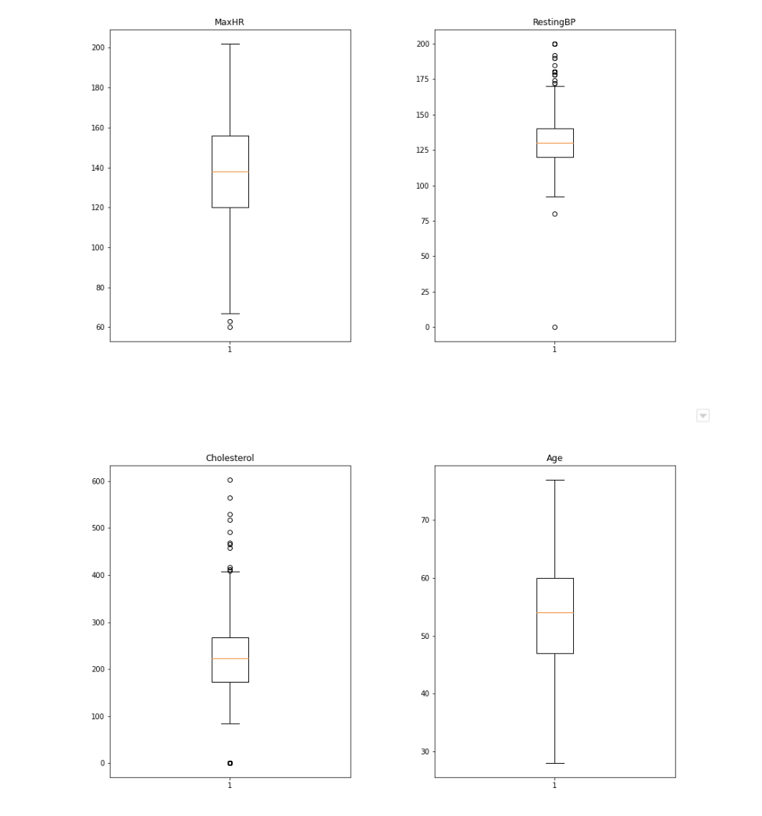
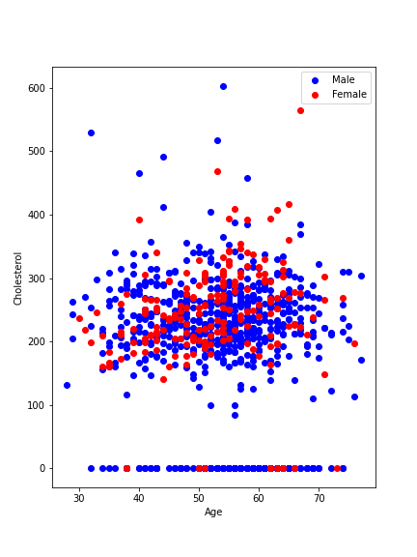
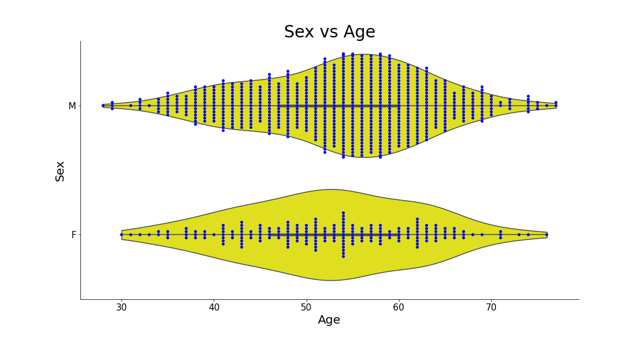
Graphs generated using Python
BoxPlots for Outliers
ScatterPlot for Cholesterol vs Age
Violin Plots for Sex vs Age and RestingECG vs Age

Slide 6
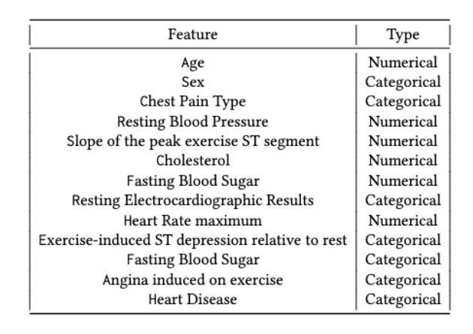
Dataset
METHODOLOGY
On the basis of our study requirements we used 5 heart disease datasets which were combined over 11 common features.
Our dataset has 918 observations.
There are a mixture of numerical and categorical features in our dataset.
Our column for prediction is Heart Disease ( Normal - 0 , Heart Disease - 1 )

Slide 7
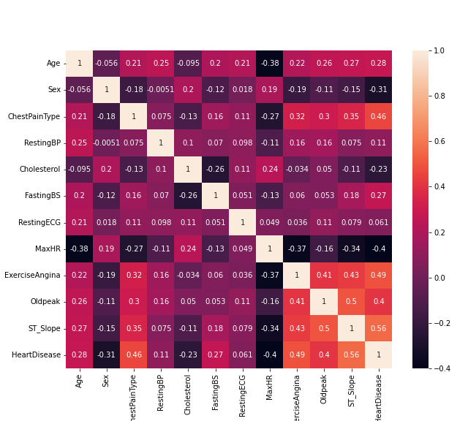
Data Wrangling
METHODOLOGY
No null and missing values were found in the dataset.
Feature Encoding - For this step we converted the categorical columns into numerical so that we can further perform machine learning on this dataset.
Categorical features - Sex , exercise angina , chest pain type, resting ECG and ST slope
We assign each class in these columns a numerical value starting with 0.
Pearson correlation coefficient - We found no 2 features having value higher than 0.7

Slide 8
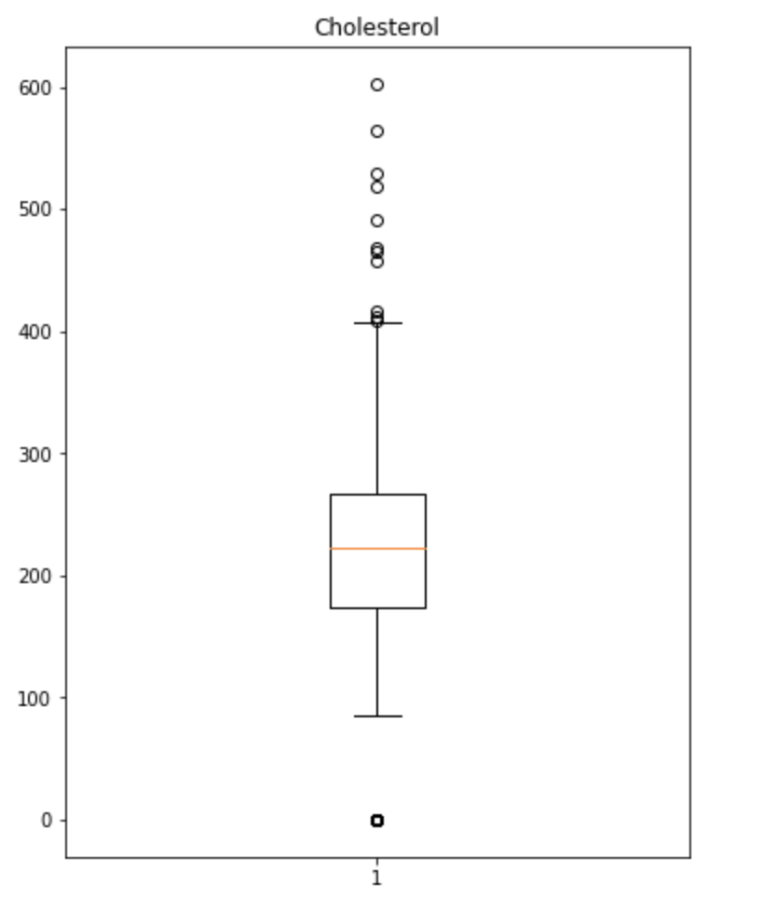
Data Wrangling
METHODOLOGY
Outlier detection and removal - For this step we use boxplots to check if the continuous features have any outliers.
We also found that the filtering of outliers increases the accuracy for most of the models.
Continuous features - Age , RestingBP , Cholesterol , MaxHR ( maximum heart rate )
Z-Score - We used the z-score to remove outliers. Z-score for each value should be between -3 and 3 or else they are removed from the data.
Our final dataset has 906 rows after outliers removal

Slide 9
Training
METHODOLOGY
Models
Logistic Regression
Naive Bayes Classifier
Support Vector Algorithm.
Tree Based Decision Algorithms
Random Forest
Gradient Boosting
eXtreme Gradient Boosting ( XGBoost )

Slide 10
Results
For each model we print the classification report to get all the results.
The classification report provides us the accuracy , precision , recall , F1-score and Area under the receiver operating curve ( AUROC ) score for each model.
To get the feature importance we use the feature importance methods provided by Random forest, gradient boosting and XGBoost.
As our dataset is slightly imbalanced, we use the AUROC scores to compare all our models.

Slide 11
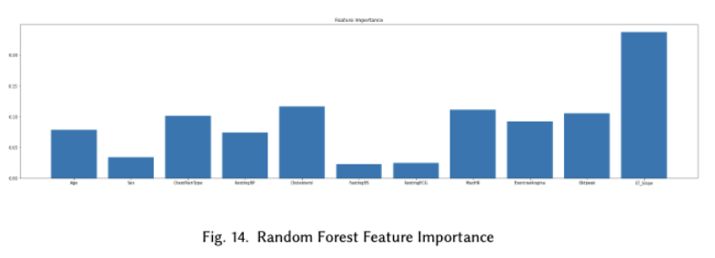
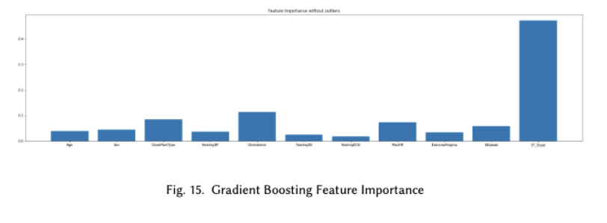
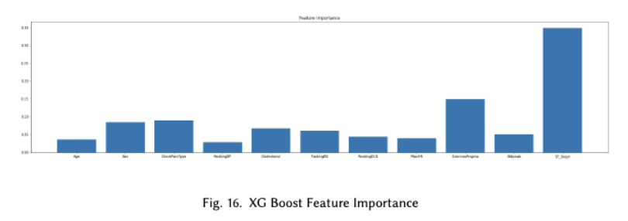
Results
Feature Importance - We formed bar plots using three decision tree based methods.
Top three common features in the top five feature importance values among all the three models are -
ST_Slope ( Slope of ST segment )
Chest Pain Type
Cholesterol.

Slide 12
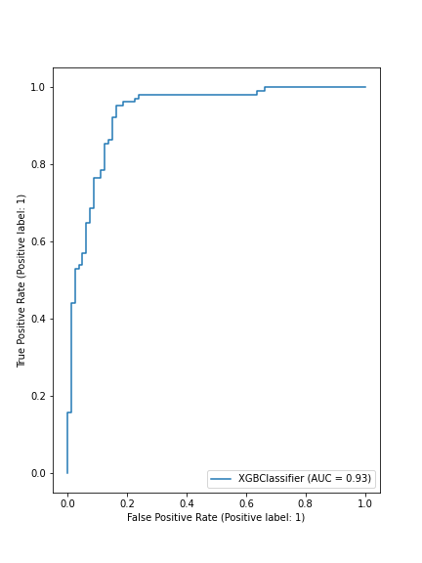
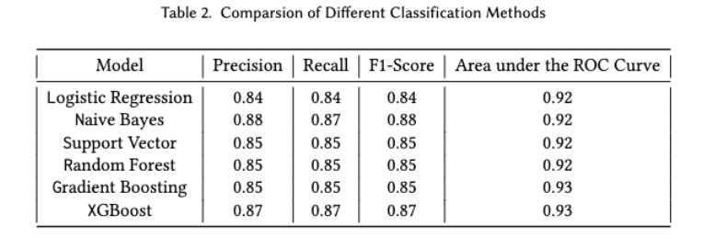
Results
A higher value of AUROC score implies the model has better performance.
XGBoost has the best performance among all models with AUROC score of approximately 0.93. It also has the best precision and recall score.
Below you can see the comparison table and ROC curve for XGBoost.
Table 2.1 Comparison of Different classification models

Slide 13
Discussions
Supervised machine learning methods have proven to be successful in the detection of heart disease among patients.
Our results for the important predictors are in line with existing literature.
Feature correlation study helped us understand that all our features are independent of each other.
Using outlier detection we were able to remove some outliers in our dataset.
Another point of discussion is that age no longer can be considered a risk factor as it was not in the top 3 most influential predictors identified.
Tree-based methods beat the other models in terms of performance.

Slide 14
Conclusions
We were able to use our combined dataset to build a robust classifier to detect heart disease among patients with high accuracy.
We also found important features in our dataset using feature importance techniques.
Auroc score for XGBoost was 0.93 as it was the best performing model among all the models we trained and tested.
Using these results we can see that machine learning models are extremely useful as screening tools in the medical industry.
Our study shows that having such a classifier can help reduce the cost of diagnosis.
In future with larger datasets we can build even better applications for patients who don't have access large hospitals.

Slide 15
References
[1] Haldun Akoglu. “User’s guide to correlation coefficients”. In: Turkish Journal of Emergency Medicine 18.3 (2018), pp. 91–93. issn: 2452-2473. doi:https://doi.org/10.1016/j.tjem.2018.08.001. url: https://www.sciencedirect.com/science/article/pii/S2452247318302164.
[2] Matthias Pfisterer Andras Janosi William Steinbrunn and Robert Detrano. UCI Machine Learning Repository. 2021. url: https://archive.ics.uci.edu/ ml/datasets/heart+disease.
[3] Leo Breiman. “Machine Learning, Volume 45, Number 1 - SpringerLink”. In: Machine Learning 45 (Oct. 2001), pp. 5–32. doi: 10.1023/A:1010933404324.
[4] Gürol Canbek et al. “Binary classification performance measures/metrics: A comprehensive visualized roadmap to gain new insights”. In: 2017 International Conference on Computer Science and Engineering (UBMK). 2017, pp. 821–826. doi: 10.1109/UBMK.2017.8093539.
[5] Tianqi Chen and Carlos Guestrin. “XGBoost: A Scalable Tree Boosting System”. In: Proceedings of the 22nd ACM SIGKDD International Conference on Knowledge Discovery and Data Mining. KDD ’16. San Francisco, California, USA: Association for Computing Machinery, 2016, pp. 785–794. isbn: 9781450342322. doi: 10.1145/2939672.2939785. url: https://doi.org/10.1145/2939672.2939785.
[6] C. Cortes and V. Vapnik. “Support Vector Networks”. In: Machine Learning 20 (1995), pp. 273–297.
[7] Jan Cramer. The Origins of Logistic Regression. Tinbergen Institute Discussion Papers 02-119/4. Tinbergen Institute, 2002. url: https://EconPapers. repec.org/RePEc:tin:wpaper:20020119.
[8] David Freedman, Robert Pisani, and Roger Purves. “Statistics (international student edition)”. In: Pisani, R. Purves, 4th edn. WW Norton & Company,New York (2007).
[9] S. M. Jeong et al. “Effect of Change in Total Cholesterol Levels on Cardiovascular Disease Among Young Adults”. In: J Am Heart Assoc 7.12 (June 2018).
[10] Lawrence J. Laslett et al. “The Worldwide Environment of Cardiovascular Disease: Prevalence, Diagnosis, Therapy, and Policy Issues”. In: Journal of the American College of Cardiology 60.25_Supplement (2012), S1–S49. doi: 10.1016/j.jacc.2012.11.002. eprint: https://www.jacc.org/doi/pdf/10.1016/j.jacc.2012.11.002. url: https://www.jacc.org/doi/abs/10.1016/j.jacc.2012.11.002.
[11] Alexey Natekin and Alois Knoll. “Gradient Boosting Machines, A Tutorial”. In: Frontiers in neurorobotics 7 (Dec. 2013), p. 21. doi: 10.3389/fnbot. 2013.00021.
[12] J. H. O’Keefe et al. “ST-segment elevation: defined by the company it keeps”. In: Mayo Clin Proc 87.7 (July 2012), pp. 610–613.
[13] J. Robson et al. “Clinical value of chest pain presentation and prodromes on the assessment of cardiovascular disease: a cohort study”. In: BMJ Open 5.4 (Apr. 2015), e007251.
[14] Songwon Seo. “A Review and Comparison of Methods for Detecting Outliers in Univariate Data Sets”. In: 2006.
[15] Harry Zhang. “The Optimality of Naive Bayes”. In: The Florida AI Research Society. 2004. Report submitted for CSCI-GA.3033-096

Slide 16
Questions ?

Slide 17
Thank you !!!
P A R T 0 1

