Slide 1
Simulating Gnutella P2P Self-Organization Protocol
Manish Kochhal
(April 28th 2003)

Slide 2
Presentation Outline
P2P Network Architectures
Gnutella Self-Organization Protocol
Designing P2P Simulator
Test Runs
Conclusions and Future Work

Slide 3
P2P Network Architectures
Centralized (Napster)
Decentralized but Structured
Decentralized and Unstructured

Slide 4
Gnutella Self Organization Protocol
PING Message
PONG Message
QUERY Message
QUERY_HIT Message
HEART_BEAT Message

Slide 5
Designing P2P Simulator
Event Scheduler
  Discrete Event simulation
  Single Process Event Queue (no problem of Race conditions)
Simulation Scenario Generators
  Internet Topology Scenario Generation
    Router Model
    AS Model
    Power Law distribution, (Random, Waxman, Barabasi Albert Model, etc ...)
    Bandwidth Distribution (Random, Exponential, Uniform, HeavyTailed).
    Brite, GT-ITM, INET

Slide 6
Designing P2P Simulator (continued …)
Simulation Scenarios Generators (contd …)
  Shared Files Scenario Generator (words, frequency of words, size of File, type of Distribution e.g Zipf ?)
  Traffic Scenario Generator (Arbitrarily Random or specific like, fixed query rate, fixed node failure rate or some distribution)
Event Handler & Protocol Specifics
  Node Handler (passed along with events)
  Command Based Interface to execute events on nodes
  ProtocolAgent implements send(), recv() and Protocol state machine

Slide 7
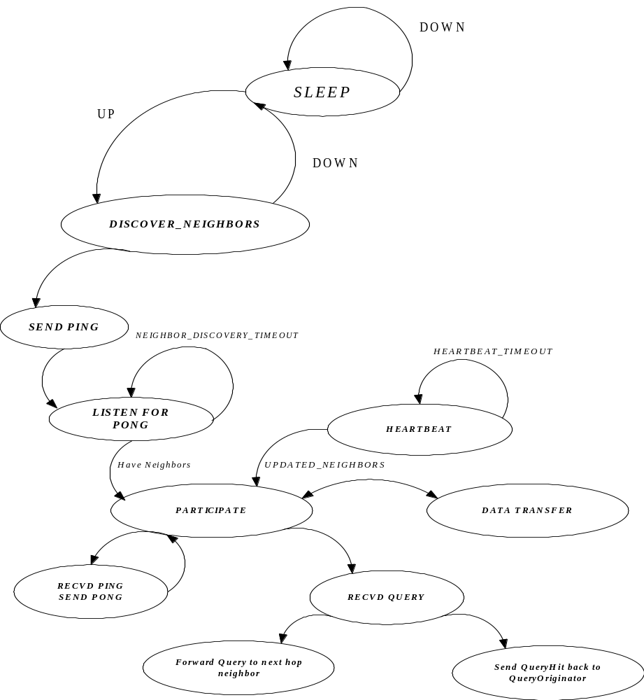
Gnutella State Machine (gnutellaAgent)

Slide 8
Simulation Package Overview (58+ Classes)
p2psimulator:
  /util
    BandwidthEventTypes.java
    CapacityEventTypes.java
    Dictionary.java
    FileTypes.java
    FormatWriter.java
    MD5.java
    Preferences.java
    PriorityQueue.java
    QueryTypes.java
    SharedFileDatabase.java
    SharedFilesReader.java
    Status.java
    TopologyReader.java
    TrafficEventTypes.java
    TrafficScenarioReader.java

Slide 9
Simulation Package Overview (continued …)
/prng
  Distribution.java
/element
  Element.java
  FileShared.java
  Node.java
/generators
  GenerateSharedFilesScenario.java
  TopologyScenarioGenerator.java
  TrafficScenarioGenerator.java

Slide 10
Simulation Package Overview (continued …)
/scen
  audioFiles.txt
  videoFiles.txt
  documentFiles.txt
  softwareFiles.txt
  Dictionary_words.txt
  Somefile.txt
  topologyScenarioFile.txt
  trafficScenarioFile.txt

Slide 11
Simulation Package Overview (Continued …)
/protocol
  ProtocolAgent.java
    /message
      Message.java
      MessageConstants.java
      PingMessage.java
      PongMessage.java
      QueryMessage.java
      QueryHitMessage.java
      HeartBeatMessage.java

Slide 12
Simulation Package Overview (continued …)
/command
  Command.java
  ElementUpdateCommand.java
  IntializeCommand.java
  NodeBandwidthCommand.java
  NodeCapacityCommand.java
  NodeStateCommand.java
  QueryCommand.java
  SendMessageCommand.java
  StopCommand.java
  TimeOutCommand.java

Slide 13
Simulation Package Overview (continued …)
/test
  TestSharedFileDatabase.java
  TestSharedFileScenarioGenerator.java
  Test_Dictionary.java
  And finally !
  Simulator.java and Test_P2PSimulator.java

Slide 14
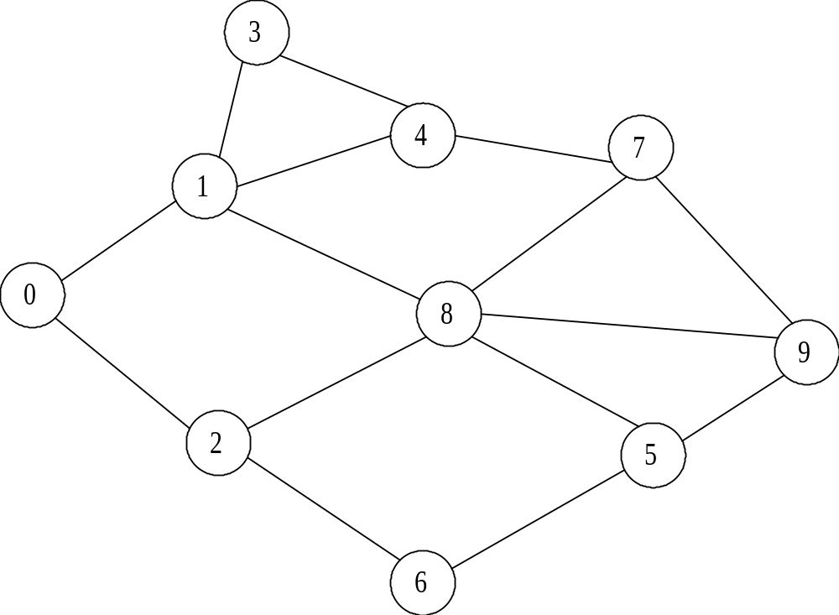
Test Run (10 Node Overlay Topology)

Slide 15
topologyScenarioFiles.txt
0: (20, 10) 2 {1, 2} {500 Mhz, 256 MB, 5000 MB, 100 Mbps};
1: (25, 60) 4 {0, 3, 4, 8} {1000 Mhz, 512 MB, 20000 MB, 10 Mbps};
2: (30, 1) 3 {0, 6, 8} {266 Mhz, 64 MB, 2000 MB, 10 Mbps};
3: (10, 78) 2 {1, 4} {900 Mhz, 128 MB, 10 MB, 0.056 Mbps};
4: (14, 9) 3 {1, 3, 7} {2000 Mhz, 256 MB, 20 MB, 1 Mbps};
5: (5, 10) 3 {6, 8, 9} {2000 Mhz, 256 MB, 20 MB, 10 Mbps};
6: (60, 54) 2 {2, 5} {900 Mhz, 128 MB, 10 MB, 1 Mbps};
7: (77, 7) 3 {4, 8, 9} {1700 Mhz, 512 MB, 40000 MB, 100 Mbps};
8: (88, 90) 5 {1, 2, 5, 7, 9} {5000 Mhz, 1000 MB, 100000 MB, 1000 Mbps};
9: (99, 90) 3 {5, 7, 8} {2530 Mhz, 1000 MB, 50000 MB, 100 Mbps};

Slide 16
trafficFileScenario.txt
0: 10 -INITIALIZE-;
0: 0 -UP-;
0: 1 -UP-;
0: 2 -UP-;
0: 3 -UP-;
0: 4 -UP-;
0: 5 -UP-;
0: 6 -UP-;
0: 7 -UP-;
0: 8 -UP-;
0: 9 -UP-;
600: 0 -INITIATE_PARTIAL_QUERY- 2 {Celine, Dion} .mp3 (4);
900: 2 -INITIATE_PARTIAL_QUERY- 1 {I} .mp3 (4);
10000: 10 -STOP_SIMULATION-;

Slide 17
Gnutella Action

Slide 18
Conclusions and Future Work
Using other Topology Generators like GT-ITM, BRITE, and INET.
Using specified distribution for traffic Scenario Generation (e.g. using Zipf)

