Slide 1
15
Knowledge Management System
Submitted by:
Ayush Goyal
Ayush Parnami
Jai Kumar Yadav
Jhalak Gupta
Mentor:
Mr. Pratipal Singh

Slide 2
Contents
Introduction
Benefits
Features
Methodology
Literature Survey
Requirements
User Requirements
Implementation
Test plan
Diagrams And Snapshot
Scope
Findings
Future works

Slide 3
Introduction
Aim is to develop an online Knowledge management system which will be helpful to college students and faculty.
Students/faculty will be able to upload any type of information/article.
Students/faculty logging in may also access/search any information put up by others.
Students can view all the articles/information related to their interest on top.

Slide 4
Benefits
For College:
Easy to manage all articles (Computer Science, Database etc.).
All information/articles can be synchronized in one place.
KMS is beneficial for both students/faculty.
It is helpful to maintain the students record (admission no, roll no, dob etc.)
Easy to create any kind of article.
Easy to query all related details of student.
Easy to read and publish article uploaded by students.

Slide 5
For Students:
Students will be aware to their interested fields
Students can get knowledge
Don’t have to search other places
Can manage their articles easily
Can get review about their article by likes/dislikes of other students
Comments can help understanding other students requirements

Slide 6
Features
Admin control
Registration and login system for students
Sharing point of knowledge article of all fields
Providing knowledge among other students
Review system before upload
Notification after signup
Sorting by various ways like date of post, field, likes, author name, etc
Password changing feature
Simple to use interface
Flexibility in features

Slide 7
Methodology
In order to develop an efficient Knowledge Management System, we have to follow the following methodology:
Knowing the proper requirements of the users:
Asking users about the requirements they need in the website.
Analyzing the requirements: After gathering all the requirements, we have to analyze the requirements to sort out which are feasible and which are not.
Selecting the proper model for developing the project:
From the various models available for developing the project, we must select the best & efficient model, which best suites our approach.

Slide 8
Literature Survey
Provides an interface which allows users to manage (create, edit, delete) content on a platform (mostly websites).
A tool that enables technical and non technical users to create, edit, manage.
publish a variety of content whilst being constrained by a centralised set of rules.

Slide 9
Requirements
Functional
User registration
Content management (articles, news.)
Non-functional
Performance requirements
Safety requirements
Security requirements
Software quality attributes

Slide 10
User Requirements
Hardware configuration
Processor : Pentium IV or above
RAM : 256 MB or higher
Hard Disk Space : 5 GB or more
Software configuration
Operating system : Windows XP/7/8
Environment : Adobe Dreamweaver,
Xampp server
Language : HTML, PHP
Back-end : MySQL

Slide 11
Implementation
Login section for users
Sign-up facility for new users
Can upload articles
Filter articles by date, author, article rank and interest
Put query if facing any problem

Slide 12
Test Plan
Activities will be observed performed by the users.
Each activity will be checked if it is working properly or not.
Internet speed will be checked while uploading or sharing information/articles.

Slide 13
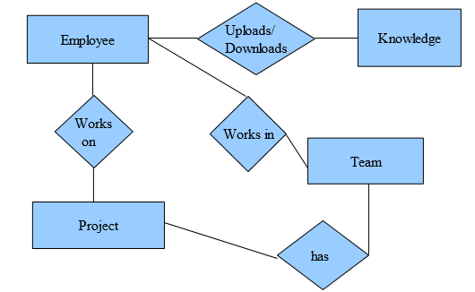
Process Logic

Slide 14
Use Case

Slide 15
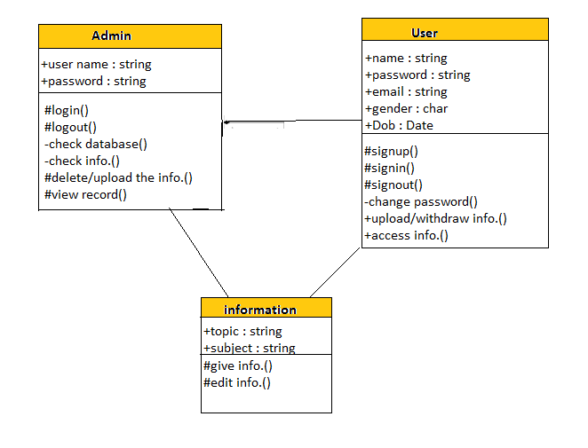
Class Diagram

Slide 16
Sequence Diagram
Home Page
Login Page
Data Base
Admin Home Page
Home Page
Login Page
Data Base
Student Home Page
Admin
Student
Use url
Use url
Press login button
Goes to Login Page
Press login button
Goes to Login Page
Press Login for Account
Press Login for Account
Validate User()
Validate User()
Time
Time
Admin login
Student login

Slide 17
Sequence Diagram
Home Page
Login Page
Database
Admin Home Page
Other Pages
Admin
Press login button()
Select Validate or Reject
Transaction ()
Press Accept/Reject Button
Select Validate or Reject Account()
Reports()
Admin validation

Slide 18
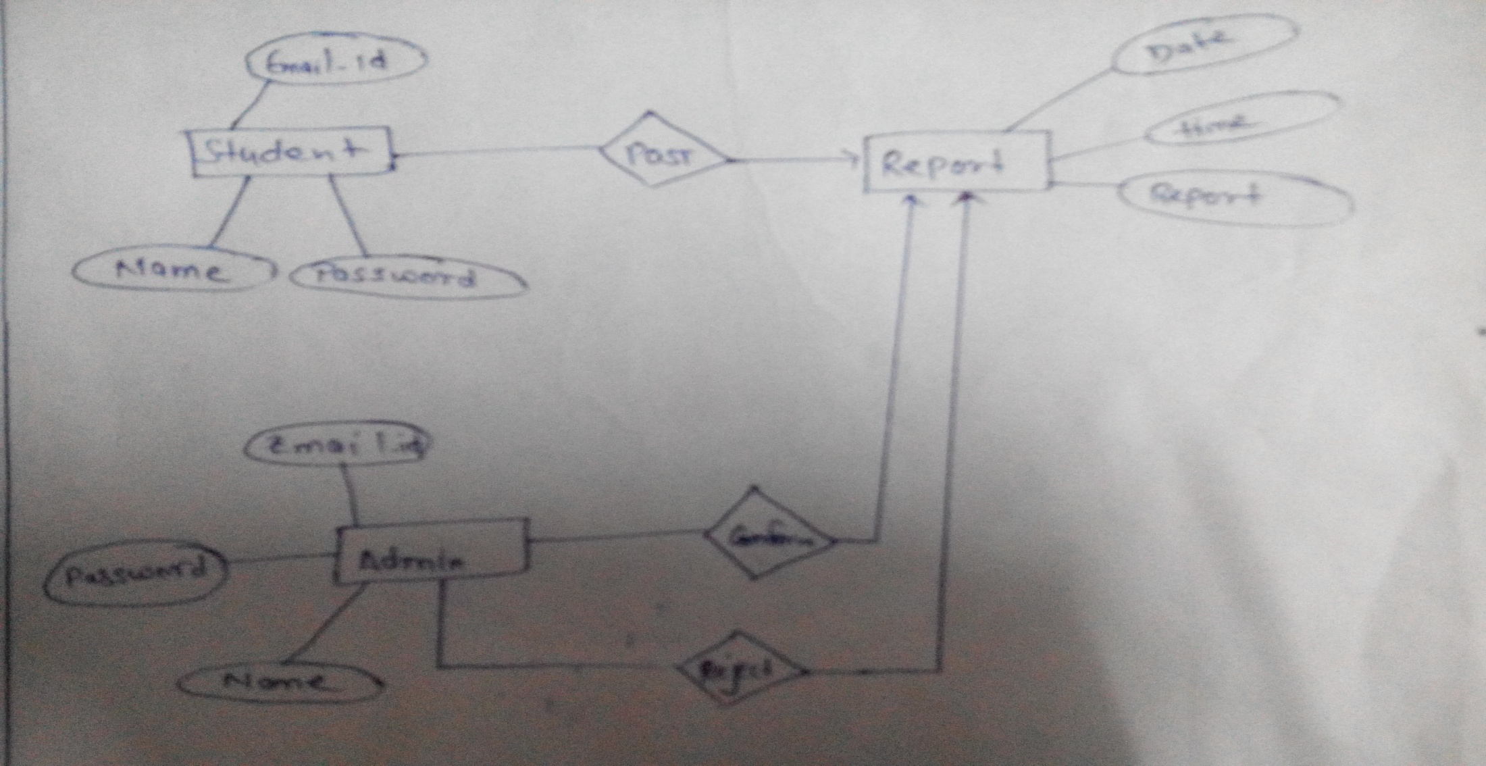
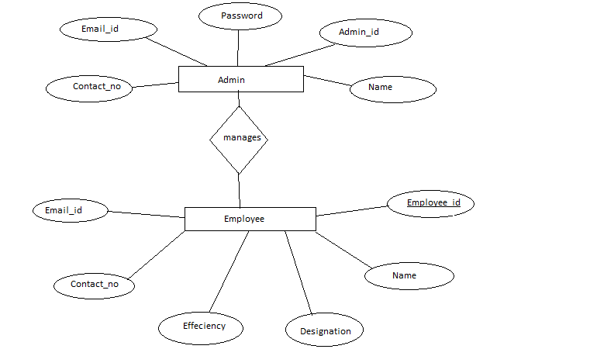
ER Diagram

Slide 19
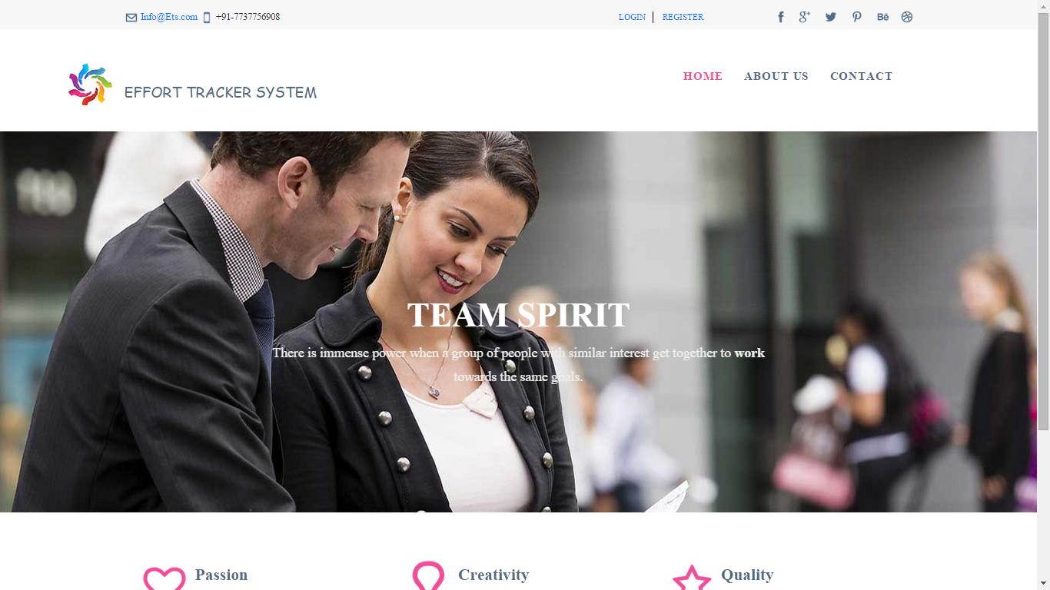
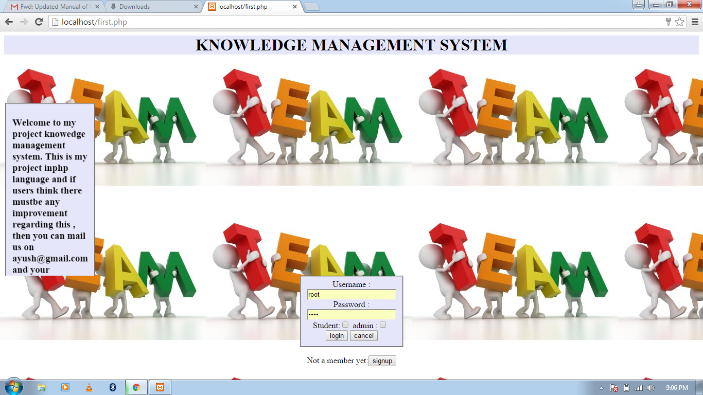
Home Page

Slide 20
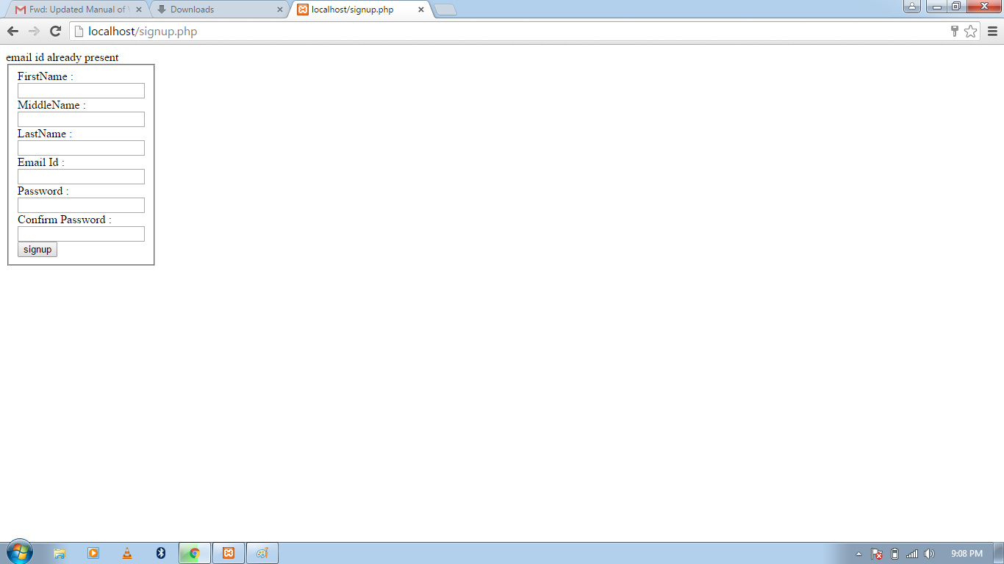
Signup Page

Slide 21
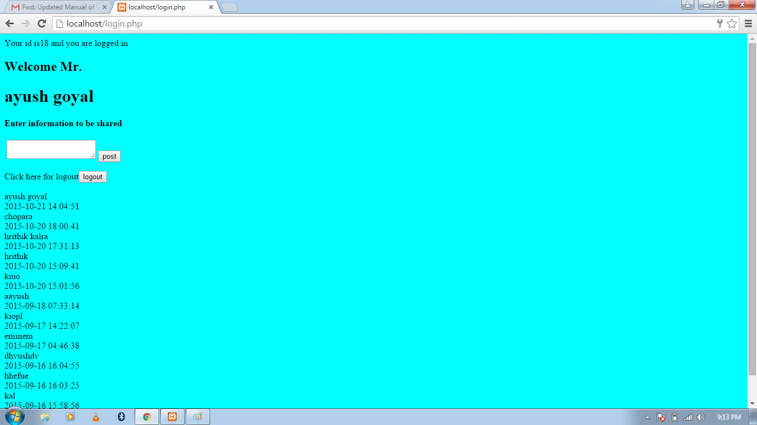
Student Page

Slide 22
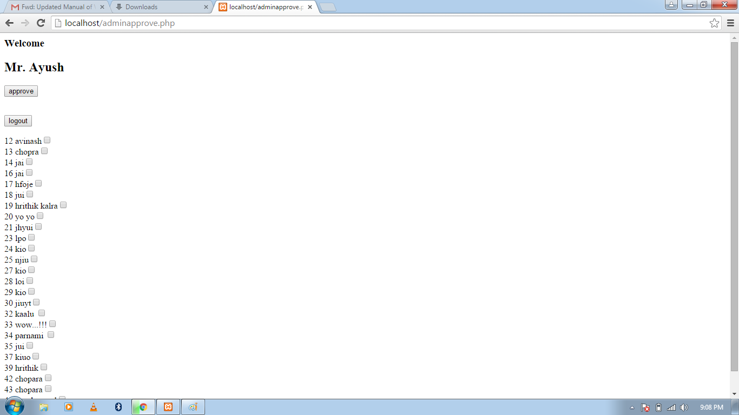
Admin Page

Slide 23
scope
Easy to use if all information is at one place.
Helpful for students and faculty.
Solutions for student queries will be there.

Slide 24
Findings
Improved Productivity- time saving because of easier and quicker navigation to the features.
Improved Accessibility- Easily Accessible and easy to browse.

Slide 25
Future Works
Add some more features to improve further
Android application can be made of the system

Slide 26
Thank You

