Slide 1
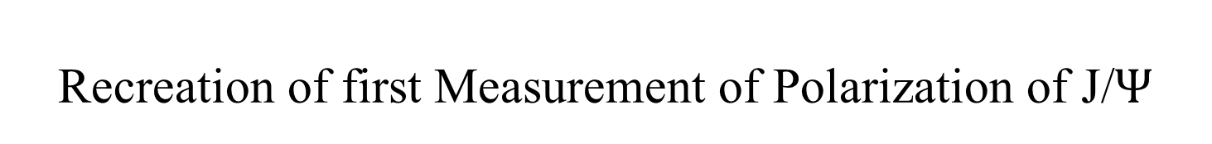
Recreation of first Measurement of Polarization of J/$Ψ$
Amrit Gautam
University of Kansas
Original Research
By
Simone Ragoni
University of Birmingham, United Kingdom

Slide 2
Project Overview
Recreate the result produced by Simone using Analysis note
Write own analysis Code to Reduce the bias
Compare the result with the Original Result
Notes:
I want to emphasize that the goal of the project is only to reproduce the result from the original work of Simone

Slide 3
Data Set
Event Selection…….
Pb–Pb dataset
– LHC15o muoncalo pass1 (nanoAODs): collected in 2015
– LHC18q muoncalo pass3 (nanoAODs): collected in 2018
– LHC18r muoncalo pass3 (nanoAODs): collected in 2018

Slide 4
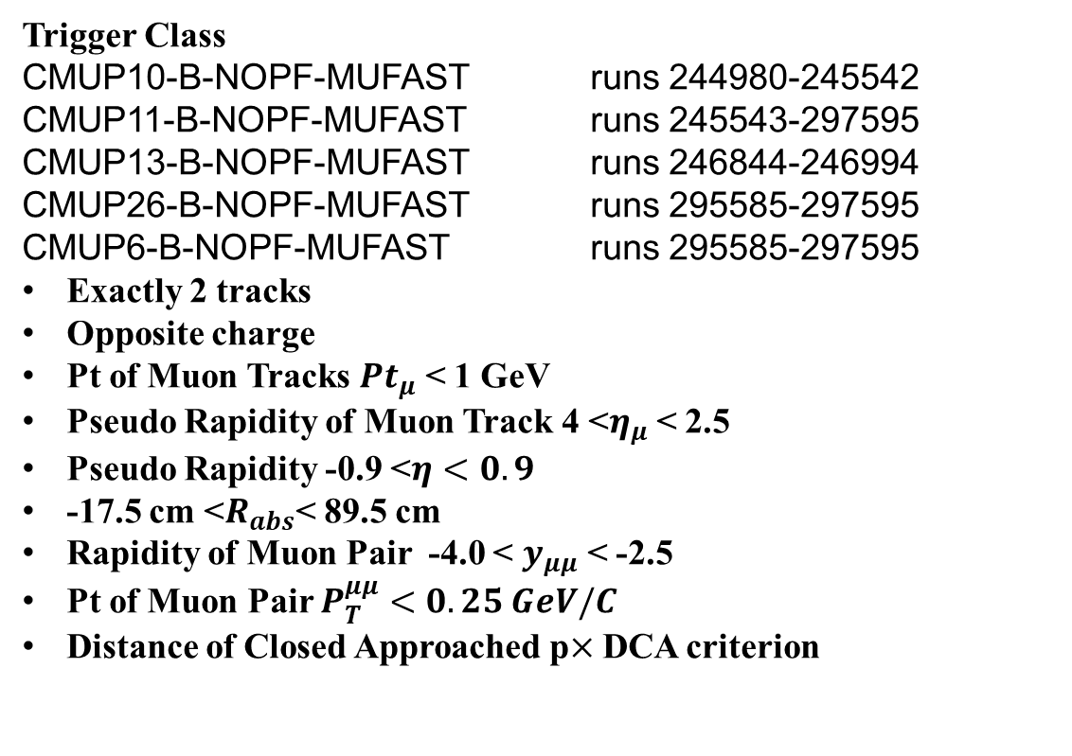
Event Selection
Trigger Class
CMUP10-B-NOPF-MUFAST runs 244980-245542
CMUP11-B-NOPF-MUFAST runs 245543-297595
CMUP13-B-NOPF-MUFAST runs 246844-246994
CMUP26-B-NOPF-MUFAST runs 295585-297595
CMUP6-B-NOPF-MUFAST runs 295585-297595
Exactly 2 tracks
Opposite charge
Pt of Muon Tracks $Pt_{μ}$ < 1 GeV
Pseudo Rapidity of Muon Track 4 <$η_{μ}$< 2.5
Pseudo Rapidity -0.9 <$η<0.9$
-17.5 cm <$R_{abs}$< 89.5 cm
Rapidity of Muon Pair -4.0 < $y_{μμ}$ < -2.5
Pt of Muon Pair $P_{T}^{μμ}<0.25 GeV/C$
Distance of Closed Approached p$×$DCA criterion
Event Selection…….
All the plots shown in this presentation will satisfy the above criteria.

Slide 6
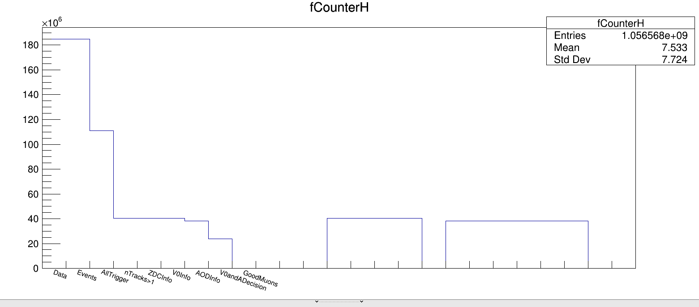
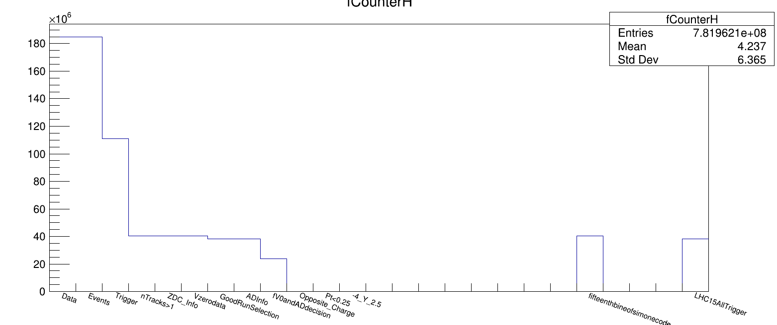
Simone
All Trigger
Amrit
All Trigger

Slide 7
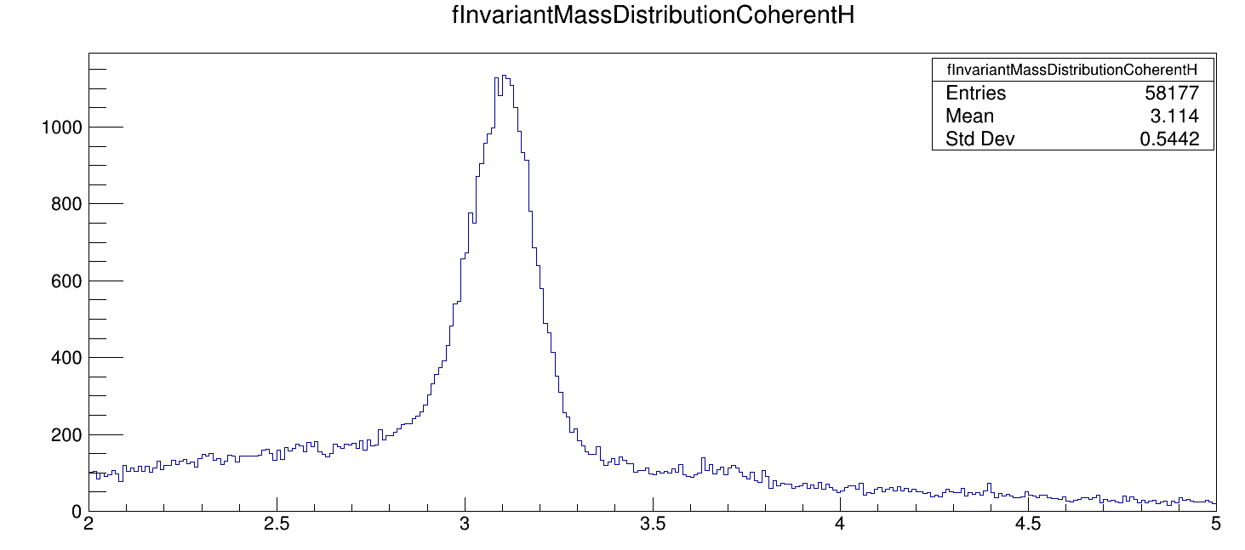
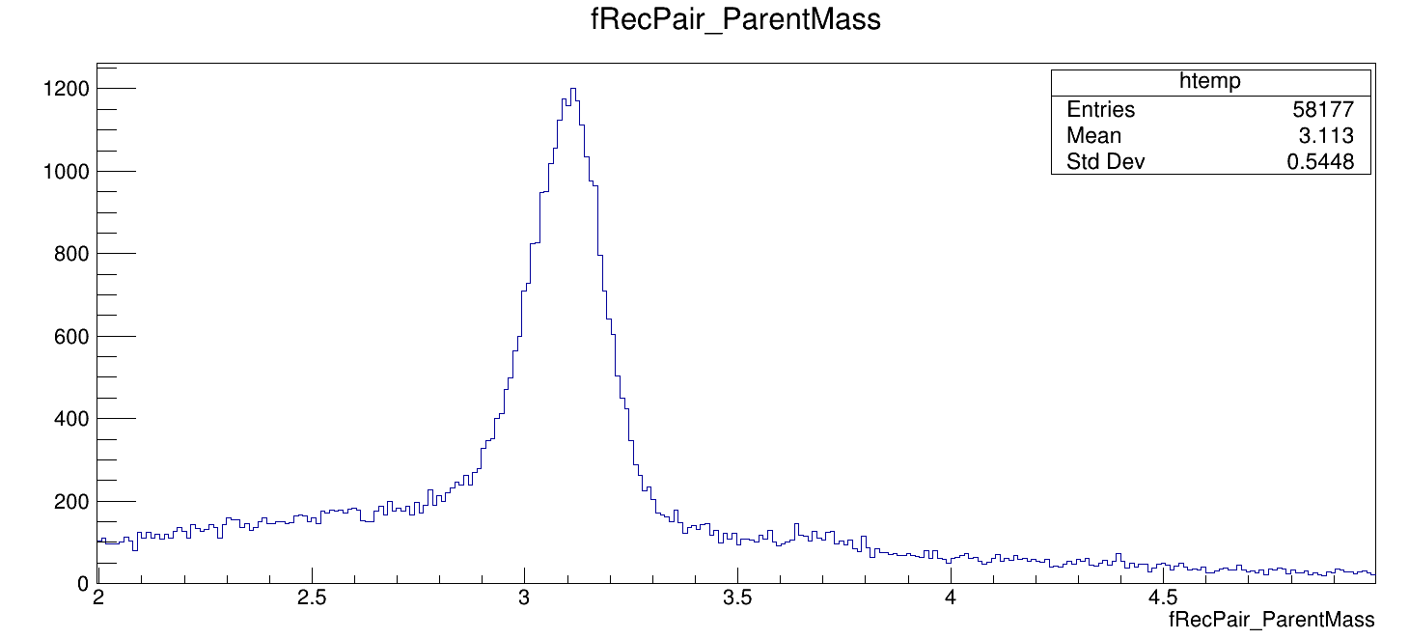

Slide 8
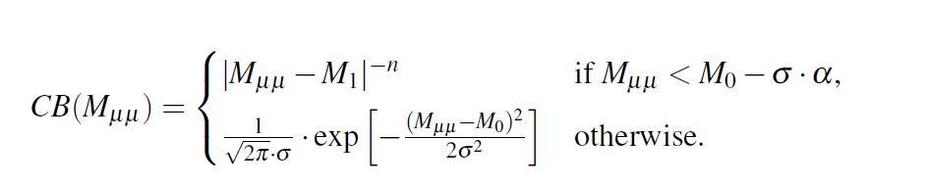
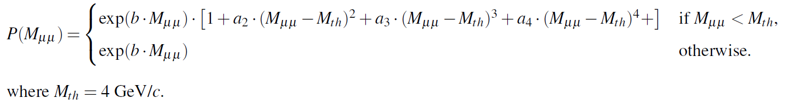
Fitting of Final Mass Distribution
Signal
Crystal ball Function
Background

Slide 15
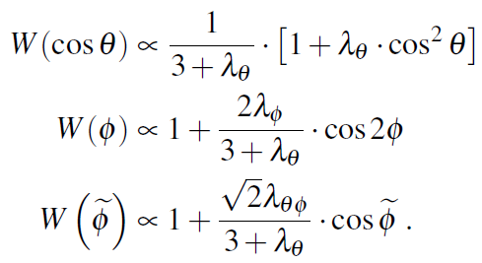
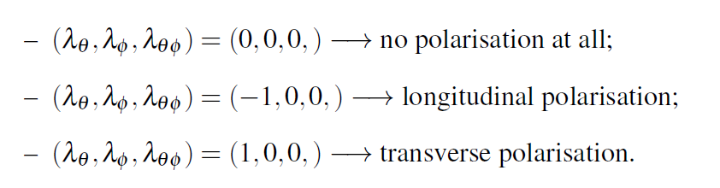
Polarization Determination

Slide 16
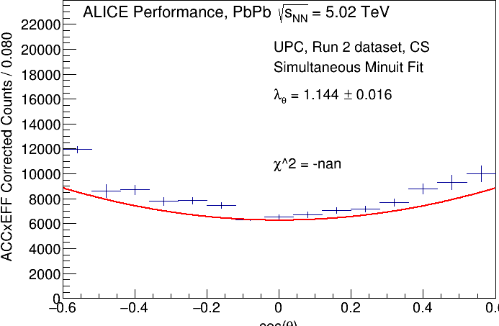
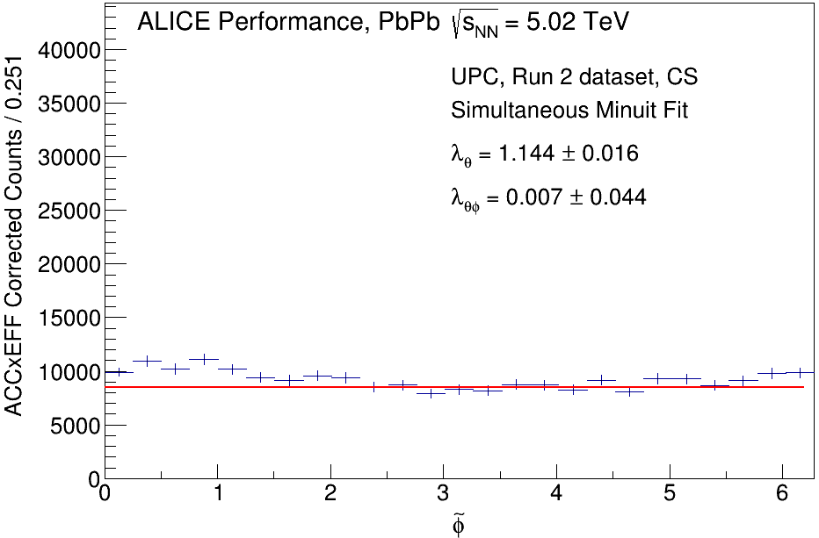
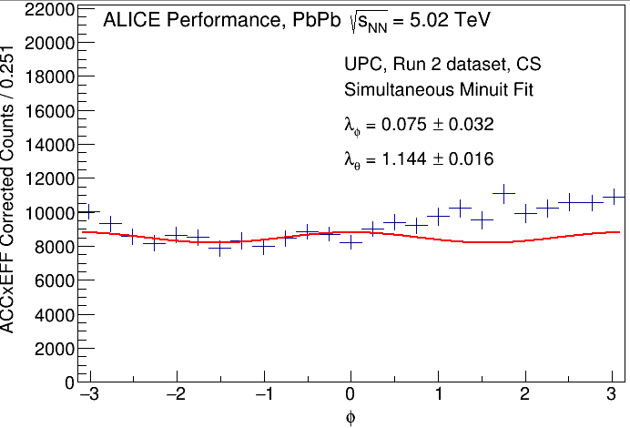

Slide 17
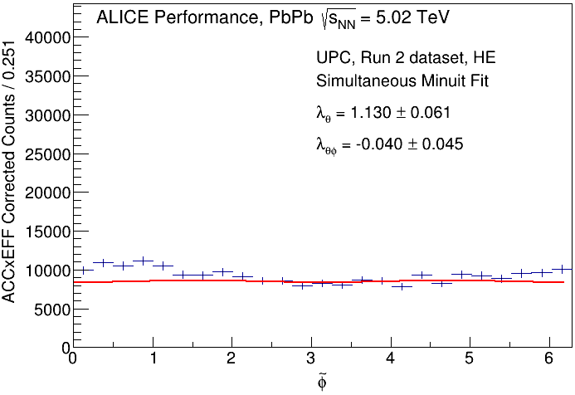
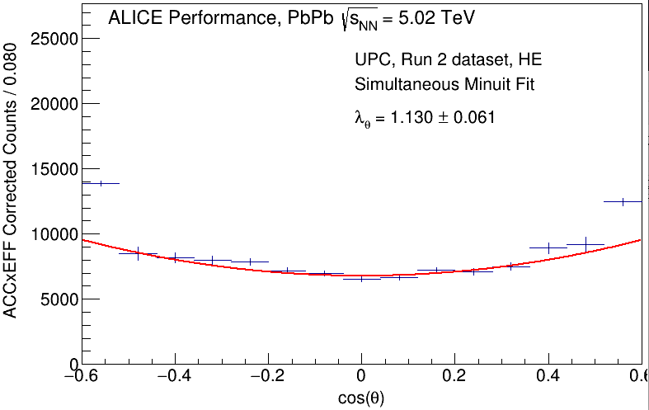
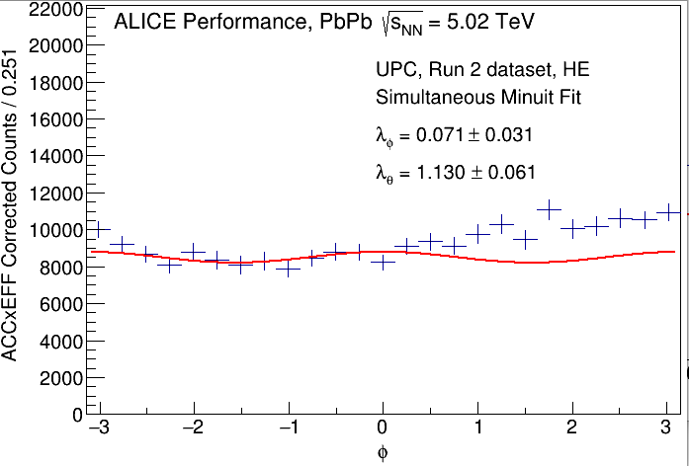

Slide 18
Questions
?

