Slide 1

Computer Science and Engineering
SMART SURVEILLANCE: MULTI-WEAPON ARMED PERSON DETECTION WITH AUTOMATED THREAT ALERTS USING YOLO V8
Guide Name: Team Members: Ms. P.Anitha
Asst. Professor/CSE
DHARANISH S (727722EUCS043)
AGASH K (727722EUCS009)
HARIBASKAR S (727722EUCS063)
GOWTHAM S (727722EUCS053)
IV CSE A
BATCH NO: 11

Slide 2
ABSTRACT
Real-time multi-weapon detection using deep learning enables automated, scalable, and efficient surveillance in public and restricted areas.
Traditional systems based on manual monitoring or motion sensors are slow, prone to human error, and unsuitable for proactive threat detection.
The proposed YOLOv8 and CNN-LSTM based framework ensures rapid and accurate identification of armed individuals in live video streams.
Integrated automated alert mechanisms enhance response speed, detection accuracy, and overall situational awareness in modern smart surveillance systems.

Slide 3
INTRODUCTION
Deep learning combined with computer vision enables precise detection and classification of weapons in complex surveillance environments.
The proposed system provides automated and real-time monitoring compared to conventional manual surveillance methods.
Integration with smart security networks strengthens threat detection, response coordination, and overall situational awareness.
Automated identification of armed individuals supports public safety through faster, more reliable, and proactive threat management.

Slide 4
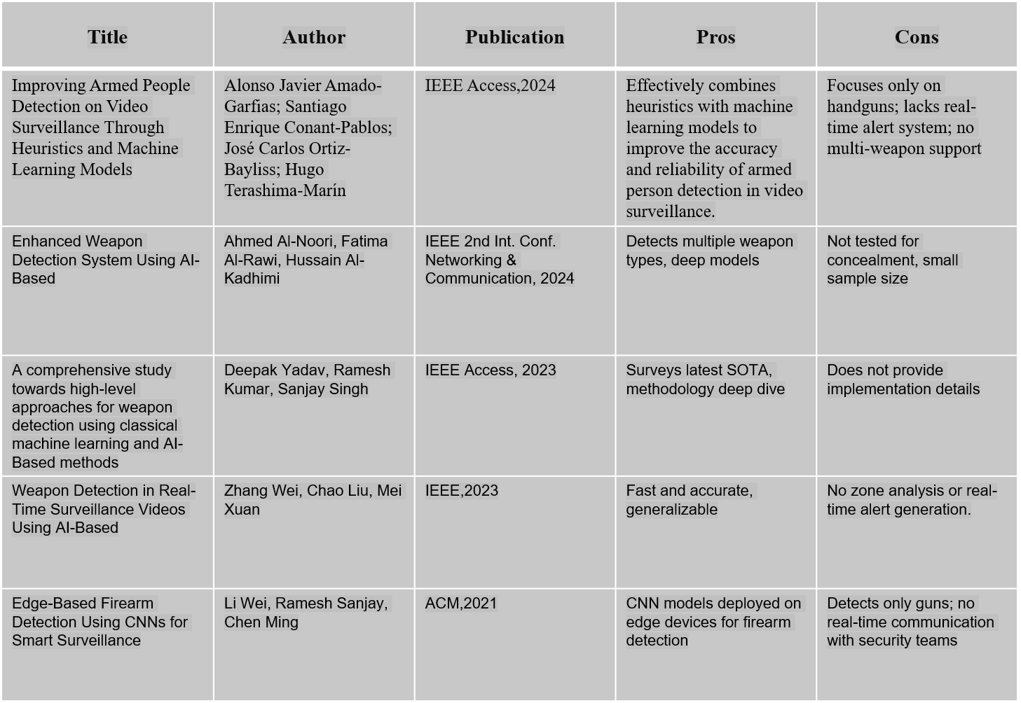
Times New Roman, size 15 and line space 1.5, Maximum 2 slides
LITERATURE REVIEW

Slide 5
MOTIVATIONS
Increasing weapon-related incidents highlight the need for intelligent and automated surveillance systems in public and restricted areas.
Deep learning–based computer vision enables accurate identification of weapons and suspicious activities in real time.
Early detection of armed individuals supports timely threat response and enhances public safety.
Real-time, automated multi-weapon detection ensures scalable and efficient monitoring for modern smart security systems.

Slide 6
PROBLEM STATEMENT
Manual monitoring of surveillance footage is time-consuming, labor-intensive, and prone to human error.
Conventional security systems lack real-time intelligence and fail to detect threats proactively.
Existing models struggle to differentiate between multiple weapon types and non-threatening objects in dynamic environments.
The absence of automated multi-weapon identification and instant alert mechanisms limits timely threat response and public safety.

Slide 7
OBJECTIVES
To develop a deep learning–based smart surveillance system using YOLOv8 And CNN-LSTM for accurate and real-time detection of armed individuals carrying multiple weapon types.
To achieve robust detection accuracy across different environments by optimizing model training with diverse datasets and advanced preprocessing techniques.
To integrate automated alert mechanisms and visualization tools for explainable, responsive, and efficient threat management in public security environments.

Slide 8
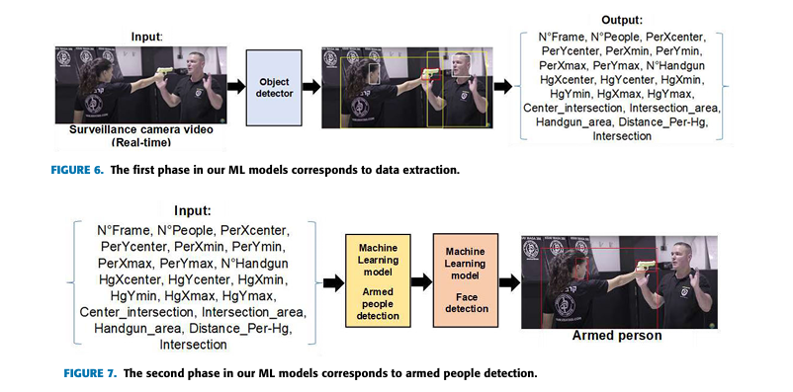
METHODOLOGIES
Existing Architecture

Slide 9
METHODOLOGIES
Exisiting Architecture
The system uses YOLOv4 to detect people, faces, and handguns in real-time video surveillance.
It applies three heuristics — Method of Centers, Distances, and Intersections to link guns with their carriers.
Seven ML models (like Random Forest and SVM) are trained using features such as distances and intersection areas for better accuracy.
The architecture works in two phases: data extraction by YOLOv4 and armed person detection by heuristics and ML models.

Slide 10
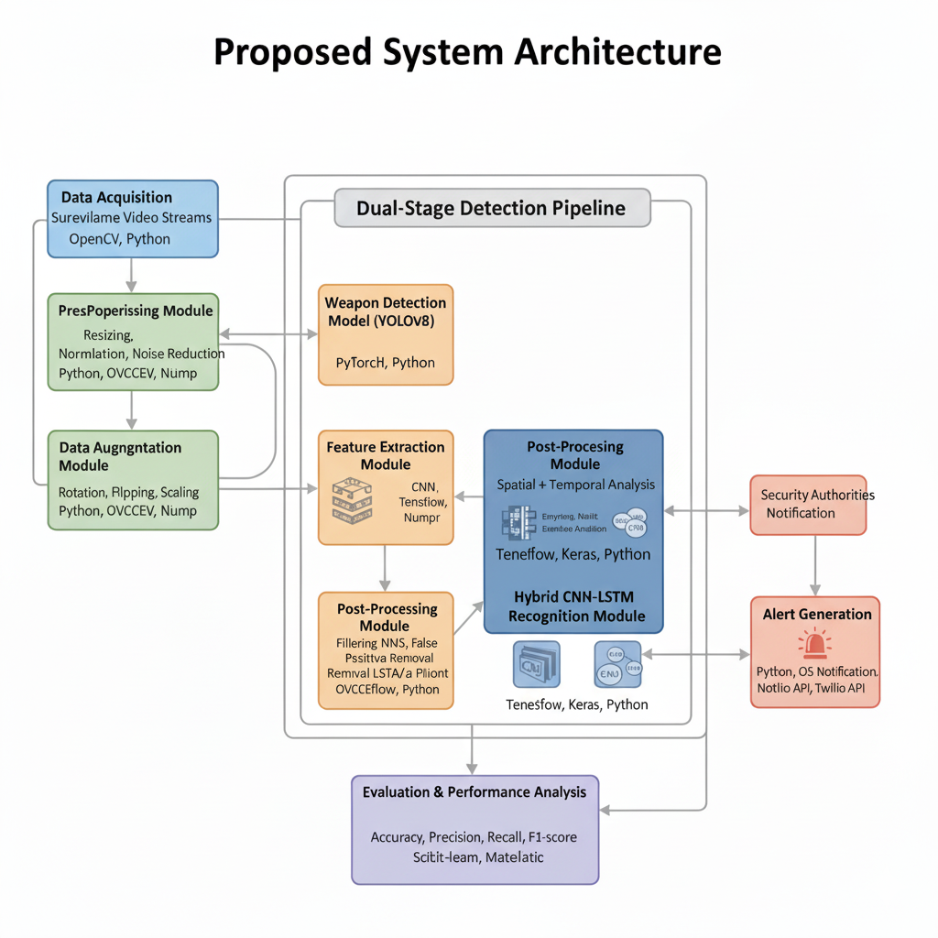
METHODOLOGIES
Proposed Architecture

Slide 11
METHODOLOGIES
Proposed System Algorithm
The proposed system integrates YOLOv8 for real-time multi-weapon detection and a CNN-LSTM hybrid network for behavior-based recognition.
YOLOv8 extracts spatial features and identifies multiple weapon types (e.g., guns, knives, rifles) within each frame, ensuring precise localization and classification.
The CNN-LSTM module captures temporal motion patterns across consecutive frames to differentiate between harmless movements and threatening actions and alert are sent for true cases.
The model’s performance is assessed using Accuracy, Precision, Recall, and F1 Score, with training and validation plots for each metrics

Slide 12
Performance Analysis
Accuracy: Measures the overall correctness of weapon detection by evaluating the ratio of correctly identified threats to the total instances.
Precision: Determines how many of the detected weapons are correctly classified, minimizing false weapon detections.
Recall: Evaluates the system’s ability to detect all actual weapons and armed individuals, reducing missed threats.
F1 Score: Combines precision and recall to provide a balanced assessment of the detection model’s overall performance.

Slide 13
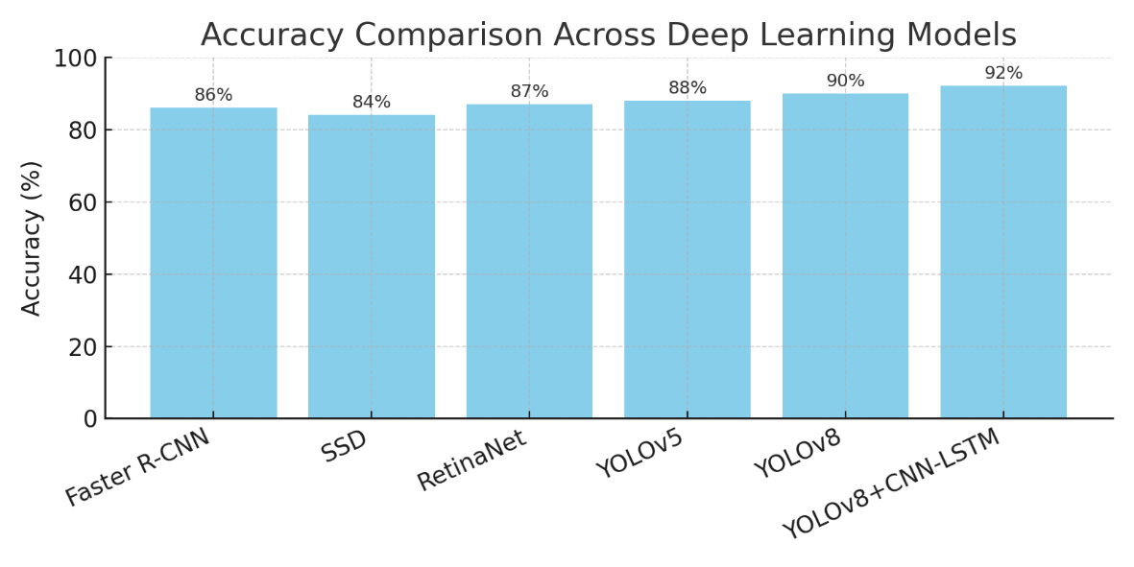

Accuracy
Proportion of correctly classified instances (weapon) out of the total test samples.
$Accuracy = (TP + TN) / (TP + TN + FP+ FN)$
Algorithm | Accuracy (%)
Faster R-CNN(Baseline) | 86
SSD-MobileNetV2 | 84
RetinaNet | 87
YOLOv5 | 88
YOLOv8 | 90
Proposed YOLOv8 + CNN-LSTM | 92.0

Slide 14
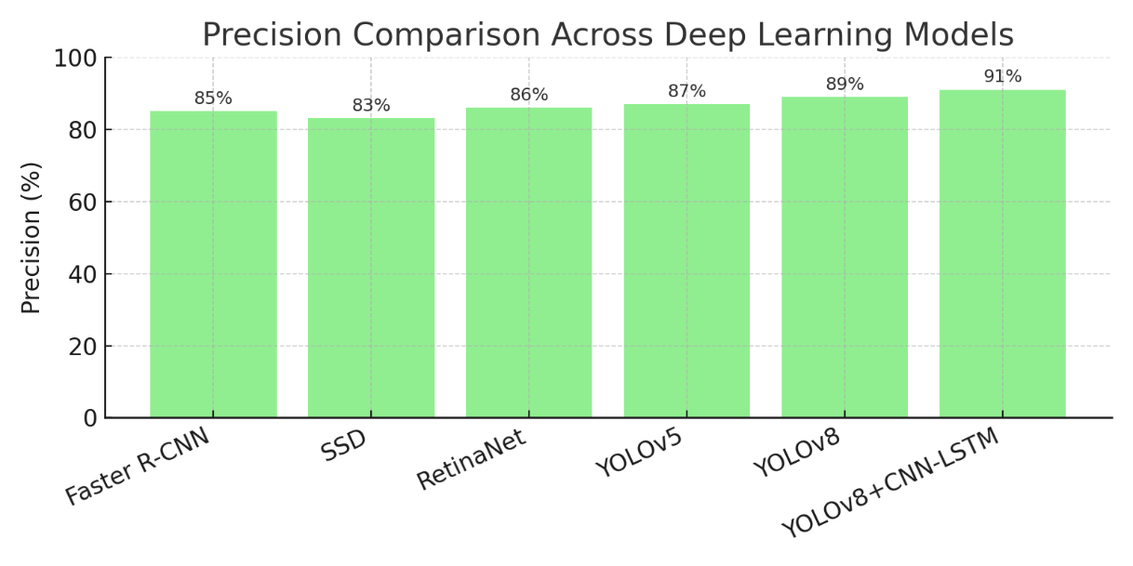

Precision
Proportion of correctly identified weapon (True Positives) out of all predicted instances (True Positives + False Positives). $Precision = TP / (TP + FP)$
Algorithm | Accuracy (%)
Faster R-CNN(Baseline) | 85
SSD-MobileNetV2 | 83
RetinaNet | 86
YOLOv5 | 87
YOLOv8 | 89
Proposed YOLOv8 + CNN-LSTM | 91

Slide 15
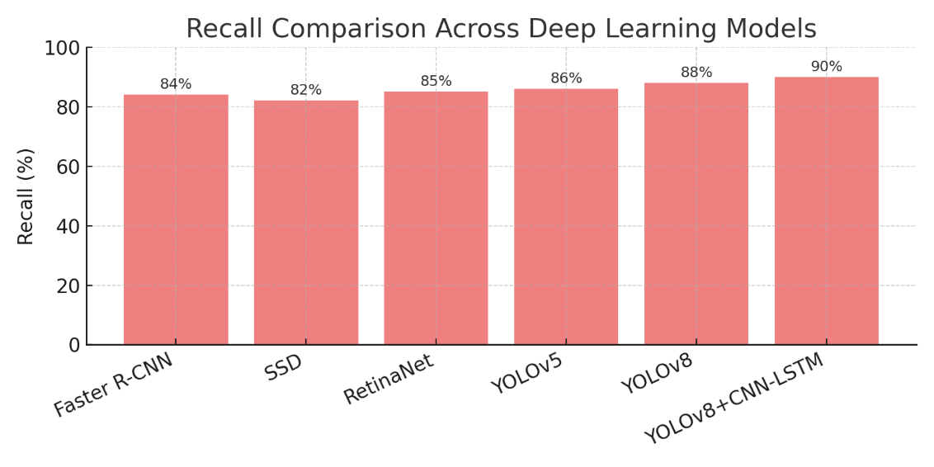

Recall
Proportion of correctly detected weapon (TP) out of all sample instances (TP + FN). $Recall = TP / (TP + FN)$
Algorithm | Accuracy (%)
Faster R-CNN(Baseline) | 84
SSD-MobileNetV2 | 82
RetinaNet | 85
YOLOv5 | 86
YOLOv8 | 98
Proposed YOLOv8 + CNN-LSTM | 90.0

Slide 16
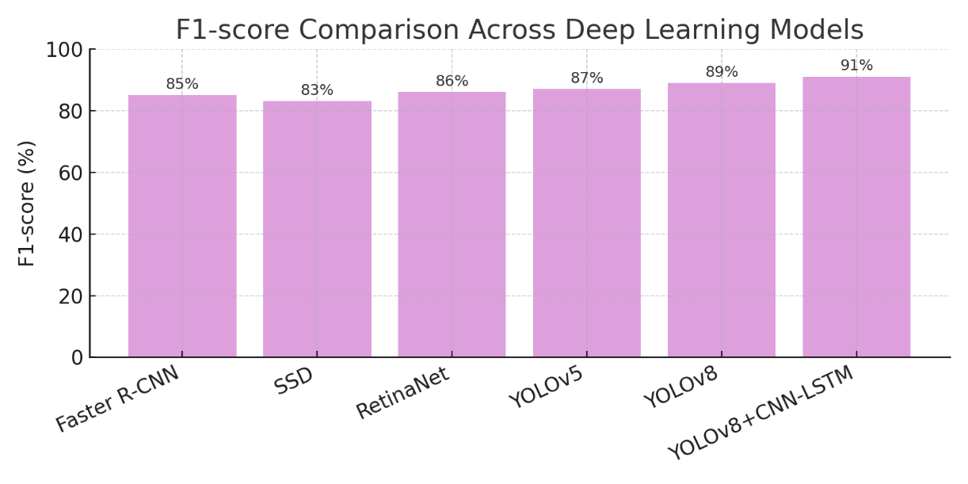

F1 Score
The harmonic mean of precision and recall, balancing true positives against false positives and false negatives.
$F1 Score = 2 ∗ (Precision ∗ Recall) / (Precision + Recall)$
Algorithm | Accuracy (%)
Faster R-CNN(Baseline) | 85
SSD-MobileNetV2 | 83
RetinaNet | 86
YOLOv5 | 87
YOLOv8 | 89
Proposed YOLOv8 + CNN-LSTM | 91.0

Slide 17
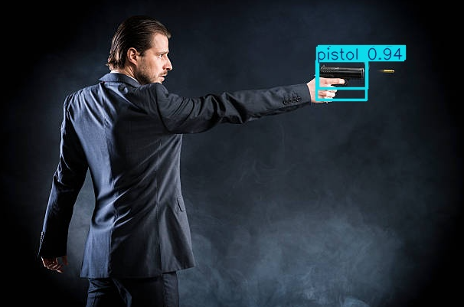
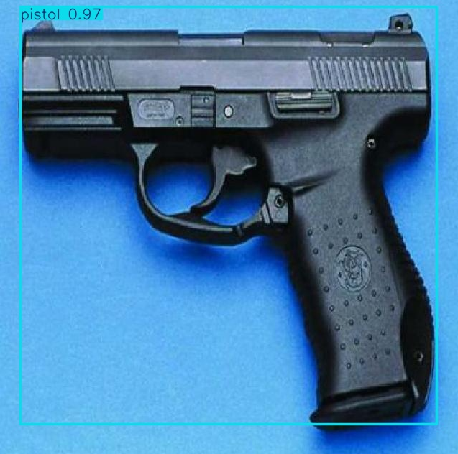
Working screenshots

Slide 18
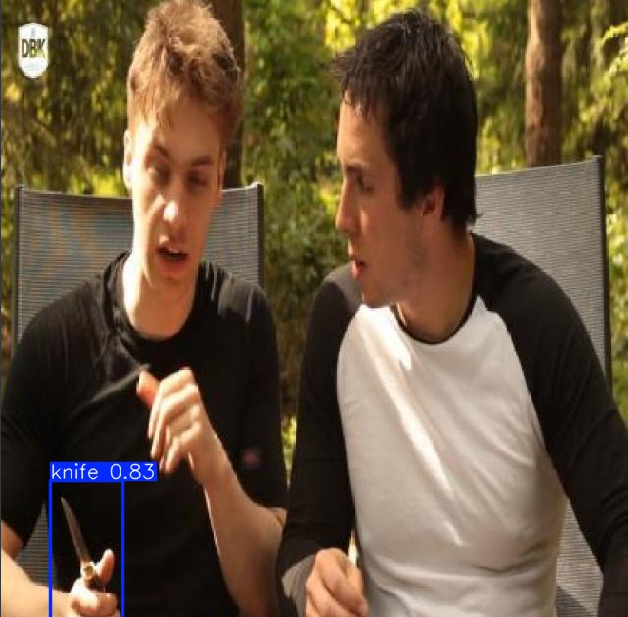
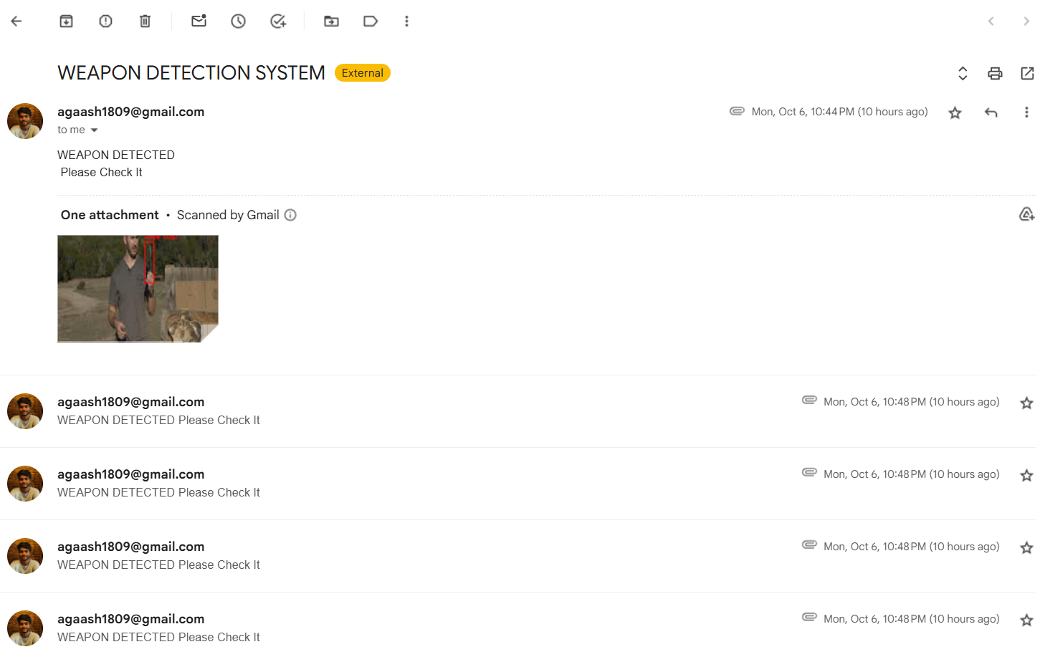
Working screenshots

Slide 19
CONCLUSION
The proposed smart surveillance framework integrates YOLOv8 with a CNN-LSTM hybrid model for accurate and real-time detection of multiple weapons in live video streams.
The system effectively identifies and classifies threats such as guns, knives, and rifles, ensuring enhanced situational awareness in public and restricted areas.
By combining YoloV8 and CNN-LSTM improves 6% of accuracy compared to existing model, which gives overall F1-score of 91.0.
The proposed architecture delivers high accuracy and rapid response, making it efficient solution for intelligent security and automated threat alert systems.

Slide 20
Reference
Dr. M. R. Raja Ramesh, P. Mamatha, P. Viswanadha Pavan Varma, and S. Wasim Akram, “Harnessing Deep Learning for Video Based Weapon Detection,” Journal of AI, ML & NN, vol. 4, no. 5, pp. 30–40, Aug. 2024.
P. V. Prasanna Kumari, G. Vikram Chandra, Sumalatha Potteti, Pornima Niranjane, Namita Parati, and N. Sudha Laxmaiah, “Deep Learning-based camouflaged object detection and tracking for enhanced video surveillance,” Panamerican Mathematical Journal, vol. 34, no. 4, Oct. 2024.
S. Ahmed, M. T. Bhatti, M. G. Khan, B. Lövström, and M. Shahid, “Development and optimization of Deep Learning models for weapon detection in surveillance videos,” Applied Sciences, vol. 12, no. 12, art. 5772, 2022.
Handgun Detection Using Combined Human Pose and Weapon Appearance,” IEEE Access, vol. 9, pp. 123815–123826, 2021.
Weapon Detection using Artificial Intelligence and Deep Learning for Security Applications, IEEE Xplore Part Number: CFP20V66-ART.
P. Janani, A. Suratgar, and A. Taghvaeipour, “Enhancing human action recognition and violence detection through Deep Learning audiovisual fusion,” arXiv preprint, Aug. 2024.
“Audio-Visual Representation Learning for Anomaly Events Detection in Crowds” (ArXiv, 2021) 3D-CNN + audio-CNN fusion improves crowd anomaly detection in surveillance.
20

Slide 21
Reference
M. R. Lima, D. J. Ferreira, E. S. Dias, M. R. Mota, A. L. B. Chagas, and P. L. S. Lobo, “Computer Vision for Weapon Detection in Educational Environments: A Systematic Literature Review,” in Anais Estendidos do impósio Brasileiro de Sistemas Multimídia e Web (WebMedia 2024), Juiz de Fora, MG, Brazil, pp. 121–128, 2024.
J. Ruiz-Santaquiteria, A. Velasco-Mata, N. Vállez, G. Bueno, J. A. Álvarez-García, and O. Deniz, “Improving handgun detection through a combination of visual features and body pose-based data,” Pattern Recognition, vol. 136, art. no. 109252, 2023.
Salido, J.; Lomas, V.; Ruiz-Santaquiteria, J.; Deniz, O. Automatic Handgun Detection with Deep Learning in Video Surveillance Images. Applied Sciences 2021, 11, 6085.
Olmos, R.; Tabik, S.; Lamas, A.; Pérez-Hernández, F.; Herrera, F. A binocular image fusion approach for minimizing false positives in handgun detection with Deep Learning. Information Fusion 2019, 49, 271–280. (Reduces false positives with stereo image fusion.)
D. Berardini, L. Migliorelli, A. Galdelli, E. Frontoni, A. Mancini, and S. Moccia, “A deep-learning framework running on edge devices for handgun and knife detection from indoor video-surveillance cameras,” Multimedia Tools and Applications, vol. 83, pp. 19109–19127, Jul. 2023.
G. Hernández, R. Fonseca, and E. López, “Concealed weapon detection using thermal cameras,” Vision, vol. 11, no. 3, p. 72, Mar. 2023.
21

Slide 22
Reference
A. Alotaibi, F. Alraddadi, and A. Jebreen, “Weapon detection in surveillance footage through Deep Learning: A systematic review,” Computer Science Review, vol. 49, p. 100612, Feb. 2024.
M. E. E. Quyyum and M. H. L. Abdullah, “Weapon Detection in Surveillance Videos Using Deep Neural Networks,” in MECON 2022, AER 214, edited by M. Y. bin Alias, pp. 183–195, 2023.
22

