Slide 1
SOLANAWATCH • IOT-BASED DISEASE EARLY WARNING SYSTEM
SOLANAWATCH | WEEKLY PROGRESS REPORT
SURFER BROS • Group 1 (3ITC) • Special Term, A/Y 2025–2026
● STATUS: ON TRACK
CURRENT TASKS:
EXPECTED CHALLENGES:
PLAN FOR NEXT WEEK:
• 100% Complete Materials Procurement
Acquired full ₱7,208 Bill of Materials with all components on-hand: ESP32 DevKit V1, DHT22 with Stevenson shield, dual DS18B20 soil temp probes, Capacitive v1.2 moisture sensor, industrial IP68 RS485 dielectric leaf wetness grid, 20W solar PV, MPPT controller, 12.8V LiFePO4 battery (47-day autonomy), and IP66 enclosure.
• Physical Circuit Bring-Up
Started breadboard layout, pin mapping, and isolated dual 5V/3.3V power rails. Verified initial 1-Wire, ADC, and RS485 communication lines.
• Interactive UI Dashboards
Completed functional PC Web Dashboard and iOS mobile views featuring live microclimate gauges, disease risk calculation, and actionable cultural alerts.
• Ethics Clearance Accomplished
Completed UST Ethics Review Form 4.2 (Protocol Assessment) and Form 7.2 (Application for Ethics Review) for institutional compliance.
• Mixed-Bus Signal Integrity
Concurrent 1-Wire, analog ADC, and RS485 lines can cause electrical noise. Separated 5V logic and 3.3V sensor rails via dual buck converters; added 4.7kΩ pull-ups and line filters.
• RS485 Modbus-RTU Timing
Potential timing contention between MAX485 switching and ESP32 Wi-Fi routines. Dedicated ESP32 Core 1 FreeRTOS task to sensor polling, isolating it from Core 0 network tasks.
• Two-Point Soil Calibration
ADC variance across Philippine clay-loam Solanaceae soils. Calibrating in controlled oven-dry (0% VWC) and saturated (100% VWC) soil samples.
• Complete Circuit Assembly
Finalize physical breadboard wiring harness connecting all 5 sensors to ESP32 and test power delivery from the 12.8V LiFePO4 battery pack.
• FreeRTOS Firmware Routines
Implement multi-sensor sampling loops and offline FIFO MicroSD buffer (telemetry_buffer.jsonl) for zero-loss edge storage.
• Cloud Ingestion & Risk Engine
Connect Node.js/Express REST API to Turso libSQL cloud database and link Wallin SV and Hydrothermal risk models.
• Sensor Bench Calibration
Execute ice-point (0.0°C) and NaCl humidity chamber (75.3% RH) calibration tests.
Team Members: Morales, Simeon Agabus S. • Rapada, Raven M. • Hernandez, Andrei S. • Eugenio, Vince Angelo | Adviser: Prof. Eugenia R. Zhuo, DIT

Slide 2
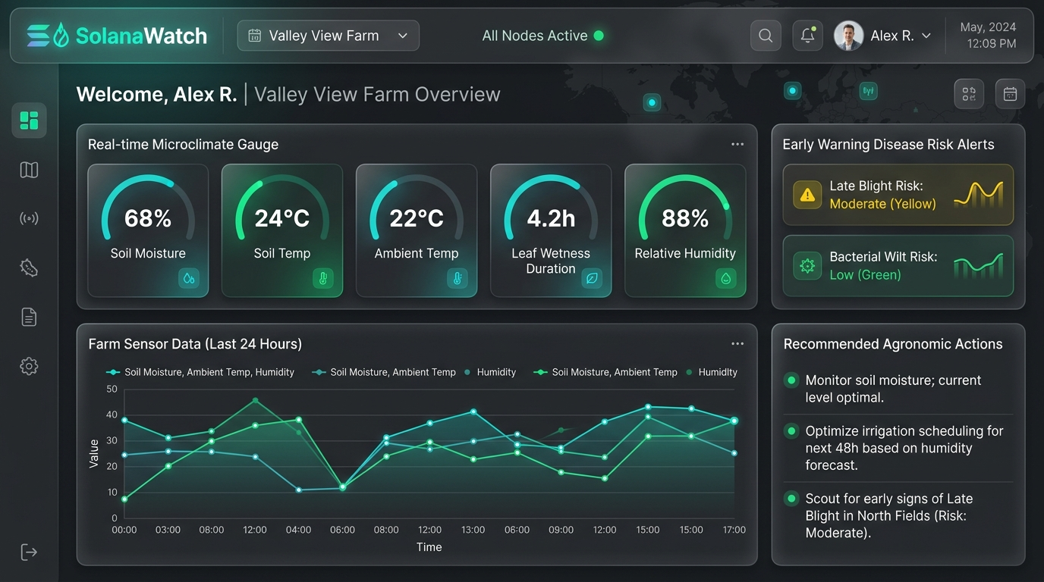
SOLANAWATCH • HARDWARE SHOWCASE & SYSTEM HIGHLIGHTS
Hardware Materials Inventory & Working Application
● 100% MATERIALS IN-HAND
Materials Inventory & System Highlights
✔ 100% Complete Hardware Materials
All components on-hand: ESP32 MCU, DHT22 in Stevenson shield, DS18B20 soil temp, Capacitive v1.2, IP68 RS485 leaf wetness grid, 20W PV, MPPT controller, and 12.8V LiFePO4 battery (47-day autonomy).
✔ Physical Circuit Bring-Up Initiated
Breadboard layout, pin mapping, isolated 5V & 3.3V power rails, and preliminary sensor communication checks actively progressing.
✔ Working Decision Support Dashboards
Functional PC Web Dashboard (desktop.html) and iOS mobile view (index.html) featuring live 5-sensor gauges and disease alerts.
✔ Pre-Symptomatic Disease Risk Engine
Embedded algorithms for Late Blight (Wallin Severity Values @ LWD >= 10h) and Bacterial Wilt (Hydrothermal Soil Risk Index R_BW).
✔ Institutional Ethics Clearance Complete
UST Form 4.2 & Form 7.2 accomplished for research protocol compliance and participant safety.
SolanaWatch: An IoT-Based Disease Early Warning System for Soil-Grown Solanaceae Crops | Interactive Prototype: SolanaWatch_PC_Dashboard.html

