Slide 1
MIE1624 Presentation

Slide 2
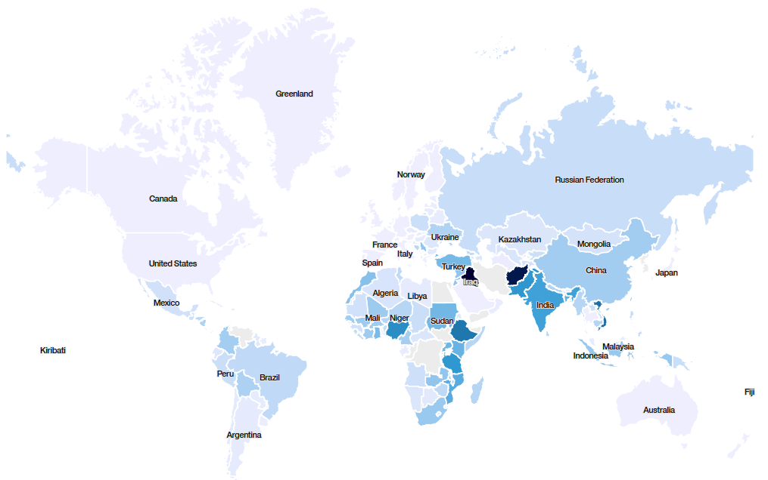

Where does Aid Go in the World?

Slide 3
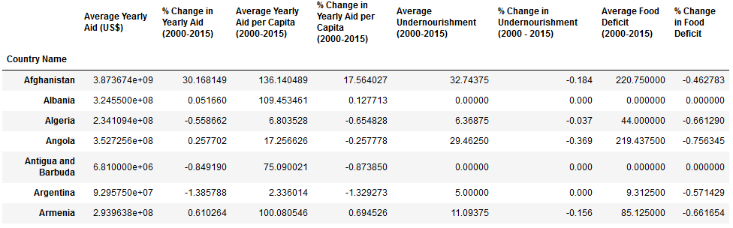
Variables Tested for Correlations
Data Selection: All countries which received more than $0 in aid between 2000-2015 (151 countries)

Slide 4
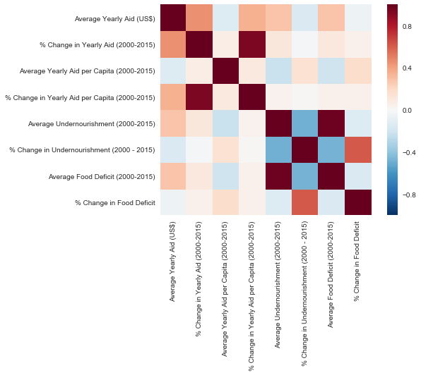
Correlation Results

