Slide 1


liber:Ghost Protocol
Phone off.
Permission on.
A prefunded payment permission
that can leave your phone.
BSC Testnet / MockUSDC / No cash value
01
Notes:
Ghost explores payment permissions prepared before a buyer loses device access. This is a BSC Testnet prototype with no cash value. The merchant remains online.
Sources:
https://liber-bnb-web.vercel.app/ghost
https://github.com/agadape/Liber_BnB_hackathon_2026

Slide 2
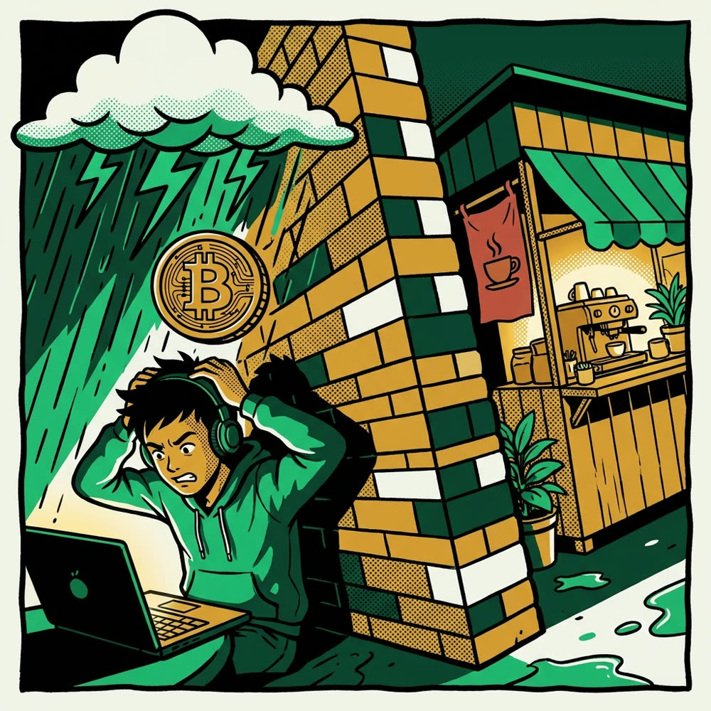
liber:Ghost Protocol
The sandwich is ready.
My battery is not.
1% battery.
100% terrible timing.
What if the permission was ready before the battery died?
02
Notes:
Illustrative scenario, not a customer testimonial: your food is ready as your battery dies. The proposed behavior is to prepare a permission earlier. Physical full-device-off testing is pending.
Sources:
Original team artwork: problem-hook.jpg
https://github.com/agadape/Liber_BnB_hackathon_2026/blob/main/docs/GHOST-JUDGE-GUIDE.md

Slide 3
liber:Ghost Protocol
Give the paper limits.
One merchant.
One amount.
An expiry. One claim.
Prefunded in the vault. Enforced by the contract.
03
Notes:
Recipient, amount, expiry and one-time use are contract-enforced. This is not a general bearer instrument: an arbitrary merchant cannot redeem. Preparation friction and recipient preselection are trade-offs.
Sources:
https://repo.sourcify.dev/97/0x0837ac35ec54F678ba08912dcfd6166a299FCA31

Slide 4
liber:Ghost Protocol
Prepare. Carry. Claim.
01 / BUYER ONLINE
02 / PRIVATE HANDOVER
03 / MERCHANT ONLINE
Sign + reserve
→
Carry the QR
→
Claim once
Merchant, amount, expiry
No wallet private key
Named wallet + gas
Unused? Owner reclaims at or after expiry.
04
Notes:
Editable protocol diagram. Buyer signs EIP-712 authorization and reserves tokens while online. Active signature is excluded from reserve calldata and shared privately. Merchant redeems online with the named wallet and gas. Unused funds may be reclaimed by the owner at or after expiry, not automatically.
Sources:
https://repo.sourcify.dev/97/0x0837ac35ec54F678ba08912dcfd6166a299FCA31
https://github.com/agadape/Liber_BnB_hackathon_2026/blob/main/submission/project-detail.md

Slide 5
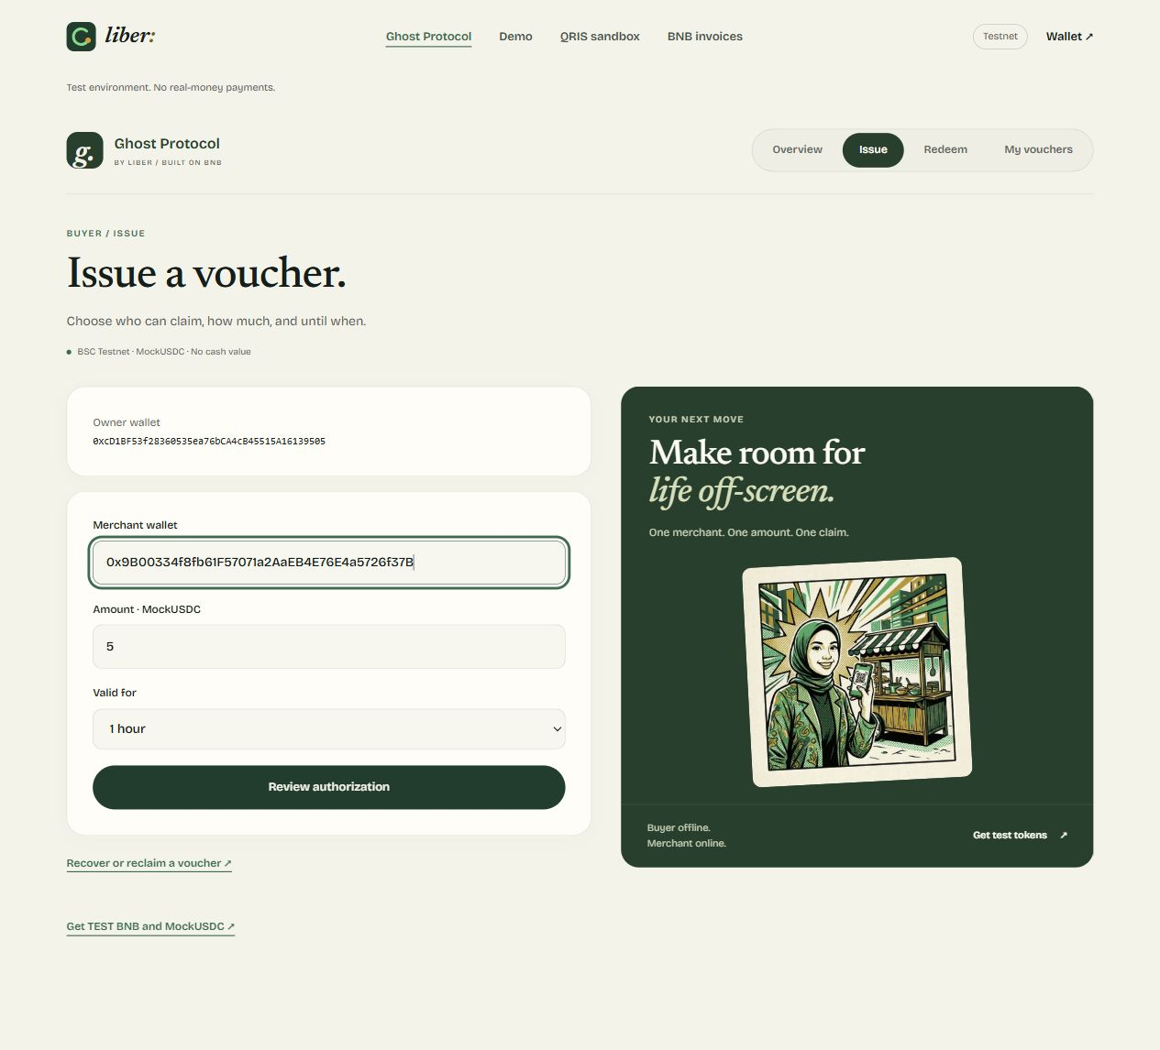
liber:Ghost Protocol
Review first.
Reserve second.
Choose the recipient.
Set the exact amount.
Pick an expiry.
Live UI walkthrough / no new transaction
05
Notes:
Actual live preparation interface captured 2 October 2026. This screenshot is a UI-only walkthrough with a new unfunded local wallet, not the historical payment evidence. No transaction was sent during this capture.
Sources:
https://liber-bnb-web.vercel.app/ghost/create

Slide 6
liber:Ghost Protocol
The paper has boundaries.
Wrong merchant → rejected
Already used → rejected
Too early to reclaim → rejected
No admin withdrawal. No upgrade path.
Share active codes privately. Delivery is outside the contract.
06
Notes:
The immutable vault checks authorization, recipient and lifecycle. No admin withdrawal, fees, pause or upgrade path exists. EOA only. Active signature becomes public after redemption. No delivery or rupiah settlement guarantee. Tests are not an independent audit.
Sources:
https://repo.sourcify.dev/97/0x0837ac35ec54F678ba08912dcfd6166a299FCA31
https://github.com/agadape/Liber_BnB_hackathon_2026/blob/main/docs/GHOST-PITCH-QA.md

Slide 7
liber:Ghost Protocol
Inspect the paper trail.
5 MockUSDC
2 MockUSDC
Claimed by the named merchant.
Returned after expiry.
Open payment proof ↗
Open reclaim proof ↗
171 automated tests / 12 hosted API checks
Recorded testnet evidence. No cash value.
07
Notes:
Separate recorded testnet transactions: five MockUSDC transferred to merchant, two MockUSDC reclaimed to owner from a different expired voucher. Both public pages verify canonical events and matching ERC20 transfers. The 171 tests and 12 hosted checks are recorded engineering evidence, not customer traction or independent audit.
Sources:
https://liber-bnb-web.vercel.app/ghost/receipt?id=0xdfad2e816fba512fdda912ced241d9464c3f1358c16427fcfd7ac3fac2067924
https://liber-bnb-web.vercel.app/ghost/receipt?id=0x5f04a6af2b67a0519ed123946b3b5834d5648974ea23edfd8c70fbf2c0a567fb
https://github.com/agadape/Liber_BnB_hackathon_2026/blob/main/contracts/deployments/ghost-demo-e2e.json

Slide 8
liber:Ghost Protocol
Built on BNB. Inspectable.
BROWSER
BSC VAULT
API / DATABASE
Private authorization
Local handover
Funds + enforcement
Public events
Unsigned metadata
Verified proofs
Ghost vault / BSC Testnet (97)
0x0837ac35ec54F678ba08912dcfd6166a299FCA31
Exact source match on Sourcify ↗
08
Notes:
The browser holds the private authorization locally. The backend stores unsigned metadata and verified proofs; it does not store active signatures or keys. SIWE guards wallet-owned metadata. Contract source has an exact Sourcify match; a BscScan source badge is not claimed. BSC Testnet chain97, EIP712 LiberGhost v1.
Sources:
https://repo.sourcify.dev/97/0x0837ac35ec54F678ba08912dcfd6166a299FCA31
https://testnet.bscscan.com/address/0x0837ac35ec54F678ba08912dcfd6166a299FCA31
https://github.com/agadape/Liber_BnB_hackathon_2026

Slide 9
liber:Ghost Protocol
Start small. Learn something real.
A prearranged event merchant pilot.
Measure preparation friction and scanning.
Test the buyer’s whole device being off.
Review security before real value.
Proposed pilot / physical and printed-paper tests pending
09
Notes:
Proposal, not traction: bounded event with prearranged merchants and sandbox community tokens. Measure setup friction, scan success and merchant comprehension. Physical full-device-off and print tests remain pending. Independent security review and a defined operating/legal model are gates before real value. No revenue, adoption or regulatory approval claimed.
Sources:
https://github.com/agadape/Liber_BnB_hackathon_2026/blob/main/docs/GHOST-PITCH-QA.md

Slide 10

liber:Ghost Protocol
Your battery gets a break.
Your permission keeps
its limits.
Explore Ghost ↗
Public code & evidence ↗
BSC Testnet / MockUSDC / No cash value
10
Notes:
Explore the live workspace and linked evidence without a wallet. We seek feedback and a small prearranged sandbox merchant pilot. This closing illustration is original Liber artwork. English film and editable pitch sources are in the repo; external video/deck publication is handled separately.
Sources:
https://liber-bnb-web.vercel.app/ghost
https://github.com/agadape/Liber_BnB_hackathon_2026

