Slide 1
Sales Web App
RingLeed Python Project
Done by:
Aditya Gade

Slide 2
Tools Used
Mac OSX bash terminal for locally running the server .
Django Web Framework
Rest APIs
Python
HTML and CSS

Slide 3
APIs Included:
Shop : Containing URL patterns and settings of the whole sales web application.
Cart: Containing functionalities , forms and views of adding a product to customer’s cart and viewing the cart before checkout. Customer will have the option to remove the product from the cart and also update quantity of products in the cart.
Orders: Containing functionalities and views of adding customers' credentials and processing the order from the cart api .Once the user enters the details and submit. The details will be saved at the django backend administration database with corresponding order ID.

Slide 4
MVC (Model-View-Controller)
I have deployed the MVC architectural pattern to define my databases and relationship between them. Below is the UML:
Category
Name
Name-Slug
1.Category [1.*FK ]
2.Name
3. Name-Slug
4.Image
5.Description
6. Price
7. Stock
8. Available
FK-Foreign key
1…*
1..*
1…*
Customer DB(Order)
1.first_name
2.last_name
3.email 4.address
5.postal_code
6.City
7.created
8..updated
1…*
1…*
Product Order
Product[1.FK*]
Customer order[1. FK]
Total_price
Quantity

Slide 5
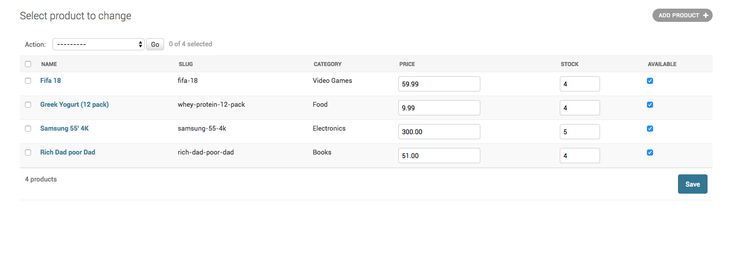
Django-admin view of the product database, I have added bogus products with images ,price and available items for adding to the cart and category to sort or filter these products.

Slide 6
Flow of the application (included sessions framework for temporary storage)
User clicks on the product
In /product_slug
Adds product to the cart
In /cart
User checks the cart and can either update or delete the products int eh cart
In /cart/order Customer enters credentials and checks out
Redirected to the Home Page when URL is entered
/order/created
Order is submitted , customer’s submission is loaded to the database

Slide 7
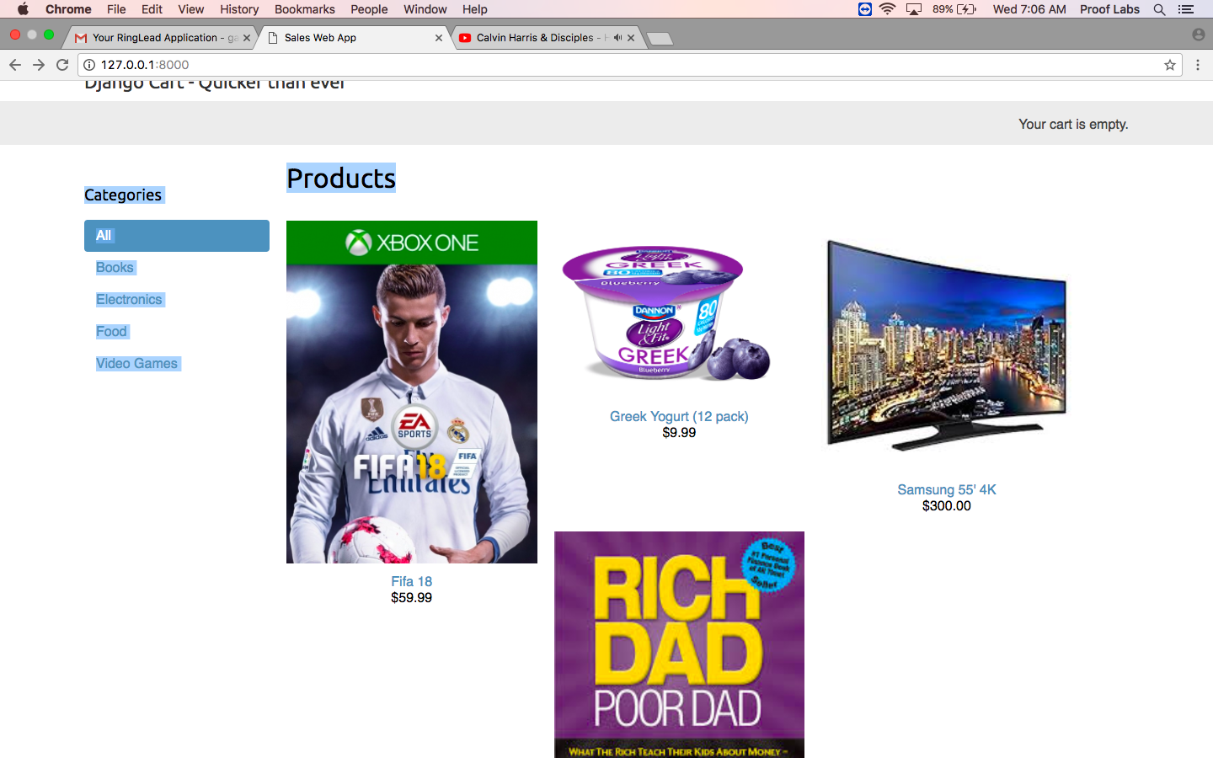
/HOME

Slide 8
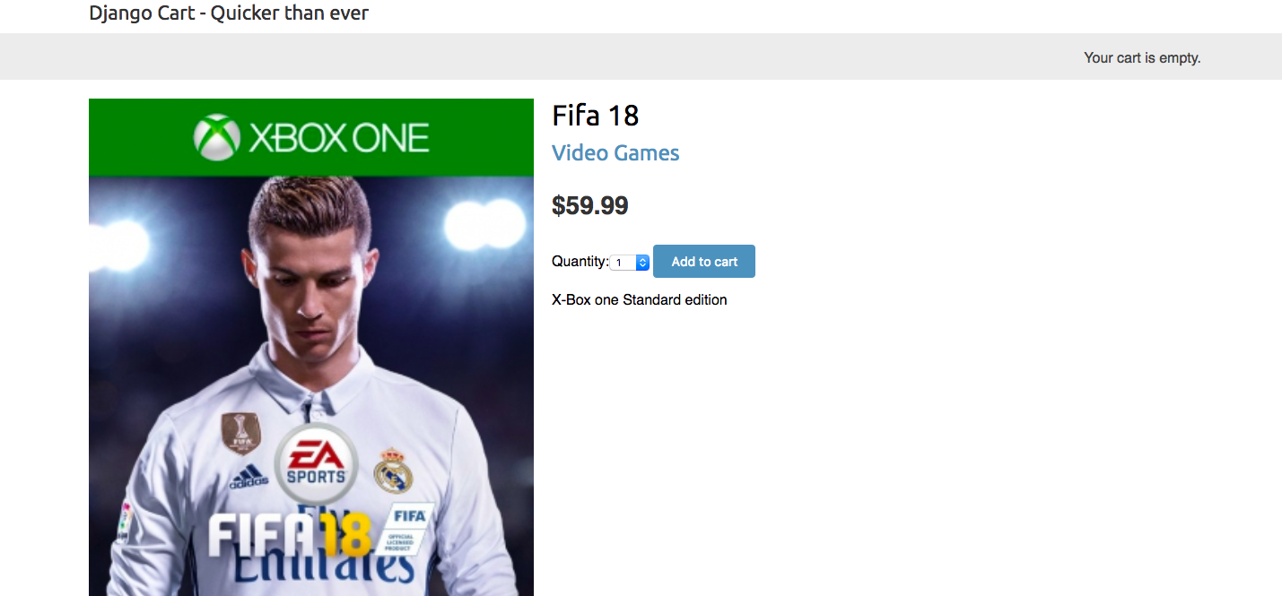
/product_slug(Product window)

Slide 9
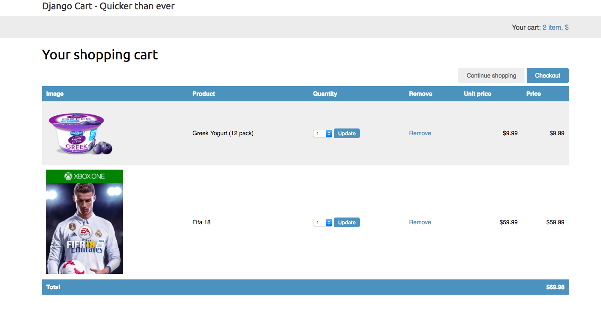
/cart

Slide 10
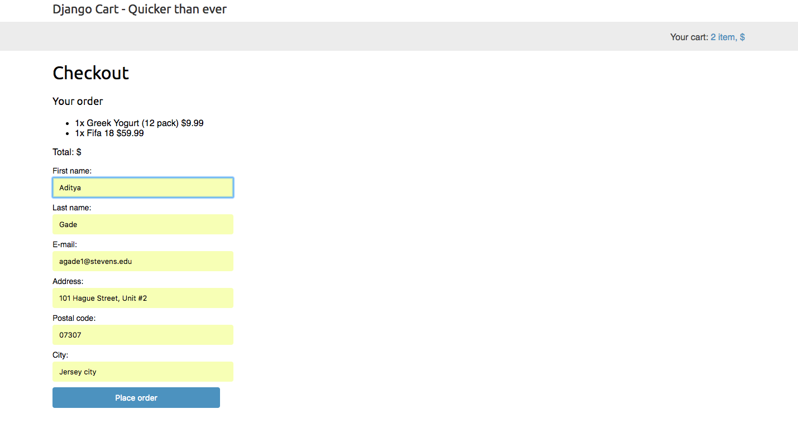
Customer checkout

Slide 11
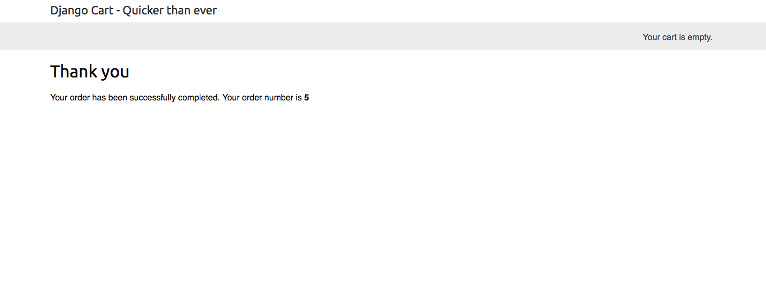
Order Submission page

Slide 12
IMPROVEMENT
I believe there can be many functionalities and optimizations to this applications like payment portal and sending the customer the invoice to the registered email.
GUI, of course can be more interactive but I wanted to make it look it simple yet easily accessible with smooth flow of process between API, Django backend framework and Database tables.

