Slide 1

Drift Rate Analysis of Detected Signals of Interest
ANNA GAGNEBIN, PHYSICS, CALIFORNIA STATE UNIVERSITY, SACRAMENTO
Cal-Bridge, Berkeley SETI Research Center, Dr. David DeBoer
Cal-Bridge Research Symposium | August 28, 2021

Slide 2
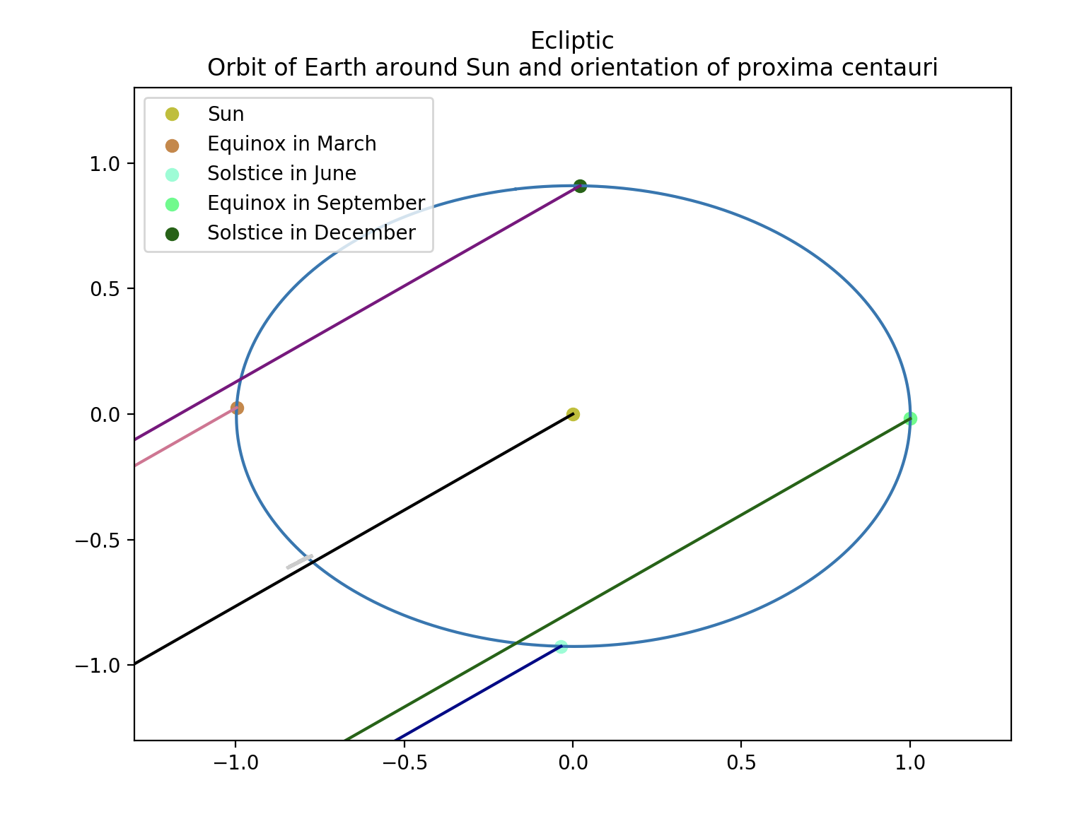
Background and Motivation
This project builds upon previous research analyzing the validity of a signal of interest that seemed to originate from Proxima Centauri.
What makes a signal interesting:
It is only observed when the telescope is directed at a specific point on the sky
It doesn’t seem to match the drift of any known astrophysical phenomenon or radio interference at the frequency of the signal
Causes of frequency drift:
Movement of the Earth as well as the signal source
Movement of man-made radio transmitters
Electronic oscillations of Earth-bound transmitters

Slide 3
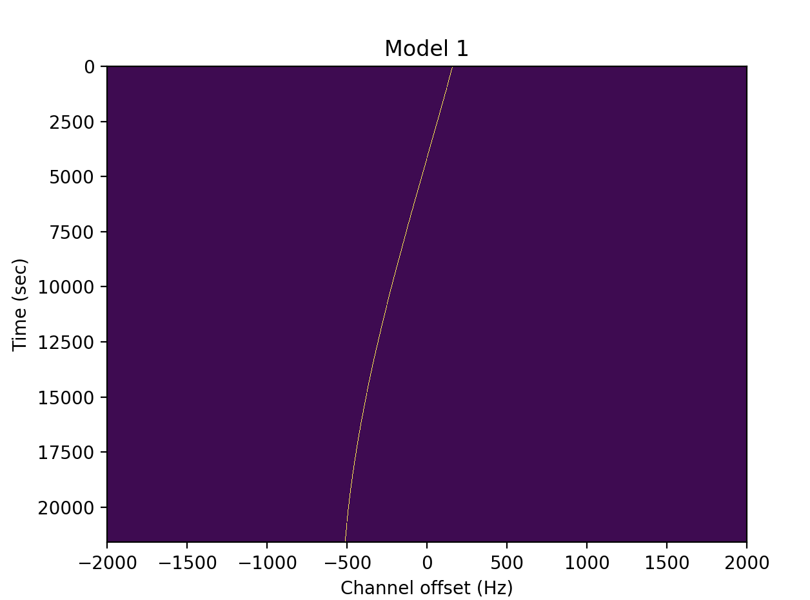
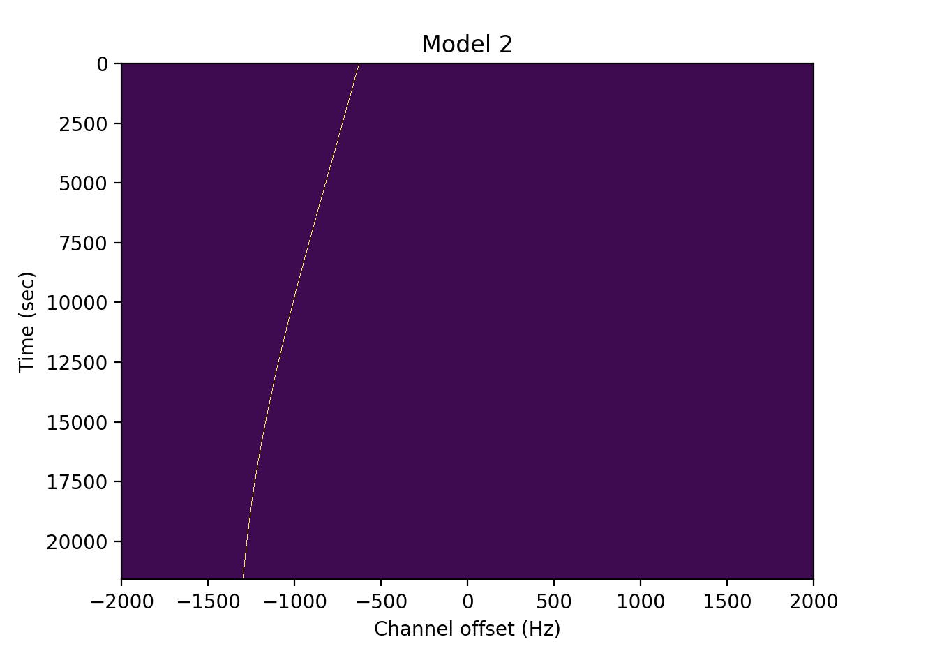
Methods
To analyze the signal, I developed a Jupyter notebook to help visualize the relative location of a potential signal as well as simulate waterfall plots of the signal’s drift.
Model 1: The signal was sent intentionally to our solar system
Model 2: The signal was intentionally sent to the Earth

Slide 4
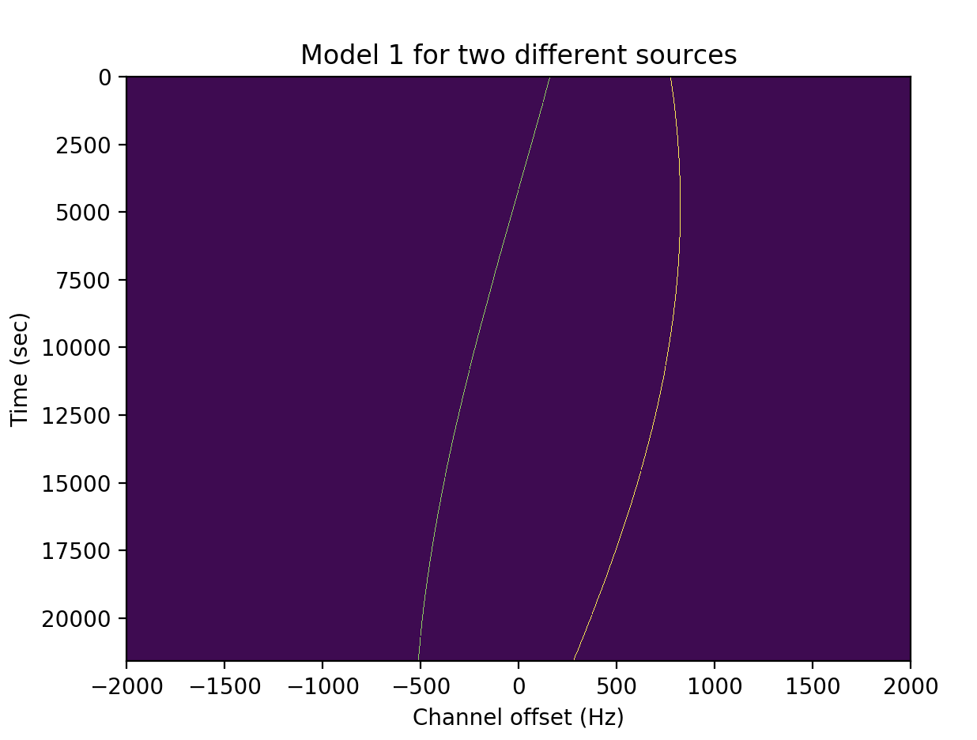
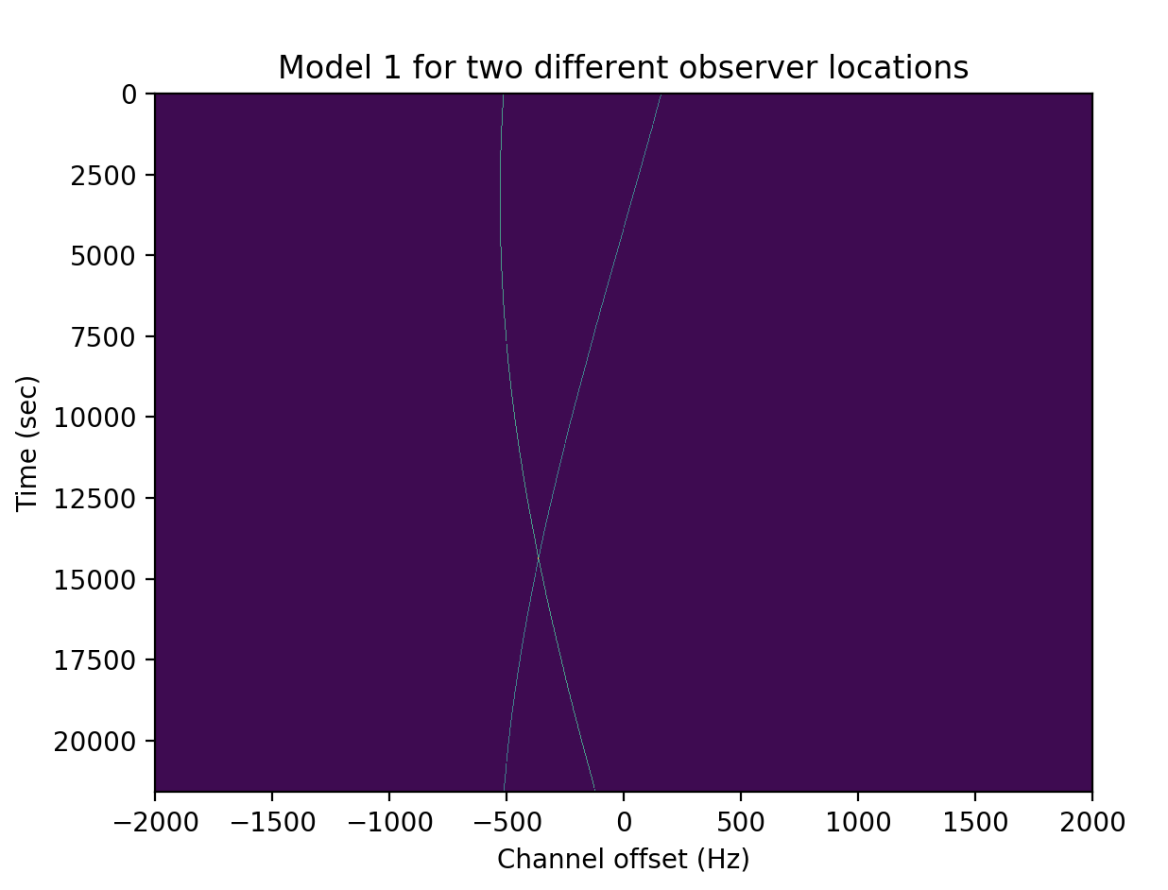
Final Product
Two other functions of the notebook:
A detailed walkthrough of the code
An overview of all the research I’ve done this summer
The point of the notebook was to develop code that could be used in any instance to aid in the search for extraterrestrial intelligence.

