Slide 1

Notes:
SaglamOl — project presentation (Marp). Render/export: npx @marp-team/marp-cli PRESENTATION.md -o PRESENTATION.pdf npx @marp-team/marp-cli PRESENTATION.md -o PRESENTATION.pptx --allow-local-files Speaker notes live in HTML comments and export into the PPTX notes pane.

Slide 2
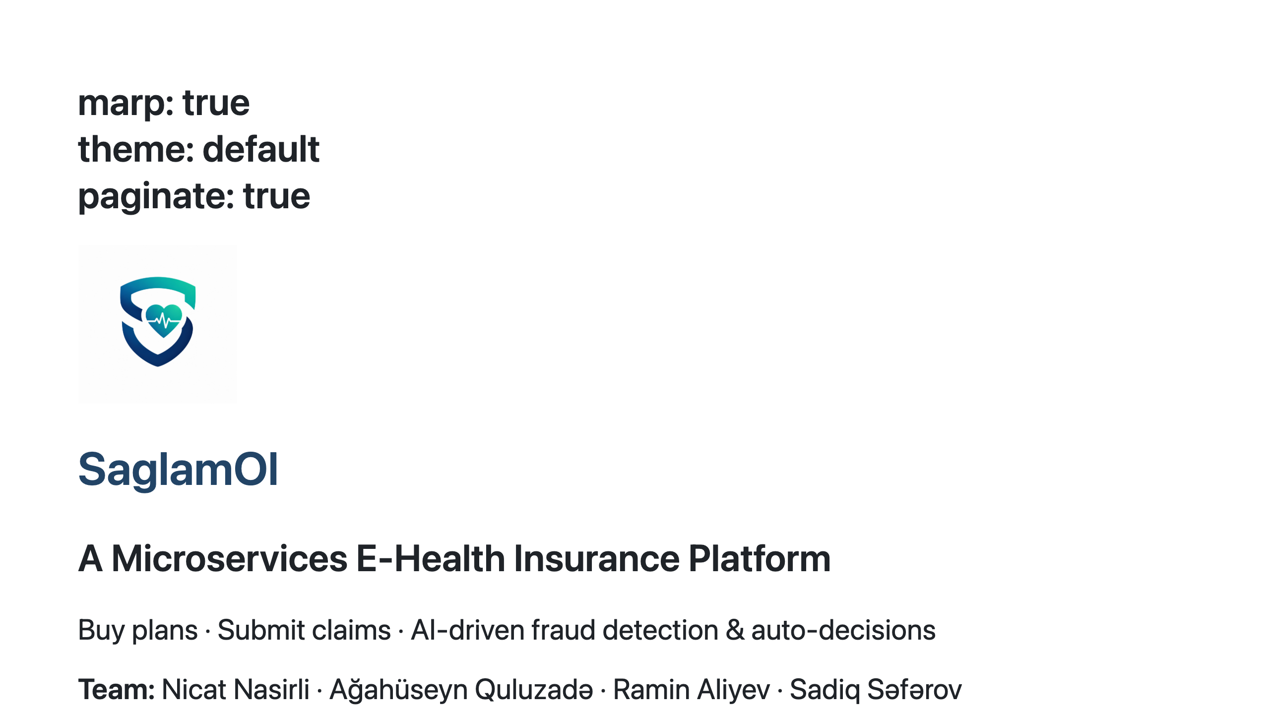
Notes:
This is SaglamOl, an online health-insurance platform we built as a set of microservices. Customers buy plans and submit claims; an AI scores each claim for fraud and auto-decides it, with staff reviewing only the uncertain ones. Over the next slides we'll walk through the architecture, the key flows, and how it all fits together.

Slide 3
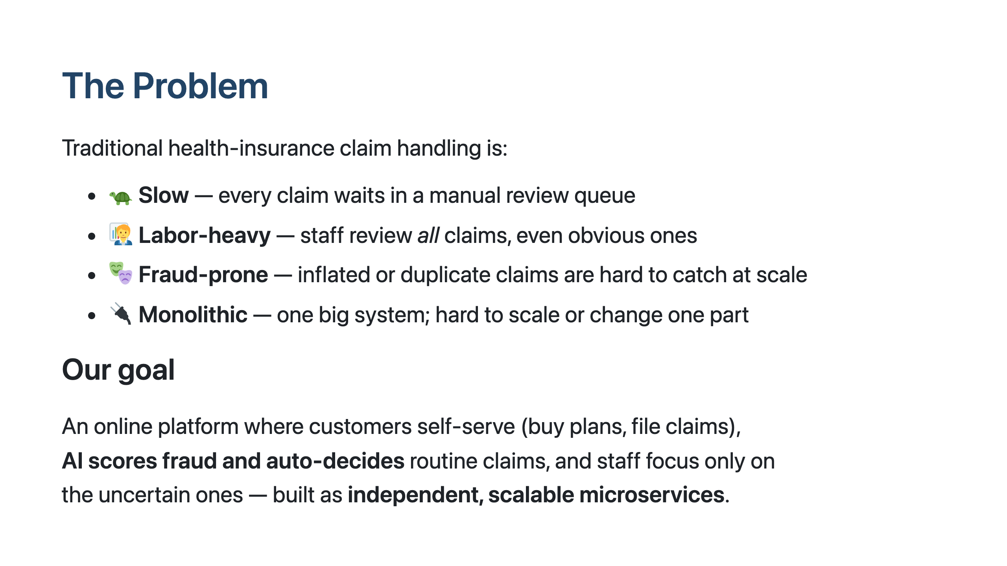
Notes:
Insurance claim processing is traditionally slow and manual — staff review every claim by hand, fraud slips through, and the systems are monolithic. Our goal was to automate the routine path: customers do everything online, an AI scores each claim and decides the clear-cut ones instantly, and humans only handle the genuinely uncertain cases. And we built it as microservices so each part can evolve and scale independently.

Slide 4
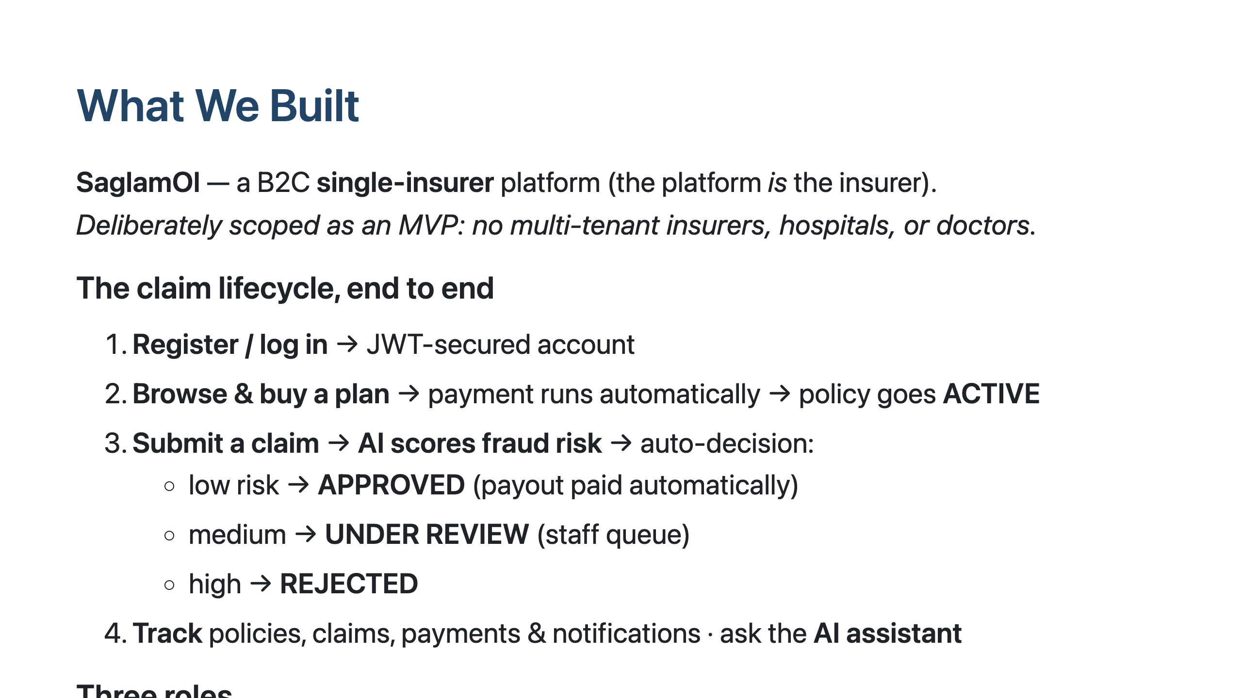
Notes:
SaglamOl is a single-insurer platform — we are the insurer, not a marketplace. The whole lifecycle is online: you register, buy a plan, and payment plus activation happen automatically. When you file a claim, the AI scores it and decides on the spot — low-risk approved and paid, high-risk rejected, and the in-between ones go to a staff review queue. Three roles: customers, staff who review, and admins who manage plans and users.

Slide 5
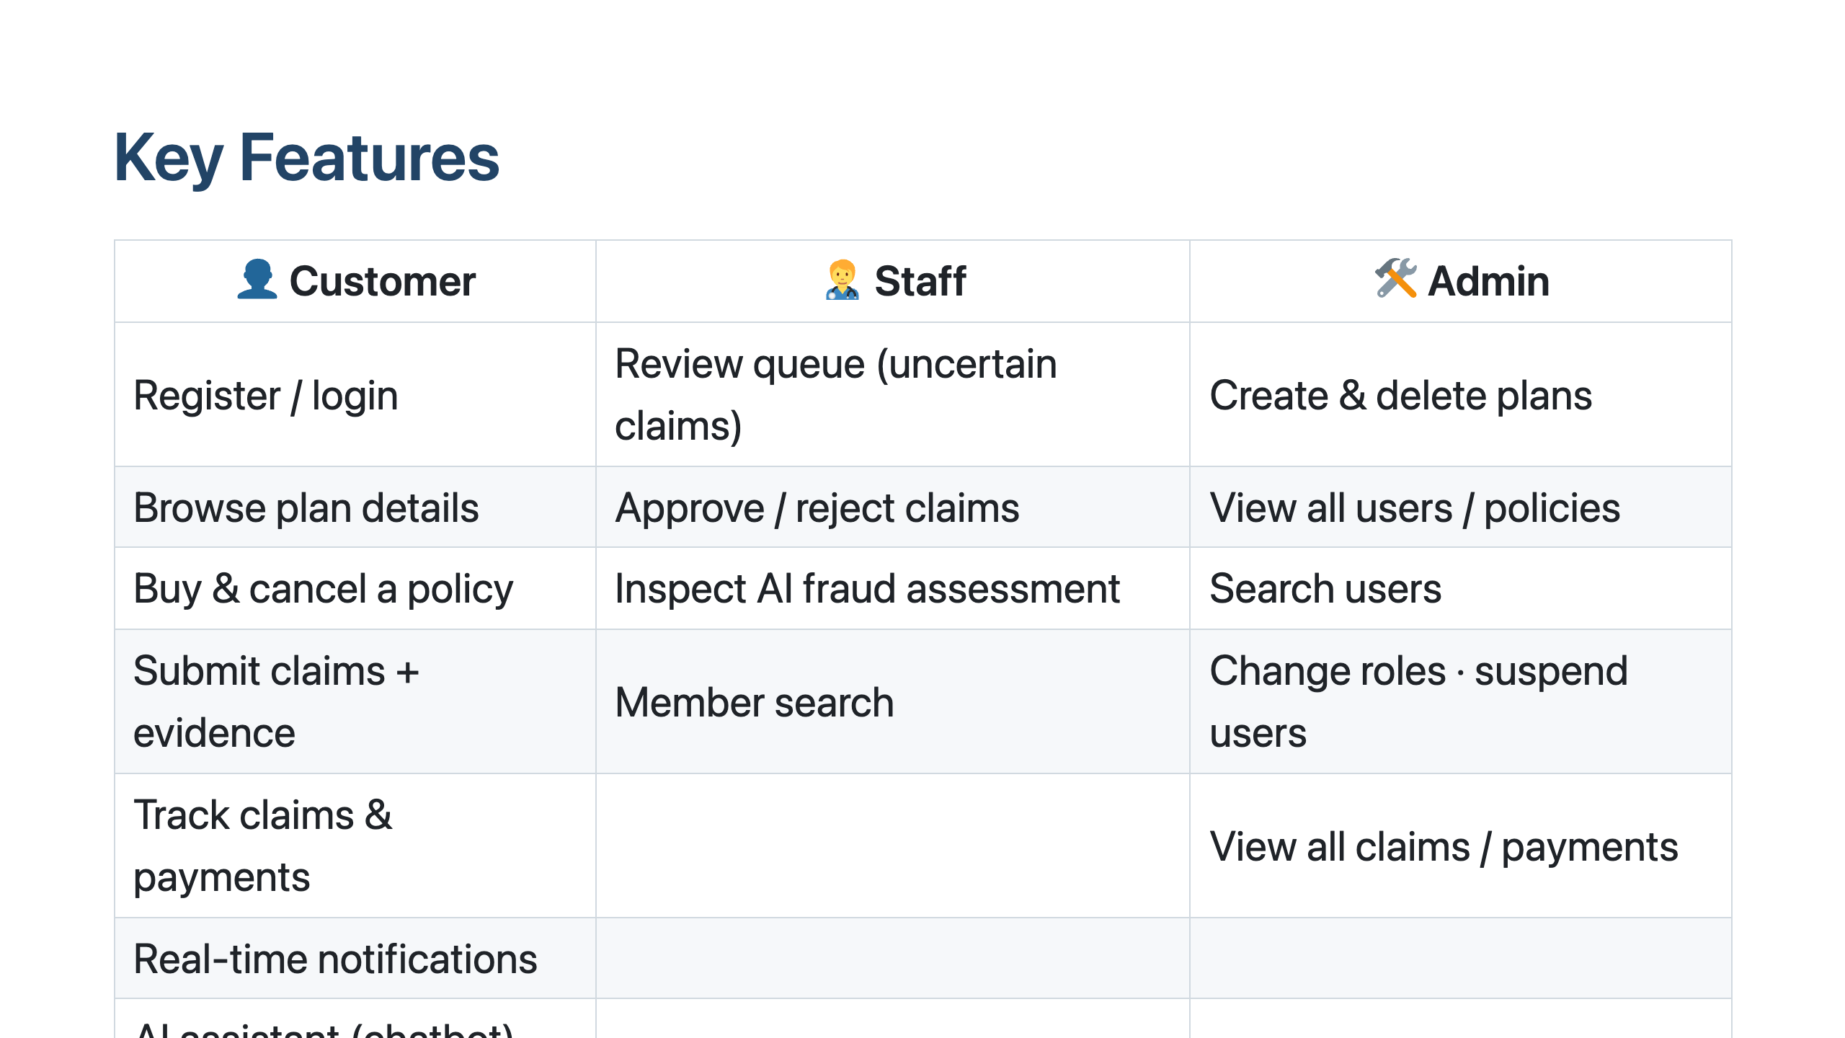
Notes:
Here's what each role can do. Customers self-serve the whole journey — plans, policies, claims with document uploads, notifications, and an AI assistant. Staff work the review queue: the uncertain claims the AI flagged, with the fraud assessment in front of them. Admins manage the catalog and users. Everything is gated by role through JWT.

Slide 6
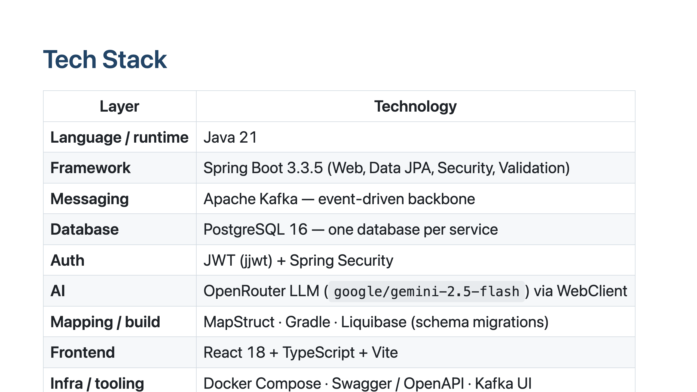
Notes:
The backend is Java 21 and Spring Boot, with Kafka as the event backbone and PostgreSQL as a separate database per service. Auth is JWT. The AI features call an LLM through OpenRouter. Schema is version-controlled with Liquibase. The frontend is React with TypeScript, and the whole stack runs under Docker Compose, with Swagger and a Kafka UI for inspection.

Slide 7
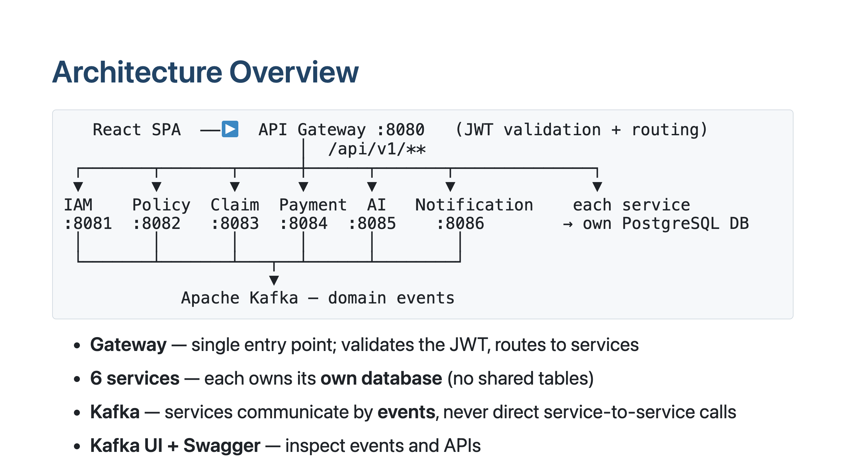
Notes:
TODO: optionally replace this ASCII block with a polished diagram image (e.g. draw.io export) Everything goes through one API gateway, which validates the JWT and routes to the right service. Six backend services, each with its own PostgreSQL database — they never share tables. They coordinate purely through Kafka events rather than calling each other directly, which keeps them decoupled. The React frontend only ever talks to the gateway.

Slide 8
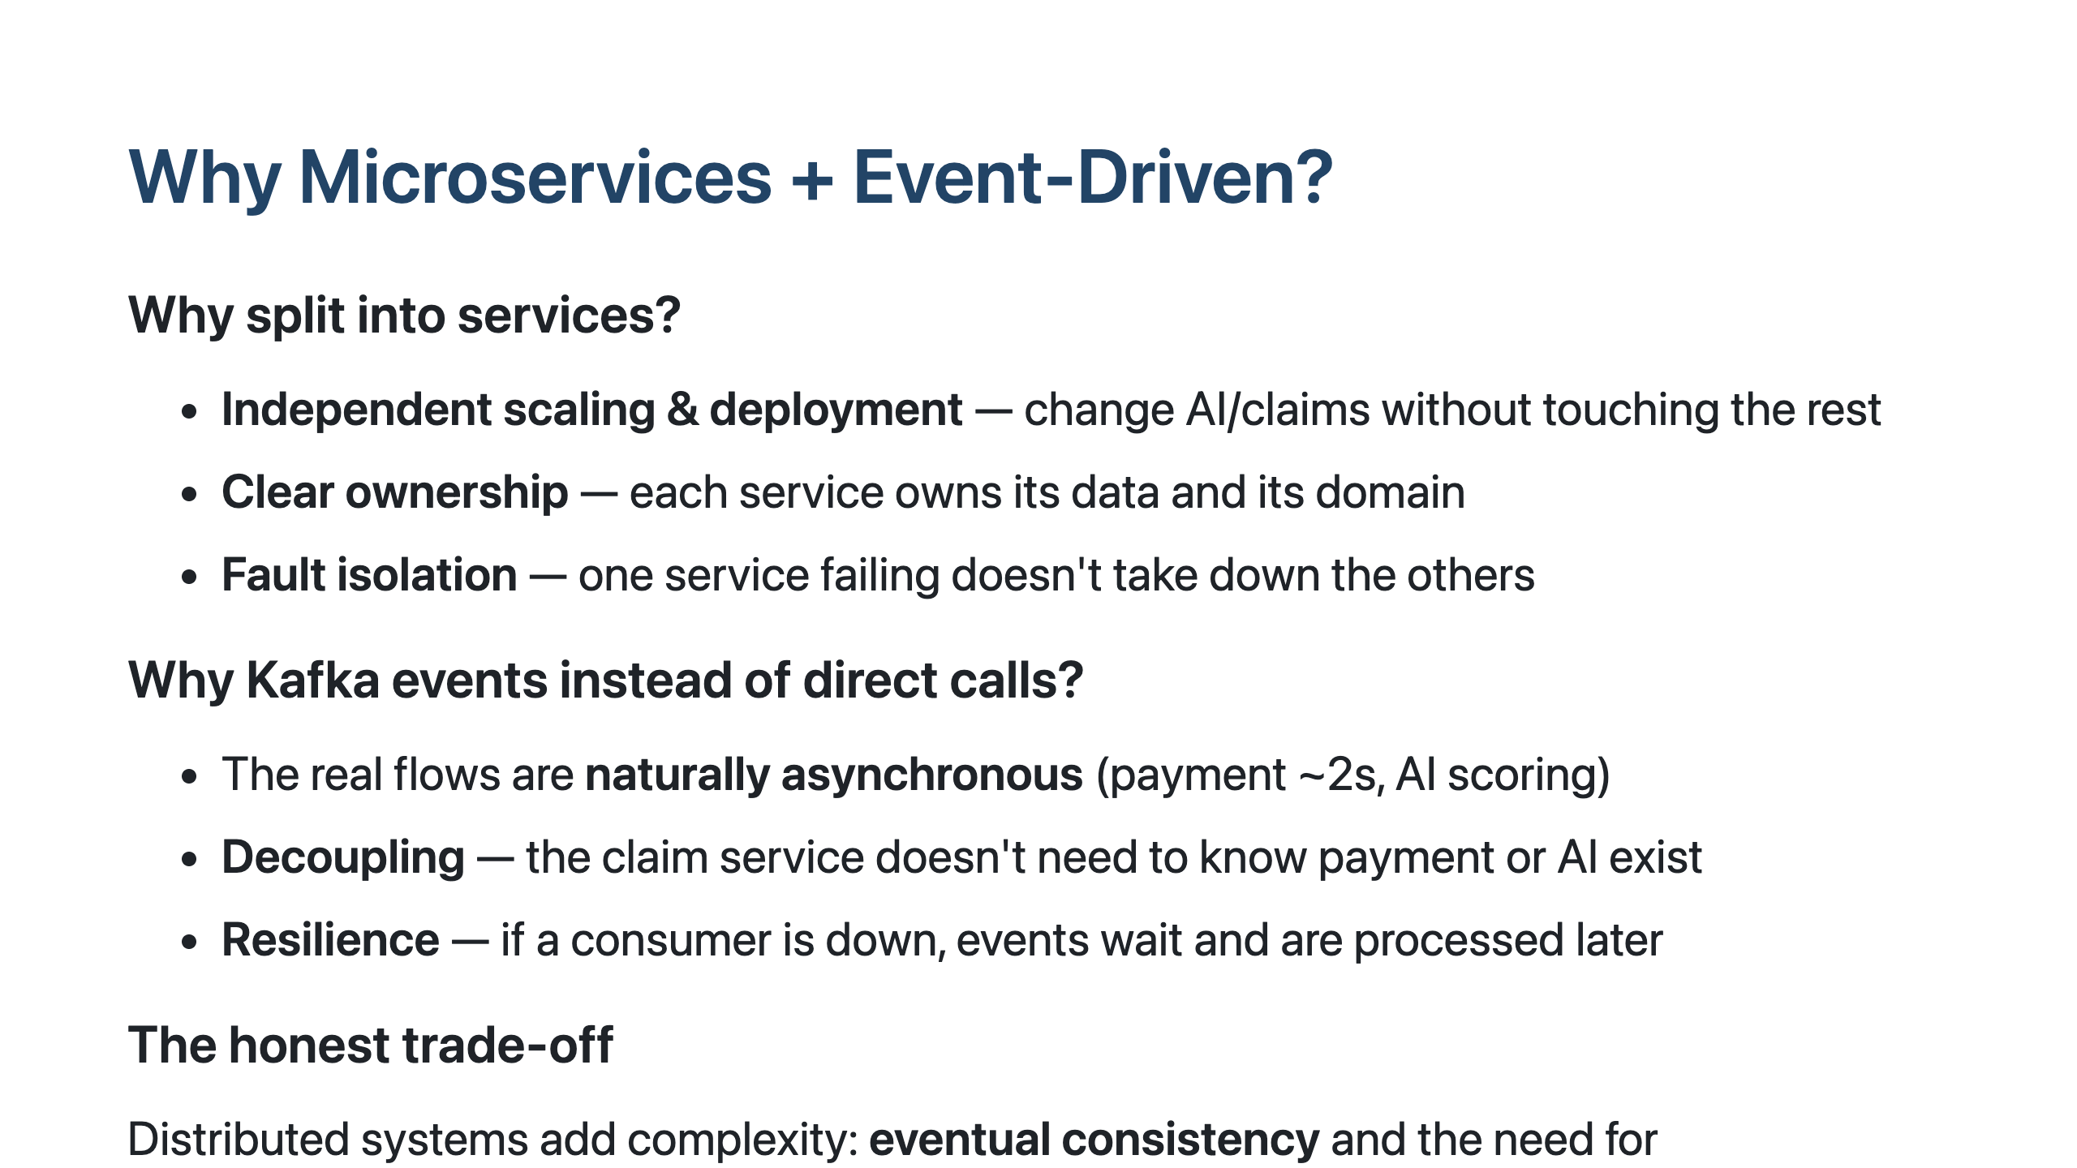
Notes:
We didn't pick microservices for buzzwords — the domain fits it. The flows are genuinely asynchronous: payment takes a couple seconds, AI scoring takes longer, so blocking HTTP calls would be wrong. Events let services stay decoupled — the claim service just announces 'a claim was submitted' and doesn't care who listens. The honest cost is eventual consistency and the need for idempotent consumers, which we addressed deliberately rather than ignored.

Slide 9
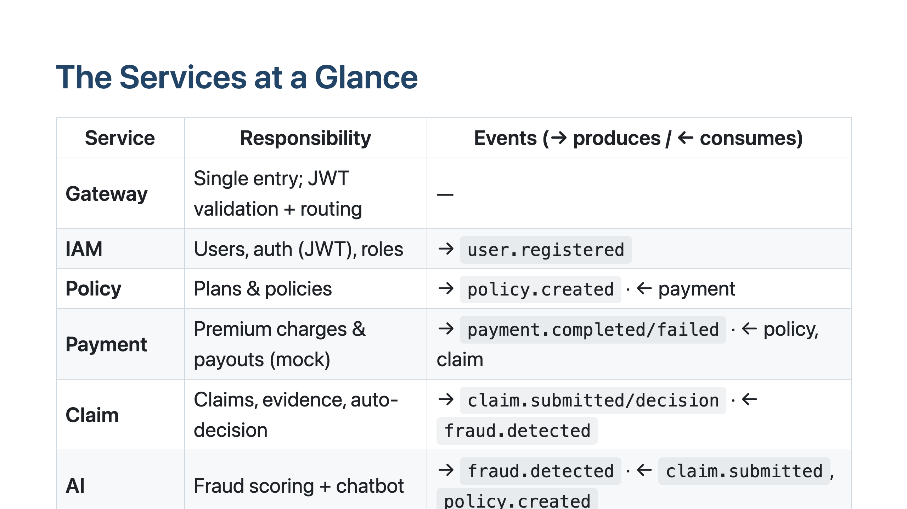
Notes:
Here's the whole system on one slide. The gateway is the front door. IAM owns identity. Policy manages plans and policies. Payment handles the money — mocked here. Claim is the heart of the workflow. AI does fraud scoring and the chatbot. Notification is a pure consumer that reacts to everything and sends emails and SMS. And 'infra' is a shared library holding the event and DTO contracts all services agree on. Note the arrows: IAM only produces, Notification only consumes.

Slide 10
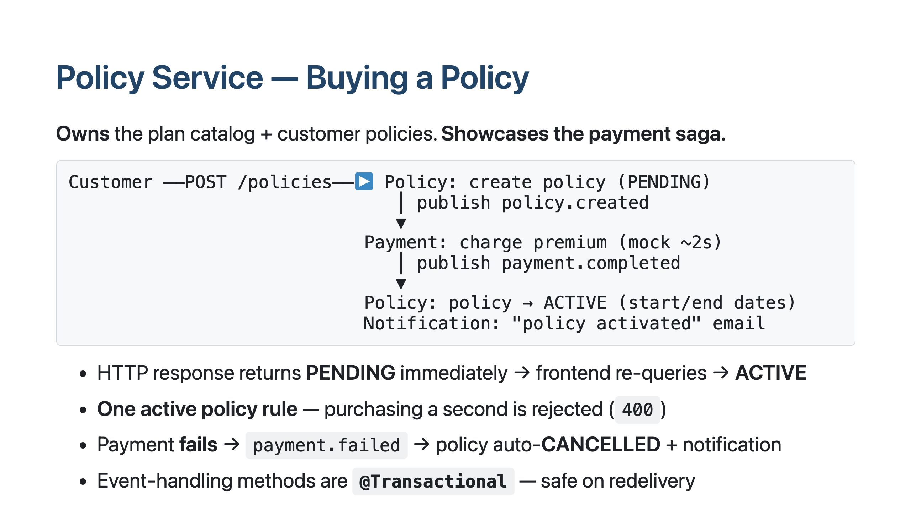
Notes:
The policy service owns plans and policies, and it's the best example of our event-driven saga. When you buy a policy, it's created as PENDING and an event is published. Payment picks that up, charges the premium — mocked, about two seconds — and publishes 'payment completed'. Policy hears that and flips to ACTIVE. So the HTTP call returns instantly as PENDING and the UI re-queries a moment later. We guard against a second active policy, and if payment fails the policy is automatically cancelled.

Slide 11
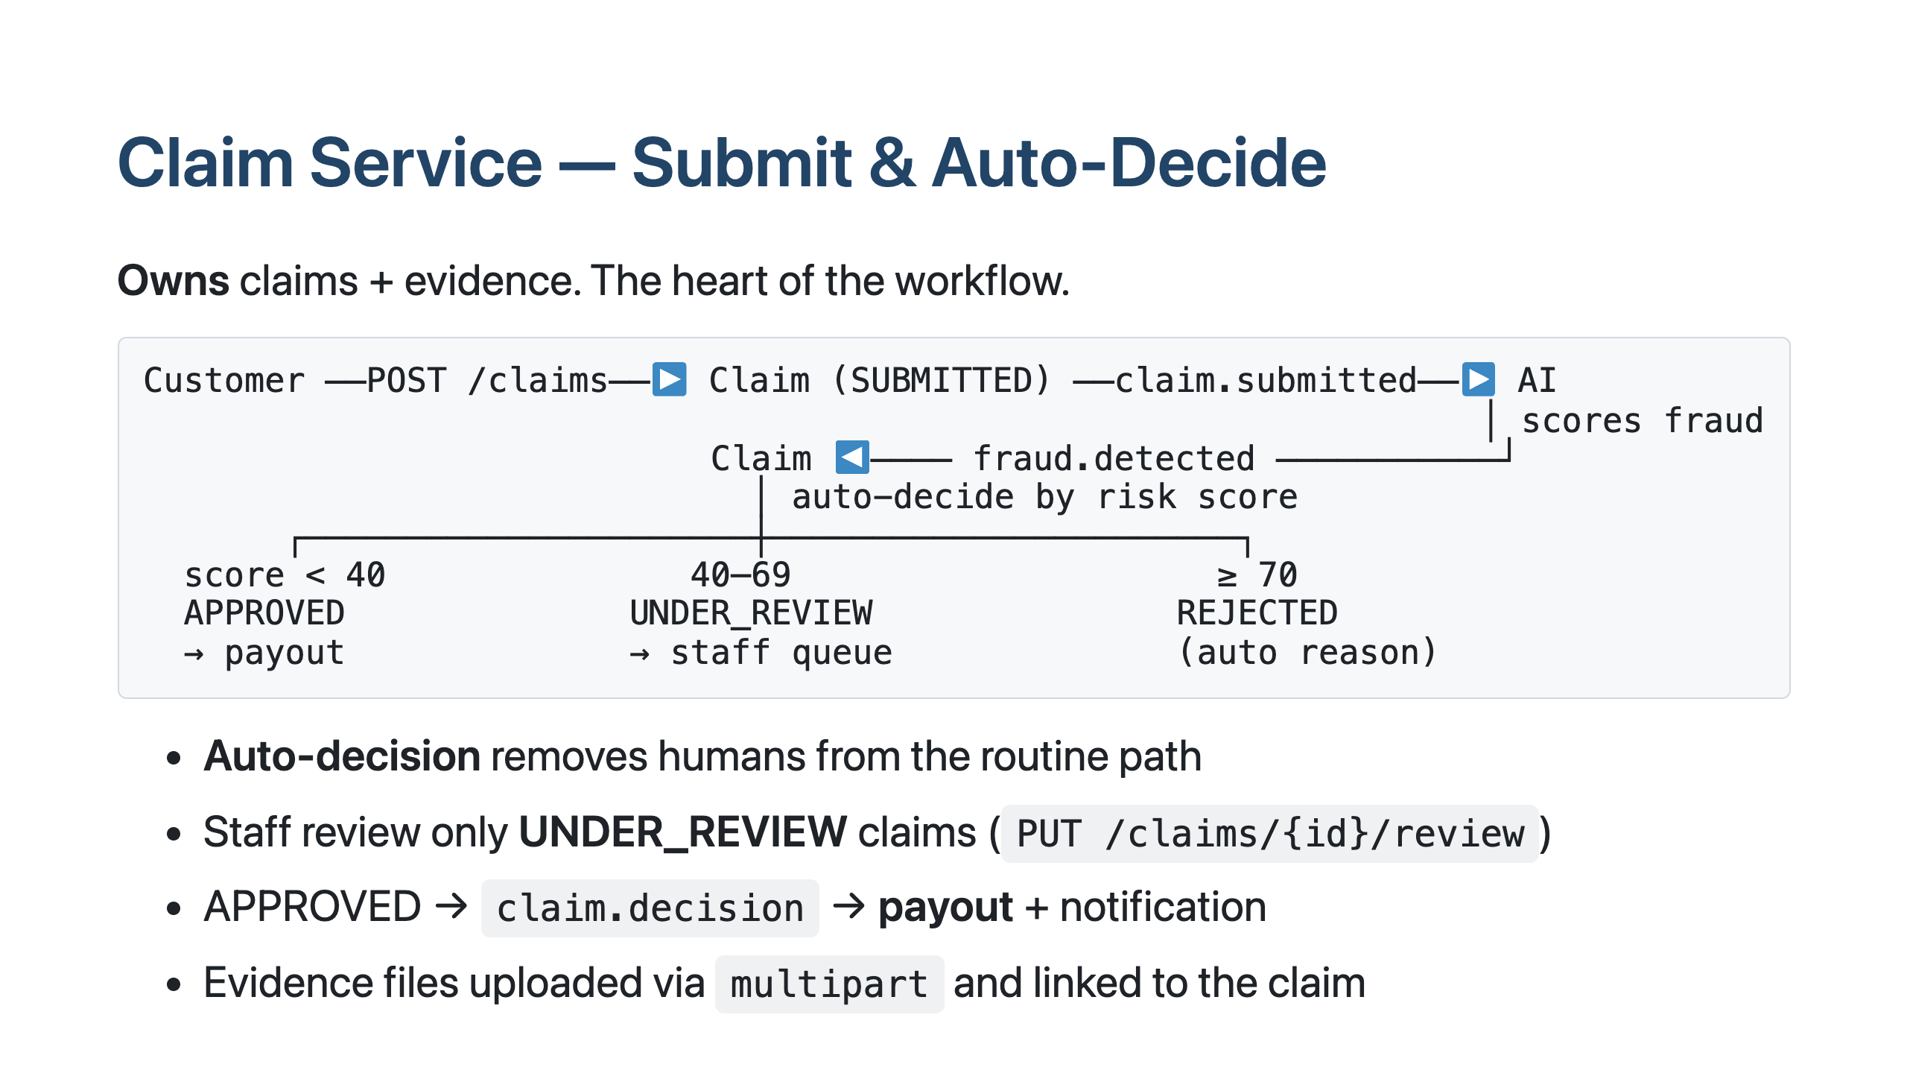
Notes:
The claim service is the heart of the system. A submitted claim is saved as SUBMITTED and an event goes to the AI service, which scores the fraud risk and sends back a 'fraud detected' event with a number. The claim service auto-decides: under 40 approved and paid automatically, 70 and above rejected, the middle band goes to the human review queue. So staff only ever see the genuinely uncertain claims — everything clear-cut is instant.

Slide 12
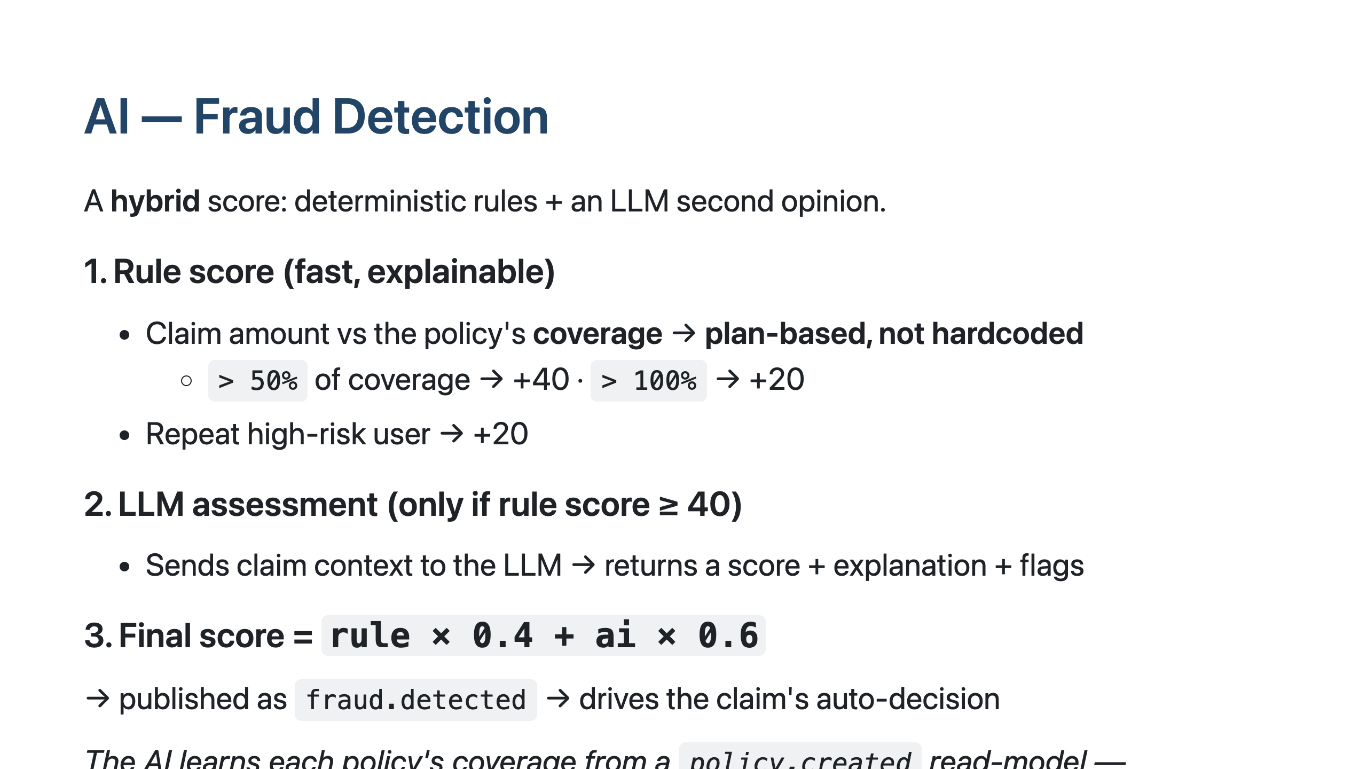
Notes:
The fraud score is a hybrid. First a fast rule-based score — the key part is the threshold is based on the policy's coverage, not a hardcoded number, so a big claim against a small plan is suspicious while the same amount against a large plan isn't. If the rule score is high enough, we ask the LLM for a second opinion with an explanation. The two blend — 40% rules, 60% AI — into a final score that drives the auto-decision. The AI learns each policy's coverage by listening to the policy-created event, so it never calls the policy service directly.

Slide 13
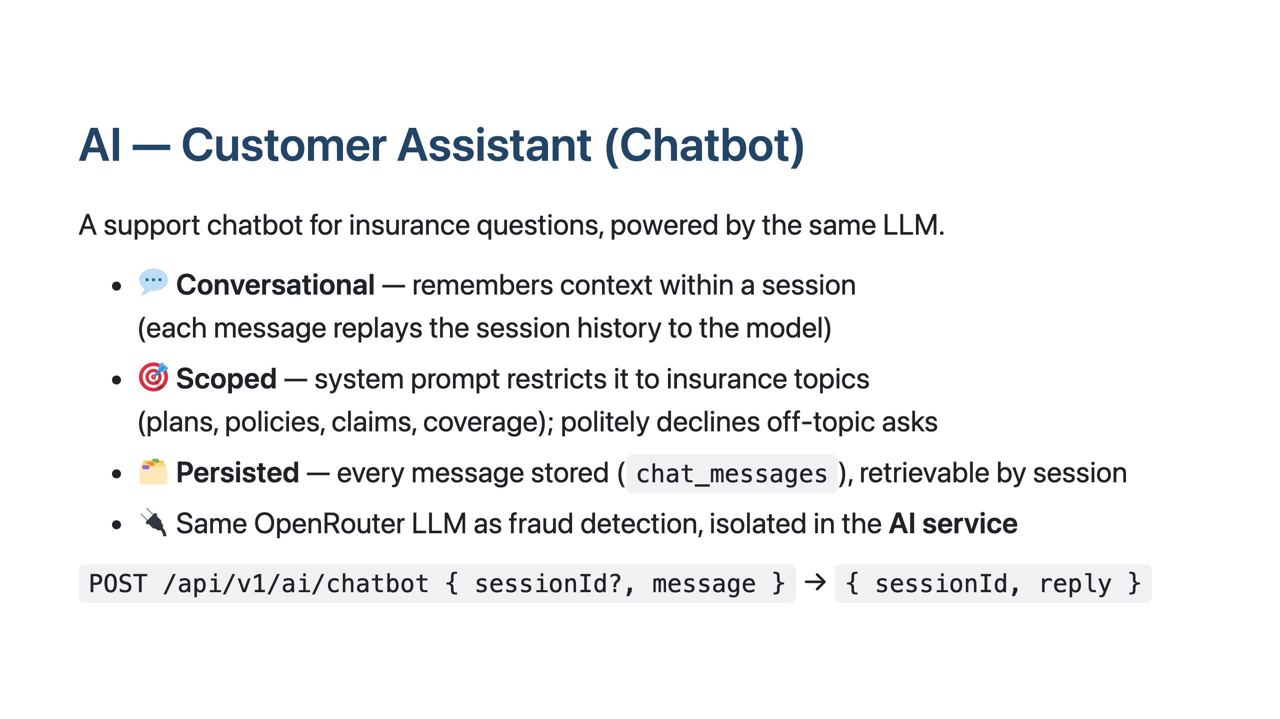
Notes:
The second AI feature is a customer chatbot for insurance questions. It's conversational — it remembers the session by replaying the history to the model each turn — and it's deliberately scoped: the system prompt keeps it on insurance topics and it declines off-topic requests like 'write me code'. Every message is stored so a conversation can be reloaded. Same LLM as fraud detection, but both live inside the isolated AI service.

Slide 14
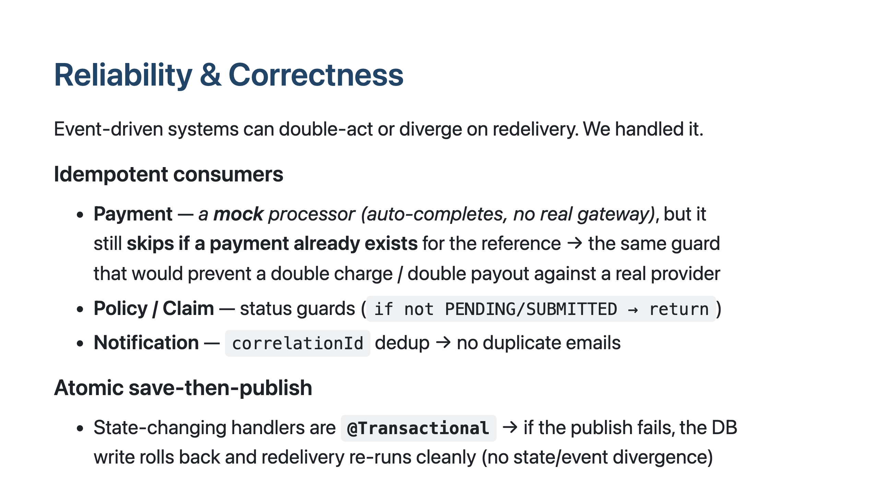
Notes:
The slide I'm most proud of. Kafka can redeliver a message, so a naive consumer could charge twice or send duplicate emails. We made every consumer idempotent — payment skips if it already processed that reference, policy and claim use status guards, notifications dedupe by a correlation id. We made save-and-publish transactional, so if publishing an event fails after the DB write, the write rolls back and re-runs cleanly. Every event is keyed by its entity id so per-entity ordering is preserved. Payment is a mock processor, but the same guard would protect a real provider.

Slide 15
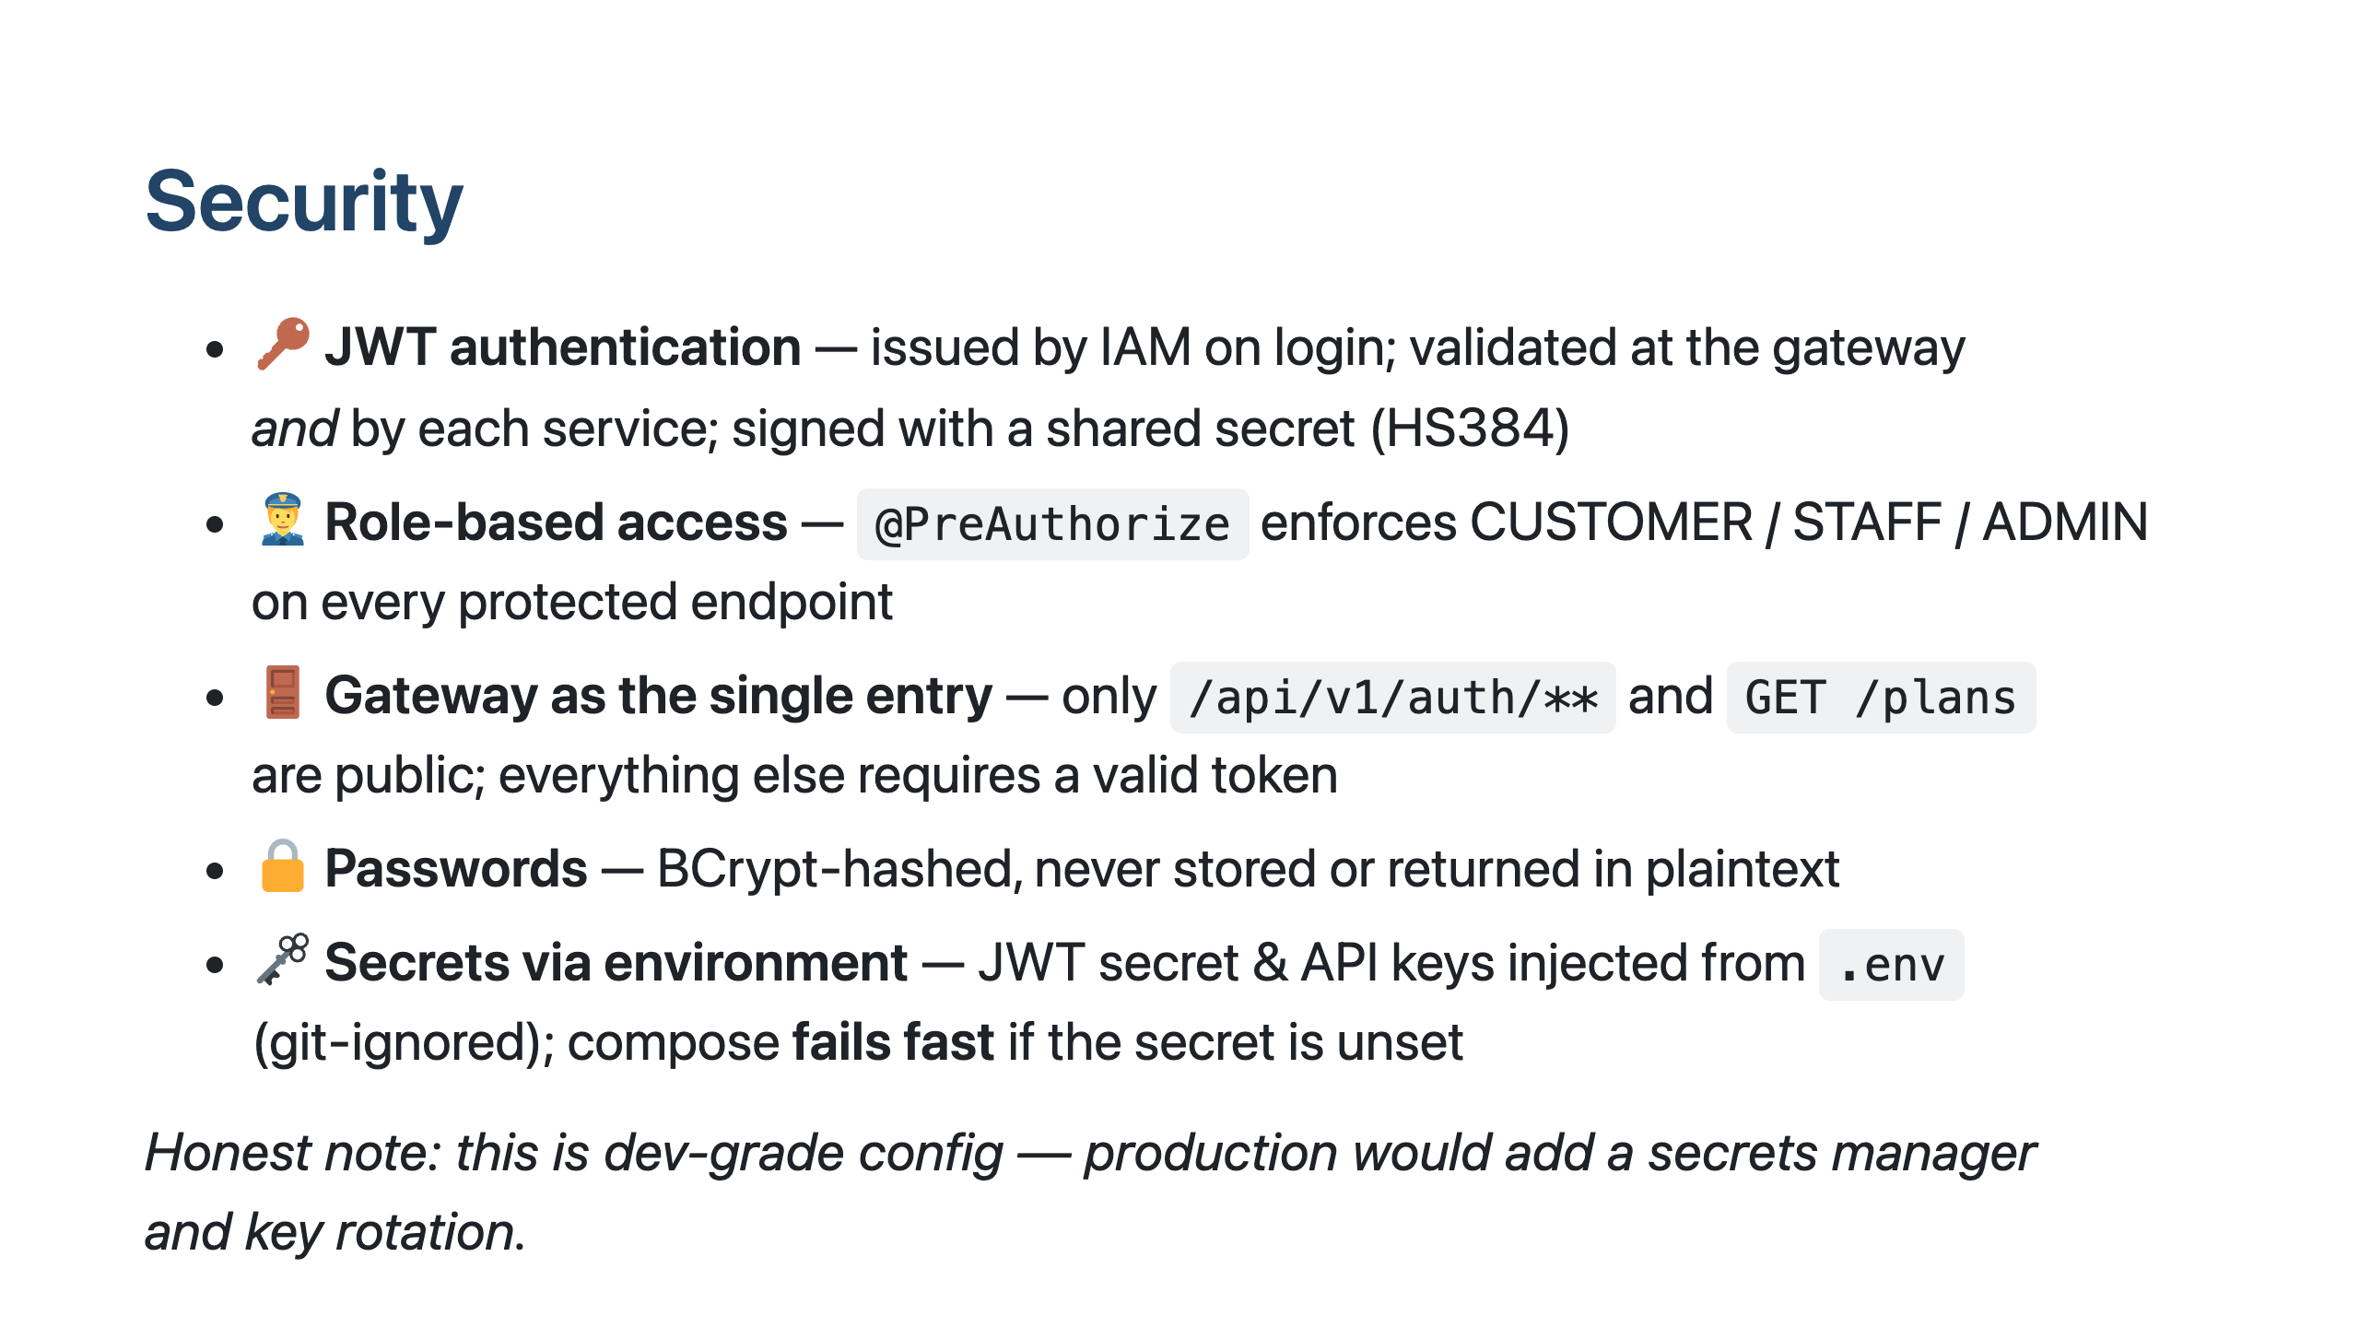
Notes:
Security is JWT-based: IAM issues a token on login, validated both at the gateway and in each service. Access is role-based — every protected endpoint declares which roles can use it. The gateway is the only public entry; only auth and browsing plans are open. Passwords are BCrypt-hashed. Secrets like the JWT key and API keys come from environment variables in a git-ignored file, and the stack refuses to start if the JWT secret is missing. We're honest this is dev-grade — production would use a real secrets manager.

Slide 16
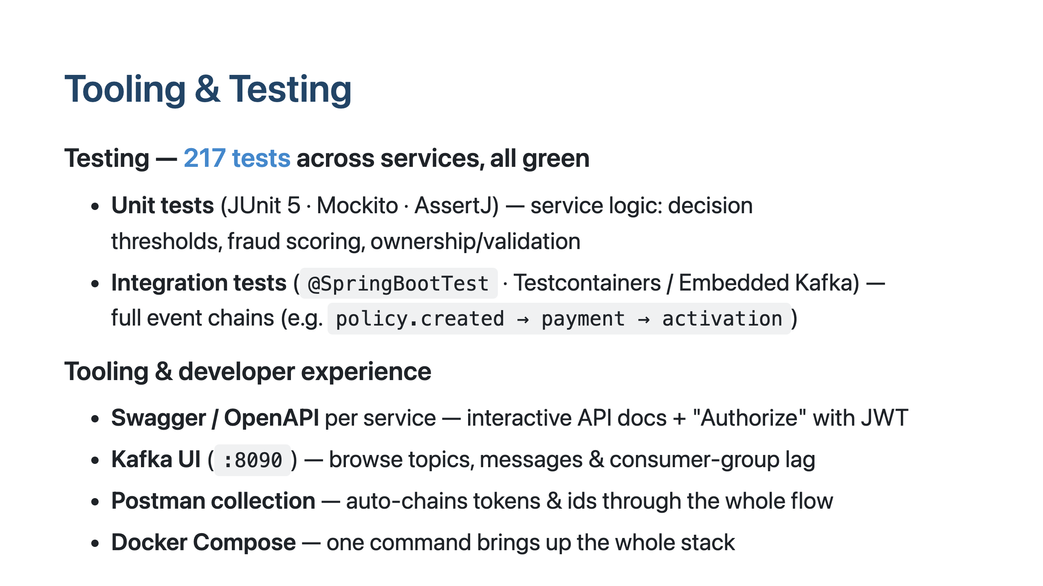
Notes:
Every service ships with tests — unit tests for the business logic like decision thresholds and fraud scoring, and integration tests that spin up real Postgres and Kafka in containers to verify the full event chains end to end — 217 in total. For developer experience and the demo, each service exposes Swagger with a JWT authorize button, there's a Kafka UI to watch events and consumer lag, a Postman collection that chains the whole flow, and the entire stack comes up with one Docker Compose command.

Slide 17
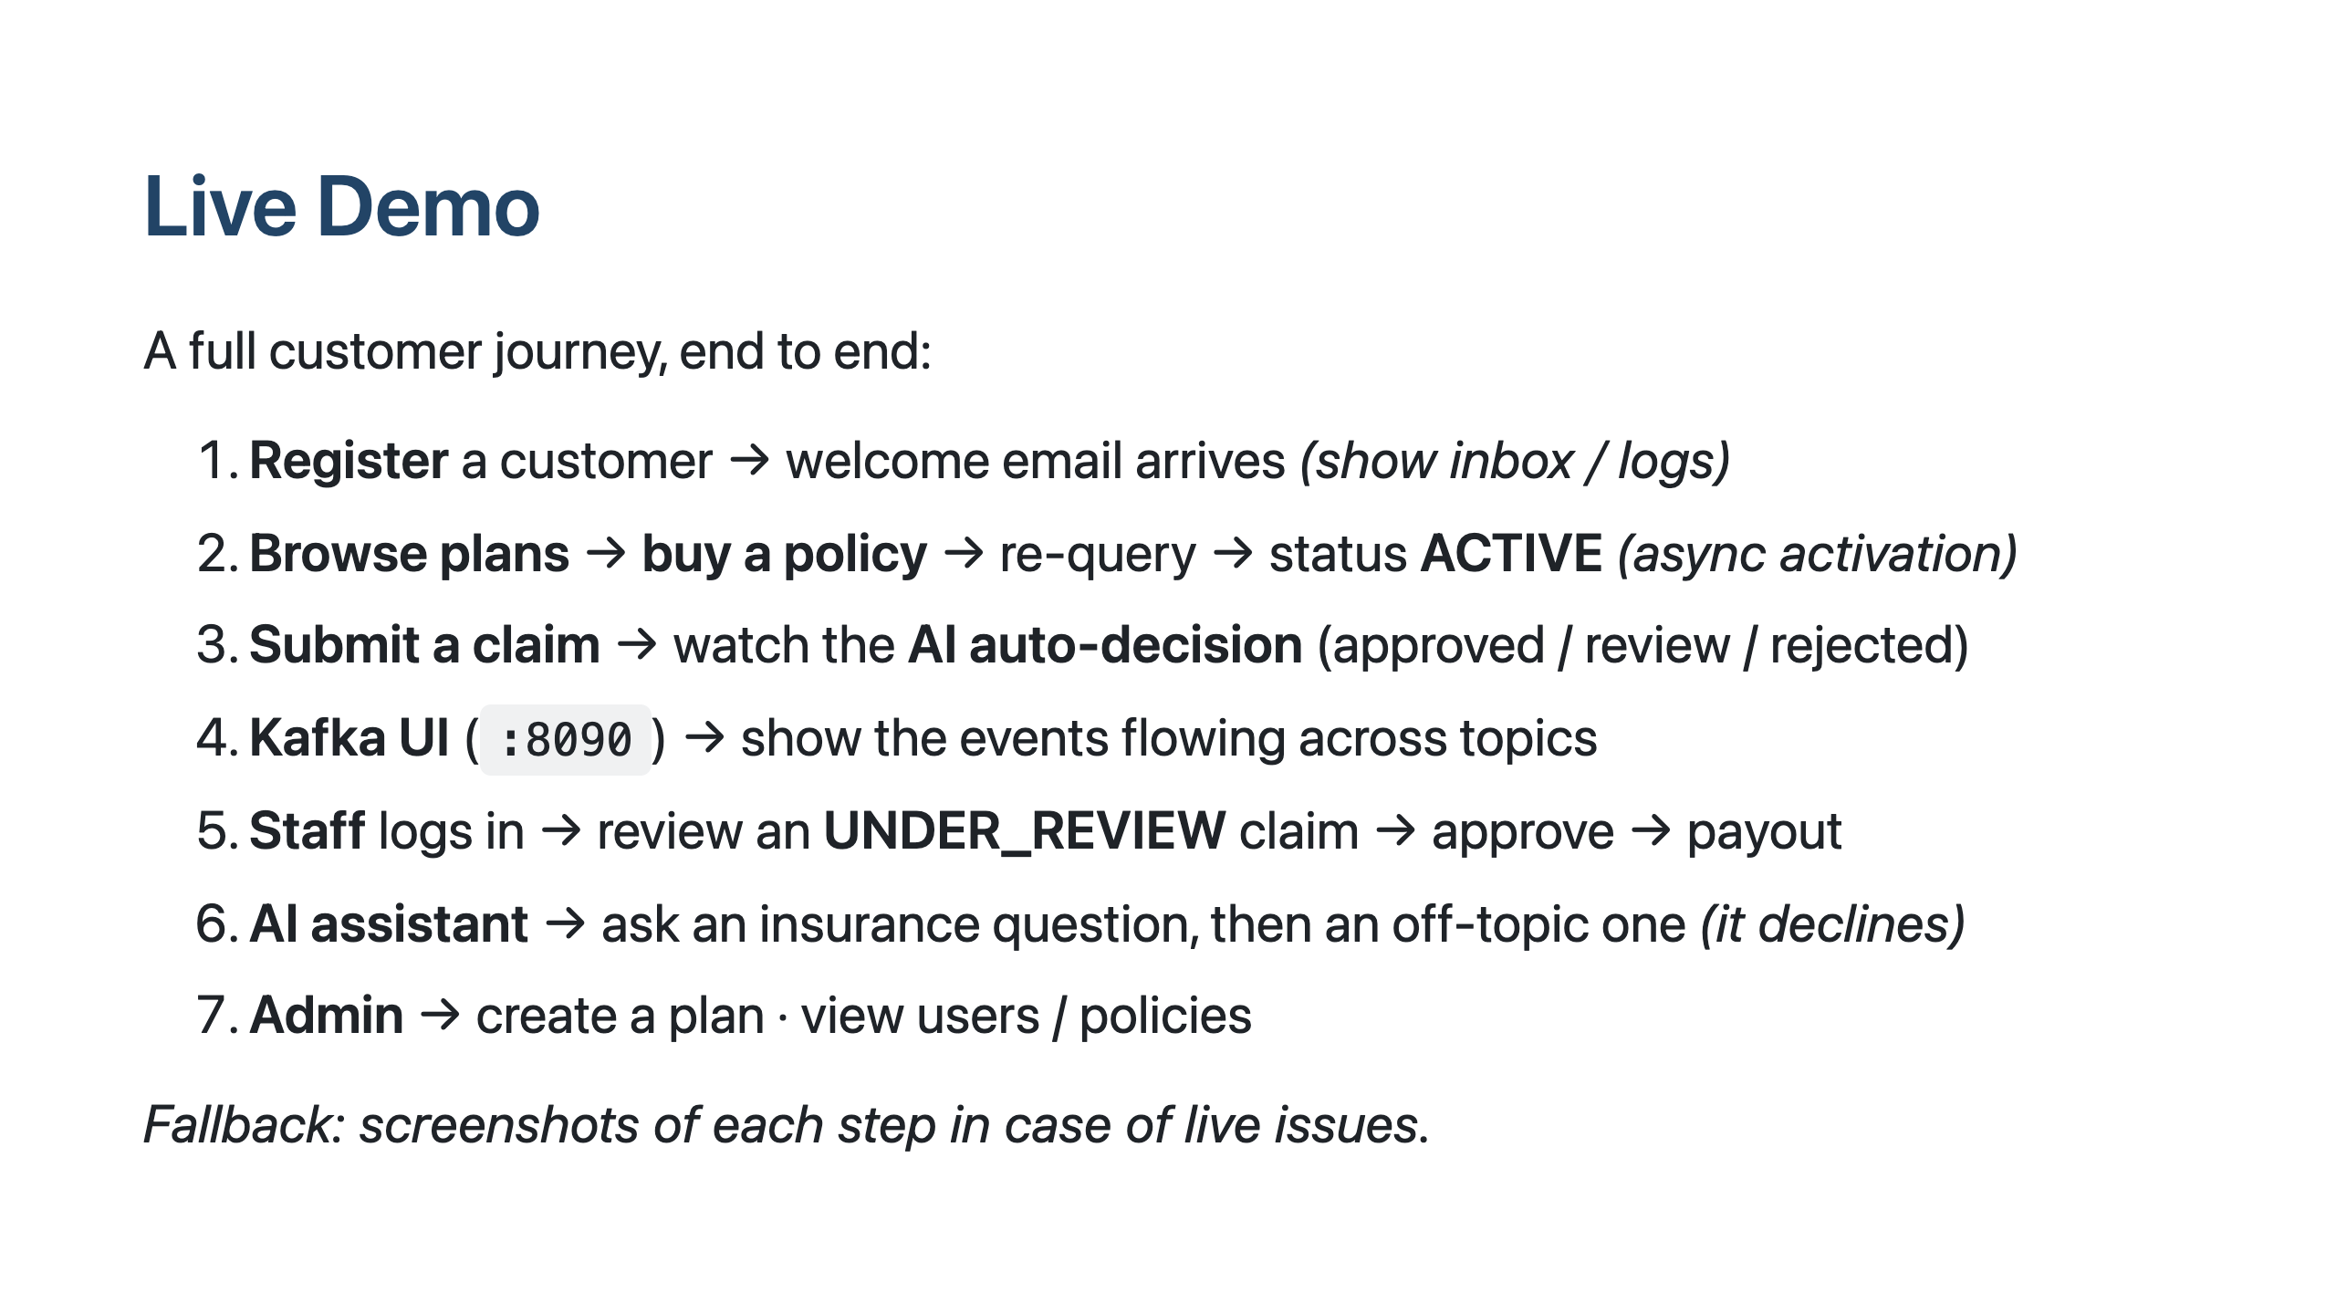
Notes:
Now a live walkthrough. I'll register as a customer and we'll see the welcome notification. Buy a policy and watch it activate asynchronously. Submit a claim and watch the AI decide it in real time, and pull up the Kafka UI to show the events moving between services. Then switch to staff to review a flagged claim, ask the AI assistant a question — including an off-topic one to show the guardrail — and finish on the admin side. If anything misbehaves live, we have screenshots as a fallback.

Slide 18
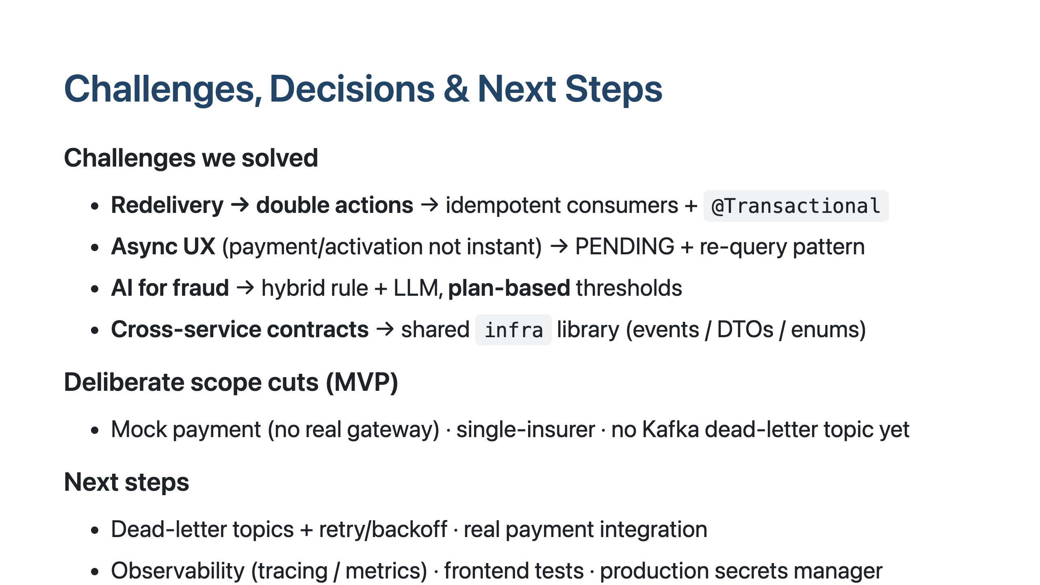
Notes:
To wrap up: the interesting challenges were handling Kafka redelivery without double-charging, designing the async UX around payment and activation, building the hybrid AI fraud scoring with plan-based thresholds, and keeping service contracts consistent through a shared library. We made deliberate MVP scope cuts — mocked payment, single insurer, no dead-letter topic yet — and the natural next steps are dead-letter and retry handling, a real payment integration, observability, and production secrets.

Slide 19
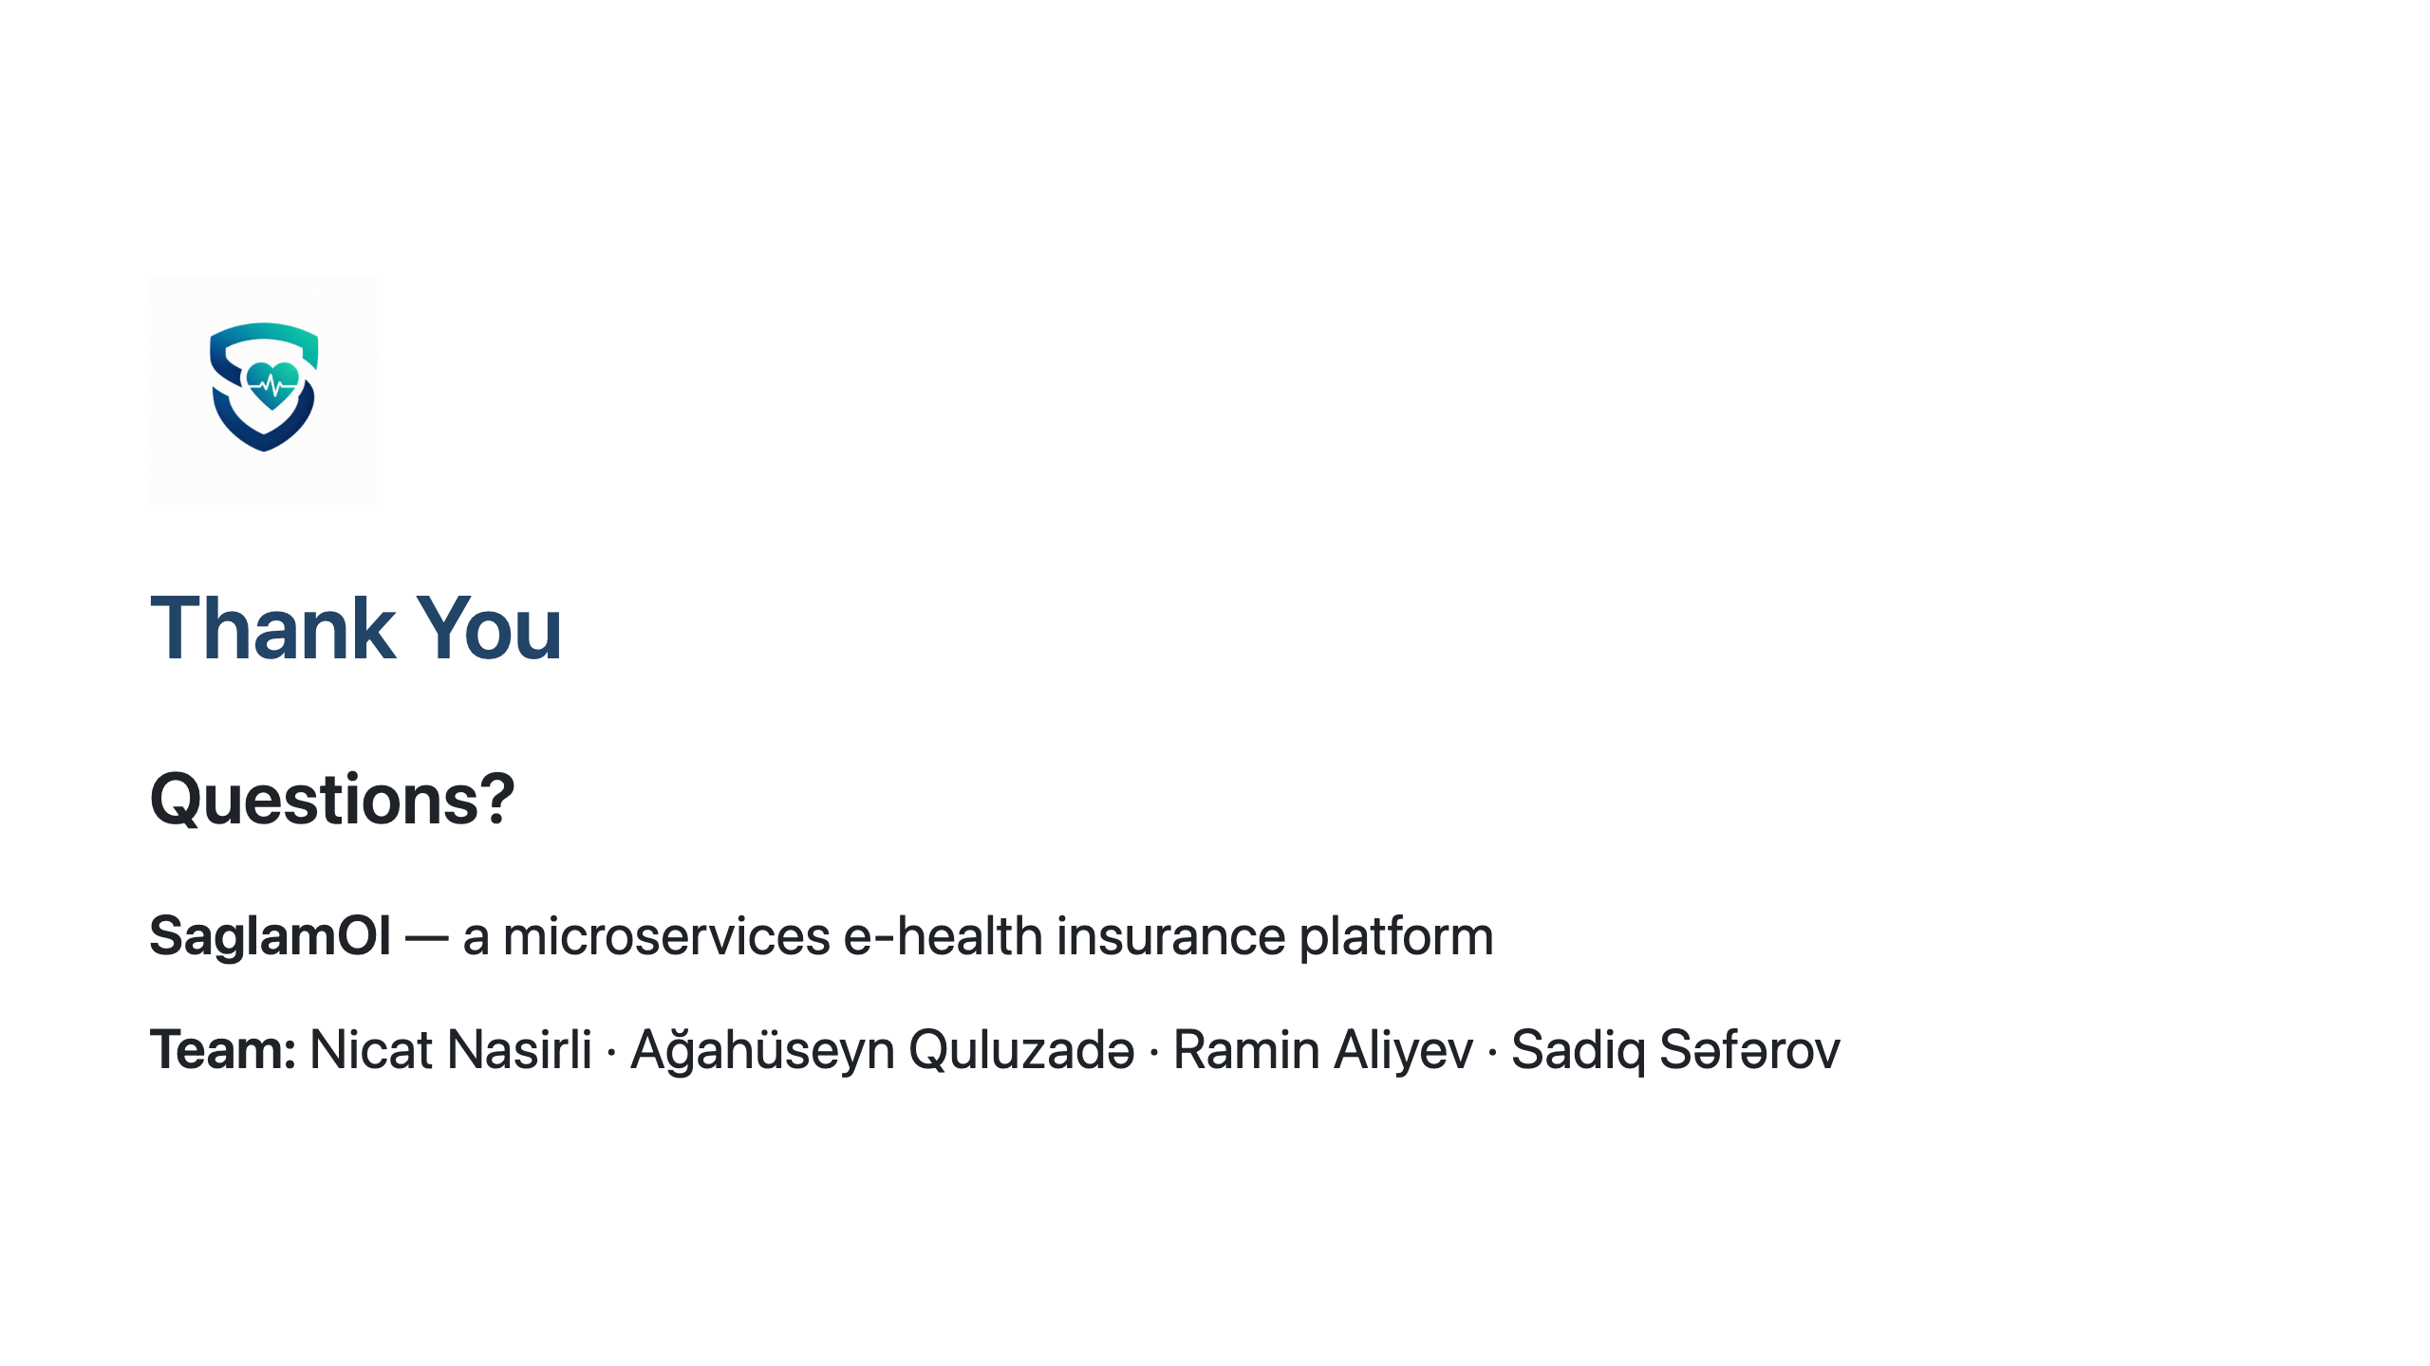
Notes:
Thank you — we're happy to take questions.

