Slide 1
Cryptography using Artificial Neural Networks :Final presentation
Presented By : Abhishek Gaikwad
CWID:893451187

Slide 2
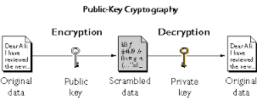
Type of Cryptography: Public key cryptography

Slide 3
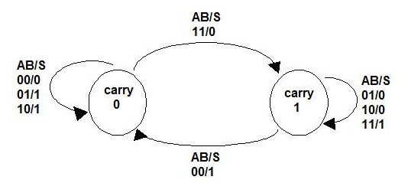
Jordan Neural Net implementation a]Implementing the adder

Slide 4
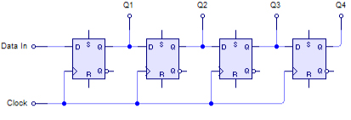
Shift register: Adder circuit

Slide 5
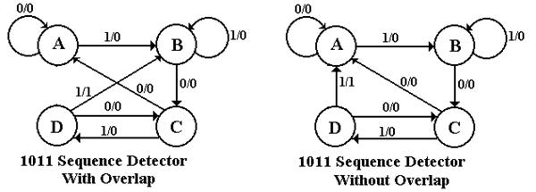
B]Sequence Detector

Slide 6
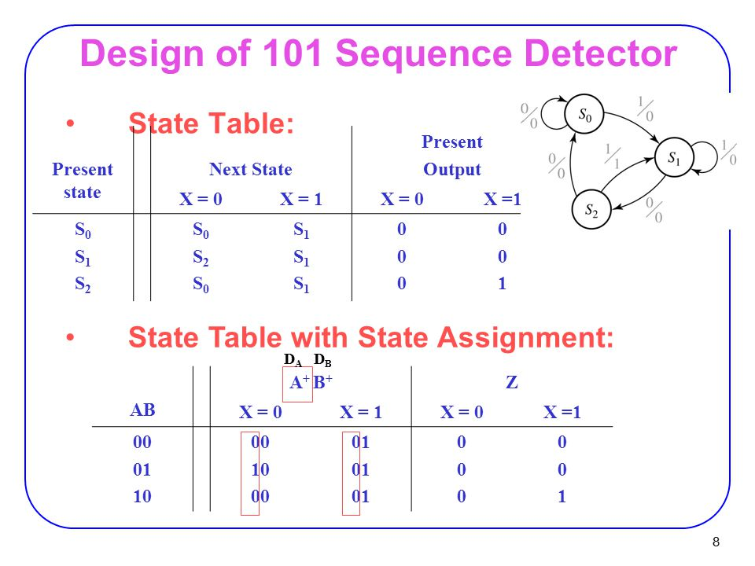
Training the algorithm: State Table

Slide 7
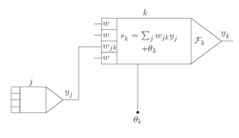
Integration of Artificial Neural Networks with Cryptography
Using a neural network based n-state sequential machine

Slide 8

Advantages of using the sequential machine algorithm
1) High security
2) No distortion
3) Suitable for system integration

Slide 9
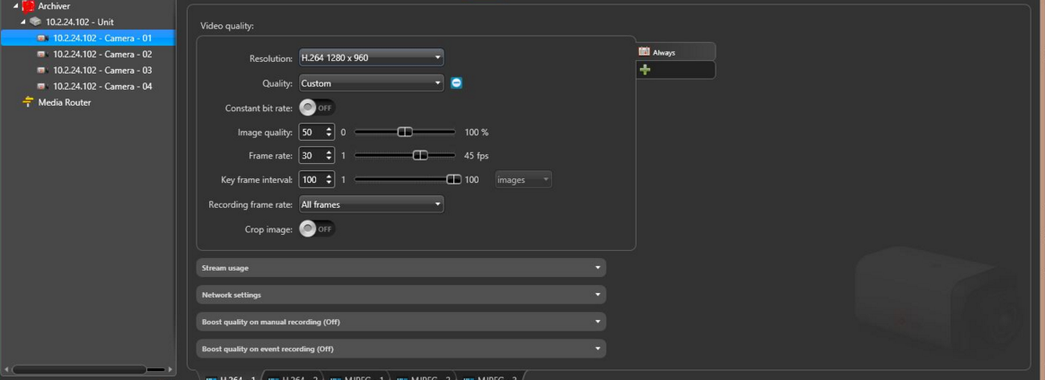
Authentication using Designed ANN

Slide 10
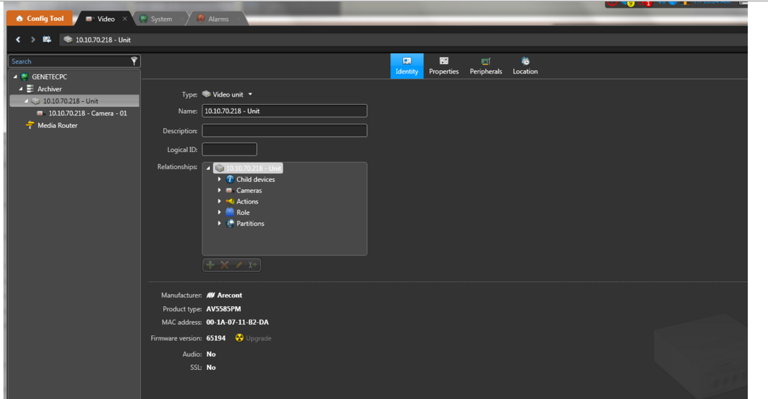
Alarms triggered by ANN

Slide 11
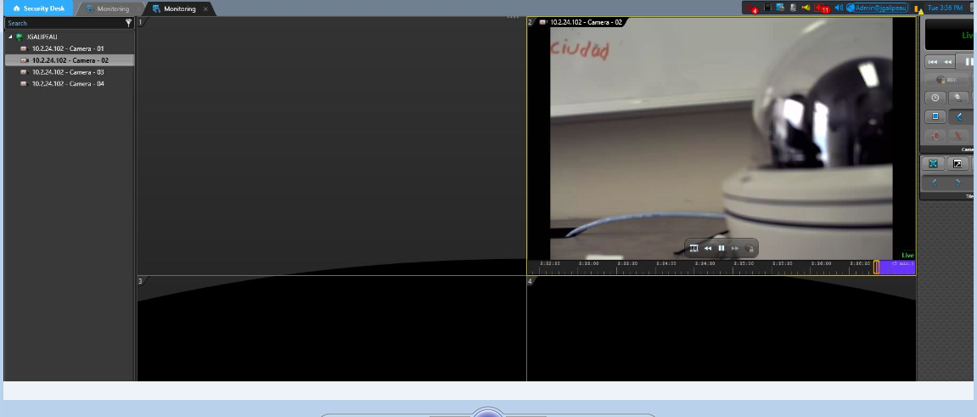
Client stream disconnections

Slide 12
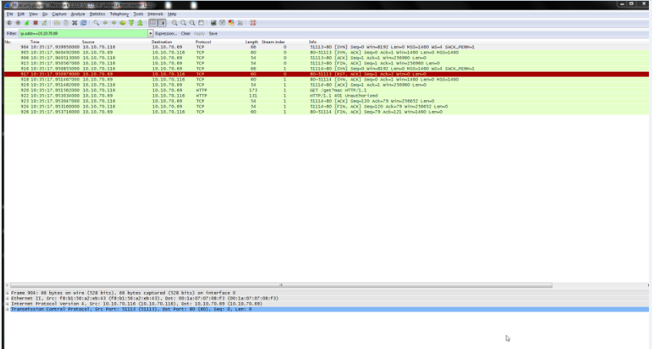
Implementation Proof: Wireshark

Slide 13
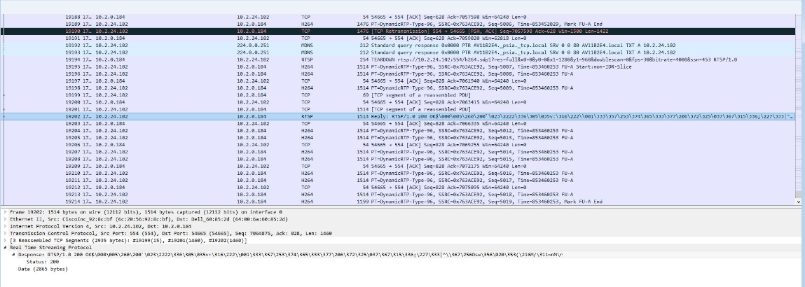
Wireshark proof

Slide 14
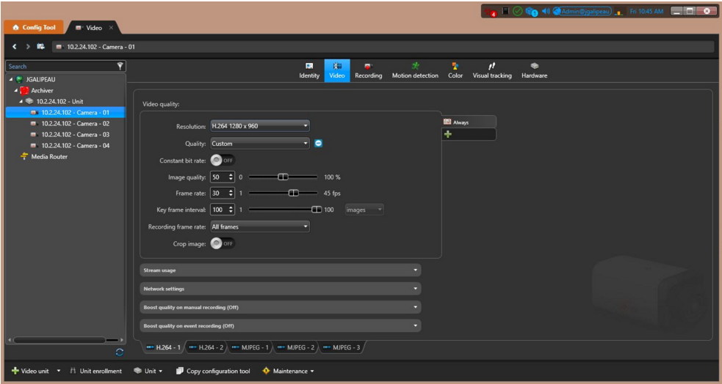
Corresponding streaming results due to ANN

Slide 15
Listed noted features
Resolution:h.264<full resolution obtained>
FPS:45(Optimal is 44)
Qos:4.86

Slide 16
Results
Successful implementation of designed artificial neural net.
Integration is feasible.
Verification of it in Genetec and Wireshark logs.
Enhanced features as seen below.

Slide 17
Future scope
a)Implementation in cloud security
b) Deep OGBF Algorithm Routing tree penetration
c) This model could help us in developing the H.265 model in general.

Slide 18
References
M. E. Smid and D. K. Branstad, “The Data Encryption Standard: Past and Future,” Proceedings of The IEEE, vol. 76, no. 5, pp. 550-559, 1988.
"An Introduction to Neural network" by Ben Krose and Patrick van der Smat Eighth edition November 1996
C. J. Kuo and M. S. Chen, “A New Signal Encryption Technique and Its Attack Study,” IEEE International Conference on Security Technology, Taipei, Taiwan,

