Slide 1
Intelligent agent systems
Alexandros gaitanis
MSc in Artificial Intelligence
Summer Semester 2021 - 2022
Department of Informatics
Aristotle University of Thessaloniki

Slide 2
PROJECT
Maze solving algorithms
A robot is trying to escape a maze
Implementation of 3 algorithms in Jason
Wall Follower
Random Mouse
Tremaux

Slide 3
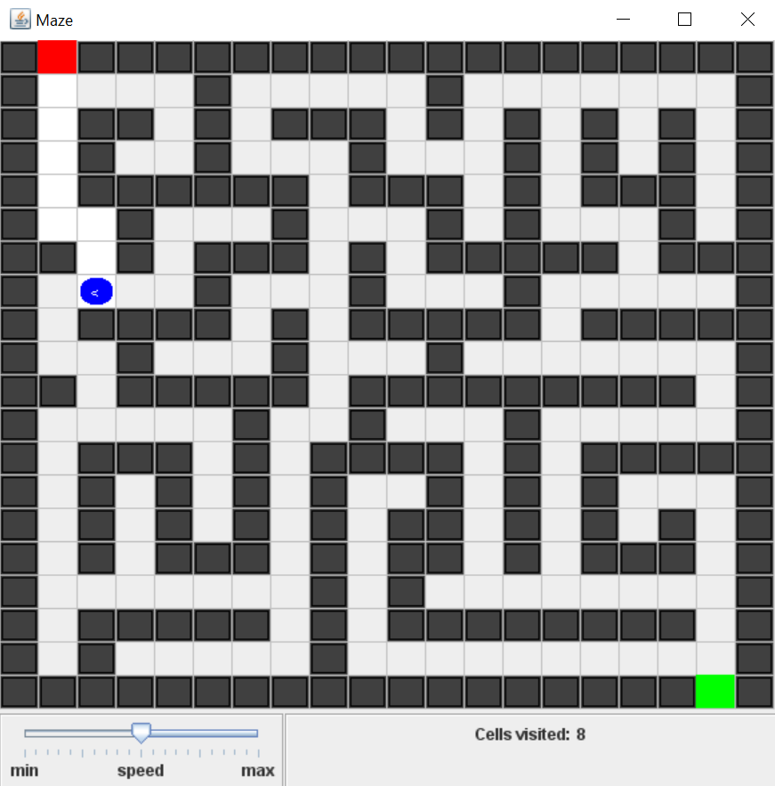
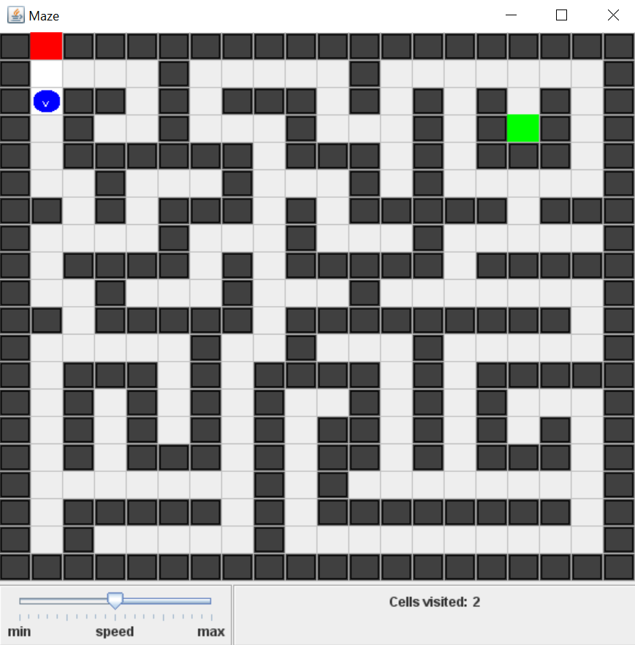
Environment
Maze A
Maze B
Grid 20x20
Walls
Corridors
Entrance
Exit
Robot
Maze A
Simply-connected graph
Maze B
Not simply-connected graph

Slide 4
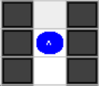
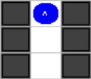
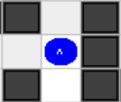
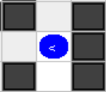
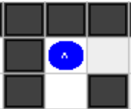
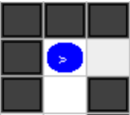
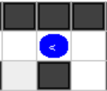
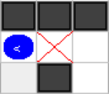
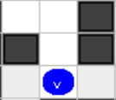
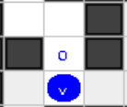
actions
move_fwd
Move one cell forward
turn_left
Turn counterclockwise 90 degrees
turn_right
Turn clockwise 90 degrees
mark_cell
mark_back_cell
move_fwd
turn_left
turn_right
mark_cell
mark_back_cell

Slide 5










percepts
cell(exit)
cell(front,obstacle), cell(left,obstacle), cell(right,obstacle)
cell(front,entrance), cell(left,entrance), cell(right,entrance)
cell(front,marked_once), cell(left,marked_once), cell(right,marked_once)
cell(front,marked_twice), cell(left,marked_twice), cell(right,marked_twice)

Slide 6
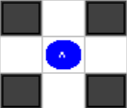
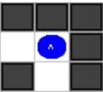
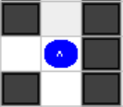
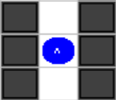
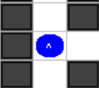
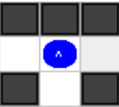
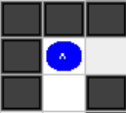
rules
left_cell_free
front_cell_free
right_cell_free
left_front_right_cell_free
left_front_cell_free
front_right_cell_free
left_right_cell_free
in_junction

Slide 7
Wall follower
Left-hand / right-hand rule
Very different results depending on the maze
The robot keeps the wall to its right
No memory required
The goal is not necessarily reached
If the maze is not a simply-connected graph the robot might return to the entrance and restart
Front Cell | Right Cell | Actions
Free | Free | turn_right, move_fwd
Free | Obstacle | move_fwd
Obstacle | Free | turn_right, move_fwd
Obstacle | Obstacle | turn_left

Slide 8
Random mouse
Every time the robot is in a junction
randomly chooses 1 of 2 possible actions
or randomly chooses 1 of 3 possible actions
No memory required
It can be extremely slow

Slide 9
tremaux
The robot marks each path it enters
It marks both ends of the path
The robot does not follow a path marked twice
Dead-ends are marked twice
In a junction, paths with the least number of marks are preferred
Requires memory
Guaranteed to find the exit
But not the shortest path

Slide 10
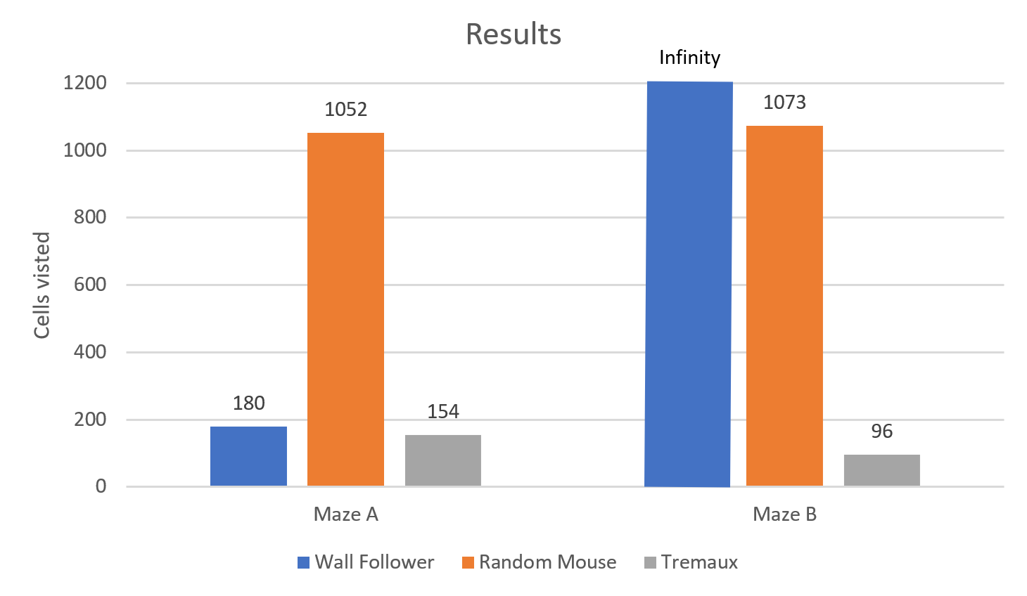
results
Wall Follower does not reach the exit in Maze B
Random Mouse takes too much time
Tremaux always finds the exit by eliminating dead-ends

