Slide 1

Dissertation
Presentation
Akhil Gupta
M. Tech. Software Engineering Final Year
Birla Institute of Technology & Science,
Pilani

Slide 2
Problem Statement:
Business Challenge
Migrating the data from self-hosted GitHub to the cloud is big challenge as this involves various categories of data for migration like code history, pull requests, releases, issues, etc.
Solution
Using the planned automation “GitHub Org Migration: Self-hosted to Cloud” the admin team can easily migrate the GitHub Org to the cloud with reduced overhead.

Slide 3

Objective:
Automate the following activities involves in GitHub organization migration from self-hosted to enterprise cloud:
Create an empty org on GitHub enterprise cloud.
Provide enterprise license to users (Providing access).
Adding users with the specific role (owner/member) in the new org.
Create a migrator file for repositories from self-hosted GitHub and import it into GitHub enterprise.

Slide 4
Methodology:
User Input
Get the existing org name.
Fetch Org.
Get org’s members details.
Assign License
Assign license to active users.
Create Org
Create org and add users.
Upload Data
Upload data and metadata

Slide 5
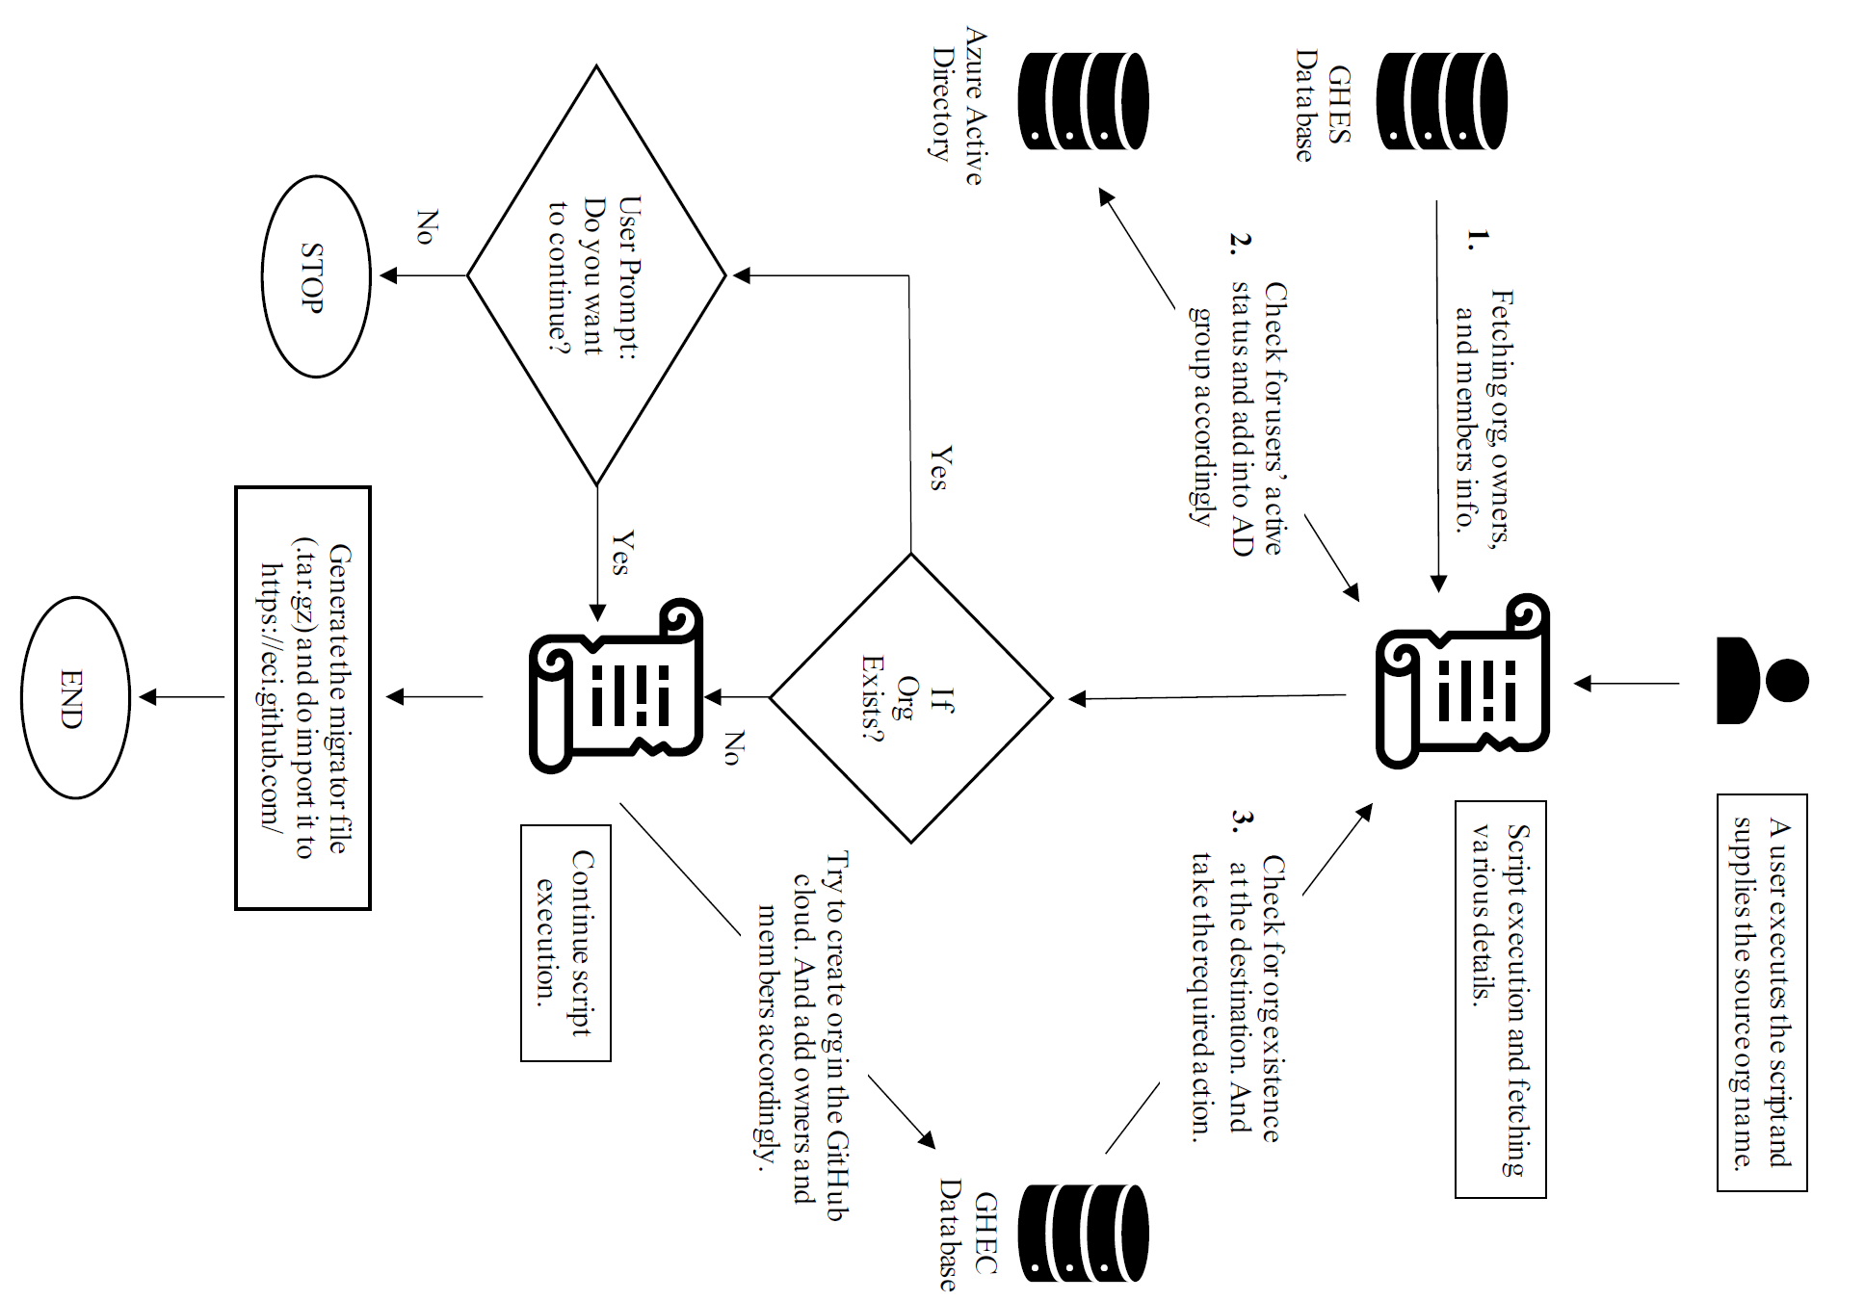
Design & Workflow:

Slide 6
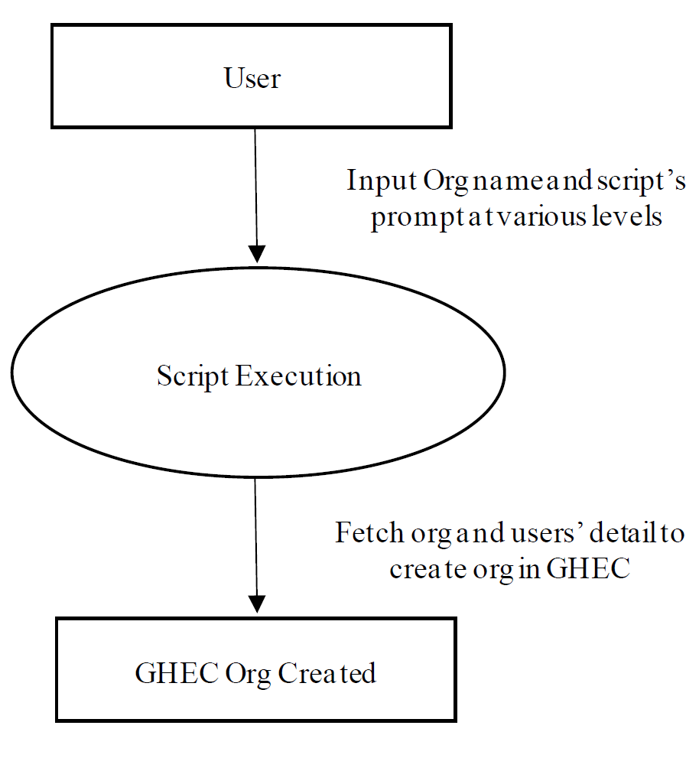
Requirements & Implementation :
Following are the requirements for the creation of the mentioned automation.
Runtime Python 3.x is needed with the 'requests' package.
Personal Access Token (PAT) from GHEC to access GitHub cloud.
Personal Access Token (PAT) from GHES to access self-hosted GitHub.
Client id, Client secret, Grant type, and URL from AZ AD OAuth for generating token to access AZ AD.
AZ AD group id to add users for assigning licenses.
Following approach is used for achieving the goal:
Input the name of the org that exists in the self-hosted GitHub. A Python script can be used for gathering the active owner and members of entered organizations.
Microsoft GraphQL can be used to validate users’ active status and provide the license to access the GitHub enterprise cloud using an automation script.
Using APIs provided by GitHub new organization can be created on the GitHub enterprise cloud. Members can be assigned to the created org with respective roles using the same.
A prepared migrator file can be imported to https://eci.github.com/ for successful migration or repositories. Documentation can be found at http://git.io/vtLRM.

Slide 7

Advantages & Conclusion
Advantages
Quickly check for org existence and required data.
Segregating owners and members of the GHES org can happen quickly. Also, filter Active/Inactive users.
Users can be added to the AZ AD group with no effort.
The script is completely interactive and requires the user’s confirmation/input to reduce the chances of errors.
The script can efficiently manage critical parameters like validate org, users, and owner/members.
For the GHES admin, the script can reduce the time taken in the migration process with improved accuracy.
Conclusion:
Using the prepared automation, manual activities such as creating org, verifying users’ active status, and providing licenses for user access get reduced for the admin team. A final report containing logs from all activities generated by the script can be reviewed by the admin team. This will come out as the ultimate solution while performing bulk migration of organizations.

Slide 8
References:
GitHub Cloud: https://github.com/
GitHub Documentation: https://docs.github.com/en/get-started/using-git/about-git
GitHub ECI portal: https://eci.github.com/
Python Documentation: https://docs.python.org/3/tutorial/
Python Learning: https://www.tutorialspoint.com/python/index.htm
GitHub Migration documentation: https://docs.github.com/en/enterprise-server@3.6/admin/user-management/migrating-data-to-and-from-your-enterprise/exporting-migration-data-from-your-enterprise
VS code and documentation: https://code.visualstudio.com/docs

Slide 9


