Slide 1







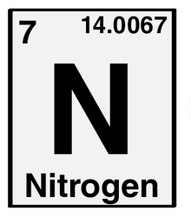




Are Mainstream media indirectly contributing
to the increase of skepticism towards scientific facts?
Questioned partiality of the media
The impact of information bubbles
The rise of alternative news outlets
Impact of current mainstream media
reports of scientific facts?

Slide 2


Are Mainstream media indirectly contributing
to the increase of skepticism towards scientific facts?
Possible suspects:
Headlines & sensationalism
Journalistic objectivity?
Others?
Child Autism!
Pro-Vaccines
???

