Slide 1
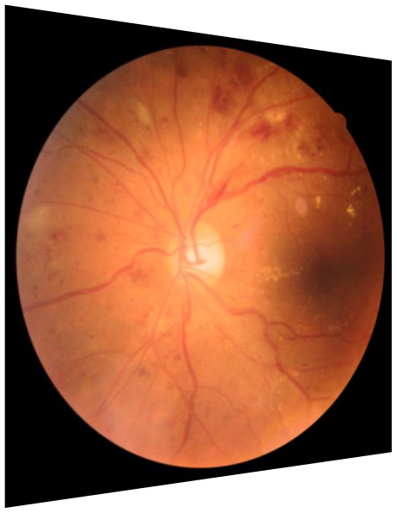
Overall
Quality
Artifact
Clarity

