Slide 1
Cost-Sensitive Regularization for Diabetic
Retinopathy Grading from Eye Fundus Images
A. Galdran¹, J. Dolz², A. Christodoulidis³, H. Chakor³, H. Lombaert², I. ben Ayed²
¹ University of Bournemouth, UK ² ETS, Canada ³ DIAGNOS INC (Canada)
Notes:
此页可以删除
<number>

Slide 2
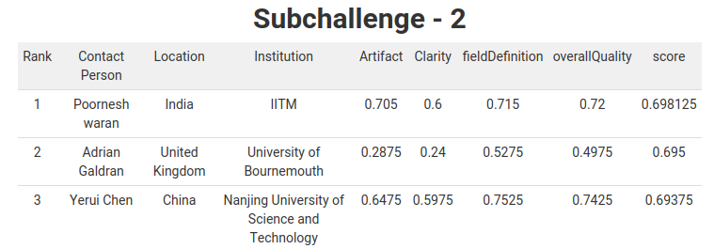
Online challenge results

Slide 3
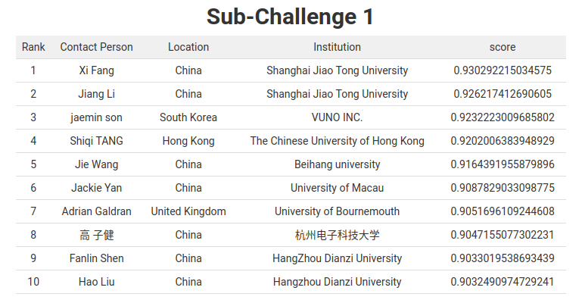
Online challenge results

Slide 4
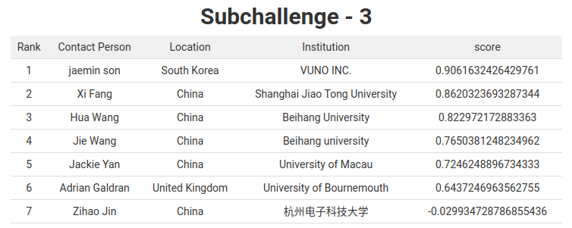
Online challenge results

Slide 5
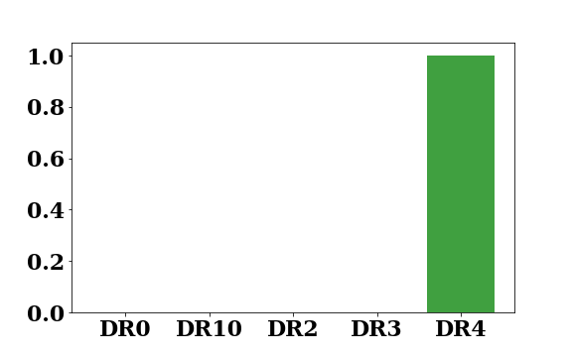
Methodology: Cost-Sensitive Regularization

Slide 6
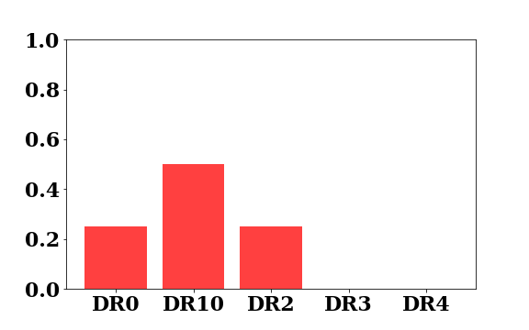
Methodology: Cost-Sensitive Regularization
Bad Prediction

Slide 7
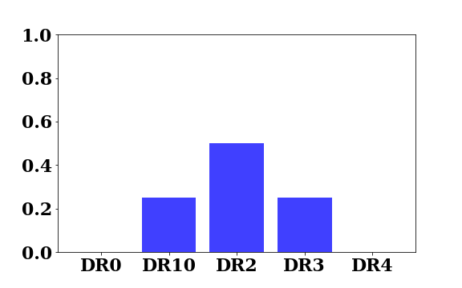
Methodology: Cost-Sensitive Regularization
Bad Prediction
Better Prediction

Slide 8
Methodology: Cost-Sensitive Regularization
Bad Prediction
CE = 4.1444
Better Prediction
CE = 4.1444

Slide 9
Methodology: Cost-Sensitive Regularization
Bad Prediction
CE = 4.1444
Better Prediction
Need to penalize differently when we have different kinds of errors!
CE = 4.1444

Slide 10

Methodology: Cost-Sensitive Regularization

Slide 11
Methodology: Cost-Sensitive Regularization

Slide 12
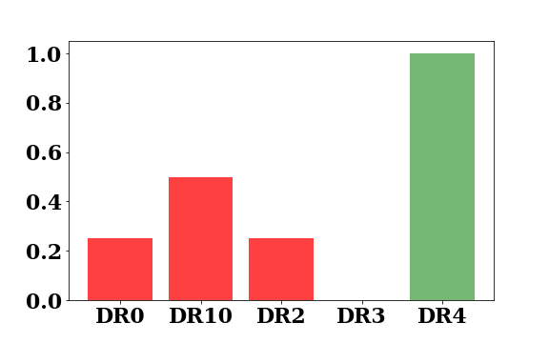

Methodology: Cost-Sensitive Regularization

Slide 13
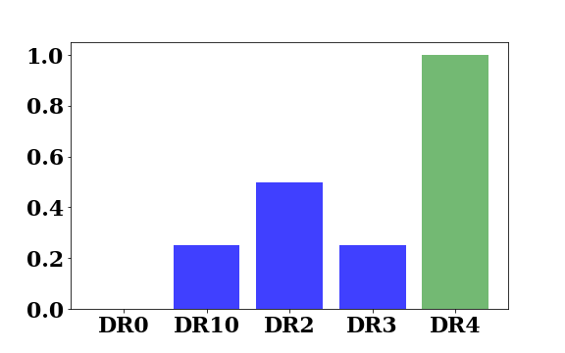

Methodology: Cost-Sensitive Regularization

Slide 14
Methodology: Cost-Sensitive Regularization
We use a base loss regularized with a CS-term:
We train different flavors of Residual Networks (Resnet50, ResNext50,...).
Cross-validate to find optimal architecture/base loss combo
Training starts from weights pretrained on Kaggle-Eyepacs dataset
Early Stopping based on the average of kappa score and multi-class AUROC
Heavy oversampling of minority classes

Slide 15
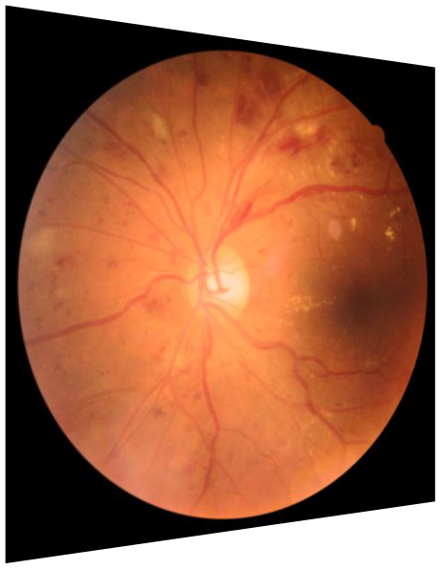
Methodology: Quality Assessment
Quality Assessment (4 Categories):
A Multi-Task CNN is combined with with a per-class CNN in test time.
Overall
Quality
Artifact
Clarity
Field Def.

Slide 16
Conclusion
Carefully consider the loss function for each task
Oversampling/Early Stopping criteria are critical
A Pytorch implementation will be made available very soon
Many thanks to the organization!

