Slide 1
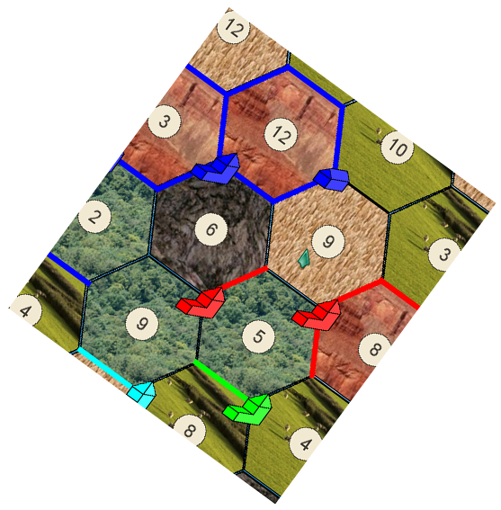
HexCraft
agale, ahojsak, hfast, jfedor

Slide 2
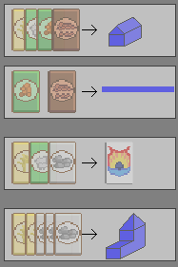
Project Overview
Hexcraft – a real-time strategy game based of the popular cult boardgame, Settlers of Catan.
Fully Networked
Complex AI
Seamless Display

Slide 3

Division of Labo(u)r
Alison: Networking
Allison: Game Logic
Hunter: Artificial Intelligence
Jason: Graphical Interface and Interactions

Slide 4
Testing
brought in industry specialists (or fake ones)
carefully analyzed their every move
fixed bugs and adjusted the interface to support their natural intuitions
lots of internal testing with a variety of human and AI players

Slide 5
Let’s go to the game!

